Slide 1
Fundamentals of
Research Data Management in the Open Science Era
May 2025
This content is based on the University of Osaka‘s research data management material” Learning the Fundamentals of Research Data Management in the Open Science Era” developed as part of the ”Research Data Ecosystem Development Project to Promote AI Utilization”. It has been revised in collaboration with the University of Osaka, Kyushu University, and the Japan Consortium for Open Access Repositories.
Notes:
Topic:Learning the Fundamentals of Research Data Management in the Open Science Era.
Voice:Joanna
```text
This material, allows new faculty members, to learn the basics of research data management, in the Open Science era, as part of their training program.
This material, is based on the Fundamental Research Data Management Educational Material, developed as part of the Research Data Ecosystem, Development Project, to Promote AI Utilization.
```
```description
This material allows new faculty members to learn the fundamentals of research data management in the Open Science era as part of their training program.
This material is based on the Fundamental Research Data Management Educational Material, developed as part of the Research Data Ecosystem Development Project to Promote AI Utilization.
```

Slide 2
Contents
Understanding Research Data Management
Research Data Policies and Related Regulations
Research Data Management Plan
Acquiring, Collecting, Storing and Sharing Research Data
Publishing Research Data
Utilizing Research Data
Introduction to Research Data Infrastructure and Integration
Notes:
Topic:Learning the Fundamentals of Research Data Management in the Open Science Era.
Voice:Joanna
```text
This program consists of seven videos.
In sections 1 to 2, we will discuss an overview of research data management.
In sections 3 to 6, we will discuss each stage of the research data lifecycle.
Finally, we will discuss the research data infrastructure, and its collaborative aspects.
```
```description
This program consists of seven videos.
Sections 1 and 2: Overview of research data management.
Sections 3 to 6: Overview of each stage in the research data lifecycle.
Sections 7: Research data infrastructure and its integration status.
```

Slide 3
1. Understanding Research Data Management
Notes:
Topic:Learning the Fundamentals of Research Data Management in the Open Science Era.
Voice:Joanna
```text
We will discuss what research data management is, while also addressing its necessity and significance.
```
```description
We will discuss what research data management is, while also addressing its necessity and significance.
```

Slide 4



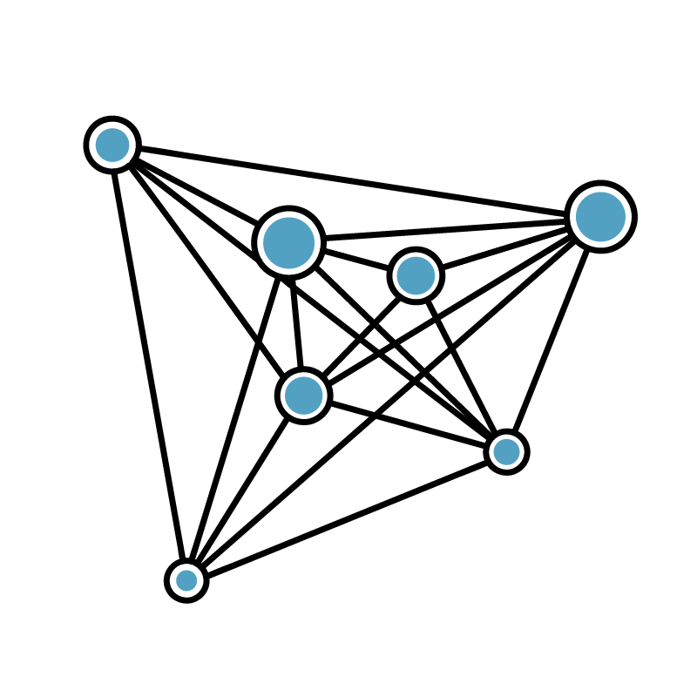
Necessity of Research Data Management
Proper Management of Research Data Leads to:
Data Loss Prevention
Research Efficiency Improvement
Interdisciplinary Collaboration
Diversifying Researcher Evaluation
Research Integrity
Open Science
Research data serves as crucial evidence for research integrity (university accountability)
Research data is an important source for research (enhancing research efficiency and innovation)
Open and Close Strategy tailored to specific characteristics of data is essential
Open Domain
Open Domain
Protection of research outputs with value for national and university interests
Strategies must consider unique characteristics of each field
Closed Domain
Closed Domain
Awareness of relevant domestic & international regulations, and internal university policies, is crucial
Research (Field A)
Research (Field B)
Notes:
Topic:Necessity of Research Data Management
Voice:Joanna
```text
We will explain the necessity, of research data management.
Research data management, is not just about handling data; it also helps prevent data loss, enhances research efficiency, fosters interdisciplinary collaboration, and broadens the scope of researcher evaluation.
[break:"0.02s"]
Researchers have always managed data, as part of their research activities.
It is the researchers who have developed efficient research data management environments, suited to each field, and these optimized methods of research, and data management are valued.
However, research data is growing exponentially, and management is no longer feasible at the level of individual researchers, or laboratories alone. Instead, university-wide management has become necessary, and research data management, is now required across different university organizations.
```
```description
This is about the necessity of research data management.
Research data management contributes to the prevention of data loss, improved research efficiency, interdisciplinary collaboration, and diversity in researcher evaluation.
Research data has always been an essential element of research activities, and researchers have already been managing research data.
Researchers have played a key role in establishing efficient research data management environments tailored to each field, and these optimized research activities and data management methods are valued.
However, research data is growing exponentially, and management is no longer feasible at the level of individual researchers or laboratories alone. Instead, university-wide management has become necessary, and research data management is now required across different university organizations.
```

Slide 5
Necessity of Research Data Management
Proper Management of Research Data Leads to:
Data Loss Prevention
Research Efficiency Improvement
Interdisciplinary Collaboration
Diversifying Researcher Evaluation
Research Integrity
Open Science
Research data serves as crucial evidence for research integrity (university accountability)
Research data is an important source for research (enhancing research efficiency and innovation)
Open and Close Strategy tailored to specific characteristics of data is essential
Open Domain
Open Domain
Protection of research outputs with value for national and university interests
Strategies must consider unique characteristics of each field
Closed Domain
Closed Domain
Awareness of relevant domestic & international regulations, and internal university policies, is crucial
Research (Field A)
Research (Field B)
Notes:
Topic:Necessity of Research Data Management
Voice:Joanna
```text
Furthermore, from the perspective of research integrity, research data serves as crucial evidence, and not only researchers but also universities are held accountable for its management.
```
```description
Furthermore, from the perspective of research integrity, research data serves as crucial evidence, and not only researchers but also universities are held accountable for its management.
```

Slide 6
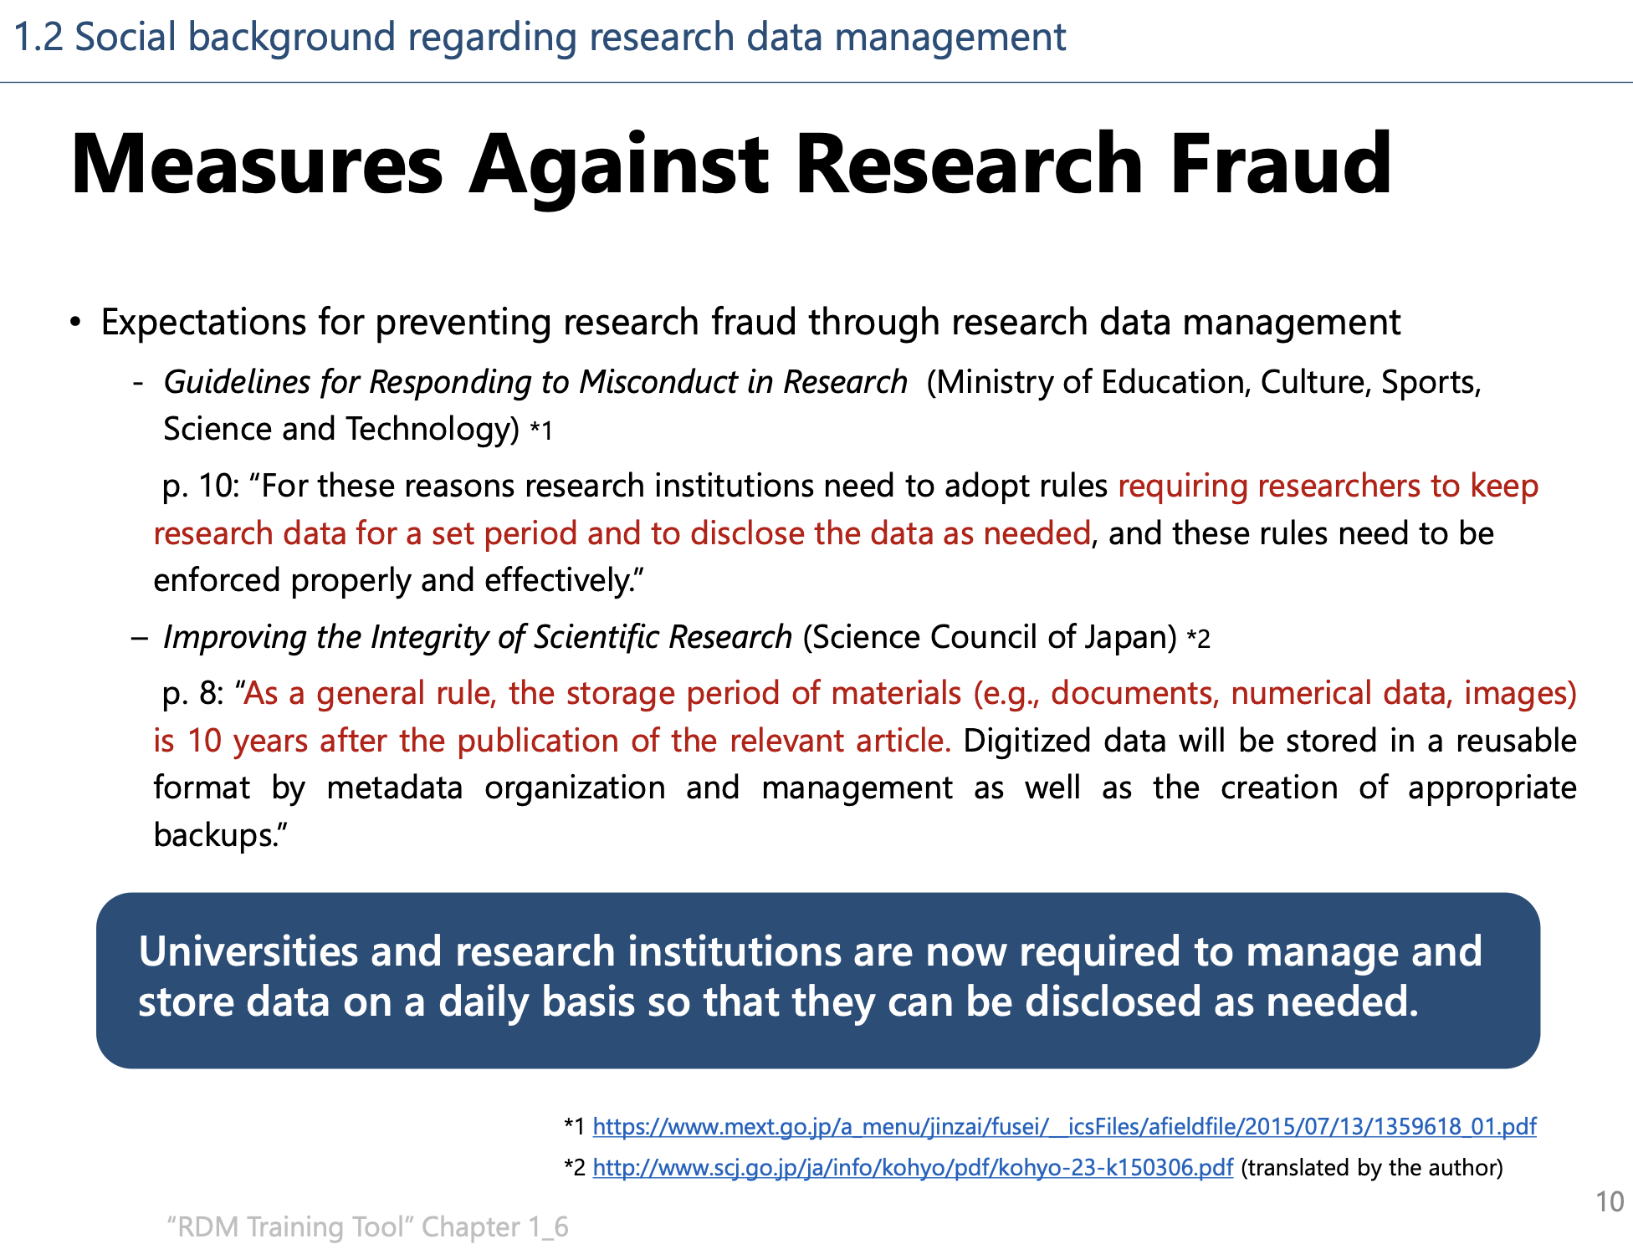
Necessity of Research Data Management
Data-Driven Innovation Initiative, Division of Research Data Service, Kyushu University & Library Office for DX Services, Kyushu University Library (2023, August). Let Us Start Research Data Management. Revised July 2024, Section 1: Introduction, p.10. https://doi.org/10.15017/7217541
Notes:
Topic:Necessity of Research Data Management
Voice:Joanna
```text
Regarding research data, the Ministry of Education, Culture, Sports, Science and Technology has stated, in its Guidelines for Responding to Misconduct in Research, that researchers are required to store research data for a certain period, and disclose it when necessary.
Additionally, in Enhancing Integrity in Scientific Research, a report reviewed by the Science Council of Japan, a concrete guideline specifies that research data should, in principle, be stored for 10 years after the publication of a paper.
Universities and research institutions, are now required to manage, and store data properly, to ensure it can be disclosed when necessary.
```
```description
On the other hand, the growing attention to research data management is also driven by expectations for its role in preventing research misconduct.
Regarding research data, the Ministry of Education, Culture, Sports, Science and Technology (MEXT) has stated in its ”Guidelines for Addressing Misconduct in Research Activities” that researchers are required to store research data for a certain period and disclose it when necessary.
Additionally, in ”Enhancing Integrity in Scientific Research”, a report reviewed by the Science Council of Japan at the request of MEXT, a concrete guideline specifies that research data should, in principle, be stored for 10 years after the publication of a paper.
Universities and research institutions are now required to manage and store data routinely to ensure it can be disclosed when necessary.
Data-Driven Innovation Initiative, Division of Research Data Service, Kyushu University & Library Office for DX Services, Kyushu University Library (2023, August). Let Us Start Research Data Management. Revised July 2024, Section 1: Introduction, p.10. https://doi.org/10.15017/7217541
```

Slide 7
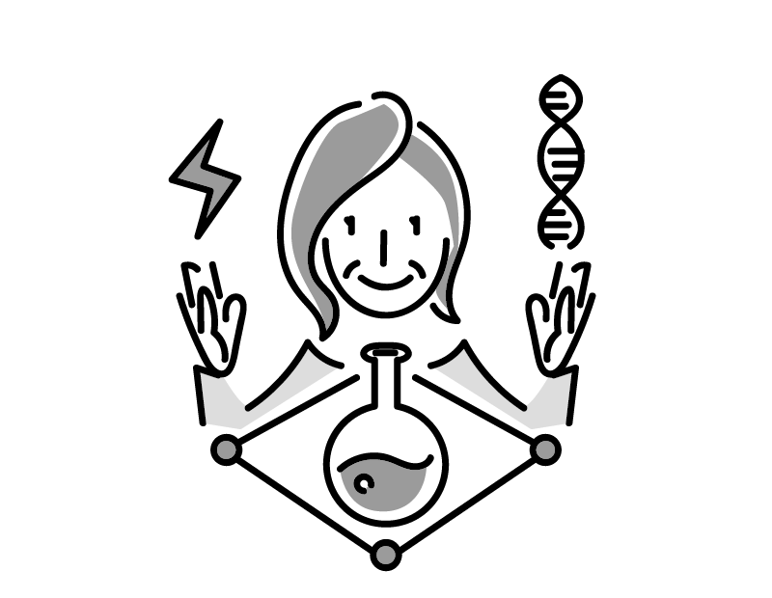

Necessity of Research Data Management
Proper Management of Research Data Leads to:
Data Loss Prevention
Research Efficiency Improvement
Interdisciplinary Collaboration
Diversifying Researcher Evaluation
Research Integrity
Open Science
Research data serves as crucial evidence for research integrity (university accountability)
Research data is an important source for research (enhancing research efficiency and innovation)
Open and Close Strategy tailored to specific characteristics of data is essential
Open Domain
Open Domain
Protection of research outputs with value for national and university interests
Strategies must consider unique characteristics of each field
Closed Domain
Closed Domain
Awareness of relevant domestic & international regulations, and internal university policies, is crucial
Research (Field A)
Research (Field B)
Notes:
Topic:Necessity of Research Data Management
Voice:Joanna
```text
From an Open Science perspective, there is a growing demand not only for managing evidence data, but also for improving research efficiency, and fostering innovation through broader research data management.
Furthermore, based on the characteristics of data, a strategy of distinguishing between public and those that should be protected as non-public—known as the 'Open and Close Strategy'—is required. This approach encourages a new way of conducting science, emphasizing research data management, with the intent of data publication and utilization.
```
```description
Additionally, from an Open Science perspective, there is a growing demand not only for managing evidence data but also for improving research efficiency and fostering innovation through broader research data management.
Furthermore, based on the characteristics of data, a strategy of distinguishing between publicly accessible and protected data—known as the 'Open and Close Strategy'—is required. This approach encourages a new way of conducting science, emphasizing research data management with the intent of data publication and utilization.
```

Slide 8
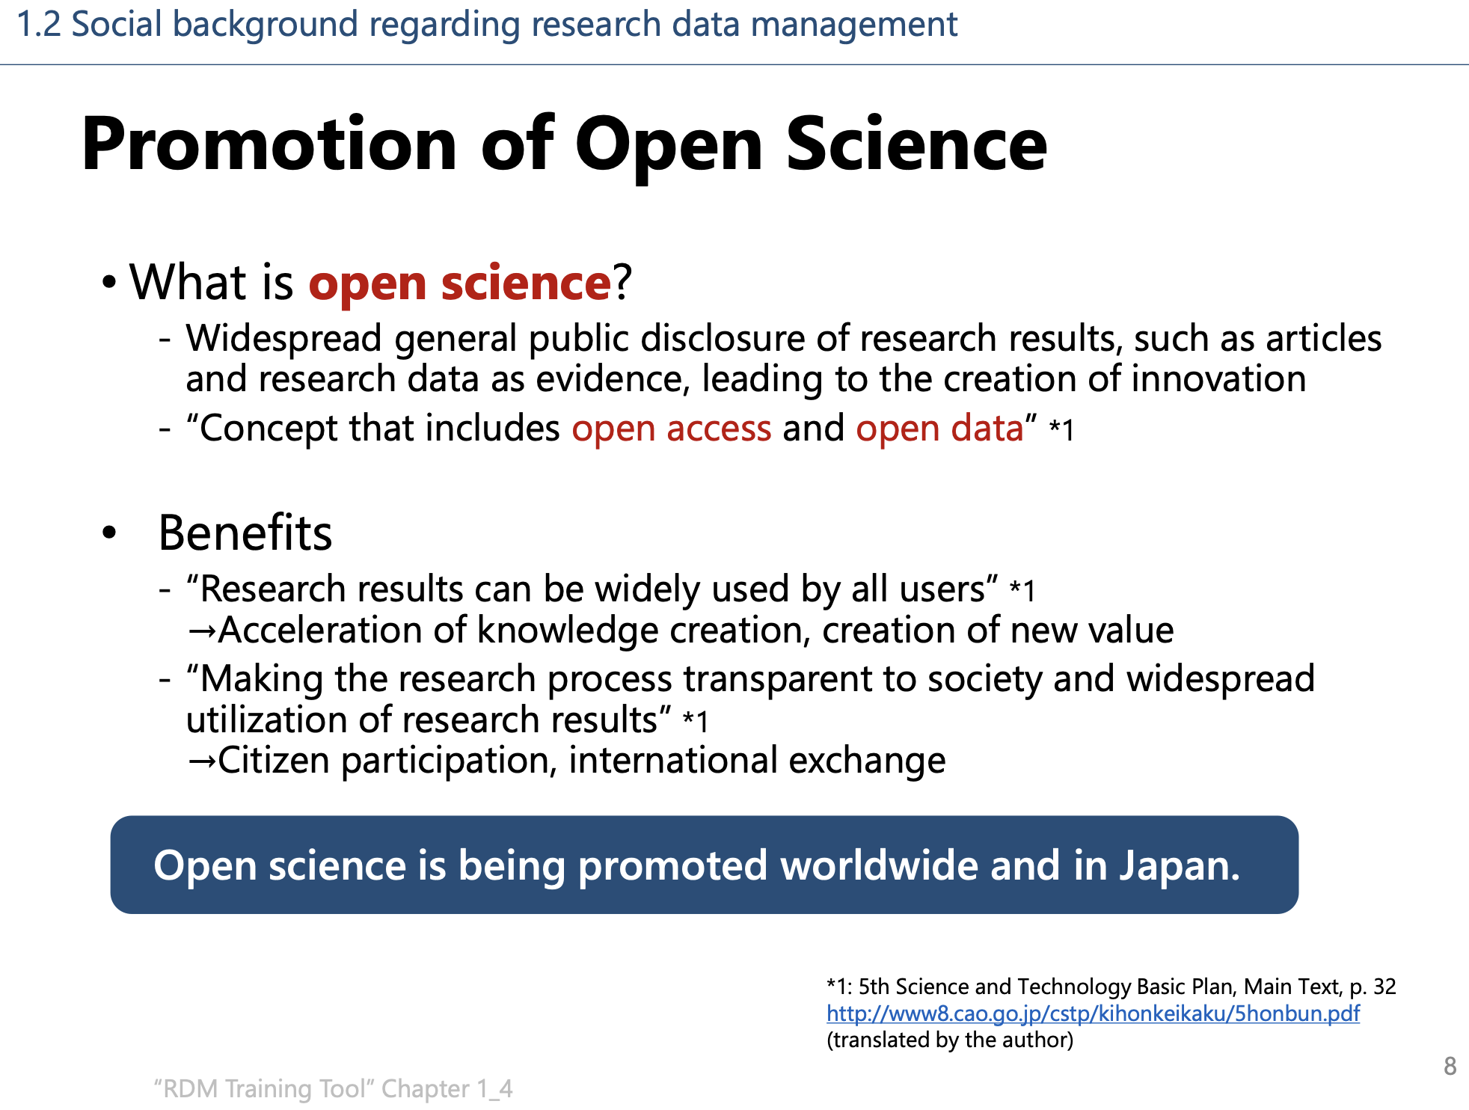
Necessity of Research Data Management
Data-Driven Innovation Initiative, Division of Research Data Service, Kyushu University & Library Office for DX Services, Kyushu University Library (2023, August). Let Us Start Research Data Management. Revised July 2024, Section 1: Introduction, p.8. https://doi.org/10.15017/7217541
Notes:
Topic:Necessity of Research Data Management
Voice:Joanna
```text
In the Fifth Science and Technology Basic Plan, formulated by the Cabinet Office in January 2016, Open Science is described as the broad dissemination of research outputs—such as papers and their supporting evidence data—to the general public, thereby fostering innovation.
The benefits include generating new interdisciplinary insights and promoting the widespread application of research findings.
Open Science is being promoted worldwide - and in Japan.
```
```description
In the Fifth Science and Technology Basic Plan, formulated by the Cabinet Office in January 2016, Open Science is described as the broad dissemination of research outputs—such as papers and their supporting evidence data—to the general public, thereby fostering innovation.
The benefits include generating new interdisciplinary insights and promoting the widespread application of research findings.
Open Science is being promoted worldwide and in Japan.
Data-Driven Innovation Initiative, Division of Research Data Service, Kyushu University & Library Office for DX Services, Kyushu University Library (2023, August). Let Us Start Research Data Management. Revised July 2024, Section 1: Introduction, p.8. https://doi.org/10.15017/7217541
```

Slide 9
Necessity of Research Data Management
Proper Management of Research Data Leads to:
Data Loss Prevention
Research Efficiency Improvement
Interdisciplinary Collaboration
Diversifying Researcher Evaluation
Research Integrity
Open Science
Research data serves as crucial evidence for research integrity (university accountability)
Research data is an important source for research (enhancing research efficiency and innovation)
Open and Close Strategy tailored to specific characteristics of data is essential
Open Domain
Open Domain
Protection of research outputs with value for national and university interests
Strategies must consider unique characteristics of each field
Closed Domain
Closed Domain
Awareness of relevant domestic & international regulations, and internal university policies, is crucial
Research (Field A)
Research (Field B)
Notes:
Topic:Necessity of Research Data Management
Voice:Joanna
```text
Furthermore, based on the characteristics of data, a strategy that differentiates between publicly accessible and protected data - known as the 'Open and Close Strategy'—is essential. This approach promotes a new model of scientific progress, emphasizing research data management that prioritizes data publication and utilization.
```
```description
Furthermore, based on the characteristics of data, a strategy that differentiates between publicly accessible and protected data - known as the 'Open and Close Strategy'—is essential. This approach promotes a new model of scientific progress, emphasizing research data management that prioritizes data publication and utilization.
```

Slide 10
Significance of Research Data Management
Benefits for Researchers:
Benefits of Research Data Management (RDM) Highlighted by Leading International Academic Institutions:
○ Increases the impact of one's own research
○ Reduces data analysis time through effective data management
○ Ensures long-term (permanent) data preservation and integrity
○ Meeting funding requirements and securing grants strengthens research competitiveness
○ Facilitates scientific discoveries and promotes effective data sharing and reuse
○ Supports open access
○ Facilitates data access and use by future researchers
Kyoto University Library Network (2023, April) ”Future Research Data Management (RDM), p.2”
https://www.kulib.Kyoto-u.ac.jp/uploads/RDM_leaflet_ja_A4.pdf (in Japanese)
Notes:
Topic:The Significance of Research Data Management
Voice:Joanna
Pad:0.2
```text
This section is about the significance of research data management.
Here are some of it’s key benefits. Research data management-
```
```description
Significance of Research Data Management:
Key benefits for researchers that can be expected from promoting research data management.
Kyoto University Library Network（April, 2023）”Future Research Data Management (RDM), p.2” https://www.kulib.Kyoto-u.ac.jp/uploads/RDM_leaflet_ja_A4.pdf
```

Slide 11
Significance of Research Data Management
Benefits for Researchers:
Benefits of Research Data Management (RDM) Highlighted by Leading International Academic Institutions:
○ Increases the impact of one's own research
○ Reduces data analysis time through effective data management
○ Ensures long-term (permanent) data preservation and integrity
○ Meeting funding requirements and securing grants strengthens research competitiveness
○ Facilitates scientific discoveries and promotes effective data sharing and reuse
○ Supports open access
○ Facilitates data access and use by future researchers
Kyoto University Library Network (2023, April) ”Future Research Data Management (RDM), p.2”
https://www.kulib.Kyoto-u.ac.jp/uploads/RDM_leaflet_ja_A4.pdf (in Japanese)
Notes:
Topic:The Significance of Research Data Management
Voice:Joanna
Pad:0.2
```text
Increases the impact of one's own research.[break:"0.1s"]
```
```description
"Increases the impact of one's own research."
```

Slide 12
Significance of Research Data Management
Benefits for Researchers:
Benefits of Research Data Management (RDM) Highlighted by Leading International Academic Institutions:
○ Increases the impact of one's own research
○ Reduces data analysis time through effective data management
○ Ensures long-term (permanent) data preservation and integrity
○ Meeting funding requirements and securing grants strengthens research competitiveness
○ Facilitates scientific discoveries and promotes effective data sharing and reuse
○ Supports open access
○ Facilitates data access and use by future researchers
Kyoto University Library Network (2023, April) ”Future Research Data Management (RDM), p.2”
https://www.kulib.Kyoto-u.ac.jp/uploads/RDM_leaflet_ja_A4.pdf (in Japanese)
Notes:
Topic:The Significance of Research Data Management
Voice:Joanna
Pad:0.2
```text
Reduces data analysis time through effective data management. [break:"0.1s"]
```
```description
Reduces data analysis time through effective data management.
```

Slide 13
Significance of Research Data Management
Benefits for Researchers:
Benefits of Research Data Management (RDM) Highlighted by Leading International Academic Institutions:
○ Increases the impact of one's own research
○ Reduces data analysis time through effective data management
○ Ensures long-term (permanent) data preservation and integrity
○ Meeting funding requirements and securing grants strengthens research competitiveness
○ Facilitates scientific discoveries and promotes effective data sharing and reuse
○ Supports open access
○ Facilitates data access and use by future researchers
Kyoto University Library Network (2023, April) ”Future Research Data Management (RDM), p.2”
https://www.kulib.Kyoto-u.ac.jp/uploads/RDM_leaflet_ja_A4.pdf (in Japanese)
Notes:
Topic:The Significance of Research Data Management
Voice:Joanna
Pad:0.2
```text
Ensures long-term data preservation and integrity[break:"0.1s"]
```
```description
"Ensure long-term (permanent) data preservation and integrity.”
```

Slide 14
Significance of Research Data Management
Benefits for Researchers:
Benefits of Research Data Management (RDM) Highlighted by Leading International Academic Institutions:
○ Increases the impact of one's own research
○ Reduces data analysis time through effective data management
○ Ensures long-term (permanent) data preservation and integrity
○ Meeting funding requirements and securing grants strengthens research competitiveness
○ Facilitates scientific discoveries and promotes effective data sharing and reuse
○ Supports open access
○ Facilitates data access and use by future researchers
Kyoto University Library Network (2023, April) ”Future Research Data Management (RDM), p.2”
https://www.kulib.Kyoto-u.ac.jp/uploads/RDM_leaflet_ja_A4.pdf (in Japanese)
Notes:
Topic:The Significance of Research Data Management
Voice:Joanna
Pad:0.2
```text
Helps researchers meet funding criteria, securing more grants, therefore strengthening research competitiveness[break:"0.1s"]
```
```description
Helps researchers meet funding criteria, securing more grants, therefore strengthening research competitiveness
```

Slide 15
Significance of Research Data Management
Benefits for Researchers:
Benefits of Research Data Management (RDM) Highlighted by Leading International Academic Institutions:
○ Increases the impact of one's own research
○ Reduces data analysis time through effective data management
○ Ensures long-term (permanent) data preservation and integrity
○ Meeting funding requirements and securing grants strengthens research competitiveness
○ Facilitates scientific discoveries and promotes effective data sharing and reuse
○ Supports open access
○ Facilitates data access and use by future researchers
Kyoto University Library Network (2023, April) ”Future Research Data Management (RDM), p.2”
https://www.kulib.Kyoto-u.ac.jp/uploads/RDM_leaflet_ja_A4.pdf (in Japanese)
Notes:
Topic:The Significance of Research Data Management
Voice:Joanna
Pad:0.2
```text
Facilitates scientific discoveries and promotes effective data sharing and reuse.[break:"0.1s"]
```
```description
Facilitates scientific discoveries and promotes effective data sharing and reuse
```

Slide 16
Significance of Research Data Management
Benefits for Researchers:
Benefits of Research Data Management (RDM) Highlighted by Leading International Academic Institutions:
○ Increases the impact of one's own research
○ Reduces data analysis time through effective data management
○ Ensures long-term (permanent) data preservation and integrity
○ Meeting funding requirements and securing grants strengthens research competitiveness
○ Facilitates scientific discoveries and promotes effective data sharing and reuse
○ Supports open access
○ Facilitates data access and use by future researchers
Kyoto University Library Network (2023, April) ”Future Research Data Management (RDM), p.2”
https://www.kulib.Kyoto-u.ac.jp/uploads/RDM_leaflet_ja_A4.pdf (in Japanese)
Notes:
Topic:The Significance of Research Data Management
Voice:Joanna
Pad:0.2
```text
Supports open access. [break:"0.1s"]
```
```description
Supports open access.
```

Slide 17
Significance of Research Data Management
Benefits for Researchers:
Benefits of Research Data Management (RDM) Highlighted by Leading International Academic Institutions:
○ Increases the impact of one's own research
○ Reduces data analysis time through effective data management
○ Ensures long-term (permanent) data preservation and integrity
○ Meeting funding requirements and securing grants strengthens research competitiveness
○ Facilitates scientific discoveries and promotes effective data sharing and reuse
○ Supports open access
○ Facilitates data access and use by future researchers
Kyoto University Library Network (2023, April) ”Future Research Data Management (RDM), p.2”
https://www.kulib.Kyoto-u.ac.jp/uploads/RDM_leaflet_ja_A4.pdf (in Japanese)
Notes:
Topic:The Significance of Research Data Management
Voice:Joanna
Pad:0.2
```text
Facilitates data access and use by future researchers.[break:"0.4s"]
```
```description
Facilitates data access and use by future researchers.
```

Slide 18
Significance of Research Data Management
Benefits for Researchers:
Benefits of Research Data Management (RDM) Highlighted by Leading International Academic Institutions:
○ Increases the impact of one's own research
○ Reduces data analysis time through effective data management
○ Ensures long-term (permanent) data preservation and integrity
○ Meeting funding requirements and securing grants strengthens research competitiveness
○ Facilitates scientific discoveries and promotes effective data sharing and reuse
○ Supports open access
○ Facilitates data access and use by future researchers
Kyoto University Library Network (2023, April) ”Future Research Data Management (RDM), p.2”
https://www.kulib.Kyoto-u.ac.jp/uploads/RDM_leaflet_ja_A4.pdf (in Japanese)
Notes:
Topic:The Significance of Research Data Management
Voice:Joanna
Pad:0.2
```text
These are some of the benefits of research data management.
```
```description
These are some of the benefits of research data management.
```

Slide 19
Research Data Lifecycle
Research Data Lifecycle
Information used or generated in a research project is organized, structured, stored, and managed within the following cycle:
Generate Data
Share
Re-use
Process
Analyse
Preserve
Before Research
Formulating a Research Data Management plan
During Research
Managing research data
throughout the entire lifecycle
and
considering every stage individually
After Research
Long-term data management after research completion
The UK Data Service. (n.d.). Research data management. https://www.ukdataservice.ac.uk/manage-data/lifecycle.aspx
Adapted from van Selm, M. (2015). RDM Support - basic training course for information specialists. figshare. Dataset. https://doi.org/10.6084/m9.figshare.1285313.v1
Adapted from: Yoshida et al. (2021, February). Design and Practice of Research Data Management Services – Chapter 1, 2nd Edition. In Educational Material: Design and Practice of Research Data Management Services, p.6. Japan Consortium for Open Access Repositories (JPCOAR), Research Data Working Group. https://jpcoar.repo.nii.ac.jp/records/607
Notes:
Topic:Research Data Lifecycle
Voice:Joanna
```text
This section discusses the research data lifecycle.
In a research project, the information used or generated is organized, structured, stored, and managed within the following cycle.
Before the research begins, a data management plan must be created.
At each stage afterward, data management is required, from data generation to processing, analysis, and storage.
Once the research is finished, it is important to consider the long-term handling of data.[break:"0.4s"]
```
```description
This section discusses the research data lifecycle.
In a research project, the information used or generated is organized, structured, stored, and managed within the following cycle.
Before the research begins, a data management plan must be formulated.
At each stage afterward, data management is required, from data generation to processing, analysis, and storage.
Once the research is finished, it is important to consider the long-term handling of data.
Cf., The UK Data Service. (n.d.). Research data management. https://www.ukdataservice.ac.uk/manage-data/lifecycle.aspx
van Selm, M. (2015). RDM Support - basic training course for information specialists. figshare. Dataset. https://doi.org/10.6084/m9.figshare.1285313.v1 .
Yoshida et al. (February, 2021). Design and Practice of Research Data Management Services – Chapter 1, 2nd Edition. In Educational Material: Design and Practice of Research Data Management Services, p.6. Japan Consortium for Open Access Repositories (JPCOAR), Research Data Working Group. https://jpcoar.repo.nii.ac.jp/records/607 ```

Slide 20
Research Data Lifecycle
研究データのライフサイクル
Examples for Each Stage of the Cycle
Data management plan
Searching, acquiring, collecting, generating data
Generate Data
Share
Re-use
Process
Analyse
Preserve
Follow-up research
New research
Digitization, format conversion, validation, verification, data cleaning
Personal data anonymization
Data distribution and sharing
Access control
Copyright management
Data extraction, interpreting information
Authoring papers, data storage preparation
Format adjustments, resizing, backup creation
Metadata and supporting documentation
Well-organized, documented, stored, and shared data accelerates scientific research and creates more opportunities for learning and innovation
Adapted from: Yoshida et al. (2021, February). Design and Practice of Research Data Management Services – Chapter 1, 2nd Edition. In Educational Material: Design and Practice of Research Data Management Services, p.15. Japan Consortium for Open Access Repositories (JPCOAR), Research Data Working Group. https://jpcoar.repo.nii.ac.jp/records/607
Notes:
Topic:Research Data Lifecycle
Voice:Joanna
Pad:0.2
```text
Here, we provide a detailed overview of necessary data handling at each stage.
```
```description
Here we examine the components of the research data lifecycle.
During data generation, alongside research planning, a data management plan is developed, and data-sharing policies are established. Additionally, existing data is searched, and new data is collected.
During data processing, the collected data undergoes digitization, format conversion, verification, validation, and cleaning. In some cases, anonymization of personal information may also become necessary.
During data analysis, necessary data is extracted from the collected and processed data, and the obtained information is interpreted. At this stage, research outputs such as papers are created, and preparations for data storage are carried out.
During data storage and preservation, the data is adjusted to appropriate formats and sizes, backups are created, and metadata along with supporting documentation is prepared.
During data publication, data distribution, sharing, access control and copyright processing are performed.
The published data is ”reused” in follow-up research and new studies.
The key point is that well-organized, documented, stored and shared data remains usable for a long time even after the project is concluded, advancing research and providing opportunities for innovation.
Yoshida et al. (2021, February 10). Design and Practice of Research Data Management Services – Chapter 1, 2nd Edition. In Educational Material: Design and Practice of Research Data Management Services, p.15. Japan Consortium for Open Access Repositories (JPCOAR), Research Data Working Group https://jpcoar.repo.nii.ac.jp/records/607
```

Slide 21
Research Data Lifecycle
研究データのライフサイクル
Examples for Each Stage of the Cycle
Data management plan
Searching, acquiring, collecting, generating data
Generate Data
Share
Re-use
Process
Analyse
Preserve
Follow-up research
New research
Digitization, format conversion, validation, verification, data cleaning
Personal data anonymization
Data distribution and sharing
Access control
Copyright management
Data extraction, interpreting information
Authoring papers, data storage preparation
Format adjustments, resizing, backup creation
Metadata and supporting documentation
Well-organized, documented, stored, and shared data accelerates scientific research and creates more opportunities for learning and innovation
Adapted from: Yoshida et al. (2021, February). Design and Practice of Research Data Management Services – Chapter 1, 2nd Edition. In Educational Material: Design and Practice of Research Data Management Services, p.15. Japan Consortium for Open Access Repositories (JPCOAR), Research Data Working Group. https://jpcoar.repo.nii.ac.jp/records/607
Notes:
Topic:Research Data Lifecycle
Voice:Joanna
Pad:0.2
```text
During data generation, alongside research planning, a data management plan is developed, and data-sharing policies are established. Existing data is searched, and new data is collected.
```
```description
```

Slide 22
Research Data Lifecycle
研究データのライフサイクル
Examples for Each Stage of the Cycle
Data management plan
Searching, acquiring, collecting, generating data
Generate Data
Share
Re-use
Process
Analyse
Preserve
Follow-up research
New research
Digitization, format conversion, validation, verification, data cleaning
Personal data anonymization
Data distribution and sharing
Access control
Copyright management
Data extraction, interpreting information
Authoring papers, data storage preparation
Format adjustments, resizing, backup creation
Metadata and supporting documentation
Well-organized, documented, stored, and shared data accelerates scientific research and creates more opportunities for learning and innovation
Adapted from: Yoshida et al. (2021, February). Design and Practice of Research Data Management Services – Chapter 1, 2nd Edition. In Educational Material: Design and Practice of Research Data Management Services, p.15. Japan Consortium for Open Access Repositories (JPCOAR), Research Data Working Group. https://jpcoar.repo.nii.ac.jp/records/607
Notes:
Topic:Research Data Lifecycle
Voice:Joanna
Pad:0.2
```text
During data processing, the collected data undergoes digitization, format conversion, verification, validation, and cleaning. In some cases, anonymization of personal information may also be necessary.
```
```description
```

Slide 23
Research Data Lifecycle
研究データのライフサイクル
Examples for Each Stage of the Cycle
Data management plan
Searching, acquiring, collecting, generating data
Generate Data
Share
Re-use
Process
Analyse
Preserve
Follow-up research
New research
Digitization, format conversion, validation, verification, data cleaning
Personal data anonymization
Data distribution and sharing
Access control
Copyright management
Data extraction, interpreting information
Authoring papers, data storage preparation
Format adjustments, resizing, backup creation
Metadata and supporting documentation
Well-organized, documented, stored, and shared data accelerates scientific research and creates more opportunities for learning and innovation
Adapted from: Yoshida et al. (2021, February). Design and Practice of Research Data Management Services – Chapter 1, 2nd Edition. In Educational Material: Design and Practice of Research Data Management Services, p.15. Japan Consortium for Open Access Repositories (JPCOAR), Research Data Working Group. https://jpcoar.repo.nii.ac.jp/records/607
Notes:
Topic:Research Data Lifecycle
Voice:Joanna
Pad:0.2
```text
During data analysis, necessary data is extracted from the collected and processed data, and the obtained information is interpreted. At this stage, research outputs, such as papers are created, and preparations for data storage and preservation are carried out.
```
```description
```

Slide 24
Research Data Lifecycle
研究データのライフサイクル
Examples for Each Stage of the Cycle
Data management plan
Searching, acquiring, collecting, generating data
Generate Data
Share
Re-use
Process
Analyse
Preserve
Follow-up research
New research
Digitization, format conversion, validation, verification, data cleaning
Personal data anonymization
Data distribution and sharing
Access control
Copyright management
Data extraction, interpreting information
Authoring papers, data storage preparation
Format adjustments, resizing, backup creation
Metadata and supporting documentation
Well-organized, documented, stored, and shared data accelerates scientific research and creates more opportunities for learning and innovation
Adapted from: Yoshida et al. (2021, February). Design and Practice of Research Data Management Services – Chapter 1, 2nd Edition. In Educational Material: Design and Practice of Research Data Management Services, p.15. Japan Consortium for Open Access Repositories (JPCOAR), Research Data Working Group. https://jpcoar.repo.nii.ac.jp/records/607
Notes:
Topic:Research Data Lifecycle
Voice:Joanna
Pad:0.2
```text
During data storage and preservation, the data is adjusted to appropriate formats and sizes, backups are created, and metadata along with supporting documentation is prepared.
```
```description
```

Slide 25
Research Data Lifecycle
研究データのライフサイクル
Examples for Each Stage of the Cycle
Data management plan
Searching, acquiring, collecting, generating data
Generate Data
Share
Re-use
Process
Analyse
Preserve
Follow-up research
New research
Digitization, format conversion, validation, verification, data cleaning
Personal data anonymization
Data distribution and sharing
Access control
Copyright management
Data extraction, interpreting information
Authoring papers, data storage preparation
Format adjustments, resizing, backup creation
Metadata and supporting documentation
Well-organized, documented, stored, and shared data accelerates scientific research and creates more opportunities for learning and innovation
Adapted from: Yoshida et al. (2021, February). Design and Practice of Research Data Management Services – Chapter 1, 2nd Edition. In Educational Material: Design and Practice of Research Data Management Services, p.15. Japan Consortium for Open Access Repositories (JPCOAR), Research Data Working Group. https://jpcoar.repo.nii.ac.jp/records/607
Notes:
Topic:Research Data Lifecycle
Voice:Joanna
Pad:0.2
```text
During data publication, data distribution, sharing, access control and copyright management are performed.
```
```description
```

Slide 26
Research Data Lifecycle
研究データのライフサイクル
Examples for Each Stage of the Cycle
Data management plan
Searching, acquiring, collecting, generating data
Generate Data
Share
Re-use
Process
Analyse
Preserve
Follow-up research
New research
Digitization, format conversion, validation, verification, data cleaning
Personal data anonymization
Data distribution and sharing
Access control
Copyright management
Data extraction, interpreting information
Authoring papers, data storage preparation
Format adjustments, resizing, backup creation
Metadata and supporting documentation
Well-organized, documented, stored, and shared data accelerates scientific research and creates more opportunities for learning and innovation
Adapted from: Yoshida et al. (2021, February). Design and Practice of Research Data Management Services – Chapter 1, 2nd Edition. In Educational Material: Design and Practice of Research Data Management Services, p.15. Japan Consortium for Open Access Repositories (JPCOAR), Research Data Working Group. https://jpcoar.repo.nii.ac.jp/records/607
Notes:
Topic:Research Data Lifecycle
Voice:Joanna
Pad:0.2
```text
The published data is ”reused” in follow-up research and new studies.
```
```description
```

Slide 27
Research Data Lifecycle
研究データのライフサイクル
Examples for Each Stage of the Cycle
Data management plan
Searching, acquiring, collecting, generating data
Generate Data
Share
Re-use
Process
Analyse
Preserve
Follow-up research
New research
Digitization, format conversion, validation, verification, data cleaning
Personal data anonymization
Data distribution and sharing
Access control
Copyright management
Data extraction, interpreting information
Authoring papers, data storage preparation
Format adjustments, resizing, backup creation
Metadata and supporting documentation
Well-organized, documented, stored, and shared data accelerates scientific research and creates more opportunities for learning and innovation
Adapted from: Yoshida et al. (2021, February). Design and Practice of Research Data Management Services – Chapter 1, 2nd Edition. In Educational Material: Design and Practice of Research Data Management Services, p.15. Japan Consortium for Open Access Repositories (JPCOAR), Research Data Working Group. https://jpcoar.repo.nii.ac.jp/records/607
Notes:
Topic:Research Data Lifecycle
Voice:Joanna
Pad:0.2
```text
Data that has been properly organized, documented, stored and shared, remains usable for a long time, even after the project is concluded, advancing research, and providing opportunities for innovation.
```
```description
The key point is that well-organized, documented, stored and shared data remains usable for a long time even after the project is concluded, advancing research and providing opportunities for innovation.
```

Slide 28
Trends in Open Science in Japan and the World:
Global Trends
世界と日本におけるオープンサイエンスの動向
－海外の動向－
Funding Agency Initiatives:
2003: U.S. National Institutes of Health (NIH) took lead, followed by National Science Foundation (NSF) and others, mandating the publication of research data and submission of Data Management Plans (DMPs)
Many European funding agencies have since adopted similar policies.
⇒Open data improves the impact of research and maximizes investment returns through data reuse
⇒Ensuring publicly funded research benefits society
Fundamental Principles
FORCE11: International initiative promoting research data sharing and reuse.
2016: FAIR Data Principles introduction
These principles ensure research data is Findable, Accessible, Interoperable, and Reusable (FAIR) providing guidelines for effective data sharing.
Data Infrastructure Development
Integrates research infrastructures to advance Open Science
2018: Establishment of European Open Science Cloud (EOSC)
A federated, open platform for sharing and reusing research data, tools, and services
Notes:
Topic:Trends in Open Science in Japan and Around the World
Voice:Joanna
```text
We will now talk about global trends in Open Science.
Since around 2003, starting with actions by the U.S. funding agency NIH, efforts to disclose research data, and to mandate the submission of data management plans, led to a growing momentum for open science.
Funding agencies are driving these efforts with motivations, such as “enhancing the value of research outcomes through data publication”, and “maximizing investment efficiency through data reuse”.
Since then, the spread of the 'FAIR principles'—which promote best practices for data publication—has contributed to the development of platforms such as the European Open Science Cloud.[break:"0.6s"]
```
```description
Global trends:
Since around 2003, starting with actions by the U.S. funding agency NIH, efforts to disclose research data and to mandate the submission of data management plans (DMPs) led to a growing momentum for open science.
Funding agencies are driving these efforts with motivations such as “enhancing the value of research outcomes through data publication” and “maximizing investment efficiency through data reuse”.
Since then, the spread of the 'FAIR principles'—which promote best practices for data publication—has contributed to the development of platforms such as the European Open Science Cloud.
```

Slide 29
Trends in Open Science in Japan and the World:
Trends in Japan
Full-scale Discussions on Open Science in Japan:
2013: G8 Science Ministers' Meeting: "Joint Statement Pledging Open Research Data"
Funding Agency Initiatives:
Since 2016, some research grants have required DMPs and evidence data disclosure
Japan’s Basic Policy:
2021: Sixth Science, Technology, and Innovation Basic Plan
By 2025, universities with institutional repositories, inter-university research institutions, and National Research and Development Agencies must establish data policies
Cabinet Office (2018): "Guidelines for Data Policy Formulation in National Research and Development Agencies”
University ICT Promotion Council (2021): "Guidelines for Formulating Research Data Policies in Universities"
By 2023, funding agencies must implement a system to assign metadata linked to DMPs for new research grants
Funding agencies requiring DMP submission (as of now):
JST, AMED, NEDO
※ From 2024, KAKENHI requires DMPs for all
research categories.
NII Research Data Infrastructure (NII RDC)
Since 2021: Integration of research data management (GakuNin RDM), publication (JAIRO Cloud), and search (CiNii) infrastructures
Notes:
Topic:Trends in Open Science in Japan and Around the World
Voice:Joanna
```text
Now, we will discuss the trends within Japan.
In Japan, following the 2013 G8 Science and Technology Ministers' Meeting, similar to Western countries, funding agencies have started implementing mandatory submission of Data Management Plans (DMPs), and the public disclosure of evidence data.
In March 2021, the Sixth Science, Technology, and Innovation Basic Plan, mandated the formulation of a data policy. As a result, funding agencies are now required to implement DMPs along with metadata assignment systems.
Similar to the European Open Science Cloud movement, mentioned earlier, Japan’s National Institute of Informatics (N-I-I) has begun concrete steps in developing and integrating the NII Research Data Cloud (N-I-I RDC). The core functions of N-I-I RDC have been operational since 2021. Further details will be explained later.[break:"0.6s"]
```
```description
Domestic Trends:
The turning point for serious discussions began with the 2013 G8 Science and Technology Ministers’ Meeting.
Following this movement, Japan has also started implementing mandatory Data Management Plan (DMP) submissions and the public disclosure of evidence data, similar to Western countries.
In March 2021, the Sixth Science, Technology, and Innovation Basic Plan mandated the formulation of a data policy. As a result, funding agencies are now required to implement DMPs along with metadata assignment systems.
Similar to the European Open Science Cloud (EOSC) movement mentioned earlier, Japan’s National Institute of Informatics (NII) has begun concrete steps in developing and integrating the NII Research Data Cloud (NII RDC). The core functions of NII RDC have been operational since 2021. Further details will be explained later.
```

Slide 30
Plan S: Europe
Trends in Open Science in Japan and the World:
Trends in Japan
Office of Science and Technology Policy (OSTP): U.S.
cOAlition S, a European research funding consortium, launched an initiative for
full and immediate Open Access (OA)
⇒ Implemented in January 2021.
Immediate Open Access (OA) for research outputs (papers & data) funded by public grants
⇒2024 (Announcement) ⇒ 2025 (Implementation)
G7 Summit (May 2023) Joint Statement
Statements from the G7 Science Ministers and Hiroshima Summit Leaders
Support immediate Open Access (OA) for publicly funded research (papers and scientific data) and promotes Open Science.
Integrated Innovation Strategy 2023 [Cabinet approval 2023/06/09]
  G7 Hiroshima Summit and G7 Sendai Science and Technology Ministers’ Meeting
  Japan established a national policy to implement immediate Open Access for academic papers (and supporting data), funded by newly announced research grants (starting in 2025)
Notes:
Topic:Trends in Open Science in Japan and Around the World
Voice:Joanna
```text
A recent domestic trend, that affects our research activities, is the push for immediate open access for academic papers, including their supporting data.
This movement is backed by initiatives such as Plan S in Europe, which calls for full and immediate open access, as well as similar efforts in the United States.
This May, a joint statement was issued at the G7 Summit, and in June, based on this statement, Japan’s Integrated Innovation Strategy 2023, set a national policy to realize immediate open access, including supporting data, for new competitive research funding calls, starting in 2025.
```
```description
We will discuss recent developments related to the immediate open access of academic papers, including supporting data, which impact our research activities.
This movement is backed by initiatives such as Plan S in Europe, which calls for full and immediate open access, and similar efforts in the United States.
This May, a joint statement was issued at the G7 Summit, and in June, based on this statement, Japan’s Integrated Innovation Strategy 2023 set a national policy to realize immediate open access, including supporting data, for new competitive research funding calls starting in fiscal year 2025.
```

Slide 31
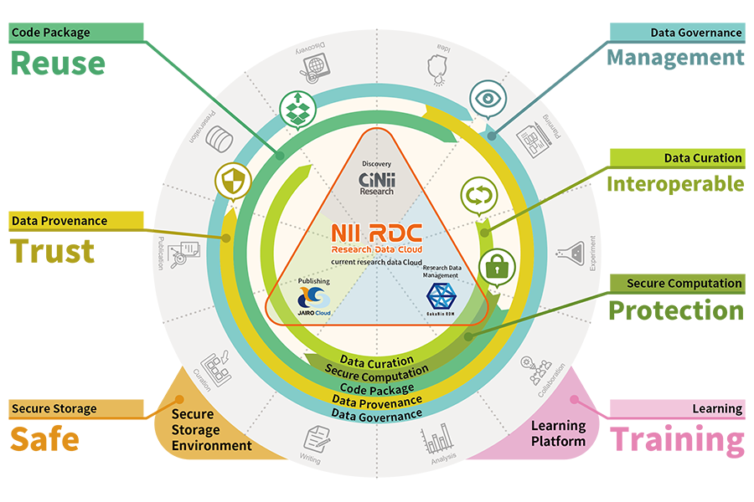
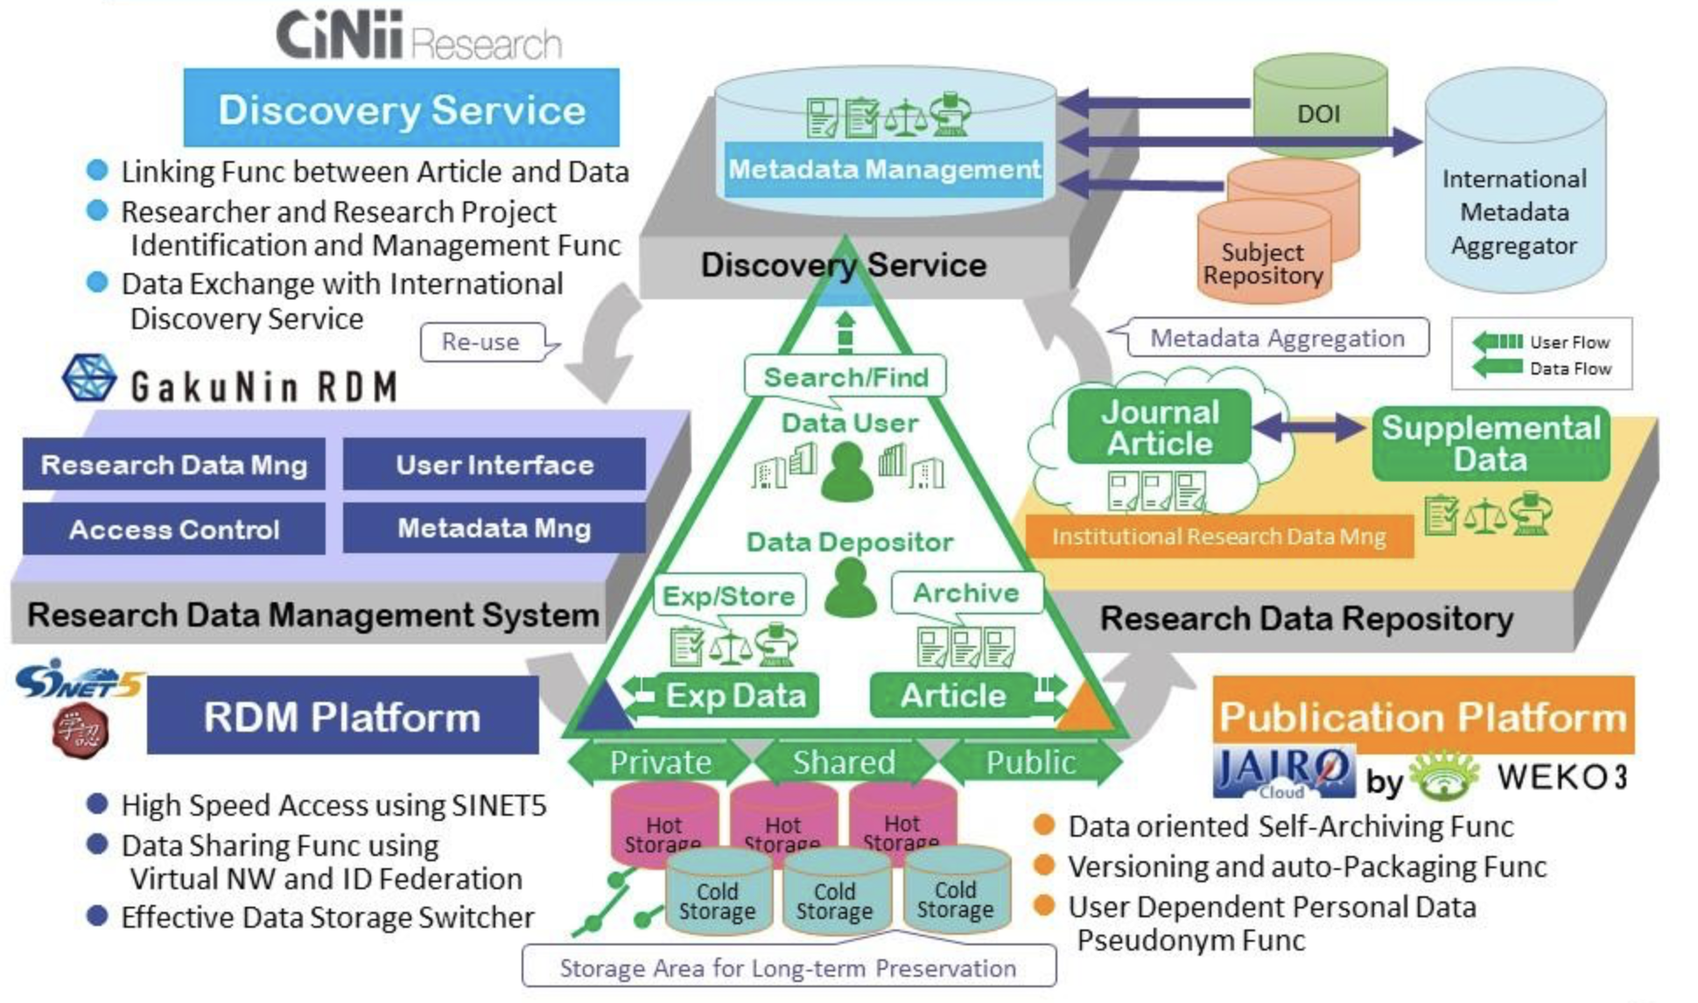
Launched in 2021
Reducing Researcher’s Workload
(NII Research Data Cloud)
Nationwide Infrastructure to support Open Science
National Institute of Informatics, Research Center for Open Science and Data Platform (n.d.). Overview of NII Research Data Cloud (NII RDC). https://rcos.nii.ac.jp/service/
Notes:
Topic:Reducing Researcher’s Workload
Voice:Joanna
```text
As research data management becomes increasingly important, efforts are being made in Japan to reduce the burden placed on researchers.
Presented here is the N I I Research Data Cloud (N I I RDC), a research data infrastructure being developed by the National Institute of Informatics.
Development is underway to support all stages of the research data lifecycle, making data management easier, and covering everything from publication to search functions, for effective use of data.
Ga kuNin RDM serves as a research data management platform and can be accessed via the Ga ku Nin Federation. The University of Osaka has already applied for participation, allowing its members to use the system.
Ga ku Nin RDM offers data-sharing capabilities among project members and includes audit trail functions to ensure research integrity. Future plans include implementing data curation and analysis features.
These data sets are published on gyro Cloud, a research data repository, which serves not only as a platform for evidence data disclosure, but also as a resource for data utilization.
Furthermore, these data sets can be searched via SighKnee, contributing to preventing data loss, improving research efficiency, fostering interdisciplinary collaboration, and diversifying researcher evaluations.
```
```description
As research data management becomes increasingly important, efforts are being made domestically to reduce the burden on researchers.
Presented here is the NII Research Data Cloud (NII RDC), a research data infrastructure being developed by the National Institute of Informatics (NII).
Development is underway to support all stages of the research data lifecycle, making data management easier and covering everything from publication to search functions for effective data utilization.
GakuNin RDM serves as a research data management platform and can be accessed via the GakuNin Federation. Osaka University has already applied for participation, allowing its members to use the system.
GakuNin RDM offers data-sharing capabilities among project members and includes audit trail functions to ensure research integrity. Future plans include implementing data curation and analysis features.
These data sets are published on JAIRO Cloud, a research data repository, which serves not only as a platform for evidence data disclosure but also as a resource for data utilization.
Furthermore, these datasets can be searched via CiNii, contributing to preventing data loss, improving research efficiency, fostering interdisciplinary collaboration, and diversifying researcher evaluations.
National Institute of Informatics, Research Center for Open Science and Data Platform (n.d.). Overview of NII Research Data Cloud (NII RDC). https://rcos.nii.ac.jp/service/
```

Slide 32
References
Kyoto University Library Network. (2023). The Future of Research Data Management (RDM) (p.2).
https://www.kulib.Kyoto-u.ac.jp/uploads/RDM_leaflet_ja_A4.pdf
Data-Driven Innovation Initiative, Division of Research Data Service, Kyushu University & Library Office for DX Services, Kyushu University Library (2023, August). Let Us Start Research Data Management. Revised July 2024, https://doi.org/10.15017/7217541
National Institute of Informatics, Research Center for Open Science and Data Platform (RCOS). (n.d.). Overview of NII Research Data Cloud (NII RDC). National Institute of Informatics.https://rcos.nii.ac.jp/service/
Yukinae Yoshida, Eriko Amano, Yuuko Matsumoto, Yui Nishizono, Kazutsuna Yamaji, Yasuyuki Minamiyama, Koichi Ojiro, Mao Tsunekawa and Hayahiko Ozono (2021). Design and Practice of Research Data Management Services – Chapter 1, 2nd Edition. In Educational Material: Design and Practice of Research Data Management Services, Japan Consortium for Open Access Repositories (JPCOAR), Research Data Working Group https://jpcoar.repo.nii.ac.jp/records/607
The UK Data Service. (n.d.). Research data management.
https://www.ukdataservice.ac.uk/manage-data/lifecycle.aspx
van Selm, M. (2015). RDM Support - basic training course for information specialists. figshare. Dataset. https://doi.org/10.6084/m9.figshare.1285313.v1
Notes:
Topic:Reducing Researcher’s Workload
Voice:Joanna
```text
And here are the references.
```
```description
Here are the references.
Kyoto University Library Network. (2023). The Future of Research Data Management (RDM) (p.2).https://www.kulib.Kyoto-u.ac.jp/uploads/RDM_leaflet_ja_A4.pdf
Data-Driven Innovation Initiative, Division of Research Data Service, Kyushu University & Library Office for DX Services, Kyushu University Library (2023, August). Let Us Start Research Data Management. Revised July 2024, https://doi.org/10.15017/7217541
National Institute of Informatics, Research Center for Open Science and Data Platform (RCOS). (n.d.). Overview of NII Research Data Cloud (NII RDC). National Institute of Informatics. https://rcos.nii.ac.jp/service/
Yukinae Yoshida, Eriko Amano, Yuuko Matsumoto, Yui Nishizono, Kazutsuna Yamaji, Yasuyuki Minamiyama, Koichi Ojiro, Mao Tsunekawa and Hayahiko Ozono (2021). Design and Practice of Research Data Management Services – Chapter 1, 2nd Edition. In Educational Material: Design and Practice of Research Data Management Services, Japan Consortium for Open Access Repositories (JPCOAR), Research Data Working Group https://jpcoar.repo.nii.ac.jp/records/607
The UK Data Service. (n.d.). Research data management. https://www.ukdataservice.ac.uk/manage-data/lifecycle.aspx
van Selm, M. (2015). RDM Support - basic training course for information specialists. figshare. Dataset. https://doi.org/10.6084/m9.figshare.1285313.v1
```

