Slide 1

Essential Material for
Humanities Researchers!
Envisioning a New Path in Humanities Research with Text Data and TEI
Developing a Research Data Ecosystem for the Promotion of Data-Driven Science
Research Data Management Teaching Materials – Practical Edition
The University of Osaka Global Japanese Studies Education and Research Incubator「Incubator-Supported Project」
ー Developing Digital Humanities Educational Materials to Enhance Research Data Management in the Humanitiesー
Notes:
Topic:What is TEI?
Voice: Joanna
```text
Imagine this: the literary text you’ve been researching is digitized. In an instant, you can identify and unify all character names, highlight key phrases or characters, and collaborate on detailed analyses with researchers around the world—all at the same time.
Now imagine that this text is preserved for centuries, allowing future scholars to use it just as you do today…
That’s the power of T E I.
In this video, we’ll introduce you to the world of T E I, a tool that can take your research to the next level.
```
```description
Imagine this: the literary text you’ve been researching is digitized. In an instant, you can identify and unify all character names, highlight key phrases or characters, and collaborate on detailed analyses with researchers around the world—all at the same time.
Now imagine that this text is preserved for centuries, allowing future scholars to use it just as you do today…
That’s the power of TEI.
In this video, we’ll introduce you to the world of TEI, a tool that can take your research to the next level.
```

Slide 2
What is TEI？
Text Encoding Initiative
Notes:
Topic:What is TEI?
Voice: Joanna
```text
Have you ever thought about how to effectively organize, preserve, and share your research data when digitizing materials?
T E I, the Text Encoding Initiative, offers one possible solution.
In this section, we’ll explore what T E I is and why it matters.
```
```description
Have you ever thought about how to effectively organize, preserve, and share your research data when digitizing materials?
TEI, the Text Encoding Initiative, offers one possible solution.
In this section, we’ll explore what TEI is and why it matters.
```

Slide 3

TEI (Text Encoding Initiative)
https://tei-c.org/
An international organization that compiles guidelines for digitally preserving and representing the meaning and structure of texts such as literary works, historical documents, and letters
Notes:
Topic:What is TEI?
Voice: Joanna
```text
T E I is an international organization that compiles guidelines for digitally preserving and representing the meaning and structure of texts used in humanities research, such as literary works, historical documents, and letters.
It was launched in 1987 by humanities scholars in Europe and North America who sought to standardize text data for research.
```
```description
TEI is an international organization that compiles guidelines for digitally preserving and representing the meaning and structure of texts used in humanities research, such as literary works, historical documents, and letters.
It was launched in 1987 by humanities scholars in Europe and North America who sought to standardize text data for research.
https://tei-c.org/
```

Slide 4
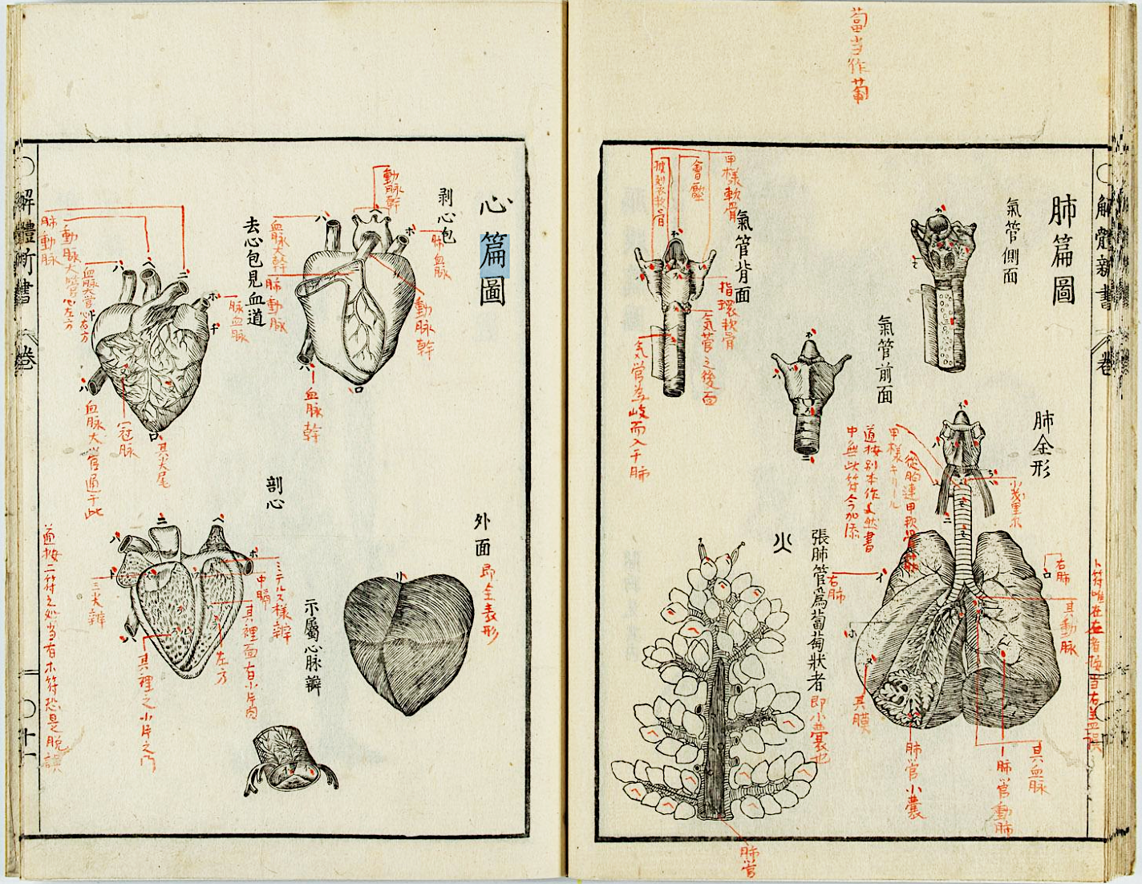
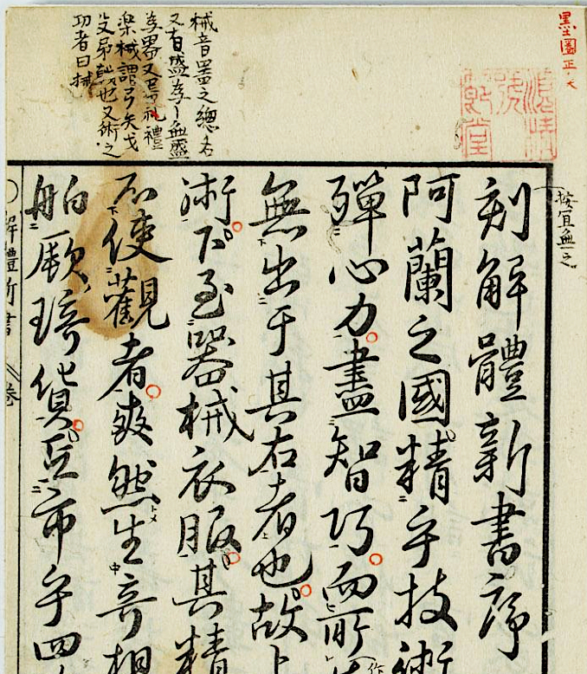
Purpose and Benefits of TEI (1)
Captures contextual elements beyond the main text—such as bibliographic data, annotations, layout, and seals
“Kaitai Shinsho,” in the collection of the Regional History and Culture Research Center, Saga University
Notes:
Topic:Purpose and Benefits of TEI
Voice: Joanna
```text
Researchers sometimes jot down their insights as annotations in the margins of research materials or mark key passages directly on the main text.
They may also add small readings, punctuation marks, or other symbols next to the text, such as kun ten, which are guiding marks for rendering Chinese into Japanese.
The text itself may also carry important meaning, its origin, character size, style, and layout can all be significant.
Until now, although the research materials themselves have often been recorded, the annotations, layout, and other forms of paratextual information mentioned earlier have rarely been datafied using standardized rules and technologies.
In humanities research, we deal with a wide range of textual materials such as historical documents, literary works, letters, and diaries.
If we lack a way to organize scholarly insights, especially those that are difficult to express or preserve, and share them as structured data with other researchers, then individual research becomes extremely difficult to pass on to future generations.
T E I provides a solution to this problem by offering rules for representing both the text and its surrounding information in a consistent format.
```
```description
Researchers sometimes jot down their insights as annotations in the margins of research materials or mark key passages directly on the main text.
They may also add small readings, punctuation marks, or other symbols next to the text, such as kunten, which are guiding marks for rendering Chinese into Japanese.
The text itself may also carry important meaning, its origin, character size, style, and layout can all be significant.
Until now, although the research materials themselves have often been recorded, the annotations, layout, and other forms of paratextual information mentioned earlier have rarely been datafied using standardized rules and technologies.
In humanities research, we deal with a wide range of textual materials such as historical documents, literary works, letters, and diaries.
If we lack a way to organize scholarly insights, especially those that are difficult to express or preserve, and share them as structured data with other researchers, then individual research becomes extremely difficult to pass on to future generations.
TEI provides a solution to this problem by offering rules for representing both the text and its surrounding information in a consistent format.
```

Slide 5
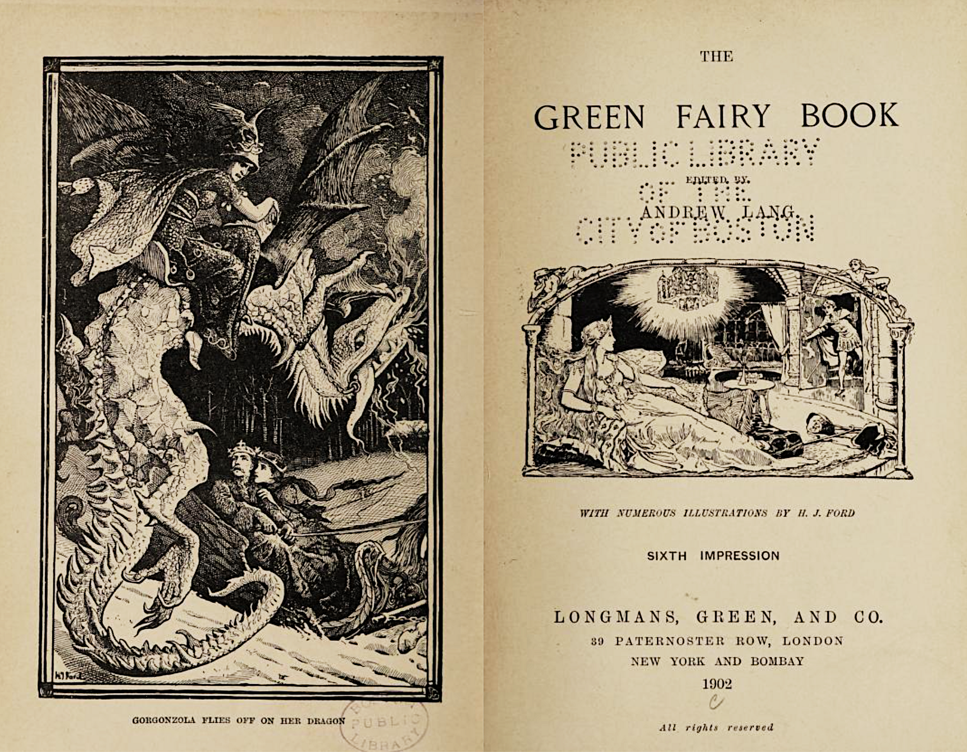

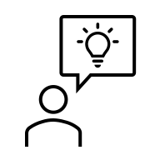

Purpose and Benefits of TEI (2)
XML（Extensible Markup Language）
A method of notation for organizing and structuring the content of text
tag
<title>The Green Fairy Book</title>
This part is a title.
I got it.
“The green fairy book” by Lang, Andrew, 1844-1912
Notes:
Topic:Purpose and Benefits of TEI
Voice: Joanna
```text
First, to organize text data, T E I uses a language called X M L.
X M L, which stands for Extensible Markup Language, is a form of notation used to organize and structure the contents of text.
Specifically, by enclosing important segments with markers called “tags,” it allows a computer to understand the meaning and position of those segments.
For example, when recording the title of a book, enclosing that portion in a title tag lets the computer know that, “This is the title.”
As a result, it becomes much easier to locate and display that title when needed.
```
```description
First, to organize text data, TEI uses a language called XML.
XML (Extensible Markup Language) is a form of notation used to organize and structure the contents of text.
Specifically, by enclosing important segments with markers called “tags,” it allows a computer to understand the meaning and position of those segments.
For example, when recording the title of a book, enclosing that portion in a title tag lets the computer know that, “This is the title.”
As a result, it becomes much easier to locate and display that title when needed.
```

Slide 6

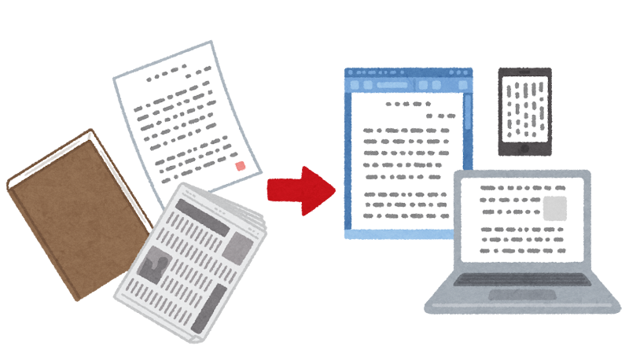
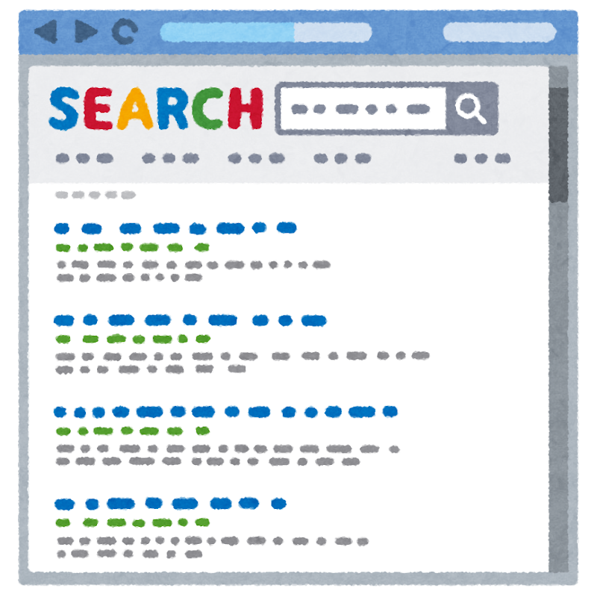
Purpose and Benefits of TEI (3)
Benefits of TEI
Compatibility Easy data sharing among researchers
Long-term Preservation Adaptable to future technological changes
Efficient search and analysis Makes it easy to find specific information or analyze data based on defined criteria
Notes:
Topic:Purpose and Benefits of TEI
Voice: Joanna
```text
There are also additional benefits of T E I, like the following.
Ensuring compatibility: Since data from any researcher is stored in the same format, it can be easily shared among researchers.
Meaning that it becomes easier to link data across different projects or reuse data of other researchers.
Long-term preservation: Saving data in a standardized format makes it easier to adapt to future technological changes and increases the chances of long-term usability.
Efficient search and analysis: By using tags to mark important parts of the text, it becomes easier to later search for specific information or analyze the data based on defined criteria.
```
```description
There are also additional benefits of TEI, like the following.
Ensuring compatibility: Since data from any researcher is stored in the same format, it can be easily shared among researchers.
Meaning that it becomes easier to link data across different projects or reuse data of other researchers.
Long-term preservation: Saving data in a standardized format makes it easier to adapt to future technological changes and increases the chances of long-term usability.
Efficient search and analysis: By using tags to mark important parts of the text, it becomes easier to later search for specific information or analyze the data based on defined criteria.
```

Slide 7
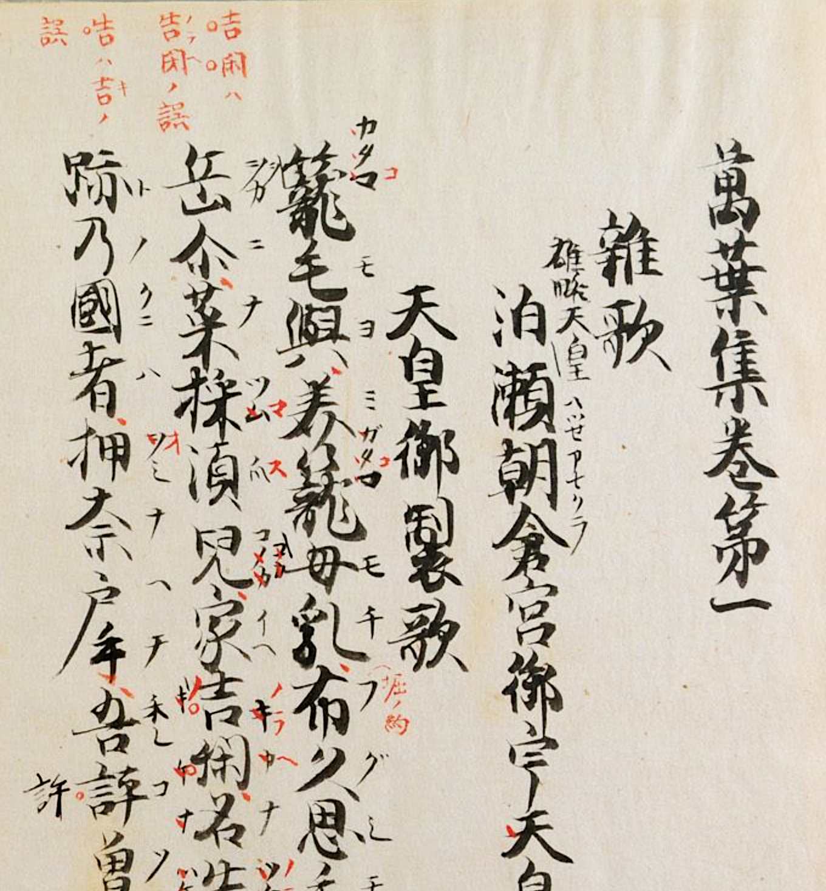
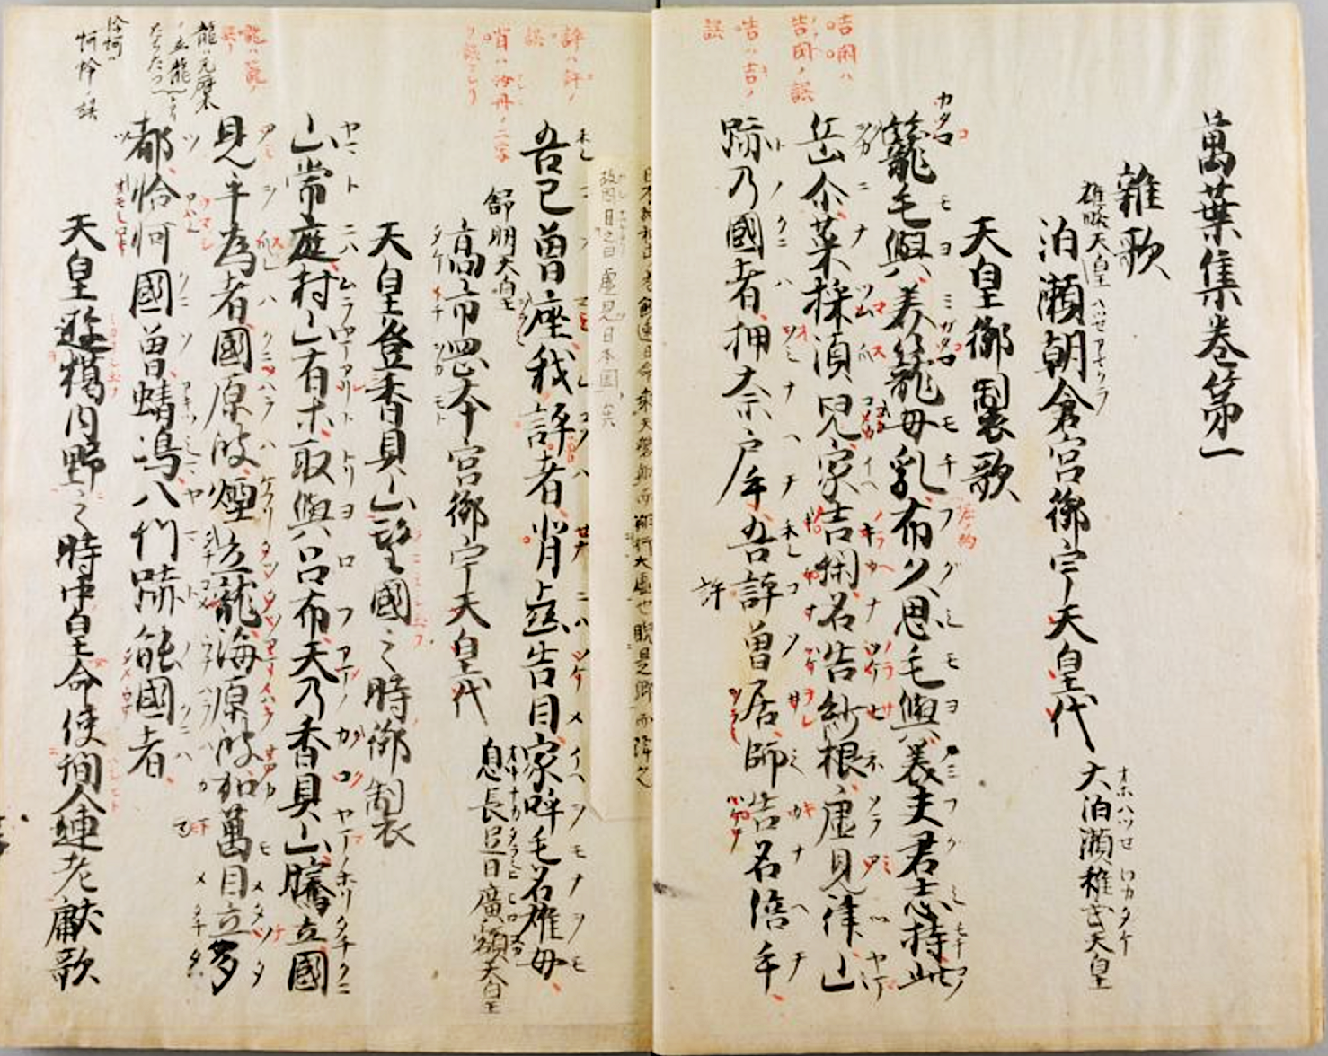
History and Background of TEI（1）
Annotations in red ink are important.
We want to digitize the meaning of the annotations as well
「萬葉集 20巻」(Man’yōshū, Volume 20) Kansai University Asia Open Research Center [KU-ORCAS]
In 1987, a project began to create a unified digital data format for the humanities → which became TEI
Notes:
Topic:The History and Background of TEI
Voice:Joanna
```text
Let’s take a moment to explore the history and background of T E I.
The Text Encoding Initiative was created to address key challenges faced by humanities researchers.
Researchers in the humanities often engage in highly detailed analysis of creative works.
The research data generated in the process can be extremely valuable to future researchers.
Yet at the same time, that data may be unintelligible without explanation from the researcher themselves.
This is a factor that may contribute to the lack of transparency sometimes associated with research in the humanities.
To address this, researchers developed a shared set of rules for embedding their own insights into textual sources, so that these could be passed on to future generations.
That’s how T E I began.
In the 1980s, as computers became more widespread, humanities researchers began considering how to digitize textual materials.
At the time, however, each researcher used their own method of handling text data, making it very difficult to share that data or reuse it across different projects.
To resolve this problem, researchers from Europe and the U.S., came together to create a unified digital data format for the humanities.
That initiative, launched in 1987, marked the beginning of T E I.
```
```description
Let’s take a moment to explore the history and background of TEI.
The Text Encoding Initiative, or TEI, was created to address key challenges faced by humanities researchers.
Researchers in the humanities often engage in highly detailed analysis of creative works.
The research data generated in the process can be extremely valuable to future researchers.
Yet at the same time, that data may be unintelligible without explanation from the researcher themselves.
This is a factor that may contribute to the lack of transparency sometimes associated with research in the humanities.
To address this, researchers developed a shared set of rules for embedding their own insights into textual sources, so that these could be passed on to future generations.
That’s how TEI began.
In the 1980s, as computers became more widespread, humanities researchers began considering how to digitize textual materials.
At the time, however, each researcher used their own method of handling text data, making it very difficult to share that data or reuse it across different projects.
To resolve this problem, researchers from Europe and the U.S., came together to create a unified digital data format for the humanities.
That initiative, launched in 1987, marked the beginning of TEI.
[「萬葉集 20巻」](https://www.iiif.ku-orcas.kansai-u.ac.jp/books/210464810#?page=9)
```

Slide 8
History and Background of TEI（2）
SGML（Standard Generalized Markup Language)
A technology used primarily in the publishing industry to structure complex documents
It did not become widely adopted by the general public
The Emergence of XML (Extensible Markup Language)
In the 2000s, XML was introduced as a more user-friendly format for many people
The TEI Guidelines (User Guide) were reconstructed based on XML
Notes:
Topic:The History and Background of TEI
Voice:Joanna
```text
The T E I project was originally developed using a markup standard called S G M L.
S G M L , which stands for Standard Generalized Markup Language, was a technology used for structuring complex documents, and it saw primary use in industries like publishing.
However, due to its complexity and difficulty of use, S G M L was never broadly adopted.
In the 2000s, a more user-friendly and widely applicable alternative emerged, called X M L.
With the adoption of X M L, the T E I Guidelines were rebuilt on this new foundation, leading to their widespread use across many areas of the humanities.
```
```description
The TEI project was originally developed using a markup standard called SGML.
SGML (Standard Generalized Markup Language) was a technology used for structuring complex documents, and it saw primary use in industries like publishing.
However, due to its complexity and difficulty of use, SGML was never broadly adopted.
In the 2000s, a more user-friendly and widely applicable alternative emerged, called XML (Extensible Markup Language).
With the adoption of XML, the TEI Guidelines were rebuilt on this new foundation, leading to their widespread use across many areas of the humanities.
```

Slide 9




History and Background of TEI（3）
Features of XML
Tags can be freely defined
You can define your own tags (labels)
Highly extensible
Because tags can be defined to match the structure and content of your data, XML can support a wide variety of data types and use cases.
Transformable structure
XML can convert data structure to other formats=the same data can be reused for various purposes
eBooks
TEI
on browsers
database
Notes:
Topic:The History and Background of TEI
Voice:Joanna
```text
X M L, simply put, is a format for organizing digital data.
By using X M L, the structure and meaning of a text can be clearly defined so that a computer can understand it.
This allowed researchers to digitize text data according to a common set of rules, making it easier to share.
By adopting X M L, T E I made it possible for researchers around the world to handle text data in the same format, greatly improving data compatibility and preservation.
The features of X M L are as follows:
Tags can be freely defined.
In X M L, you can freely decide which tags (labels) to use.
This means that unlike H T M L, which uses a fixed set of tags, you can create appropriately named tags based on the content, making the data easier to organize and understand.
It is highly extensible and versatile.
Because tags can be defined to match the structure and content of the data, XML can accommodate many data types and purposes.
This is why XML is considered to be highly extensible.
It’s structure can be transformed.
XML allows data structures to be converted into other formats.
For example, XML data can be converted into HTML, CSV, or other data formats.
In essence, the same data can be reused for a variety of purposes.
```
```description
XML, simply put, is a format for organizing digital data.
By using XML, the structure and meaning of a text can be clearly defined so that a computer can understand it.
This allowed researchers to digitize text data according to a common set of rules, making it easier to share.
By adopting XML, TEI made it possible for researchers around the world to handle text data in the same format, greatly improving data compatibility and preservation.
The features of XML are as follows:
Tags can be freely defined.
In XML, you can freely decide which tags (labels) to use.
This means that unlike HTML, which uses a fixed set of tags, you can create appropriately named tags based on the content, making the data easier to organize and understand.
It is highly extensible.
XML is versatile.
Because tags can be defined to match the structure and content of the data, XML can accommodate many data types and purposes.
This is why XML is considered to be highly extensible.
It’s structure can be transformed.
XML allows data structures to be converted into other formats.
For example, XML data can be converted into HTML, CSV, or other data formats.
In essence, the same data can be reused for a variety of purposes.
```

Slide 10
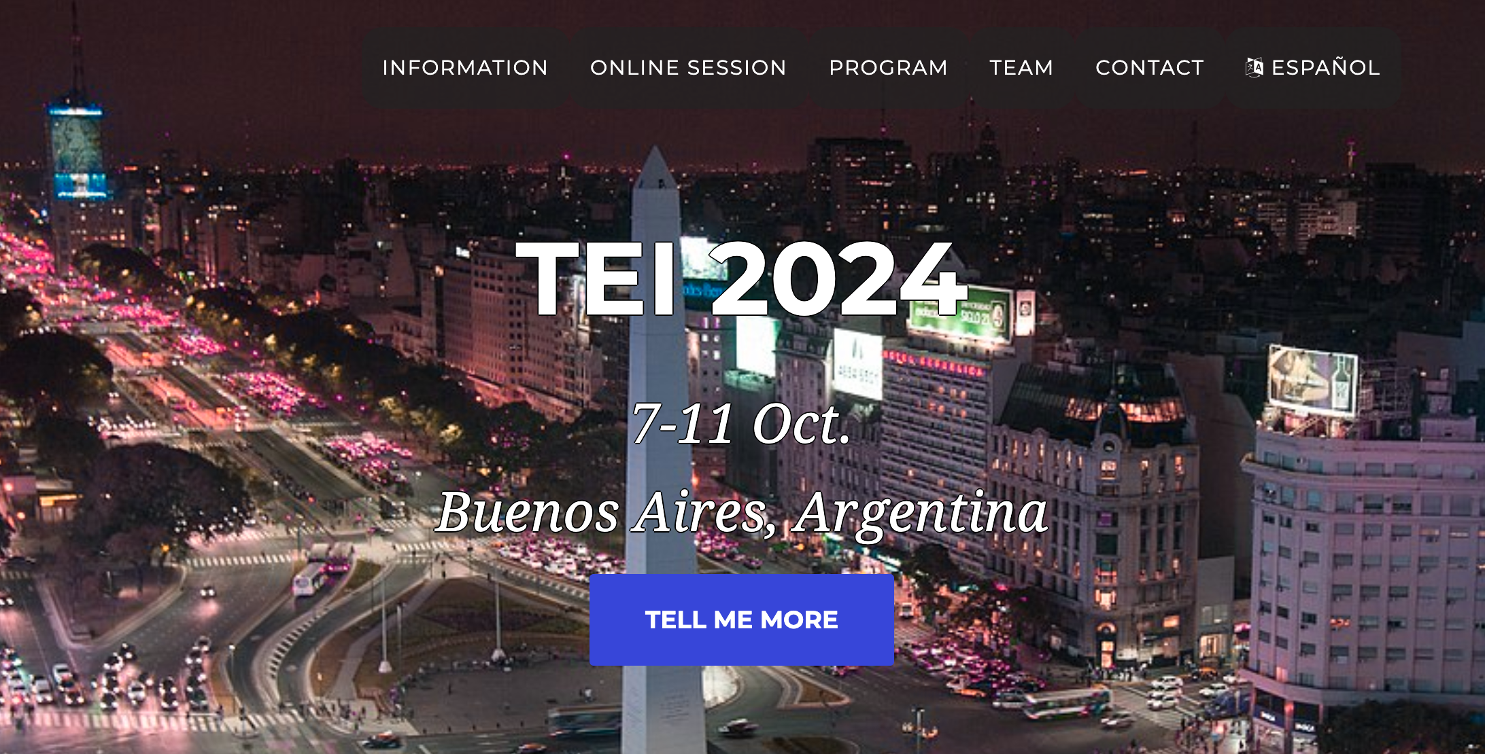
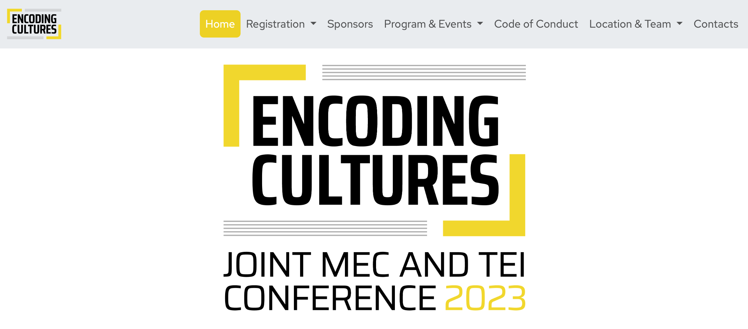
History and Background of TEI（4）
The TEI's conference and annual general meetings
https://members.tei-c.org/Events/meetings
Notes:
Topic:The History and Background of TEI
Voice:Joanna
```text
T E I has grown into an international project, and researchers around the world are collaborating to continuously revise and expand its guidelines.
An international T E I conference is also held annually, and active research discussions and information exchange take place.
As T E I adoption grows across diverse areas of the humanities, text data is being digitized more extensively, enabling more powerful and effective research than ever before.
```
```description
TEI has grown into an international project, and researchers around the world are collaborating to continuously revise and expand its guidelines.
An international TEI conference is also held annually, and active research discussions and information exchange take place.
https://members.tei-c.org/Events/meetings
As TEI adoption grows across diverse areas of the humanities, text data is being digitized more extensively, enabling more powerful and effective research than ever before.
```

Slide 11
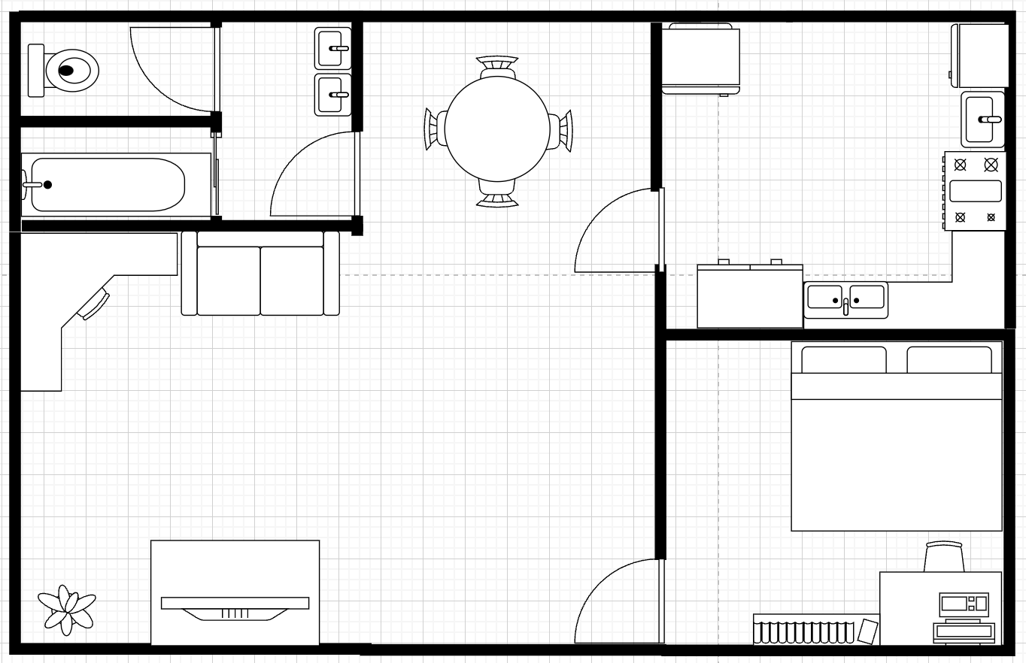
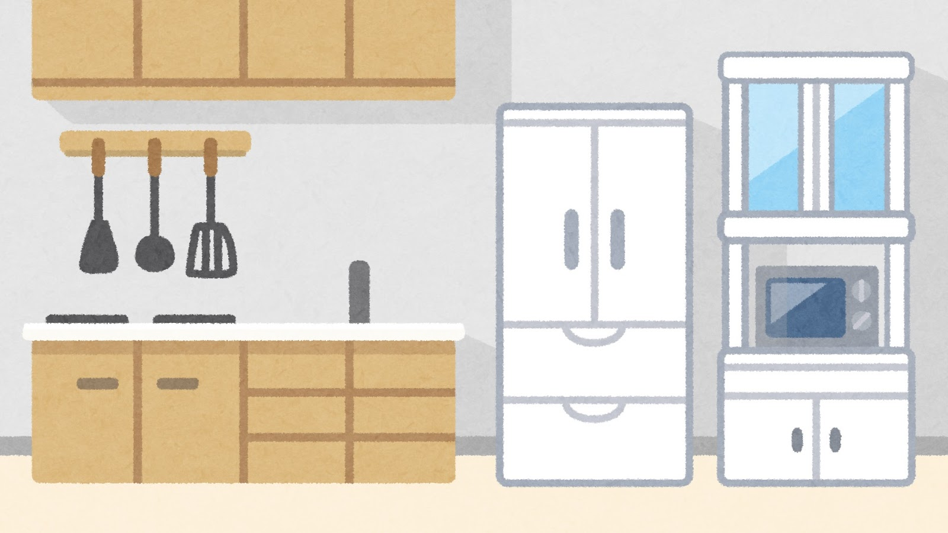
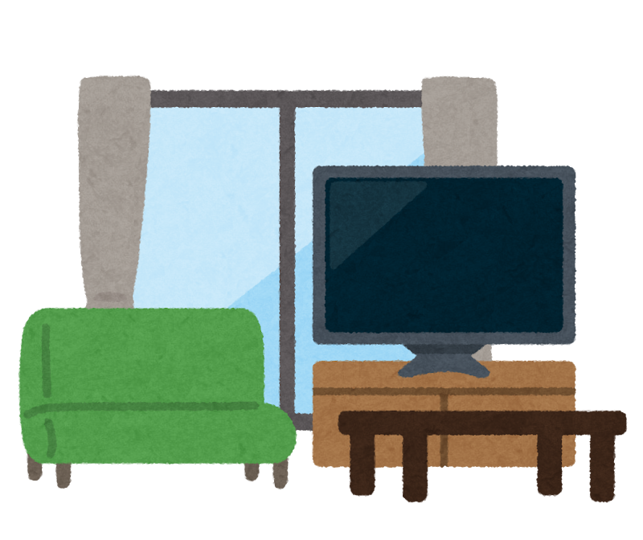
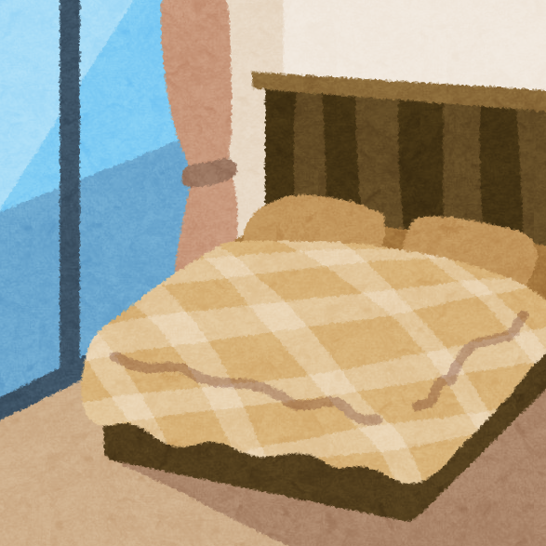
TEI Structure (1)
Each room = a section of the text, such as a chapter or paragraph
House (floor plan)
- Living Room
    -- sofa
    - Kitchen
    -- refrigerator
    - Bedroom
      -- bed
Notes:
Topic:TEI Structure
Voice:Joanna
```text
Now, let’s briefly look at how T E I is structured.
T E I offers a set of rules and procedures for organizing various types of texts, and in order to understand it, it is important to know how T E I tags are used.
Organizing a text using T E I is much like properly arranging furniture in a house.
For example, a house contains different rooms, such as a living room, kitchen, and bedroom.
If we map this to the “structure” of a text, each room corresponds to a chapter or paragraph.
Just as the living room contains a sofa or a TV, a chapter or paragraph contains components such as headings, sentences, or quotations.
You can think of T E I tags as the “furniture placement rules”, that are used to label and organize those components.
```
```description
Now, let’s briefly look at how TEI is structured.
TEI offers a set of rules and procedures for organizing various types of texts, and in order to understand it, it is important to know how TEI tags are used.
Organizing a text using TEI is much like properly arranging furniture in a house.
For example, a house contains different rooms, such as a living room, kitchen, and bedroom.
If we map this to the “structure” of a text, each room corresponds to a chapter or paragraph.
Just as the living room contains a sofa or a TV, a chapter or paragraph contains components such as headings, sentences, or quotations.
You can think of TEI tags as the “furniture placement rules”, that are used to label and organize those components.
```

Slide 12
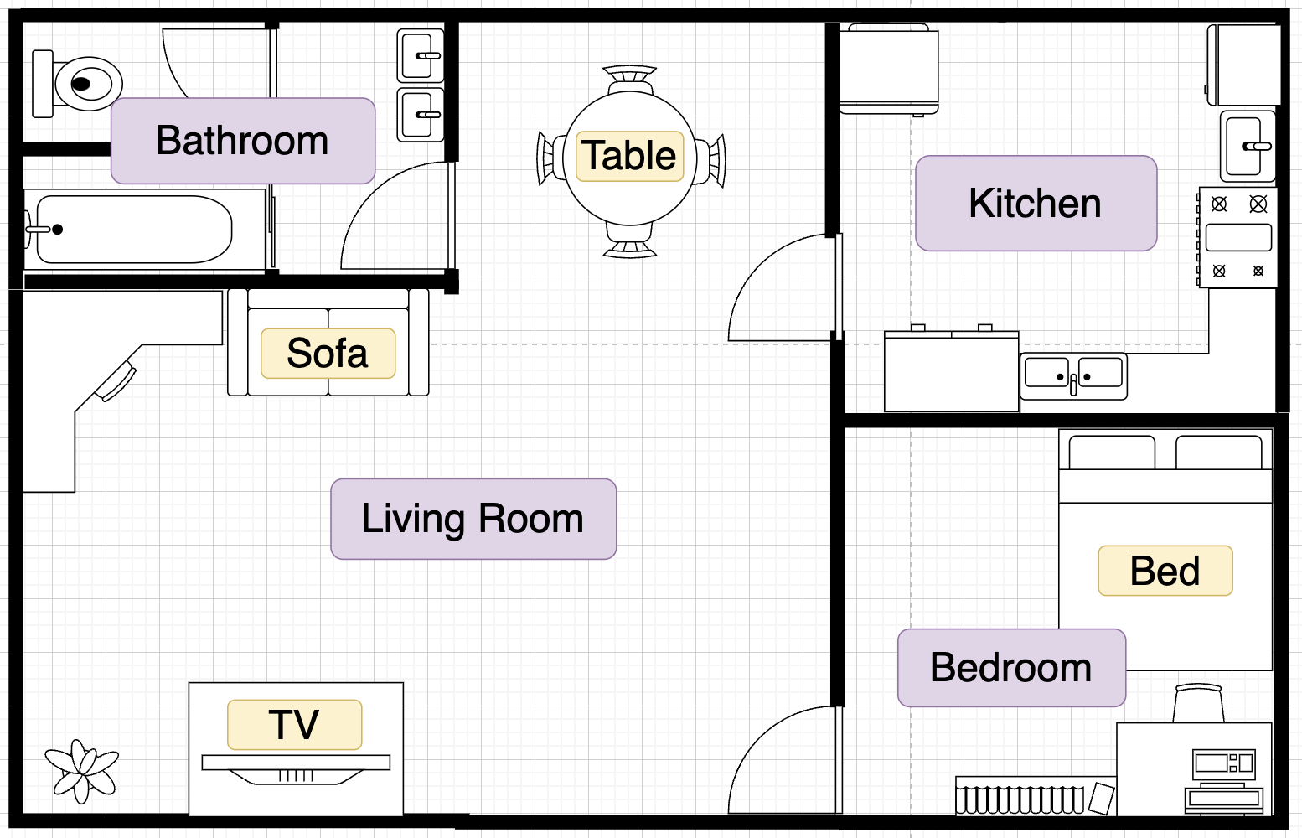
TEI Structure (2)
<house>
<room>
<room>
<room>
</room>
<furniture>
</furniture>
</room>
<room>
</room>
</room>
</house>
Notes:
Topic:TEI Structure
Voice:Joanna
```text
T E I tags are markers that clarify which parts of the text represent what.
For example, if you label a book title as “title,” anyone, as well as the computer, can immediately recognize it as the title.
In the house analogy, this is like placing a label that says “sofa” on the sofa in the living room.
By doing so, the house becomes organized, and anyone can quickly tell what is where.
```
```description
TEI tags are markers that clarify which parts of the text represent what.
For example, if you label a book title as “title,” anyone, as well as the computer, can immediately recognize it as the title.
In the house analogy, this is like placing a label that says “sofa” on the sofa in the living room.
By doing so, the house becomes organized, and anyone can quickly tell what is where.
```

Slide 13
TEI Structure (3)
Metadata Tags
  Tags that provide information about the text as a whole (author, date of writing, place of publication, etc.)
Structure Tags
  Tags that indicate major structural components of the text (such as chapters, paragraphs, and sections)
Content Tags
  Tags that describe the content of the text (such as headings, names, dates, quotations, etc.)
Notes:
Topic:TEI Structure
Voice:Joanna
```text
T E I tags can be broadly categorized into three types:
Metadata tags: These indicate information about the entire text, such as the author, date of writing and where it was published.
In other words, they are like the exterior of a house, the name of its owner and its address.
Structure tags: These tags form the framework of the text. They indicate major components like chapters, paragraphs, and sections.
In terms of the house analogy, this is equivalent to a house’s floor plan.
Content tags: These tags describe the content of the text.
They label elements such as headings, names, dates, and quotations.
It’s like putting labels on the furniture and decorations inside a house.
In short, T E I tags are tools for organizing and tidying up textual data, just like labeling the furnishings inside a house.
```
```description
TEI tags can be broadly categorized into three types:
Metadata tags: These indicate information about the entire text, such as the author, date of writing and where it was published.
In other words, they are like the exterior of a house, the name of its owner and its address.
Structure tags: These tags form the framework of the text. They indicate major components like chapters, paragraphs, and sections.
In terms of the house analogy, this is equivalent to a house’s floor plan.
Content tags: These tags describe the content of the text.
They label elements such as headings, names, dates, and quotations.
It’s like putting labels on the furniture and decorations inside a house.
In short, TEI tags are tools for organizing and tidying up textual data, just like labeling the furnishings inside a house.
```

Slide 14
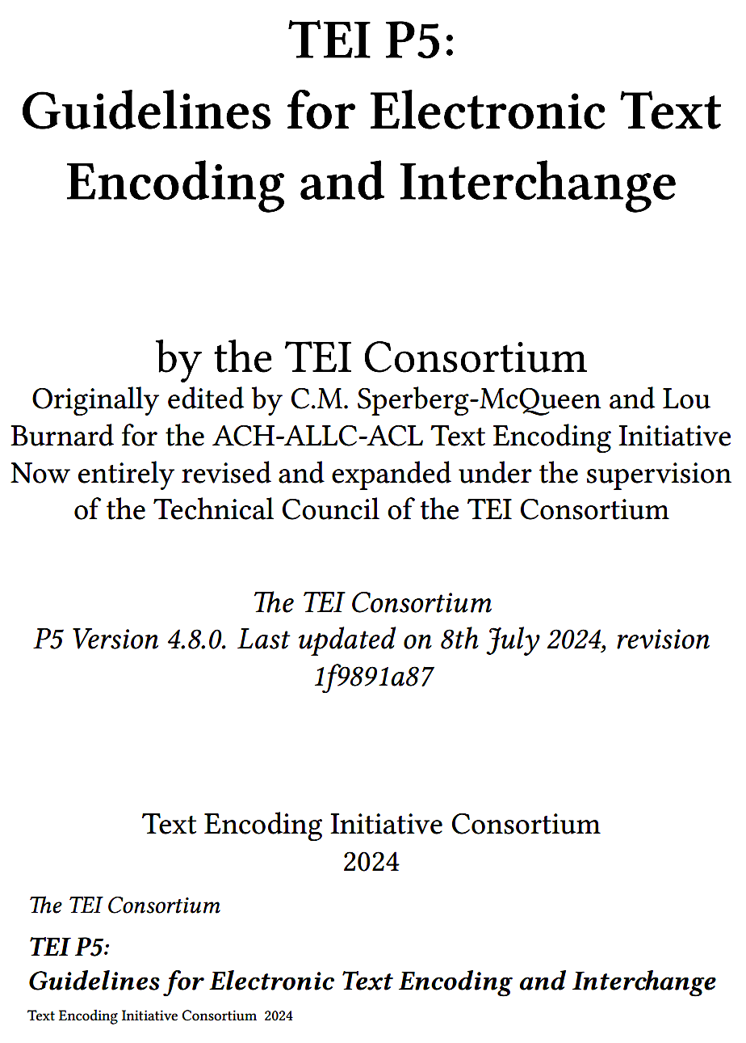
TEI Guidelines (1)
TEI Guidelines Homepage
Guidelines for tagging text, its structure, annotations, and other contextual information
https://www.tei-c.org/release/doc/tei-p5-doc/en/html/index.html
(Please search for: “TEI guidelines”)
Notes:
Topic:TEI Guidelines
Voice:Joanna
```text
So far, we’ve seen how T E I structures text and how its tags work.
Here, we’ll explain the “T E I Guidelines,” which define how these tags should be used.
These guidelines cover the basic rules of T E I and serve as a reference for humanities researchers to digitize and preserve texts for future use.
By following the T E I Guidelines, anyone can organize digital data in a consistent format, regardless of who created the data.
This makes it easier to share and reuse data among researchers and across different projects.
```
```description
So far, we’ve seen how TEI structures text and how its tags work.
Here, we’ll explain the “TEI Guidelines,” which define how these tags should be used.
These guidelines cover the basic rules of TEI and serve as a reference for humanities researchers to digitize and preserve texts for future use.
By following the TEI Guidelines, anyone can organize digital data in a consistent format, regardless of who created the data.
This makes it easier to share and reuse data among researchers and across different projects.
(TEI Guidelines, available both online and as a downloadable file) (https://www.tei-c.org/release/doc/tei-p5-doc/en/html/index.html)
```

Slide 15

TEI Guidelines (2)
Goal
The Standardization of Text Data
Notes:
Topic:TEI Guidelines
Voice:Joanna
```text
The main goal of the T E I Guidelines is the standardization of text data.
Standardization means establishing common rules for handling data, so that everyone organizes texts in the same way.
For example, when another researcher uses your data, they can immediately understand how it’s structured.
This makes preservation and sharing of data much smoother.
```
```description
The main goal of the TEI Guidelines is the standardization of text data.
Standardization means establishing common rules for handling data, so that everyone organizes texts in the same way.
For example, when another researcher uses your data, they can immediately understand how it’s structured.
This makes preservation and sharing of data much smoother.
```

Slide 16
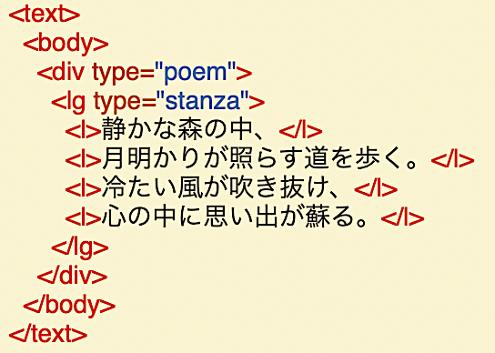
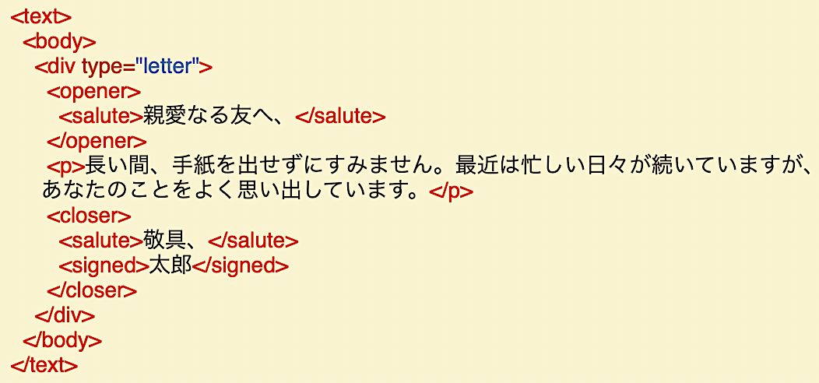
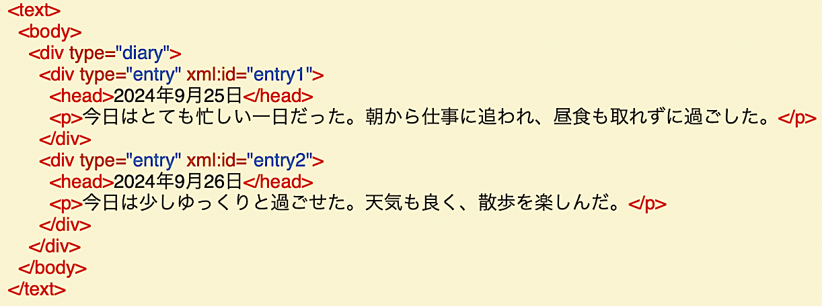
TEI Guidelines (3)
<text>
<body>
<div type="letter">
<opener>
<salute>Dear friend,</salute>
</opener>
<p>Sorry I haven’t written in so long. Life has been busy lately,
but I think of you often.</p>
<closer>
<salute>Best regards,</salute>
<signed>Taro</signed>
</closer>
</div>
</body>
</text>
<text>
<body>
<div type= "poem" >
<lg type= "stanza">
<l>In the quiet forest,</l>
<l>I walk the path lit by moonlight.</l>
<l>A cold wind blows through,</l>
<l>and memories stir within me.</l>
</lg>
</div>
</body>
</text>
Letter→
<text>
<body>
<div type="diary">
<div type="entry" xml:id="entry1">
<head>September 25, 2024</head>
<p>Today was an extremely busy day. I was rushed with work from the morning and couldn’t even eat lunch.</p>
</div>
<div type=”entry" xml:id="entry2">
<head>September 26, 2024</head>
<p>Today I took things slowly. The weather was nice, and I enjoyed a walk.</p>
</div>
</div>
</body>
</text>
↑Poem
Diary→
Notes:
Topic:TEI Guidelines
Voice:Joanna
```text
The T E I Guidelines are designed to be highly flexible and can accommodate many different types of texts.
This is because you can choose and apply appropriate tags when digitizing various kinds of textual materials.
For example, in texts like poems where rhythm and meter are important, you use tags suited to that purpose; for texts with specific formats like letters or diaries, you apply tags appropriate to those genres.
This flexibility is one of the reasons why T E I is widely adopted across many fields of research.
```
```description
The TEI Guidelines are designed to be highly flexible and can accommodate many different types of texts.
This is because you can choose and apply appropriate tags when digitizing various kinds of textual materials.
For example, in texts like poems where rhythm and meter are important, you use tags suited to that purpose; for texts with specific formats like letters or diaries, you apply tags appropriate to those genres.
This flexibility is one of the reasons why TEI is widely adopted across many fields of research.
```

Slide 17
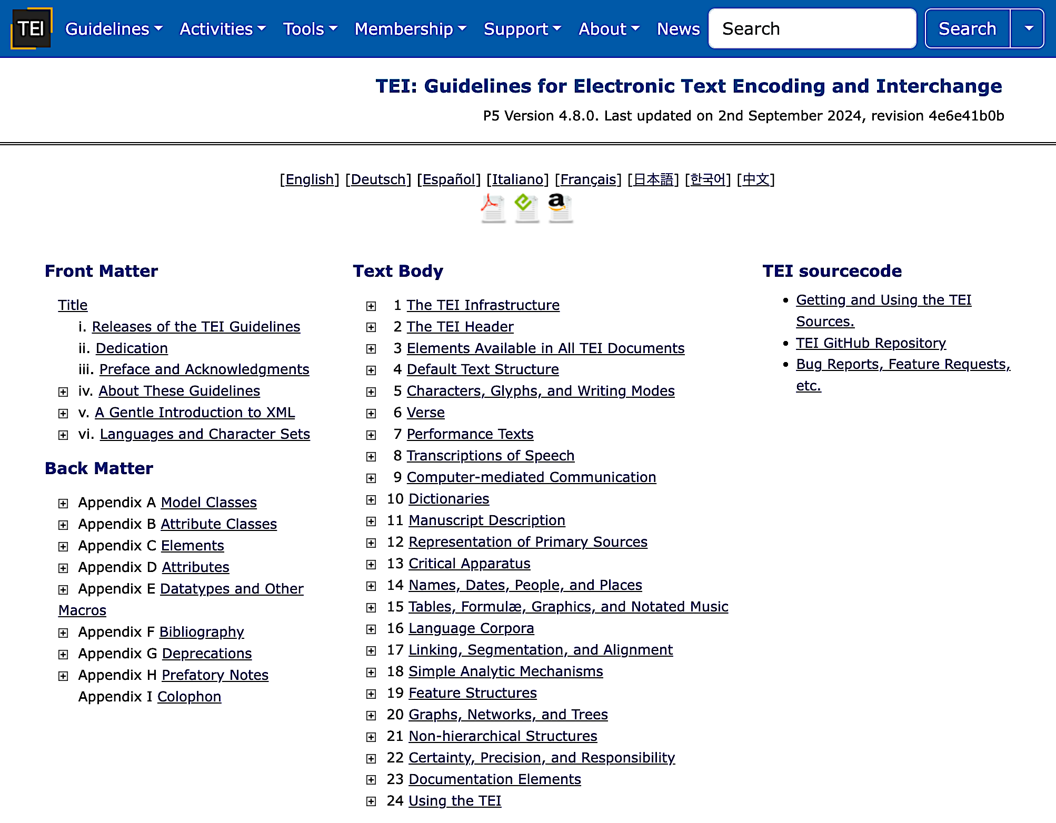
TEI Guidelines (4)
TEI Guidelines Homepage →
Notes:
Topic:TEI Guidelines
Voice:Joanna
```text
The T E I guidelines explain in detail which tags to use and how to apply them.
For example, tags for indicating the title of a document, the author’s name, the date, and place, are all described in the guidelines.
However, if you’re using T E I for the first time, you may feel overwhelmed by the sheer volume of the guidelines.
So in the next section, we’ll introduce specific ways to use tags when structuring a text, while also explaining how to refer to the guidelines as needed.
```
```description
The TEI guidelines explain in detail which tags to use and how to apply them.
For example, tags for indicating the title of a document, the author’s name, the date, and place, are all described in the guidelines.
However, if you’re using TEI for the first time, you may feel overwhelmed by the sheer volume of the guidelines.
So in the next section, we’ll introduce specific ways to use tags when structuring a text, while also explaining how to refer to the guidelines as needed.
```

