Slide 1
Using TEI tags
Notes:
Topic:What are tags?
Voice:Joanna
```text
Using T E I tags
```
```description
Using TEI tags
```

Slide 2
What are tags?
<xxxxx>A block of text or characters</xxxxx>
Element = a part of text enclosed by tags
End-tag
Start-tag
2. <xxxxx />
This tag allows you to assign meaning at a specific position even if there is no text.
Empty tag
Notes:
Topic:What are tags?
Voice:Joanna
```text
Let’s review what we covered last time.
Tags are identifiers that are written in angled brackets
They are used to mark the start and end of specific portions of text or characters.
By tagging a section this way, you can assign meaning to that text.
A closing tag includes a slash to indicate where the marked portion ends.
The material between the start-tag and the end-tag is known as the content of the element.
There is also a type of tag that does not enclose any text.
This is called an empty tag or empty element, and is used when you want to assign a specific meaning to a position in the text even if there is no content to surround.
```
```description
Let’s review what we covered last time.
Tags are identifiers that are written in angled brackets
They are used to mark the start and end of specific portions of text or characters.
By tagging a section this way, you can assign meaning to that text.
A closing tag includes a slash to indicate where the marked portion ends.
The material between the start-tag and the end-tag is known as the content of the element.
There is also a type of tag that does not enclose any text.
This is called an empty tag or empty element, and is used when you want to assign a specific meaning to a position in the text even if there is no content to surround.
```

Slide 3
Rules of tagging
Start-tags and end-tags must always be used as a pair when enclosing a block of text.
Pairs of start-tag and end-tag may be nested.
Nested elements cannot overlap.
←This is correct
← This is incorrect
Notes:
Topic:What are tags?
Voice:Joanna
```text
There are two rules when adding tags.
When enclosing a block of text with a start-tag and end-tag, they must always be used as a pair.
Also, sets of start-tag and end-tag can be nested.
However, nested pairs cannot overlap.
```
```description
There are two rules when adding tags.
When enclosing a block of text with a start-tag and end-tag, they must always be used as a pair.
Also, sets of start-tag and end-tag can be nested.
However, nested elements cannot overlap.
```

Slide 4
Structure of TEI-formatted Data
<TEI xmlns="http://www.tei-c.org/ns/1.0">
<teiHeader>
<!-- ... -->
</teiHeader>
<text>
<front>
<!-- front matter of copy text, if any, goes here -->
</front>
<body>
<!-- body of copy text goes here -->
</body>
<back>
<!-- back matter of copy text, if any, goes here -->
</back>
</text>
</TEI>
Notes:
Topic:What are tags?
Voice:Joanna
```text
When creating T E I formatted data, you first prepare a format that serves as a template.
This format is called the T E I format.
An example template is shown on screen.
With any basic text editor, you can start working on it right away.
That said, computers won’t catch small errors that humans easily would, so be careful with spelling and tagging rules when entering text.
```
```description
When creating TEI-formatted data, you first prepare a format that serves as a template.
This format is called the TEI format.
An example template is shown on screen.
With any basic text editor, you can start working on it right away.
That said, computers won’t catch small errors that humans easily would, so be careful with spelling and tagging rules when entering text.
```

Slide 5
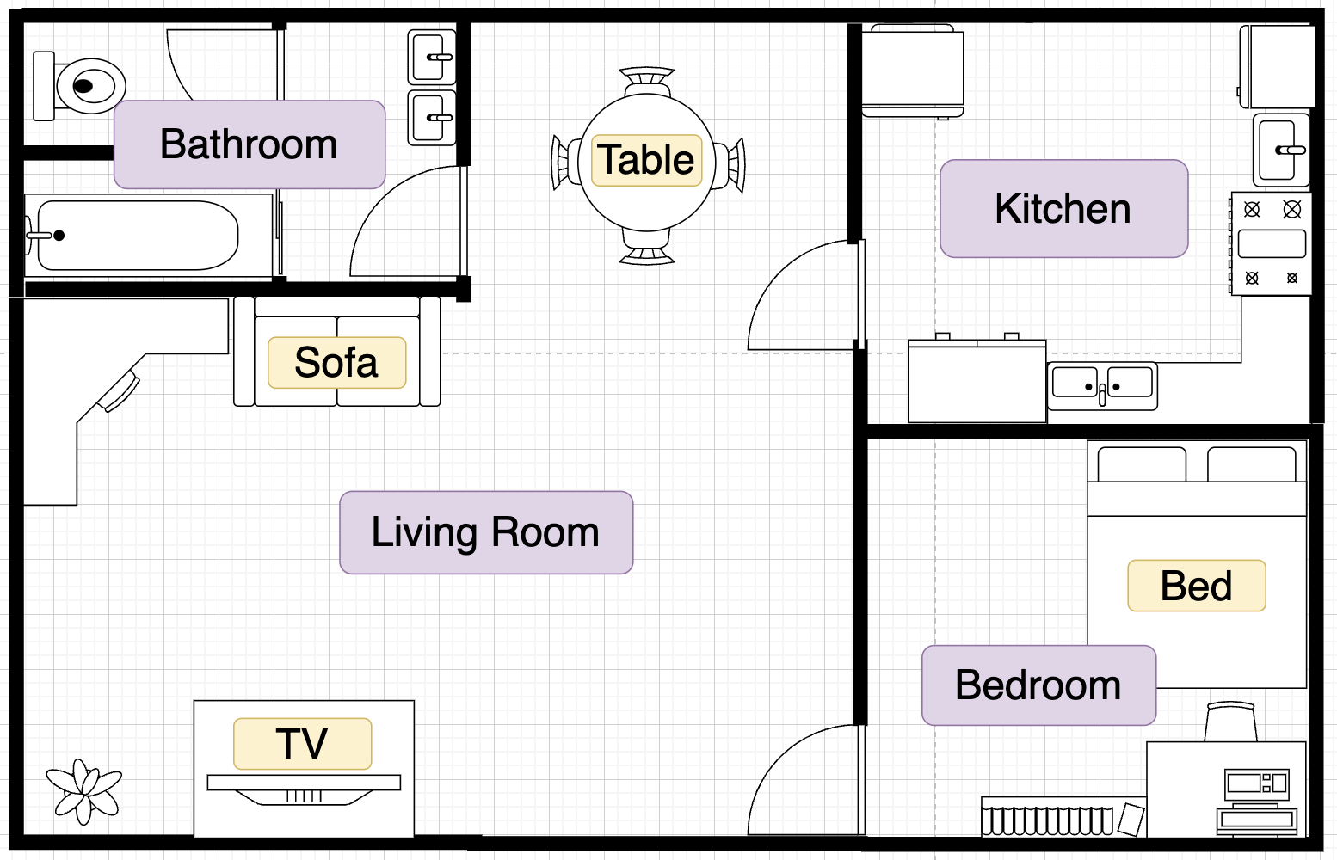
<TEI> Tag (Root Element)
<TEI>
<TEI>
Root Element
（This tag must always come first）
</TEI>
Notes:
Topic:What are tags?
Voice:Joanna
```text
The basic structure of the T E I format is organized into several main parts.
First, every T E I document begins with the T E I tag, which encloses various components.
This T E I tag plays a role like the outer walls of a house, enclosing everything inside.
```
```description
The basic structure of the TEI format is organized into several main parts.
First, every TEI document begins with the <TEI> tag, which encloses various components.
This <TEI> tag plays a role like the outer walls of a house, enclosing everything inside.
```

Slide 6
<teiHeader> Tag
<TEI>
<teiHeader>
</teiHeader>
<text>
</text>
</TEI>
<teiHeader> Tag
A required element that appears inside the <TEI> tag.
The section that manages surrounding information about the text (such as the title, author name, publication date, etc.)
Summary or supplementary information about Main Text
Main Text
Notes:
Topic:What are tags?
Voice:Joanna
```text
Within the T E I tag, there is a tag called t e i Header.
This is the part that manages various information about the text.
For example, the document’s title, author name, and publication date are recorded here.
This part corresponds to something like a library catalog entry, describing essential details of a document.
The t e i Header tag is necessary for organizing background information about the text.
```
```description
Within the <TEI> tag, there is a tag called <teiHeader>.
This is the part that manages various information about the text.
For example, the document’s title, author name, and publication date are recorded here.
This part corresponds to something like a library catalog entry, describing essential details of a document.
The <teiHeader> tag is necessary for organizing background information about the text.
```

Slide 7
<text> Tag (Main Text)
<TEI>
<teiHeader>
</teiHeader>
<text>
</text>
</TEI>
<text> Tag
Contains the actual content of the text
Structures chapters, paragraphs, headings, etc
Summary or supplementary information about Main Text
Main Text
Notes:
Topic:What are tags?
Voice:Joanna
```text
After the t e i Header tag, comes the text tag.
It contains the actual contents of the text.
Within the text tag, tags for organizing chapters, paragraphs, headings, etc. can be used.
```
```description
After the <teiHeader> tag, comes the <text> tag.
It contains the actual contents of the text.
Within the <text> tag, tags for organizing chapters, paragraphs, headings, etc. can be used.
```

Slide 8
Structure of TEI-formatted Data
<TEI xmlns="http://www.tei-c.org/ns/1.0">
<teiHeader>
<!-- ... -->
</teiHeader>
<text>
<front>
<!-- front matter of copy text, if any, goes here -->
</front>
<body>
<!-- body of copy text goes here -->
</body>
<back>
<!-- back matter of copy text, if any, goes here -->
</back>
</text>
</TEI>
Notes:
Topic:What are tags?
Voice:Joanna
```text
Let’s revisit what T E I formatted data looks like.
By now, this structure might be starting to feel more familiar.
```
```description
Let’s revisit what TEI-formatted data looks like.
By now, this structure might be starting to feel more familiar.
```

Slide 9
Journal Article (a simple example)
(Bibliography)
Title: My Paper
Author: Taro Yamada
Publisher: UOsaka Publishing
Year of Publication: 2025
(Main Text)
My Paper
Taro Yamada
Introduction
This is the introduction of my paper.
…
<TEI>
<teiHeader>
(Source＝Bibliographic information、
catalog、metadata)
</teiHeader>
<text>
(Main text)
</text>
</TEI>
Notes:
Topic:What are tags?
Voice:Joanna
```text
Let’s look at a more specific example.
Say you have a file titled My Paper, like the one shown on the left.
First, it is necessary to describe the source of such a file.
This typically includes bibliographic details, catalog entries, and metadata.
By entering that information inside the t e i Header tag, others will easily understand where the file comes from and how to use it.
Next, the actual content of the paper—the body text—is added within the text tag.
```
```description
Let’s look at a more specific example.
Say you have a file titled My Paper, like the one shown on the left.
First, it is necessary to describe the source of such a file.
This typically includes bibliographic details, catalog entries, and metadata.
By entering that information inside the <teiHeader> tag, others will easily understand where the file comes from and how to use it.
Next, the actual content of the paper—the body text—is added within the <text> tag.
```

Slide 10
Tag Structure
(Bibliography)
Title: My Paper
Author: Taro Yamada
Publisher: UOsaka Publishing
Year of Publication: 2025
(Main Text)
My Paper
Taro Yamada
Introduction
This is the introduction of my paper.
…
<TEI>
<teiHeader>
<fileDesc>
<titleStmt>
<title>My Paper</title>
<author>Taro Yamada</author>
</titleStmt>
<publicationStmt>
<publisher>UOSaka Publishing</publisher>
<date>2024</date>
</publicationStmt>
</fileDesc>
</teiHeader>
<text>
(Main text)
</text>
</TEI>
Notes:
Topic:What are tags?
Voice:Joanna
```text
Take a closer look inside the t e i Header.
To give more detailed bibliographic information about this file, tags such as fileDesk, title s t m t, and publication s t m t have been added.
These tags are needed to describe the file’s overview.
When making T E I data, it’s important to figure out where and how to use such tags, though this does take a bit of skill.
```
```description
Take a closer look inside the <teiHeader>.
To give more detailed bibliographic information about this file, tags such as <fileDesc>, <titleStmt> and <publicationStmt> have been added.
These tags are needed to describe the file’s overview.
When making TEI data, it’s important to figure out where and how to use such tags, though this does take a bit of skill.
```

Slide 11
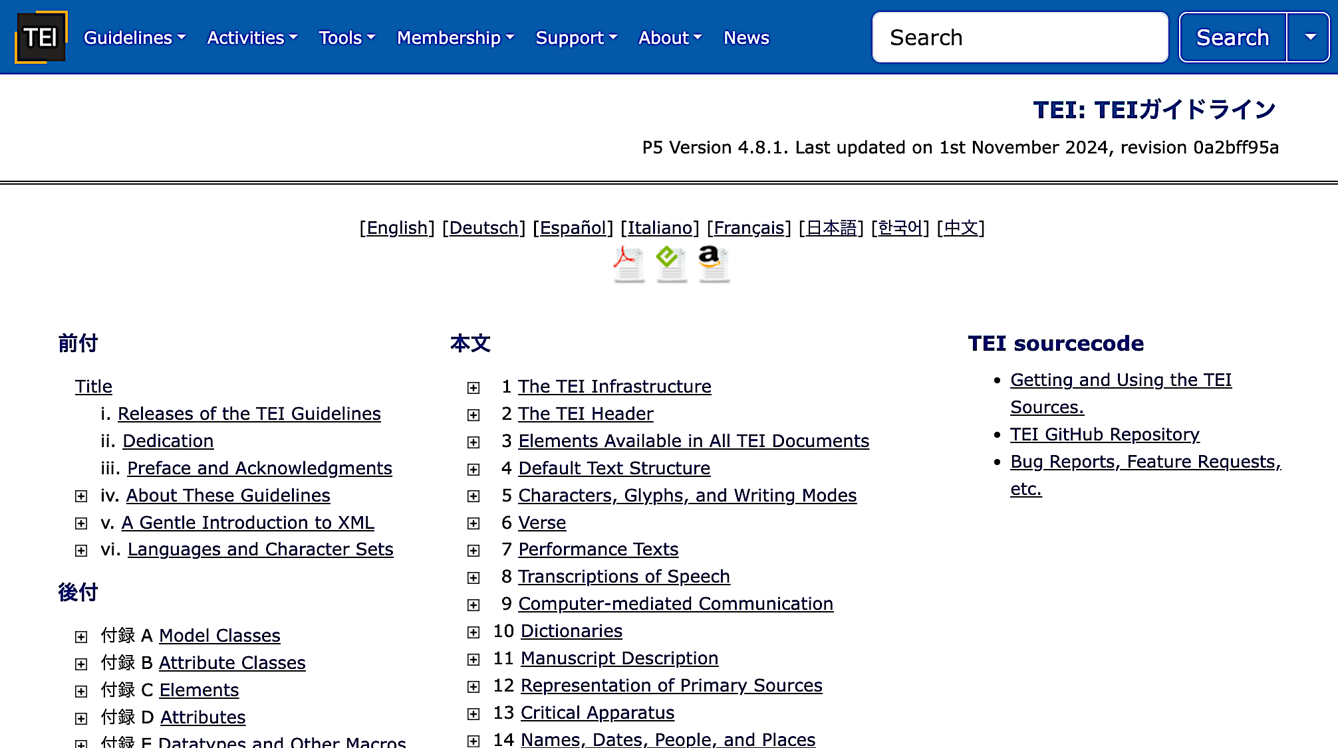
Using the TEI Guidelines (1)
If you search for “TEI guidelines” in your browser, you’ll find a page like the one on the right: “The TEI Guidelines” (Current Guidelines).
Notes:
Topic:Using the TEI Guidelines
Voice:Joanna
```text
To begin, search for the guidelines in your browser and open them.
If you can, pause the video here and open the web page shown on the screen before moving on to the next part.
Following along with the video hands-on will help you better understand how to look up tags in the guidelines.
```
```description
To begin, search for the guidelines in your browser and open them.
If you can, pause the video here and open the web page shown on the screen before moving on to the next part.
Following along with the video hands-on will help you better understand how to look up tags in the guidelines.
```

Slide 12

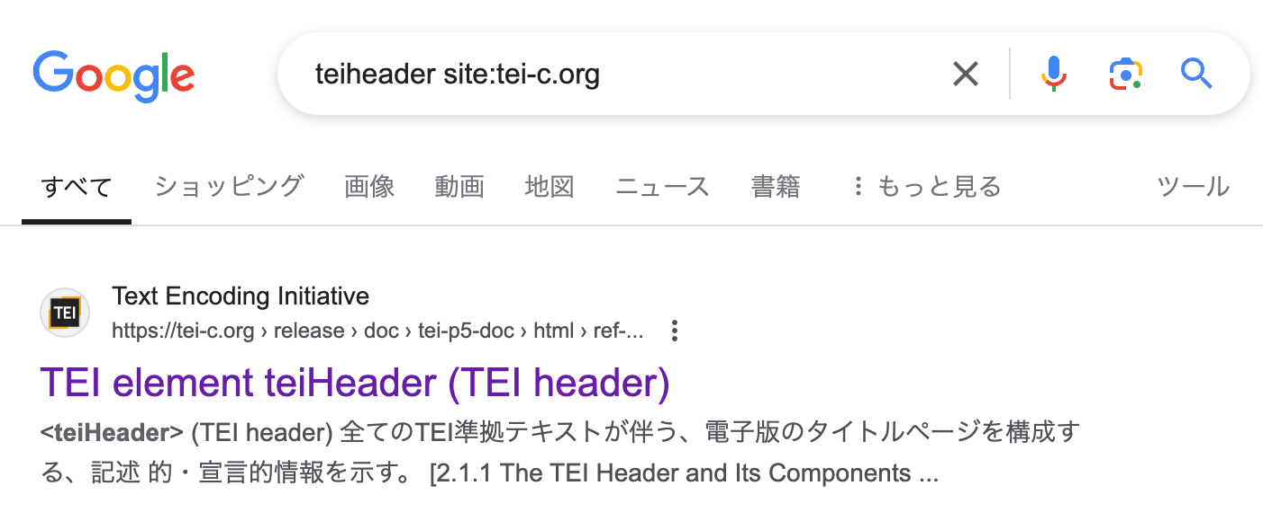
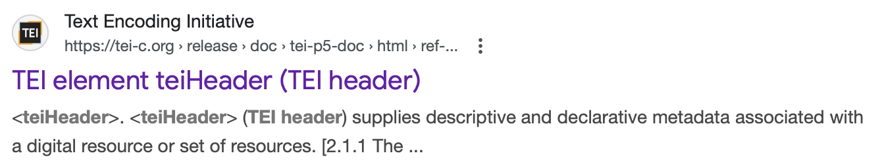
Using the TEI Guidelines (2)
Japanese version
English version
Notes:
Topic:Using the TEI Guidelines
Voice:Joanna
```text
In the search box on the top page menu, try typing something like T E I header.
Clicking the Search button will take you to the Google search results page.
From there, click the link related to t e i header on the Text Encoding Initiative site.
If you prefer to read the summary text under the link in another language, choose a link that appears in your desired language in the results—this will usually lead to a version of the page in that language.
```
```description
In the search box on the top page menu, try typing something like teiheader.
Clicking the Search button will take you to the Google search results page.
From there, click the link related to teiheader on the Text Encoding Initiative site.
If you prefer to read the summary text under the link in another language, choose a link that appears in your desired language in the results—this will usually lead to a version of the page in that language.
```

Slide 13
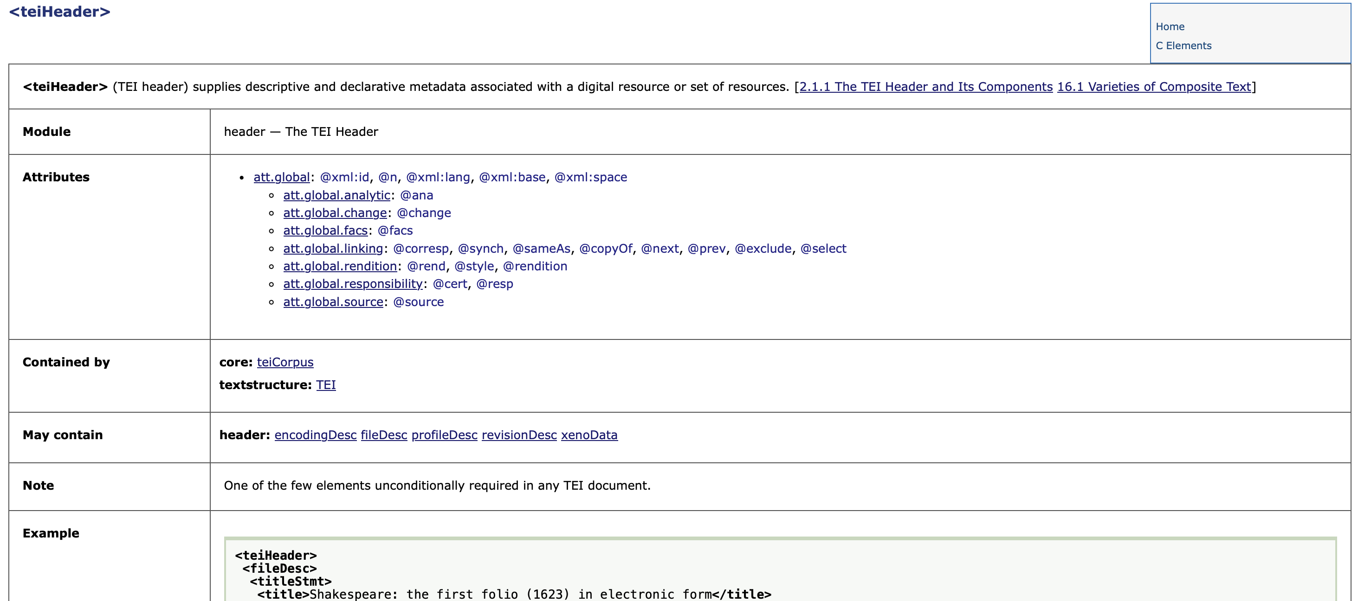
Using the TEI Guidelines (3)
Notes:
Topic:Using the TEI Guidelines
Voice:Joanna
```text
When you get to the T E I site’s page that defines t e i Header, focus on the “may contain” section.
Since T E I data follows the X M L format, its tags are arranged in a clean nested structure.
That means the guidelines show you which tags should be placed outside a given tag (parent tags) and which should go inside (child tags).
You can see that there are five tags that can be used within t e i Header.
In other words, you just need to choose from those five when writing inside the t e i Header tag.
So how should each tag be used?
The easiest way is to look up some examples.
```
```description
When you get to the TEI site’s page that defines teiHeader, focus on the “may contain” section.
Since TEI data follows the XML format, its tags are arranged in a clean nested structure.
That means the guidelines show you which tags should be placed outside a given tag (parent tags) and which should go inside (child tags).
You cfan see that there are five tags that can be used within teiHeader.
In other words, you just need to choose from those five when writing inside the teiHeader tag.
So how should each tag be used?
The easiest way is to look up some examples.
```

Slide 14
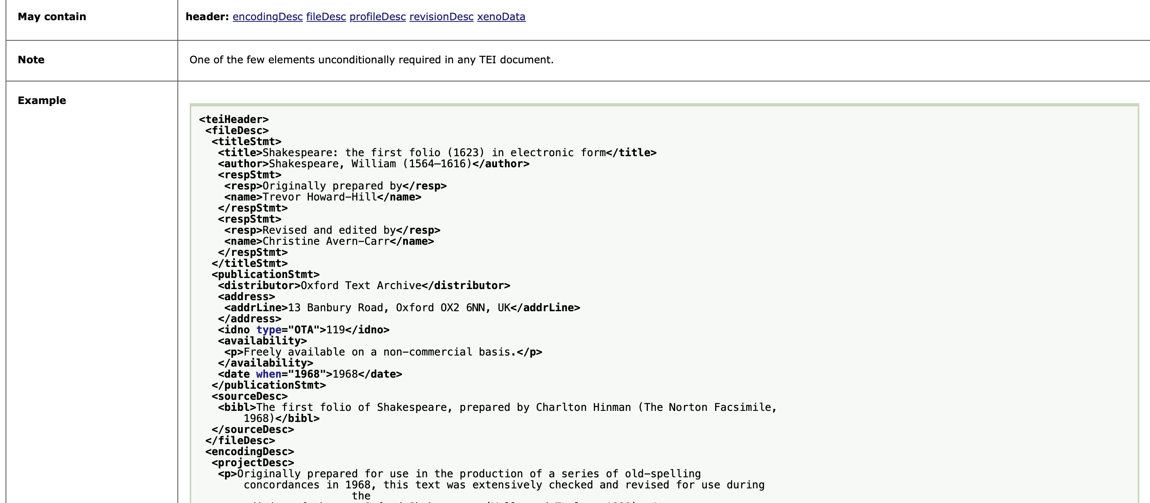

Using the TEI Guidelines (4)
Scroll down and click on the link that says:
Notes:
Topic:Using the TEI Guidelines
Voice:Joanna
```text
Take a look at the “Example” section.
If you scroll down, you’ll see a link labeled “Show all”. Please click it.
```
```description
Take a look at the “Example” section.
If you scroll down, you’ll see a link labeled “Show all”. Please click it.
```

Slide 15
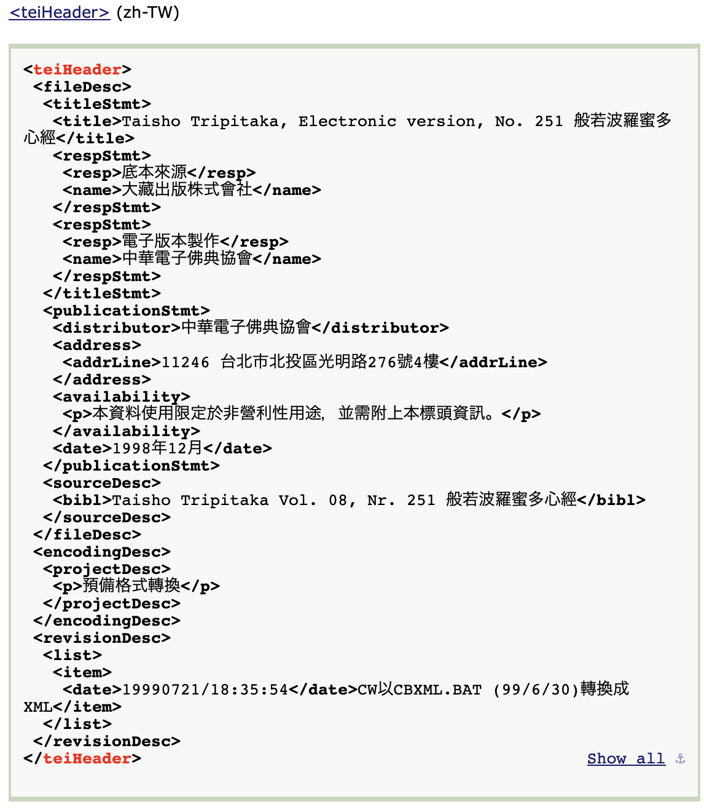
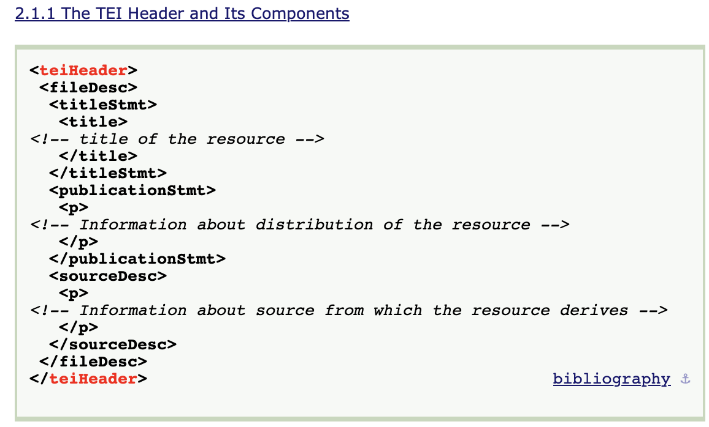
Using the TEI Guidelines (5)
Portion of the screen where all the “teiHeader” examples are displayed
Notes:
Topic:Using the TEI Guidelines
Voice:Joanna
```text
Doing so will take you to a screen, where you’ll find many examples of how the t e i Header tag is used.
For instance, the example on the left includes explanatory notes about how to use the nested child tags.
In some cases, like the example on the right, you can even view sample entries in different languages.
Referring to these official T E I examples and when working on your own markup, is probably the best way to avoid mistakes.
```
```description
Doing so will take you to a screen, where you’ll find many examples of how the <teiHeader> tag is used.
For instance, the example on the left includes explanatory notes about how to use the nested child tags.
In some cases, like the example on the right, you can even view sample entries in different languages.
Referring to these official TEI examples and when working on your own markup, is probably the best way to avoid mistakes.
```

Slide 16
Considering the Structure of the Text
(Bibliography)
Title: My Paper
Author: Taro Yamada
Publisher: UOsaka Publishing
Year of Publication: 2025
(Main Text)
My Paper
Taro Yamada
Introduction
This is the introduction of my paper.
…
Understand the overall structure of the text
Bibliography --- teiHeader tag
Main Text --- text tag
  Chapter
  Paragraphs
  Section breaks
  Annotations
  Quotations
Notes:
Topic:Using TEI tagging
Voice:Joanna
```text
Have you gotten a sense of how to find the appropriate tags using the T E I Guidelines?
The T E I Guidelines introduced in Chapter 1 are very detailed, but basically, they explain “what kind of text to structure and how to structure it.”
Now, we’ll begin putting together the actual tags.
Start by identifying the overall structure of the text you’re working with, for example, catalog metadata, book chapters, paragraphs, annotations, or quotations.
Once you’ve outlined the structure, the next step is to look up which tags to use for marking each component, such as chapters or paragraphs.
```
```description
Have you gotten a sense of how to find the appropriate tags using the TEI Guidelines?
The TEI Guidelines introduced in Chapter 1 are very detailed, but basically, they explain “what kind of text to structure and how to structure it.”
Now, we’ll begin putting together the actual tags.
Start by identifying the overall structure of the text you’re working with, for example, catalog metadata, book chapters, paragraphs, annotations, or quotations.
Once you’ve outlined the structure, the next step is to look up which tags to use for marking each component, such as chapters or paragraphs.
```

Slide 17
Starting with the Essential Tags
Let’s try expressing the main structure of the text using basic tags
Example of a simplified markup
(Bibliography)
Title: My Paper
Author: Taro Yamada
Publisher: UOsaka Publishing
Year of Publication: 2025
(Main Text)
My Paper
Taro Yamada
Introduction
This is the introduction of my paper.
…
<TEI>
<teiHeader>
<title>My Paper</title>
<author>Taro Yamada</author>
<publisher>UOsaka Publishing</publisher>
<date>2024</date>
</teiHeader>
<text>
<body>
Introduction
This is the introduction of my paper
</body>
</text>
</TEI>
This is for illustration only and does not represent the complete or accurate TEI structure.
Notes:
Topic:Using TEI tagging
Voice:Joanna
```text
Let’s begin tagging the structure from the previous slide.
When adding tags under t e i Header and text, rather than looking up T E I tags one by one from the top, it might be easier at first to roughly examine the overall structure of the text in advance and then loosely insert the main tags that define the basic structure.
You might try expressing it like the markup example on the right.
Also, as with t e i Header, if you look up the text tag in the Guidelines, you will find a tag called body.
This is the tag used to enclose the main text.
Use the Guidelines’ search function to keep exploring more tags.
```
```description
Let’s begin tagging the structure from the previous slide.
When adding tags under teiHeader and text, rather than looking up TEI tags one by one from the top, it might be easier at first to roughly examine the overall structure of the text in advance and then loosely insert the main tags that define the basic structure.
You might try expressing it like the markup example on the right.
Also, as with teiHeader, if you look up the text tag in the Guidelines, you will find a tag called body.
This is the tag used to enclose the main text.
Use the Guidelines’ search function to keep exploring more tags.
```

Slide 18
Example of Markup
<TEI>
<teiHeader>
<fileDesc>
<titleStmt>
<title>My Paper</title>
<author>Taro Yamada</author>
</titleStmt>
<publicationStmt>
<distributor>UOsaka Publishing</distributor>
<date>2024</date>
</publicationStmt>
<sourceDesc>
<p>An example made for this video</p>
</sourceDesc>
</fileDesc>
</teiHeader>
<text>
<body>
<div>
<head>Introduction</head>
<p>This is the introduction of my paper</p>
</div>
</body>
</text>
</TEI>
（Continues to <text>）
Notes:
Topic:Using TEI tagging
Voice:Joanna
```text
By referring to the T E I Guidelines and entering the appropriate tags, your markup should roughly resemble what’s shown on the screen.
In this section, we introduced how to represent textual information and structure using T E I.
In the following sections, we’ll look at how to tag the content itself to make it useful for research.
```
```description
By referring to the TEI Guidelines and entering the appropriate tags, your markup should roughly resemble what’s shown on the screen.
In this section, we introduced how to represent textual information and structure using TEI.
In the following sections, we’ll look at how to tag the content itself to make it useful for research.
```

Slide 19
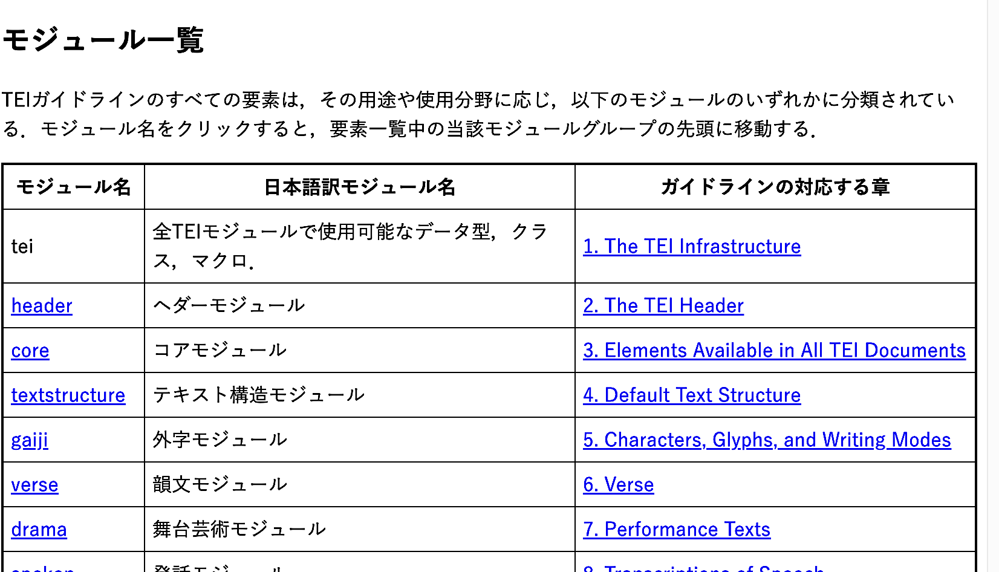
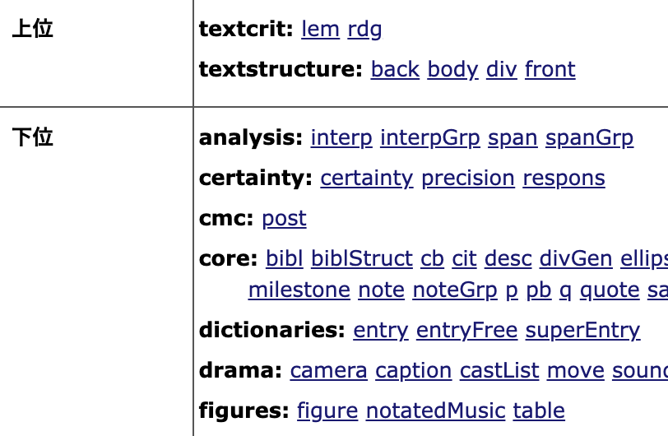
Quick References
This is a recommended site to use as reference for resources in Japanese
“TEI Guidelines Modules Elements, and Attributes List”
https://tei-lab.github.io/element_list/
The bold text indicates modules, which are components that group together tags and structures for specific purposes.
Excerpt from TEI Guidelines Laboratory by Hideaki Muranami
Notes:
Topic:Using TEI tagging
Voice:Joanna
```text
That said, in the beginning, it’s often difficult to know which tags to choose.
In the definition table of tags introduced earlier, there are many terms called modules, such as core and text structure, which might be confusing.
So here, let me explain a little how to read this table.
Modules are components that group together tags and structures for specific purposes. Once you understand how modules work, it becomes easier to select appropriate tags depending on your situation.
In most cases, you’ll use general-purpose modules like core and text structure, which apply to many kinds of text.
However, if your text is in a specific style, such as verse or a dictionary, you can create more suitable T E I data by using a specialized module.
Regarding these modules, there is a Japanese quick reference, explained in detail on the page shown here.
Since reading the entire vast guideline would be hard, try marking up your data while prioritizing by searching for necessary modules and sample examples using this quick reference.
```
```description
That said, in the beginning, it’s often difficult to know which tags to choose.
In the definition table of tags introduced earlier, there are many terms called modules, such as core and textstructure, which might be confusing.
So here, let me explain a little how to read this table.
Modules are components that group together tags and structures for specific purposes. Once you understand how modules work, it becomes easier to select appropriate tags depending on your situation.
In most cases, you’ll use general-purpose modules like core and textstructure, which apply to many kinds of text.
However, if your text is in a specific style, such as verse or a dictionary, you can create more suitable TEI data by using a specialized module.
Regarding these modules, there is a Japanese quick reference, explained in detail on the page shown here.
Since reading the entire vast guideline would be hard, try marking up your data while prioritizing by searching for necessary modules and sample examples using this quick reference.
```

Slide 20
Japanese Resources & Communities on TEI
Institute of Humanities and Information Science Research. Introduction to Text Data Construction for the Humanities: Initiatives Based on the TEI Guidelines.(一般財団法人人文情報学研究所ほか. 人文学のためのテキストデータ構築入門: TEIガイドラインに準拠した取り組みにむけて. 東京, 文学通信) 2022, ISBN978-4-909658-84-5.
TEI Research Group https://tei.dhii.jp/home
Aozora Bunko TEI Automation Project https://github.com/TEI-EAJ/auto_aozora_tei
Notes:
Topic:Using TEI tagging
Voice:Joanna
```text
If you’d like to explore T E I more deeply, there are several helpful Japanese-language resources and communities.
One example is the book Introduction to Text Data Construction for the Humanities, which not only explains key T E I concepts but also presents concrete examples of converting materials used in humanities research, to T E I data.
The T E I research Group regularly hosts online workshops and collaborative projects, open to anyone interested in working with T E I.
Additionally, T E I markup is being applied to Aozora Bunko texts, a long-standing project that digitizes Japanese literary works, with the resulting data made publicly available.
```
```description
If you’d like to explore TEI more deeply, there are several helpful Japanese-language resources and communities.
One example is the book Introduction to Text Data Construction for the Humanities, which not only explains key TEI concepts but also presents concrete examples of converting materials used in humanities research, to TEI data.
The TEI research Group ( https://tei.dhii.jp/home ) regularly hosts online workshops and collaborative projects, open to anyone interested in working with TEI.
Additionally, TEI markup is being applied to Aozora Bunko texts, a long-standing project that digitizes Japanese literary works, with the resulting data made publicly available. ( https://github.com/TEI-EAJ/auto_aozora_tei )
```

Slide 21
In Conclusion
Because humanities materials are so diverse, TEI takes the approach that tagging should be decided by the users or communities handling each type of text.
So, it’s often fastest and highly recommended to find TEI examples similar to your text or to try working with hands-on exercises. 👍
Notes:
Topic:Using TEI tagging
Voice:Joanna
```text
The T E I Guidelines are based on the idea that, because materials in the humanities are so diverse, it is the users or communities who should decide how to apply tagging.
For that reason, it is recommended to look for T E I samples that are similar to the type of text you are working with.
Even if you’re still unsure about how to use tags at this point, don’t worry.
In the next section, we will do a hands-on session where we create T E I data and analyze it using an app.
Practice makes perfect after all! Let’s dive in!
```
```description
The TEI Guidelines are based on the idea that, because materials in the humanities are so diverse, it is the users or communities who should decide how to apply tagging.
For that reason, it is recommended to look for TEI samples that are similar to the type of text you are working with.
Even if you’re still unsure about how to use tags at this point, don’t worry.
In the next section, we will do a hands-on session where we create TEI data and analyze it using an app.
Practice makes perfect after all! Let’s dive in!
```

