Slide 1
TEI Hands-on
Preparing Visual Studio Code and Project Files
Notes:
Topic:Installing VS Code
Voice:Joanna
```text
T E I Hands-on.
Preparing Visual Studio Code, and Project Files
```
```description
TEI Hands-on
Preparing Visual Studio Code and Project Files
```

Slide 2


Setting up
Things to prepare
Text editing software
Tag creation support tool
Internet connection
（Free）
（Paid）
Notes:
Topic:Installing VS Code
Voice:Joanna
```text
Before creating a tee E I document, it’s important to set up an environment that lets you work comfortably.
While you can use any text editor, having tools that support tag creation, can make your work much easier.
The two most commonly used tools are Visual Studio Code, which is free, and Oxygen XML Editor, which offers powerful support for T E I tags.
Oxygen is paid software, but it comes with a range of advanced features that make it especially useful when working extensively with T E I or XML.
Also, note that you’ll need an internet connection to install these tools, or use browser-based resources.
In this video, we’ll focus on Visual Studio Code, which is easy to access and free to use.
Once you install the extensions we’ll introduce, it becomes a very comfortable environment for editing T E I texts.
```
```description
Before creating a TEI document, it’s important to set up an environment that lets you work comfortably.
While you can use any text editor, having tools that support tag creation can make your work much easier.
The two most commonly used tools are Visual Studio Code, which is free, and Oxygen XML Editor, which offers powerful support for TEI tags.
Oxygen is paid software, but it comes with a range of advanced features that make it especially useful when working extensively with TEI or XML.
Also, note that you’ll need an internet connection to install these tools or use browser-based resources.
In this video, we’ll focus on Visual Studio Code, which is easy to access and free to use.
Once you install the extensions we’ll introduce, it becomes a very comfortable environment for editing TEI texts.
```

Slide 3
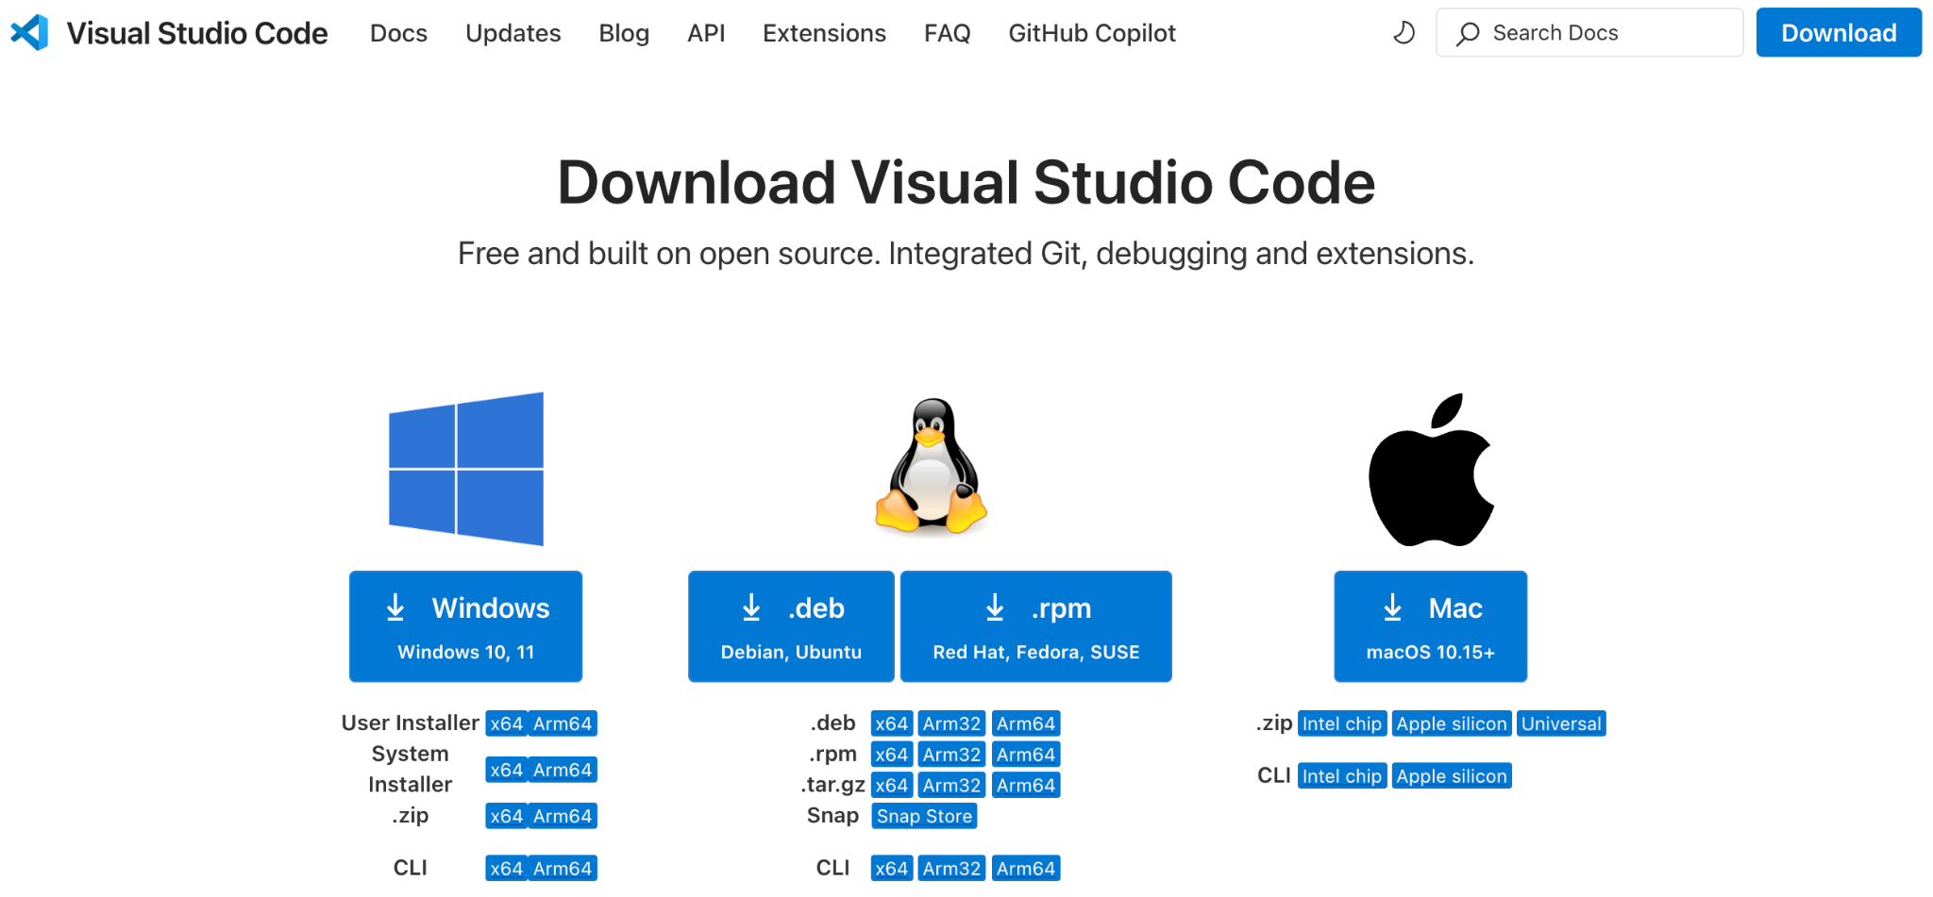
Installing VS Code
https://code.visualstudio.com/Download
Notes:
Topic:Installing VS Code
Voice:Joanna
```text
Since Visual Studio Code is a bit long, we’ll refer to it as V S Code from now on.
You can download V S Code from the official website.
Just click the download link at the top right of the page and select the version for your computer.
```
```description
Since Visual Studio Code is a bit long, we’ll refer to it as VS Code from now on.
You can download VS Code from the official website.
Just click the download link at the top right of the page and select the version for your computer.
```

Slide 4
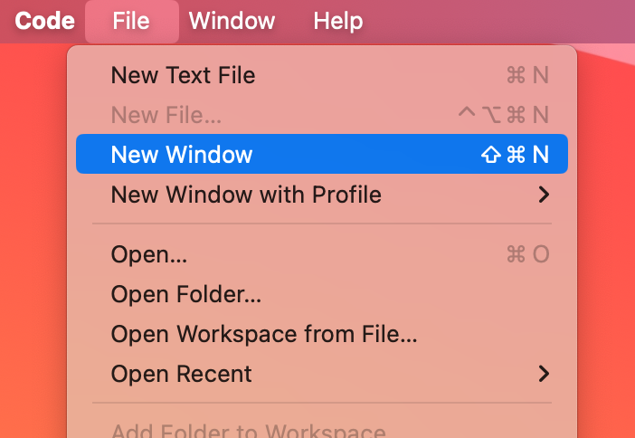
Opening a New Window in VS Code
→
Notes:
Topic:Installing VS Code
Voice:Joanna
```text
After installing, go ahead and launch the software.
First, open New Window from the File menu.
It may look similar to New Text File, but New Window is the starting workspace for any task or project.
```
```description
After installing, go ahead and launch the software.
First, open New Window from the File menu.
It may look similar to New Text File, but New Window is the starting workspace for any task or project.
```

Slide 5
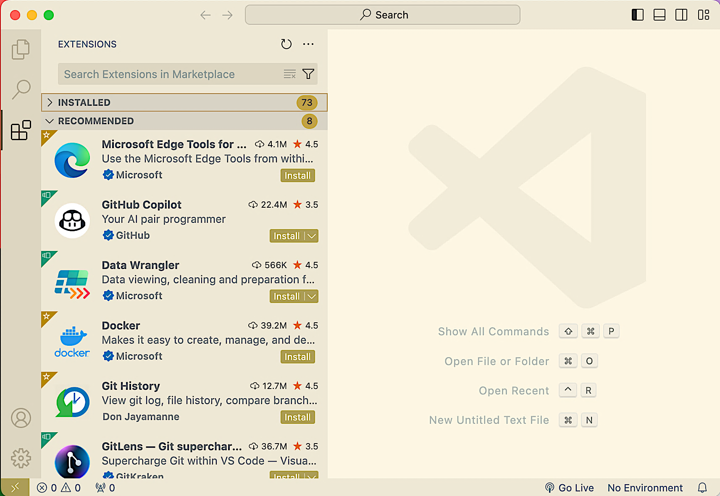
Opening a New Window in VS Code
Extensions→
Notes:
Topic:Installing Extensions
Voice:Joanna
```text
When you open the window, you’ll see the Extensions menu on the left.
This is where you can add features that are useful for working in V S Code.
Click the icon, and a list of available extensions will appear, like in the image.
```
```description
When you open the window, you’ll see the Extensions menu on the left.
This is where you can add features that are useful for working in VS Code.
Click the icon, and a list of available extensions will appear, like in the image.
```

Slide 6

Changing the Menu to Japanese
Click “install”
Notes:
Topic:Installing Extensions
Voice:Joanna
```text
For instance, if you’re not used to English menus, you can install an extension that switches the interface to another language, such as Japanese, as shown on the screen.
Type “Japanese” into the search bar at the top, and you’ll find the Japanese Language Pack for Visual Studio Code.
Select it from the list and click the install button.
Once the “Install” button changes to “Uninstall,” the setup is complete.
```
```description
For instance, if you’re not used to English menus, you can install an extension that switches the interface to another language, such as Japanese, as shown on the screen.
Type “Japanese” into the search bar at the top, and you’ll find the Japanese Language Pack for Visual Studio Code.
Select it from the list and click the install button.
Once the “Install” button changes to “Uninstall,” the setup is complete.
```

Slide 7

Changing the Menu to Japanese
Please restart the Application
Notes:
Topic:Installing Extensions
Voice:Joanna
```text
After installation finishes, a dialog like the one shown will appear.
Click the button to restart the app. When it restarts, the menu will appear in your desired language.
```
```description
After installation finishes, a dialog like the one shown will appear.
Click the button to restart the app. When it restarts, the menu will appear in your desired language.
```

Slide 8
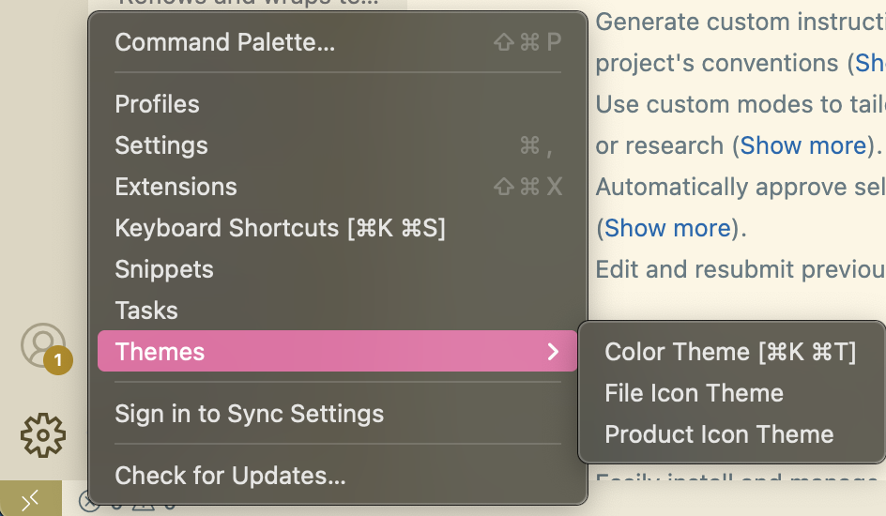
Choosing a Comfortable Color Scheme
This Theme is:「Solarized Light」
Notes:
Topic:Installing Extensions
Voice:Joanna
```text
Next, adjust the screen’s color theme to one that’s comfortable for your eyes.
Click the gear icon in the lower-left corner of the screen and select the “Theme” option.
This allows you to change the color scheme to your preferred look.
Try out several themes to find the one you like best.
```
```description
Next, adjust the screen’s color theme to one that’s comfortable for your eyes.
Click the gear icon in the lower-left corner of the screen and select the “Theme” option.
This allows you to change the color scheme to your preferred look.
Try out several themes to find the one you like best.
```

Slide 9
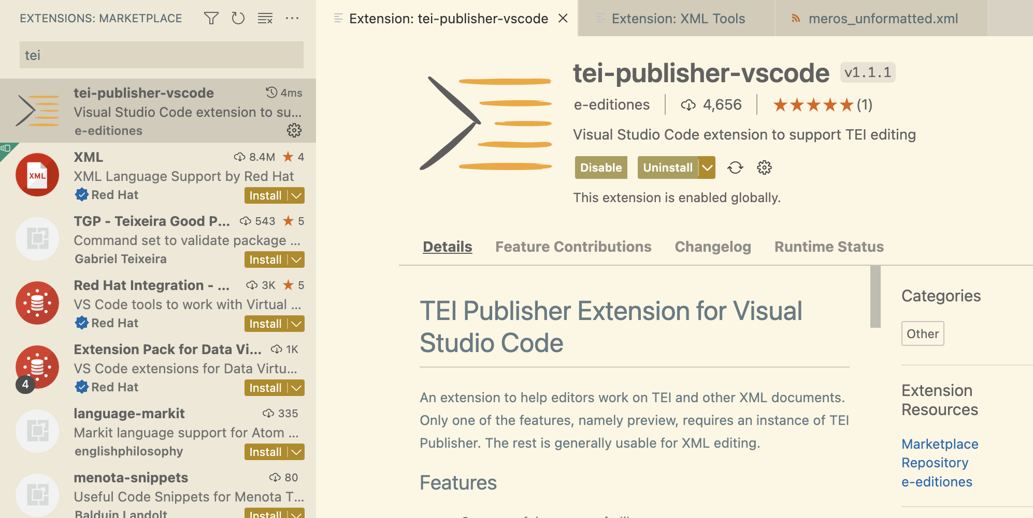
Installing TEI-Specific Extensions
Notes:
Topic:Installing Extensions
Voice:Joanna
```text
Next, install extensions that make working with T E I files more convenient.
Type “T E I” into the search bar at the top of the extensions list.
You’ll see a list of T E I-related results.
From these, you can select “t e i-publisher-v s code” and click the Install button on the right-hand side.
```
```description
Next, install extensions that make working with TEI files more convenient.
Type “TEI” into the search bar at the top of the extensions list.
You’ll see a list of TEI-related results.
From these, you can select “TEI Japanese Editor” and click the Install button on the right-hand side.
```

Slide 10
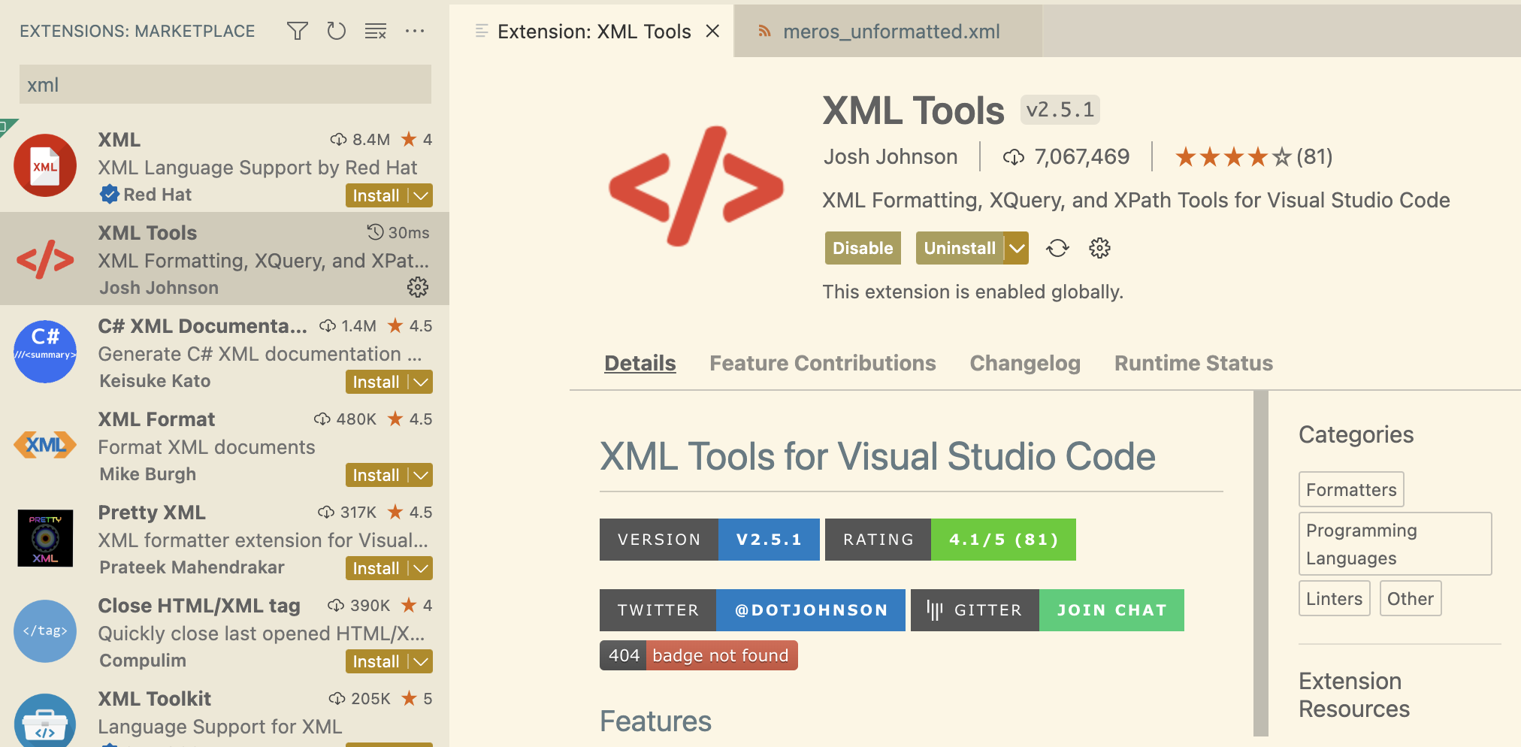
Installing XML-Specific Extensions
This is displayed when it is already installed
Notes:
Topic:Installing Extensions
Voice:Joanna
```text
Next, install extensions that make working with XML files more convenient.
Type “XML” into the search bar at the top of the extensions list.
You’ll see a list of XML-related results.
From these, you can select “XML Tools” and click the Install button on the right-hand side.
```
```description
Next, install extensions that make working with XML files more convenient.
Type “XML” into the search bar at the top of the extensions list.
You’ll see a list of XML-related results.
From these, you can select “XML Tools” and click the Install button on the right-hand side.
```

Slide 11
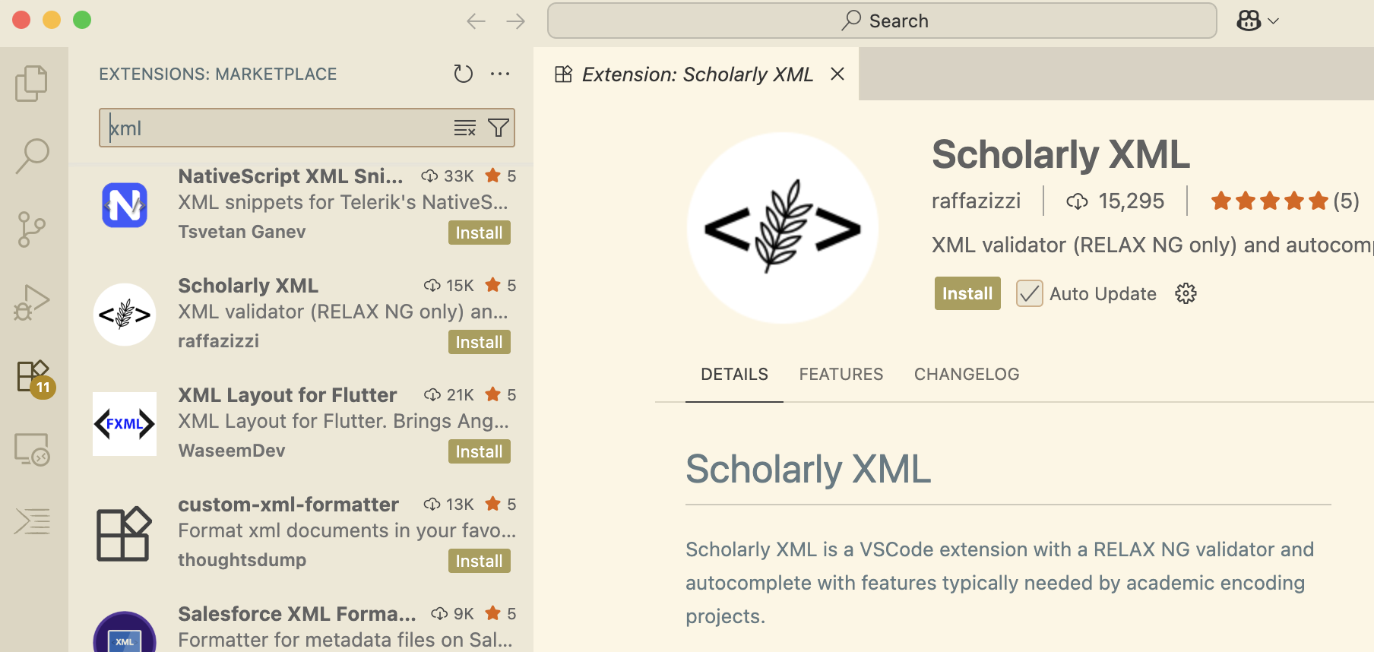
Installing XML-Specific Extensions
Notes:
Topic:Installing Extensions
Voice:Joanna
```text
Next, we’ll install an extension called Scholarly XML.
It’s a helpful tool that detects unclosed tags, syntax issues, and typos in XML files, including T E I documents.
```
```description
Next, we’ll install an extension called Scholarly XML.
It’s a helpful tool that detects unclosed tags, syntax issues, and typos in XML files, including TEI documents.
```

Slide 12
(Recommended) Helpful Tools for Tag Creation
Auto Close Tag
Automatically inserts the closing tag when creating a new tag
Auto Rename Tag
Automatically changes the name of the paired tag when a tag is modified
Notes:
Topic:Installing Extensions
Voice:Joanna
```text
There are also other useful extensions for editing XML files that we recommend installing.
For example, Auto Close Tag automatically inserts a closing tag when you create a new tag.
Auto Rename Tag automatically changes the paired tag name when you change a tag.
```
```description
There are also other useful extensions for editing XML files that we recommend installing.
For example, Auto Close Tag automatically inserts a closing tag when you create a new tag.
Auto Rename Tag automatically changes the paired tag name when you change a tag.
```

Slide 13
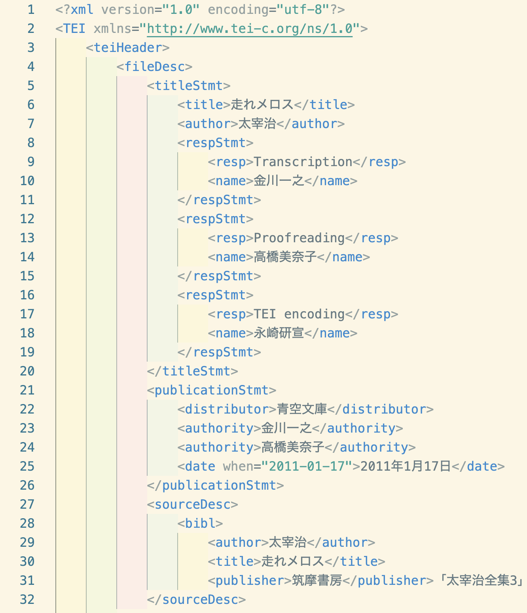
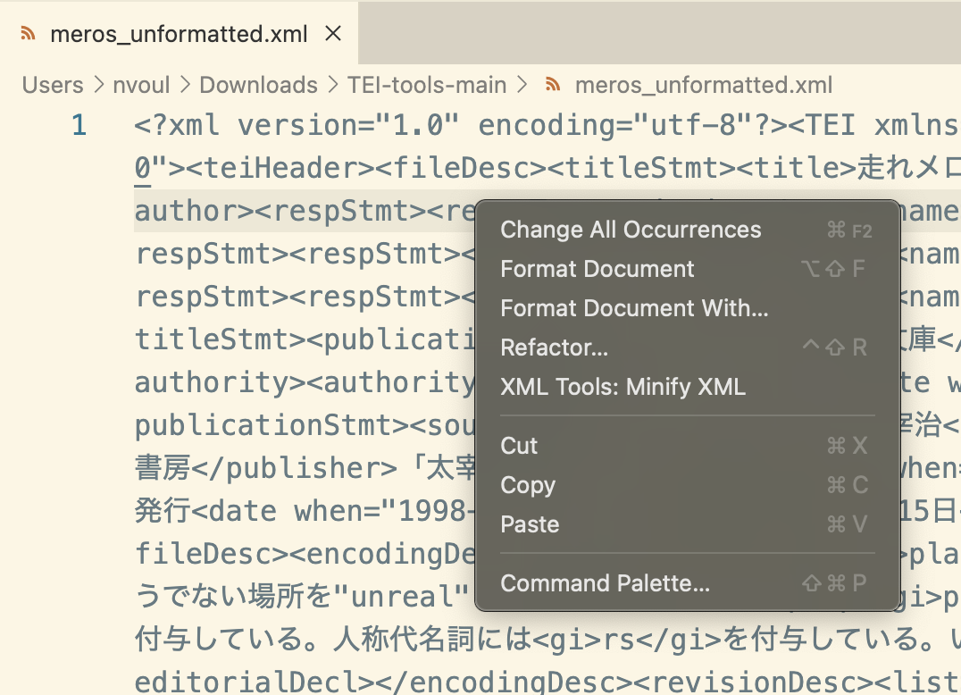
Autoformatting
This menu appears when you right-click on the opened file ↓
↑Example of a hard-to-read code
“meros_unformatted.xml
Notes:
Topic:Installing Extensions
Voice:Joanna
```text
V s Code has a built-in autoformat function.
If you right-click on hard-to-read code like on the left—where line breaks are missing—and select “Format Document,” the code will be neatly organized as shown on the right.
The colored indentation on the right is a result of the “Indent Rainbow” extension, which will be explained later.
```
```description
VS Code has a built-in autoformat function.
If you right-click on hard-to-read code like on the left—where line breaks are missing—and select “Format Document,” the code will be neatly organized as shown on the right.
The colored indentation on the right is a result of the “Indent Rainbow” extension, which will be explained later.
```

Slide 14
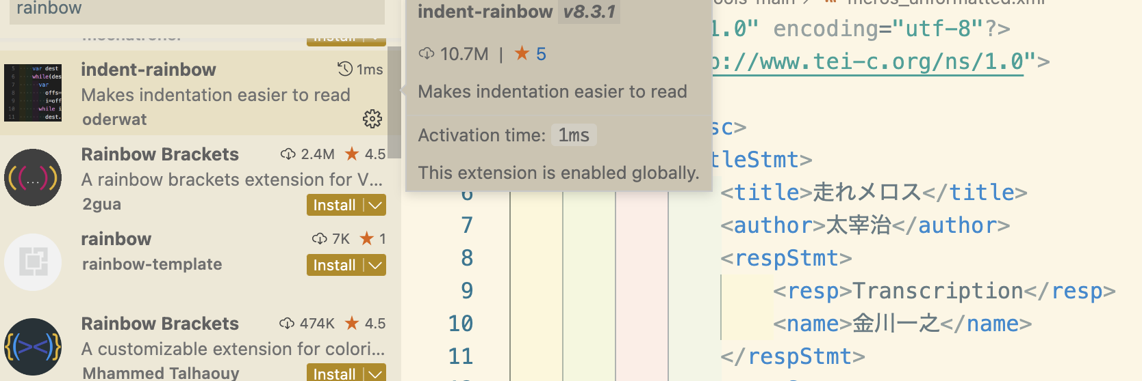
Recommended extension: indent-rainbow
Notes:
Topic:Installing Extensions
Voice:Joanna
```text
When writing T E I code, installing a few extensions can make your code easier to read.
For example, “Indent Rainbow” visually separates different levels of code by color.
With this, your environment for creating T E I files is now fully set up.
```
```description
In addition, when writing TEI code, installing a few extensions can make your code easier to read.
For example, “Indent Rainbow” visually separates different levels of code by color.
With this, your environment for creating TEI files is now fully set up.
```

Slide 15
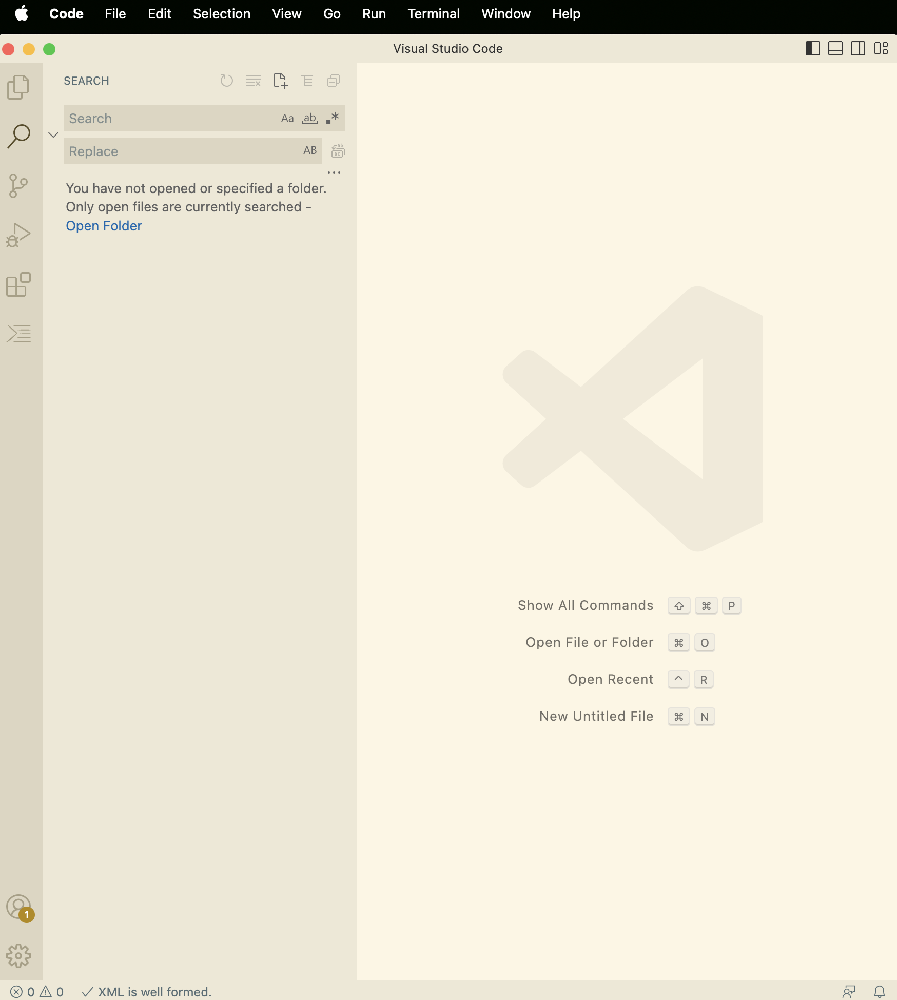
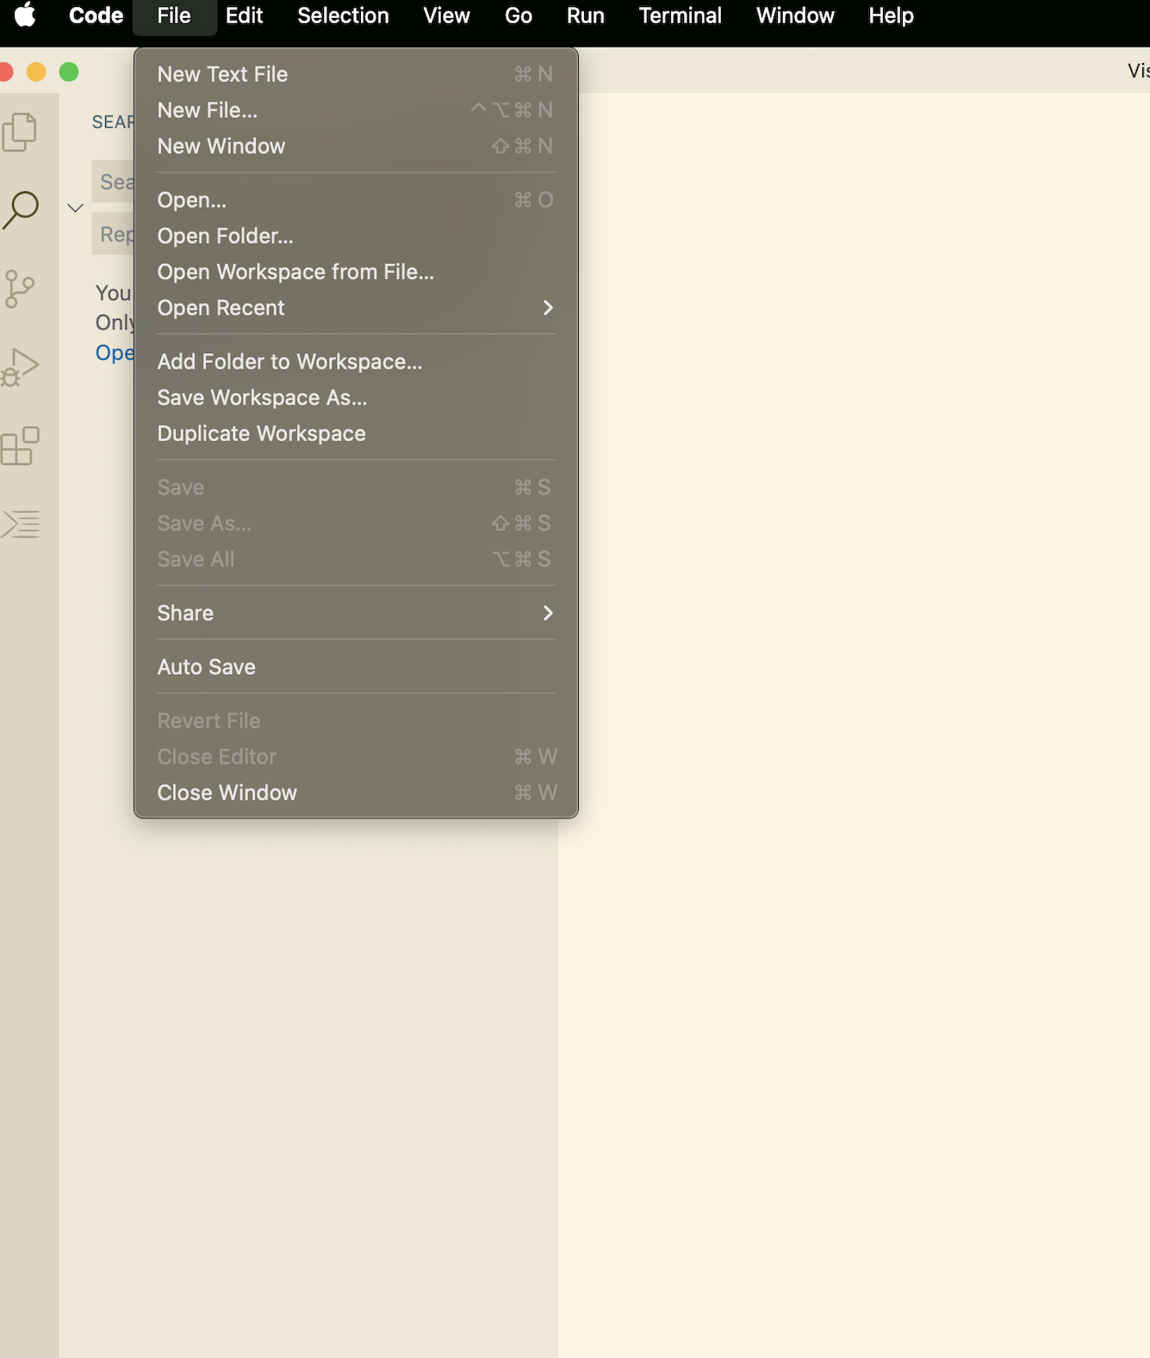
Creating a New XML File in VSCode
Method 2:
File→New Text File
Method 1:
Shortcut
(Mac)
Cmd + N
(Windows)
Control + N
Notes:
Topic:How to use VS Code
Voice:Joanna
```text
Clicking the Explorer icon displays the contents of your working folder.
Right now, there probably isn’t anything there.
Let’s begin by opening a new file to edit T E I tags.
There are several ways to open a new file:
you can use a keyboard shortcut, select “New File” from the menu, or click the plus icon in the Explorer panel to create one.
```
```description
Clicking the Explorer icon displays the contents of your working folder.
Right now, there probably isn’t anything there.
Let’s begin by opening a new file to edit T E I tags.
There are several ways to open a new file:
you can use a keyboard shortcut, select “New File” from the menu, or click the plus icon in the Explorer panel to create one.
```

Slide 16
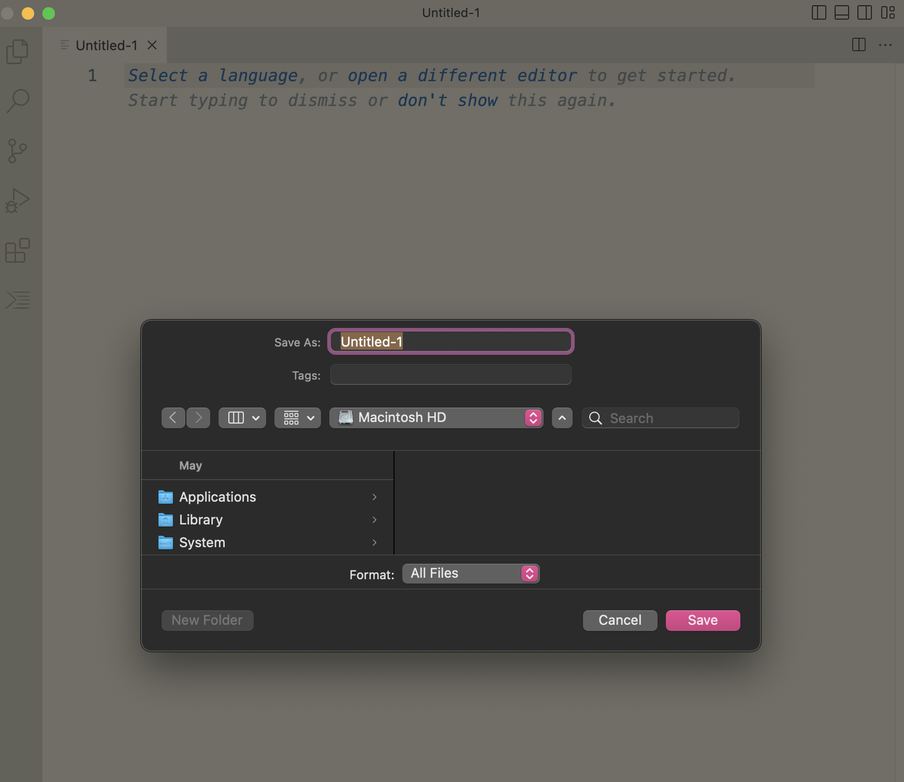
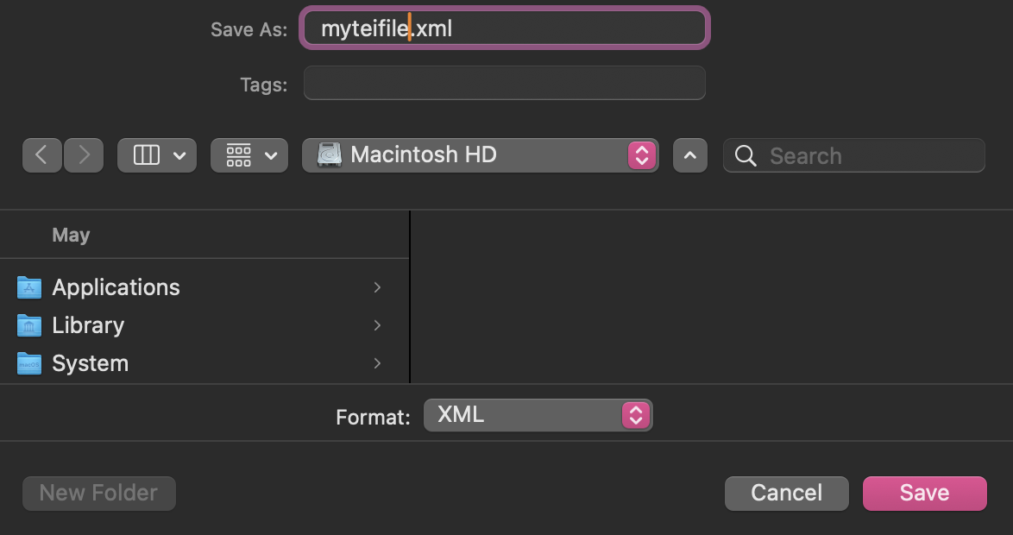
Saving XML files with VSCode
Shortcut
(Mac)
Command + S
(Windows)
Control + S
Notes:
Topic:How to use VS Code
Voice:Joanna
```text
You can leave the file name as “Untitled” for now, or choose any name you like.
The file you’re creating this time will have an xml extension.
As shown on the screen, please specify the file name and extension, and save it temporarily in your preferred folder.
```
```description
You can leave the file name as “Untitled” for now, or choose any name you like.
The file you’re creating this time will have an .xml extension.
As shown on the screen, please specify the file name and extension, and save it temporarily in your preferred folder.
```

Slide 17
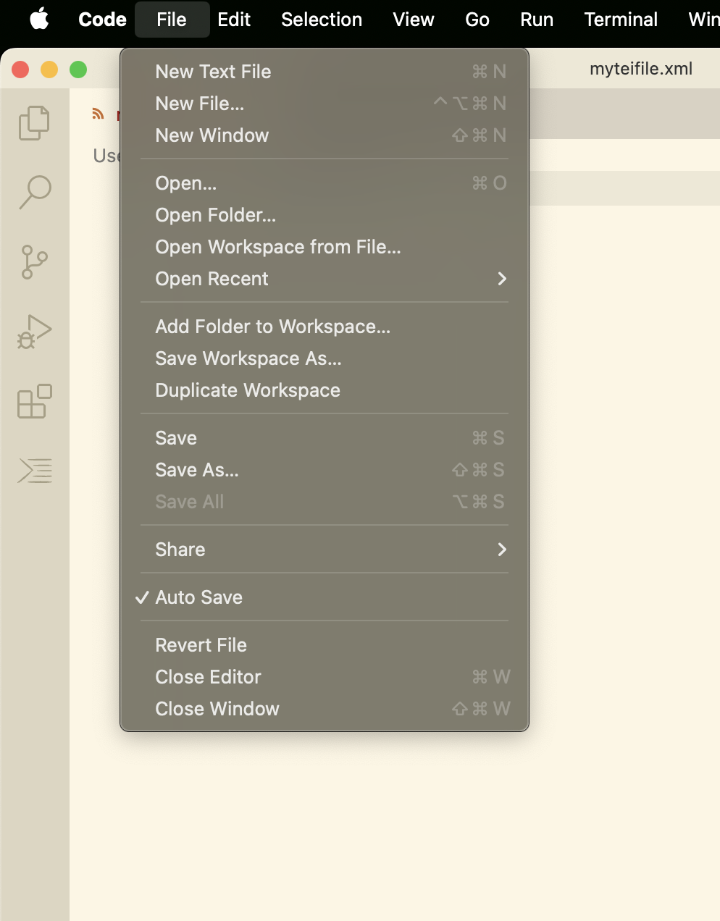
Auto-save
You can have the file be saved automatically
Notes:
Topic:How to use VS Code
Voice:Joanna
```text
You can also enable auto-save for the file.
Go to the “File” menu and check the “Auto Save” option.
```
```description
You can also enable auto-save for the file.
Go to the “File” menu and check the “Auto Save” option.
```

Slide 18
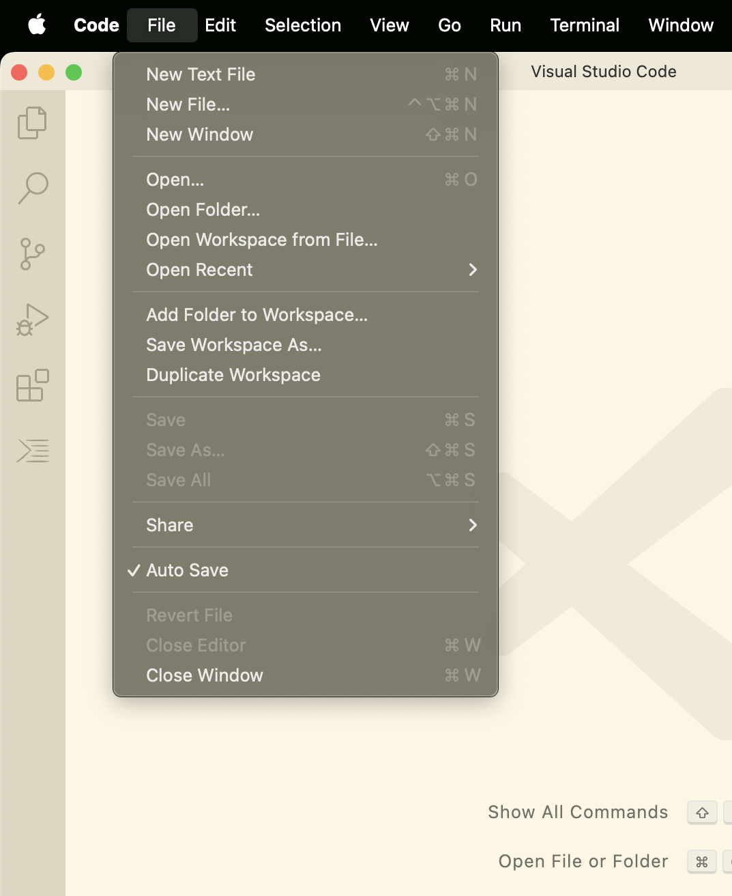
Opening Files with VS Code
Method 1:
Shortcut
(Mac):
Cmd + O
(Windows):
Control + O
Method 2:
(File→Open)
Notes:
Topic:How to use VS Code
Voice:Joanna
```text
If you want to reopen a file you’ve already created, click the Explorer icon and select the file,
or use a shortcut or the menu to open it, as shown on the screen.
```
```description
If you want to reopen a file you’ve already created, click the Explorer icon and select the file,
or use a shortcut or the menu to open it, as shown on the screen.
```

Slide 19
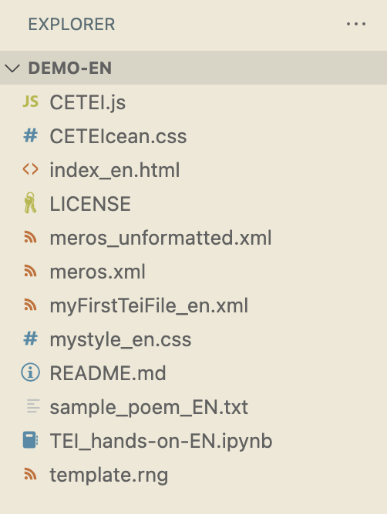
Setting up a Demo Folder
Please create a demo folder in a location on your computer where you can work with files.
The files inside the demo folder can also be downloaded from GitHub:
https://github.com/nikolito/TEI-tools-EN/
Notes:
Topic:How to use VS Code
Voice:Joanna
```text
We’ll now begin the hands-on session in this video.
Sample files have been placed inside the demo folder, so you can refer to them as you follow along.
The demo folder is available via the university website or from this GitHub link, so please download the necessary files.
```
```description
We’ll now begin the hands-on session in this video.
Sample files have been placed inside the demo folder, so you can refer to them as you follow along.
The demo folder is available via the university website or from this GitHub link, so please download the necessary files. https://github.com/nikolito/TEI-tools-EN/
```

Slide 20
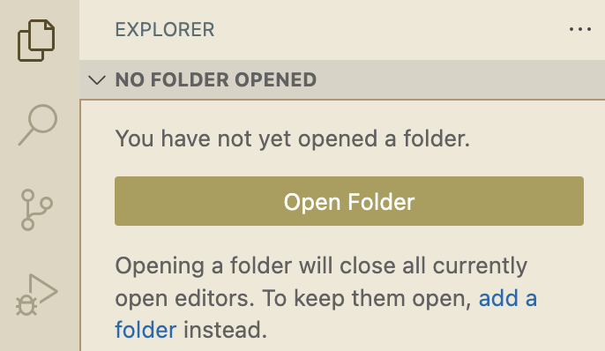
Deciding on Project Location
Once you select your working folder, the project window will display the files inside it.
Notes:
Topic:How to use VS Code
Voice:Joanna
```text
Now, let’s set up the actual folder where you’ll create your T E I file.
At the top of the menu on the right side of the screen, there’s an icon for the Explorer, click that.
A folder selection window will open, so choose or create a location on your computer where you want to place your folder.
If you’ve already downloaded the demo folder, you can use that as your working directory.
Once you’ve selected the working folder, the project window will display the files inside it.
```
```description
Now, let’s set up the actual folder where you’ll create your TEI file.
At the top of the menu on the right side of the screen, there’s an icon for the Explorer, click that.
A folder selection window will open, so choose or create a location on your computer where you want to place your folder.
If you’ve already downloaded the demo folder, you can use that as your working directory.
Once you’ve selected the working folder, the project window will display the files inside it.
```

Slide 21
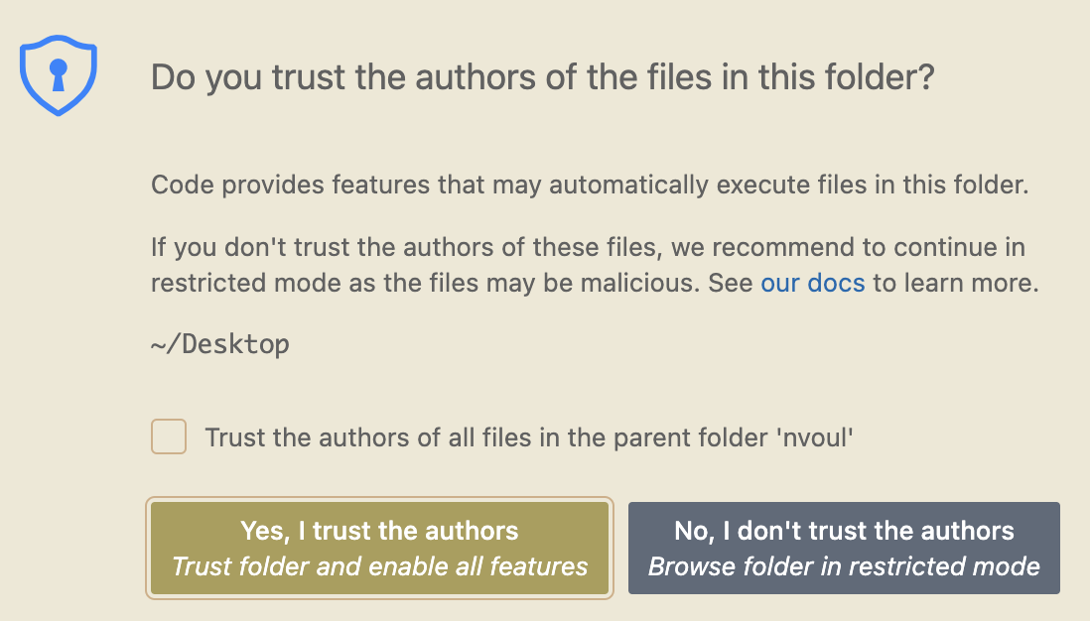
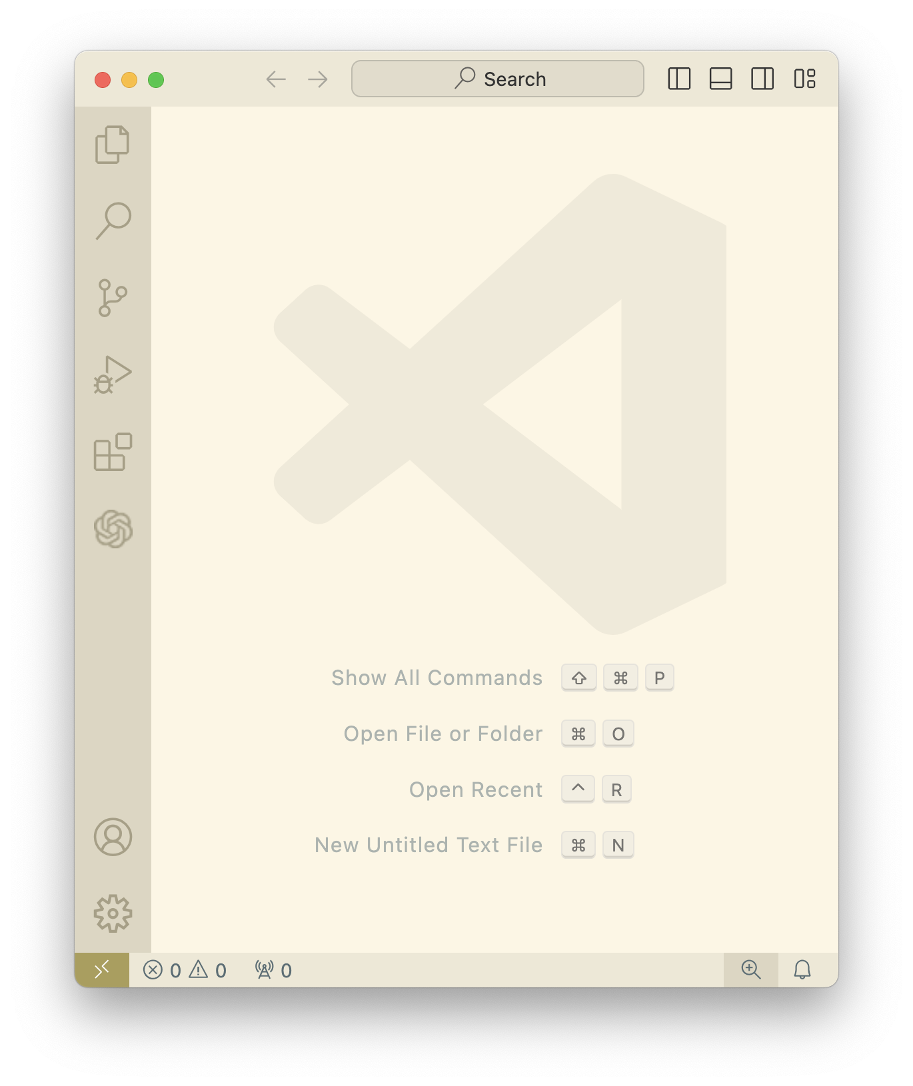
方法2：
File→New Text File
(The project folder location will be displayed here.)
Notes:
Topic:How to use VS Code
Voice:Joanna
```text
When you select a folder for your project, a dialog box like this will appear.
At that point, click the “Yes” button.
That’s it for the basic usage of V S Code.
Next, we’ll move on to the hands-on section for T E I.
```
```description
When you select a folder for your project, a dialog box like this will appear.
At that point, click the “Yes” button.
That’s it for the basic usage of VS Code.
Next, we’ll move on to the hands-on section for TEI.
```

