Slide 1
TEI Hands-on
The Basics
Notes:
Topic:Tagging Practice
Voice:Joanna
```text
This video offers a hands-on explanation of how to create a T E I file.
If you haven’t prepared Visual Studio Code and the working files required for T E I file creation, please watch “T E I Hands-on: Preparing Visual Studio Code and Project Files” before continuing with this video.
```
```description
This video offers a hands-on explanation of how to create a TEI file.
If you haven’t prepared Visual Studio Code and the working files required for TEI file creation, please watch “TEI Hands-on: Preparing Visual Studio Code and Project Files” before continuing with this video.
```

Slide 2
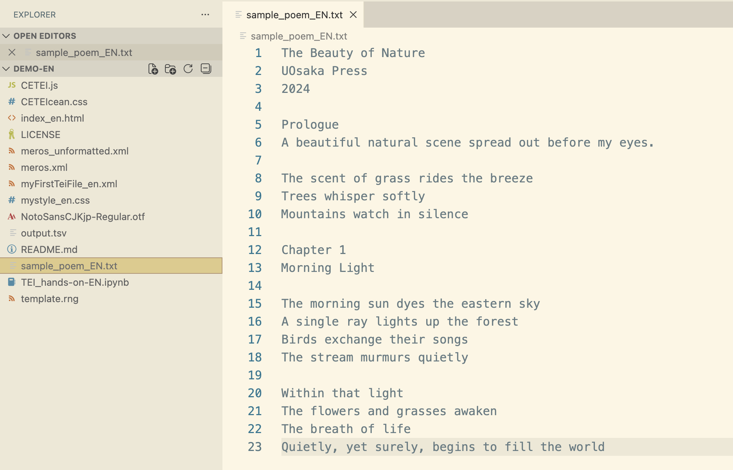
Preparing sample_poem_EN.txt
Notes:
Topic:Tagging Practice
Voice:Joanna
```text
Let’s now convert a poem titled “The Beauty of Nature,” generated by ChatGPT, into T E I format.
First, open sample_poem_EN.txt found in the demo folder.
If you don’t have it yet, please download it into your working folder.
```
```description
Let’s now convert a poem titled “The Beauty of Nature,” generated by ChatGPT, into TEI format.
First, open sample_poem_EN.txt found in the demo folder.
If you don’t have it yet, please download it into your working folder.
```

Slide 3
Selecting the Text and Creating the Basic Structure
The Beauty of Nature
Hanako Yamada
UOsaka Press
2024
Prologue
A beautiful natural scene spread out
before my eyes.
The scent of grass rides the breeze
Trees whisper softly
Mountains watch in silence
Tag:
<xxxxx>A block of text</xxxxx>
Notes:
Topic:Tagging Practice
Voice:Joanna
```text
Now, let’s begin encoding the text in T E I format.
First, choose the text you want to digitize. It’s best to start with something simple, like a short poem like the one shown on screen.
Once the text is chosen, you’ll create a basic structure.
To do this, you’ll need to enclose blocks of text with “tags”, like sandwiching them between markers.
Each block is marked with an opening tag and a closing tag, which includes a slash.
```
```description
Now, let’s begin encoding the text in TEI format.
First, choose the text you want to digitize. It’s best to start with something simple, like a short poem like the one shown on screen.
Once the text is chosen, you’ll create a basic structure.
To do this, you’ll need to enclose blocks of text with “tags”, like sandwiching them between markers.
Each block is marked with an opening tag and a closing tag, which includes a slash.
```

Slide 4
TEI Tagging in Practice 1
<TEI>
Indicates that the document is structured in TEI format.
<teiHeader>
Indicates that the content concerns bibliographic information about the text
<text>
Indicates that the actual content of the text is written here
<TEI>
<teiHeader>
The Beauty of Nature
Hanako Yamada
UOsaka Press
2024
</teiHeader>
<text>
Prologue
A beautiful natural scene spread out
before my eyes.
The scent of grass rides the breeze
Trees whisper softly
Mountains watch in silence
</text>
</TEI>
Notes:
Topic:Tagging Practice
Voice:Joanna
```text
First, let’s wrap the entire document using the T E I tag.
Next, enclose the bibliographic information, such as the title and author name, using the t e i Header tag.
This bibliographic information is also called metadata, meaning data that summarizes the document.
More specifically, it includes things like the document’s title, how it was created, terms of use, and copyright details.
Metadata helps with document management, search, and usage, just like when you look for a book in a library.
Then, wrap the actual main text using the text tag.
In short, both t e i Header and text are contained within the T E I tag.
```
```description
First, let’s wrap the entire document using the <TEI> tag.
Next, enclose the bibliographic information, such as the title and author name, using the <teiHeader> tag.
This bibliographic information is also called metadata, meaning data that summarizes the document.
More specifically, it includes things like the document’s title, how it was created, terms of use, and copyright details.
Metadata helps with document management, search, and usage, just like when you look for a book in a library.
Then, wrap the actual main text using the <text> tag.
In short, both <teiHeader> and <text> are contained within the <TEI> tag.
```

Slide 5
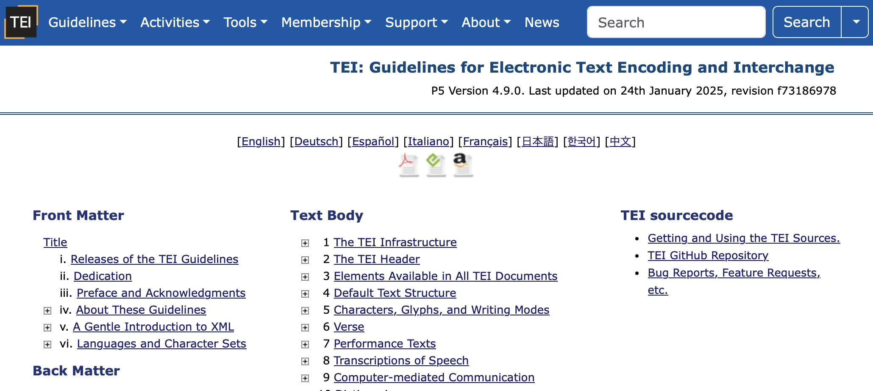
TEI Tagging in Practice 2
TEI Guidelines: https://tei-c.org/release/doc/tei-p5-doc/en/html/index.html
Notes:
Topic:Tagging Practice
Voice:Joanna
```text
Next, lets begin tagging the selected text.
As much as possible, choose tag types based on the T E I Guidelines.
That said, the Guidelines are quite complex, so first check what genre your text is closest to, and look for useful examples in the Guidelines.
In this case, since the text is a passage of poetry, it’s best to refer to section 6, “verse”.
```
```description
Next, lets begin tagging the selected text.
As much as possible, choose tag types based on the TEI Guidelines.
That said, the Guidelines are quite complex, so first check what genre your text is closest to, and look for useful examples in the Guidelines.
In this case, since the text is a passage of poetry, it’s best to refer to section 6, “verse”.
https://tei-c.org/release/doc/tei-p5-doc/en/html/index.html
```

Slide 6
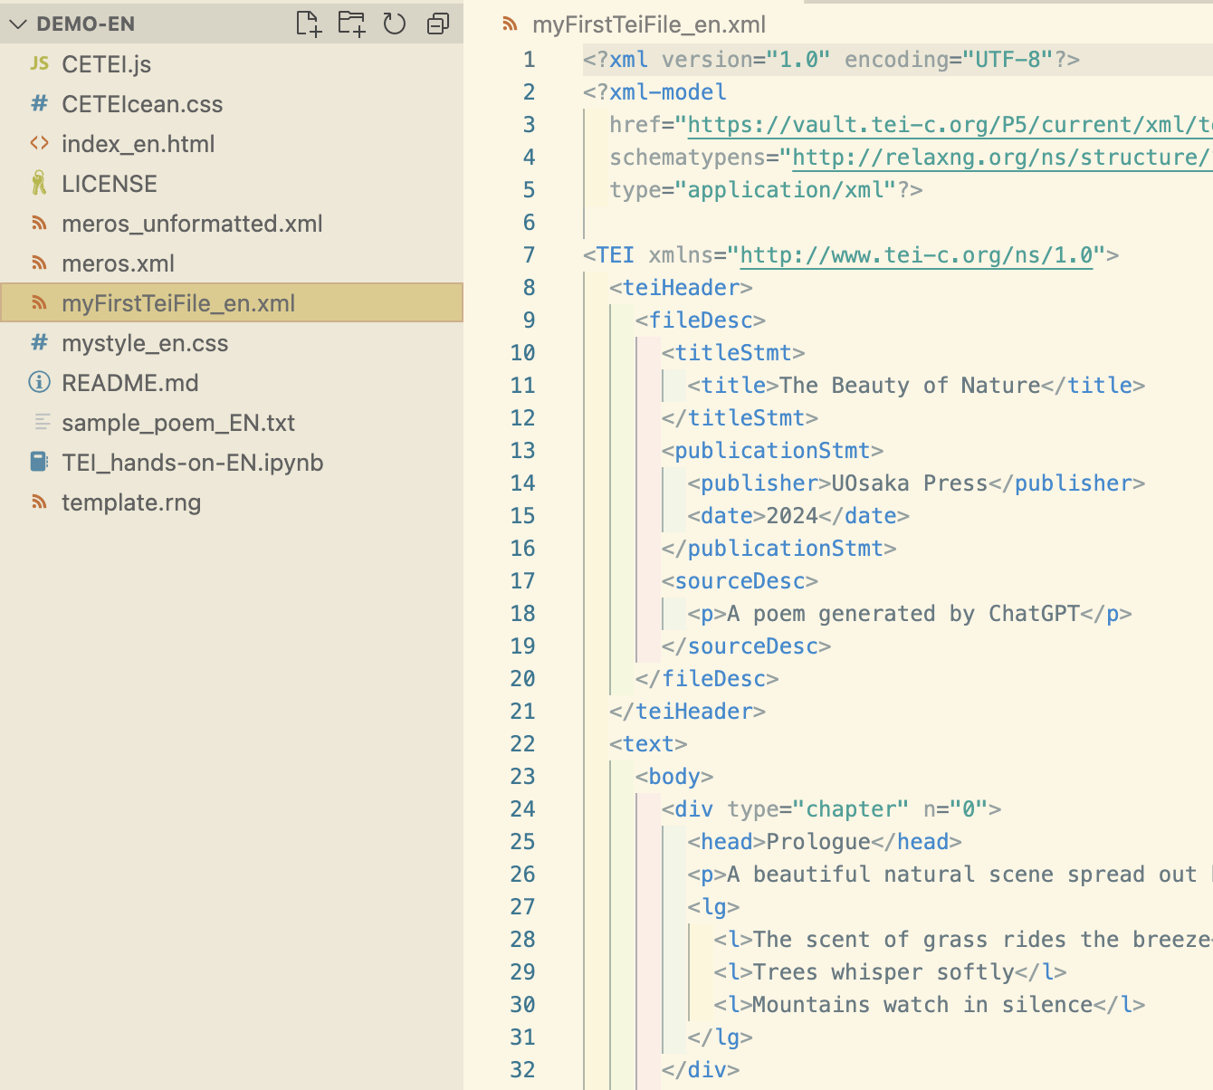
Opening a Sample File
Example file:
MyFirstTeiFile_en.xml
Notes:
Topic:Tagging Practice
Voice:Joanna
```text
Now, please open the sample T E I file.
Actually, “The Beauty of Nature” already has the T E I version prepared.
So go ahead and open my First T e i File _ en, as well.
If you’re unsure at any point, use this example as a reference.
```
```description
Now, please open the sample TEI file.
Actually, “The Beauty of Nature” already has a TEI version prepared.
So go ahead and open myFirstTeiFile_en.xml as well.
If you’re unsure at any point, use this example as a reference.
```

Slide 7
TEI Tagging in Practice 3
<TEI>
<teiHeader>
<fileDesc>
<titleStmt>
<title>The Beauty of Nature</title>
<author>Hanako Yamada</author>
</titleStmt>
<publicationStmt>
<publisher>UOsaka Press</publisher>
<date>2024</date>
</publicationStmt>
<sourceDesc>
<p>A poem automatically generated by ChatGPT</p>
</sourceDesc>
</fileDesc>
</teiHeader>
<text>
<body>
<head>Prologue</head>
<p>A beautiful natural scene spread out before my eyes.</p>
<lg>
<l>The scent of grass rides the breeze</l>
<l>Trees whisper softly</l>
<l>Mountains watch in silence</l>
</lg>
</body>
</text>
</TEI>
Chapter/section title--- <head>
Paragraph ---------- <p>
Line of poetry---------- <l>
Stanza (group of lines)- <lg>
Notes:
Topic:Tagging Practice
Voice:Joanna
```text
Let’s take another look at the text tag, which represents the main body of the poem.
This poem begins with a heading, “Prologue,” followed by a single complete sentence that starts with, “A beautiful.”
After a blank line, three poetic fragments are presented across three lines.
The T E I Guidelines recommend enclosing the whole body in a body tag first.
For structuring poems, refer to the “verse” section of the Guidelines: use head for headings, p for complete sentences, l for poetic lines or sentence fragments, and lg to group lines into stanzas.
```
```description
Let’s take another look at the <text> tag, which represents the main body of the poem.
This poem begins with a heading, “Prologue,” followed by a single complete sentence that starts with “A beautiful.”
After a blank line, three poetic fragments are presented across three lines.
The TEI Guidelines recommend enclosing the whole body in a <body> tag first.
For structuring poems, refer to the “verse” section of the Guidelines: use <head> for headings, <p> for complete sentences, <l> for poetic lines or sentence fragments, and <lg> to group lines into stanzas.
```

Slide 8
TEI Tagging in Practice 4
<text>
<body>
<div type="chapter" n="0">
<head>Prologue</head>
<p>A beautiful natural scene spread out before my eyes.</p>
<lg>
<l>The scent of grass rides the breeze</l>
<l>Trees whisper softly</l>
<l>Mountains watch in silence</l>
</lg>
</div>
<div type="chapter" n="1">
<head>Chapter 1</head>
<title>Morning Light</title>
<lg>
<l>The morning sun dyes the eastern sky</l>
<l>A single ray lights up the forest</l>
<l>Birds exchange their songs</l>
<l>The stream murmurs quietly</l>
</lg>
<lg>
<l>Within that light</l>
<l>The flowers and grasses awaken</l>
<l>The breath of life</l>
<l>Quietly, yet surely, begins to fill the world</l>
</lg>
</div>
</body>
</text>
Chapter 1
Morning Light
The morning sun dyes the eastern sky
A single ray lights up the forest
Birds exchange their songs
The stream murmurs quietly
Within that light
The flowers and grasses awaken
The breath of life
Quietly, yet surely, begins to fill the world
Attribute
type
  Specifies the type or category of the element.
n
  Assigns an identifier to the element to simplify ordering or referencing.
Notes:
Topic:Tagging Practice
Voice:Joanna
```text
We add tags to specific text segments so that we can later classify or extract them based on those tags.
For example, after the prologue comes Chapter 1.
To distinguish between chapters, we’ll use the div tag, which indicates section divisions.
Since the poem is divided into chapters, we’ll wrap each chapter in a div tag.
Because the chapters follow a set order, we’ll also assign a type and number to each div using attributes.
In the code shown, these are the type, and, n, attributes.
For example, even within the same species of humans, each person is distinguished by name.
Likewise, tags can be given unique properties, or attributes, to differentiate them.
```
```description
We add tags to specific text segments so that we can later classify or extract them based on those tags.
For example, after the prologue comes Chapter 1.
To distinguish between chapters, we’ll use the <div> tag, which indicates section divisions.
Since the poem is divided into chapters, we’ll wrap each chapter in a <div> tag.
Because the chapters follow a set order, we’ll also assign a type and number to each <div> using attributes.
In the code shown, these are the type and n attributes.
For example, even within the same species of humans, each person is distinguished by name.
Likewise, tags can be given unique properties, or “attributes,” to differentiate them.
```

Slide 9
Manual Tagging Result
<lg>
<l>The scent of grass rides the breeze</l>
<l>Trees whisper softly</l>
<l>Mountains watch in silence</l>
</lg>
</div>
<div type="chapter" n="1">
<head>Chapter 1</head>
<title>Morning Light</title>
<lg>
<l>The morning sun dyes the eastern sky</l>
<l>A single ray lights up the forest</l>
<l>Birds exchange their songs</l>
<l>The stream murmurs quietly</l>
</lg>
<lg>
<l>Within that light</l>
<l>The flowers and grasses awaken</l>
<l>The breath of life</l>
<l>Quietly, yet surely, begins to fill the world</l>
</lg>
</div>
</body>
</text>
</TEI>
<TEI>
<teiHeader>
<fileDesc>
<titleStmt>
<title>The Beauty of Nature</title>
<author>Hanako Yamada</author>
</titleStmt>
<publicationStmt>
<publisher>Osaka University Press</publisher>
<date>2024</date>
</publicationStmt>
<sourceDesc>
<p>A poem generated by ChatGPT</p>
</sourceDesc>
</fileDesc>
</teiHeader>
<text>
<body>
<div type="chapter" n="0">
<head>Prologue</head>
<p>A beautiful natural scene spread out before my eyes.</p>
Notes:
Topic:Tagging Practice
Voice:Joanna
```text
With this, we’ve completed structuring the poem using T E I tags.
The sample poem is split into ordered section, a prologue and Chapter 1.
Each chapter contains a stanza made up of about four lines, whether complete sentences or fragments.
By turning a simple example like this into T E I data, you’ll get more used to how tagging works.
Great work!
```
```description
With this, we’ve completed structuring the poem using TEI tags.
The sample poem is split into ordered section, a prologue and Chapter 1.
Each chapter contains a stanza made up of about four lines, whether complete sentences or fragments.
By turning a simple example like this into TEI data, you’ll get more used to how tagging works.
Great work!
```

Slide 10
Creating TEI Files Easily & Accurately 1
<TEI xmlns="http://www.tei-c.org/ns/1.0">
<teiHeader>
<fileDesc>
<titleStmt>
<title></title>
</titleStmt>
<publicationStmt>
<publisher></publisher>
</publicationStmt>
<sourceDesc>
<p></p>
</sourceDesc>
</fileDesc>
</teiHeader>
<text>
<body>
<div></div>
</body>
</text>
</TEI>
Contents of “template.rng”
<?xml version="1.0" encoding="UTF-8"?>
<?xml-model href="https://vault.tei-c.org/P5/current/xml/tei/custom/schema/relaxng/tei_all.rng” schematypens="http://relaxng.org/ns/structure/1.0" type="application/xml"?>
（Continues with <TEI> ... on the right）
Please copy from template.rng as much as possible
Notes:
Topic:Creating TEI Files Easily and Accurately
Voice:Joanna
```text
Here’s a simpler and more accurate way to input T E I tags:
just copy the T E I template into a new file.
While some paid software will load a template automatically, in most cases you’ll need to get one yourself.
But don’t worry—this video comes with a template.
You can either open the provided file and copy everything, or just type out the code shown above.
The key part is the code on the left.
Once you include that in your T E I file, Scholarly X M L will automatically check if your tags are valid.
```
```description
Here’s a simpler and more accurate way to input TEI tags:
just copy the TEI template into a new file.
While some paid software will load a template automatically, in most cases you’ll need to get one yourself.
But don’t worry—this video comes with a template.
You can either open the provided file and copy everything, or just type out the code shown above.
The key part is the code on the left.
Once you include that in your TEI file, Scholarly XML will automatically check if your tags are valid.
```

Slide 11
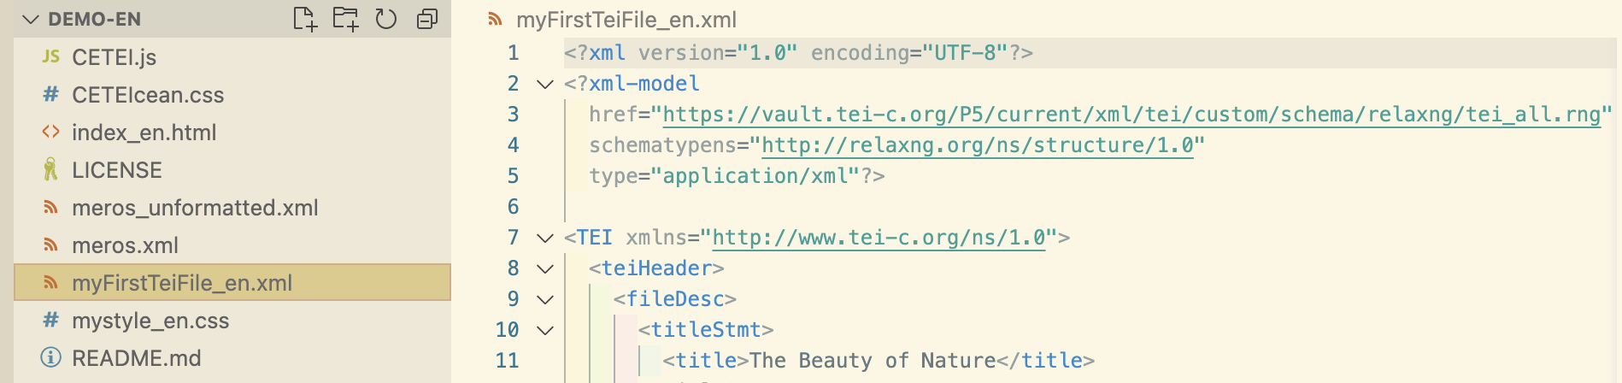
Creating TEI Files Easily & Accurately 2
Add the <?xml ... ?> declaration at the very top, before the <TEI> tag
Notes:
Topic:Creating TEI Files Easily and Accurately
Voice:Joanna
```text
Let’s go ahead and test the template by applying it to a sample poem and checking whether the data follows the T E I Guidelines.
Copy and paste the first 7 lines of the template to match what’s shown on screen.
```
```description
Let’s go ahead and test the template by applying it to a sample poem and checking whether the data follows the TEI Guidelines.
Copy and paste the first 7 lines of the template to match what’s shown on screen.
```

Slide 12
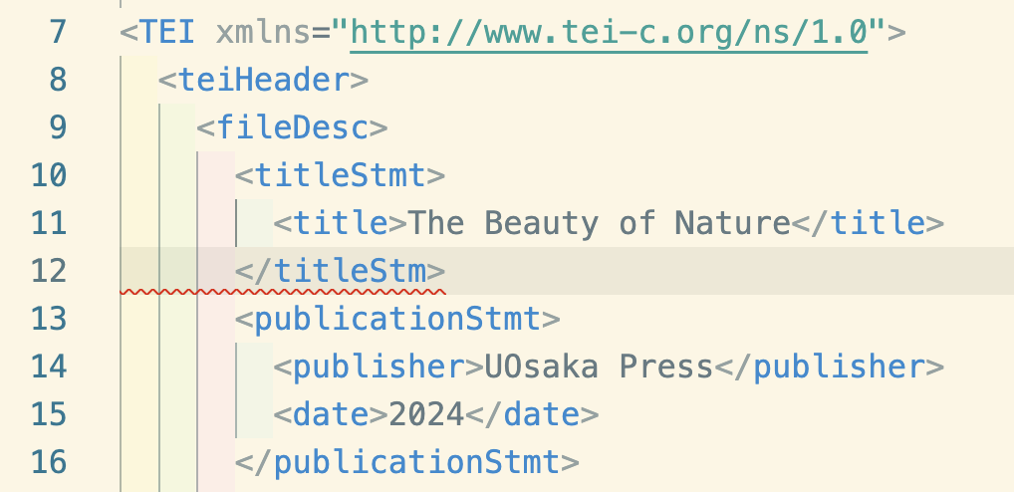
Creating TEI Files Easily & Accurately 3
Keep correcting it until the error disappears
Notes:
Topic:Creating TEI Files Easily and Accurately
Voice:Joanna
```text
After pasting the template, for example, if the tag name is incorrect or there is a structural error like on the screen, the error will be shown with a wavy underline.
If nothing happens, try making a mistake on purpose.
Once an error appears, correct it until it disappears.
```
```description
For example, if the tag name is incorrect or there is a structural error like on the screen, the error will be shown with a wavy underline.
If nothing happens, try making a mistake on purpose.
Once an error appears, correct it until it disappears.
```

Slide 13
Changing the appearance of TEI files
demo folder/TEI-tools
CETEI.js
CETEIcean.css
Index.html
myFirstTeiFile_en.xml
mystyle_en.css
...etc.
Drag and drop the file on the right into your file explorer
CETEIcean
A convenient tool for displaying TEI-format files in a browser
https://github.com/TEIC/CETEIcean
Notes:
Topic:Changing the appearance of TEI files
Voice:Joanna
```text
With a tool like C E T E I-seean, you can display T E I files directly in your web browser.
This video continues using the files in the demo folder or from the T E I-tools GitHub repository.
If you haven’t set them up yet, check the “How to Use V S Code” section to learn how to place and access the required files in your file explorer.
Once everything is ready, try opening index.html in your browser.
```
```description
With a tool like C E T E I-cean, you can display T E I files directly in your web browser.
This video continues using the files in the demo folder or from the T E I-tools GitHub repository.
(https://github.com/nikolito/TEI-tools-EN)
If you haven’t set them up yet, check the “How to Use V S Code” section to learn how to place and access the required files in your file explorer.
Once everything is ready, try opening index.html in your browser.
```

Slide 14

Live Server Extension
Live Server
Each time you save a file to be displayed in a web browser, it updates in real time
Notes:
Topic:Changing the appearance of TEI files
Voice:Joanna
```text
First, please install an extension called lyve Server.
The useful point of this extension is that, when adjusting the appearance of a website, you don’t need to manually refresh the web browser each time because it updates in real time.
```
```description
First, please install an extension called Live Server.
The useful point of this extension is that, when adjusting the appearance of a website, you don’t need to manually refresh the web browser each time because it updates in real time.
```

Slide 15
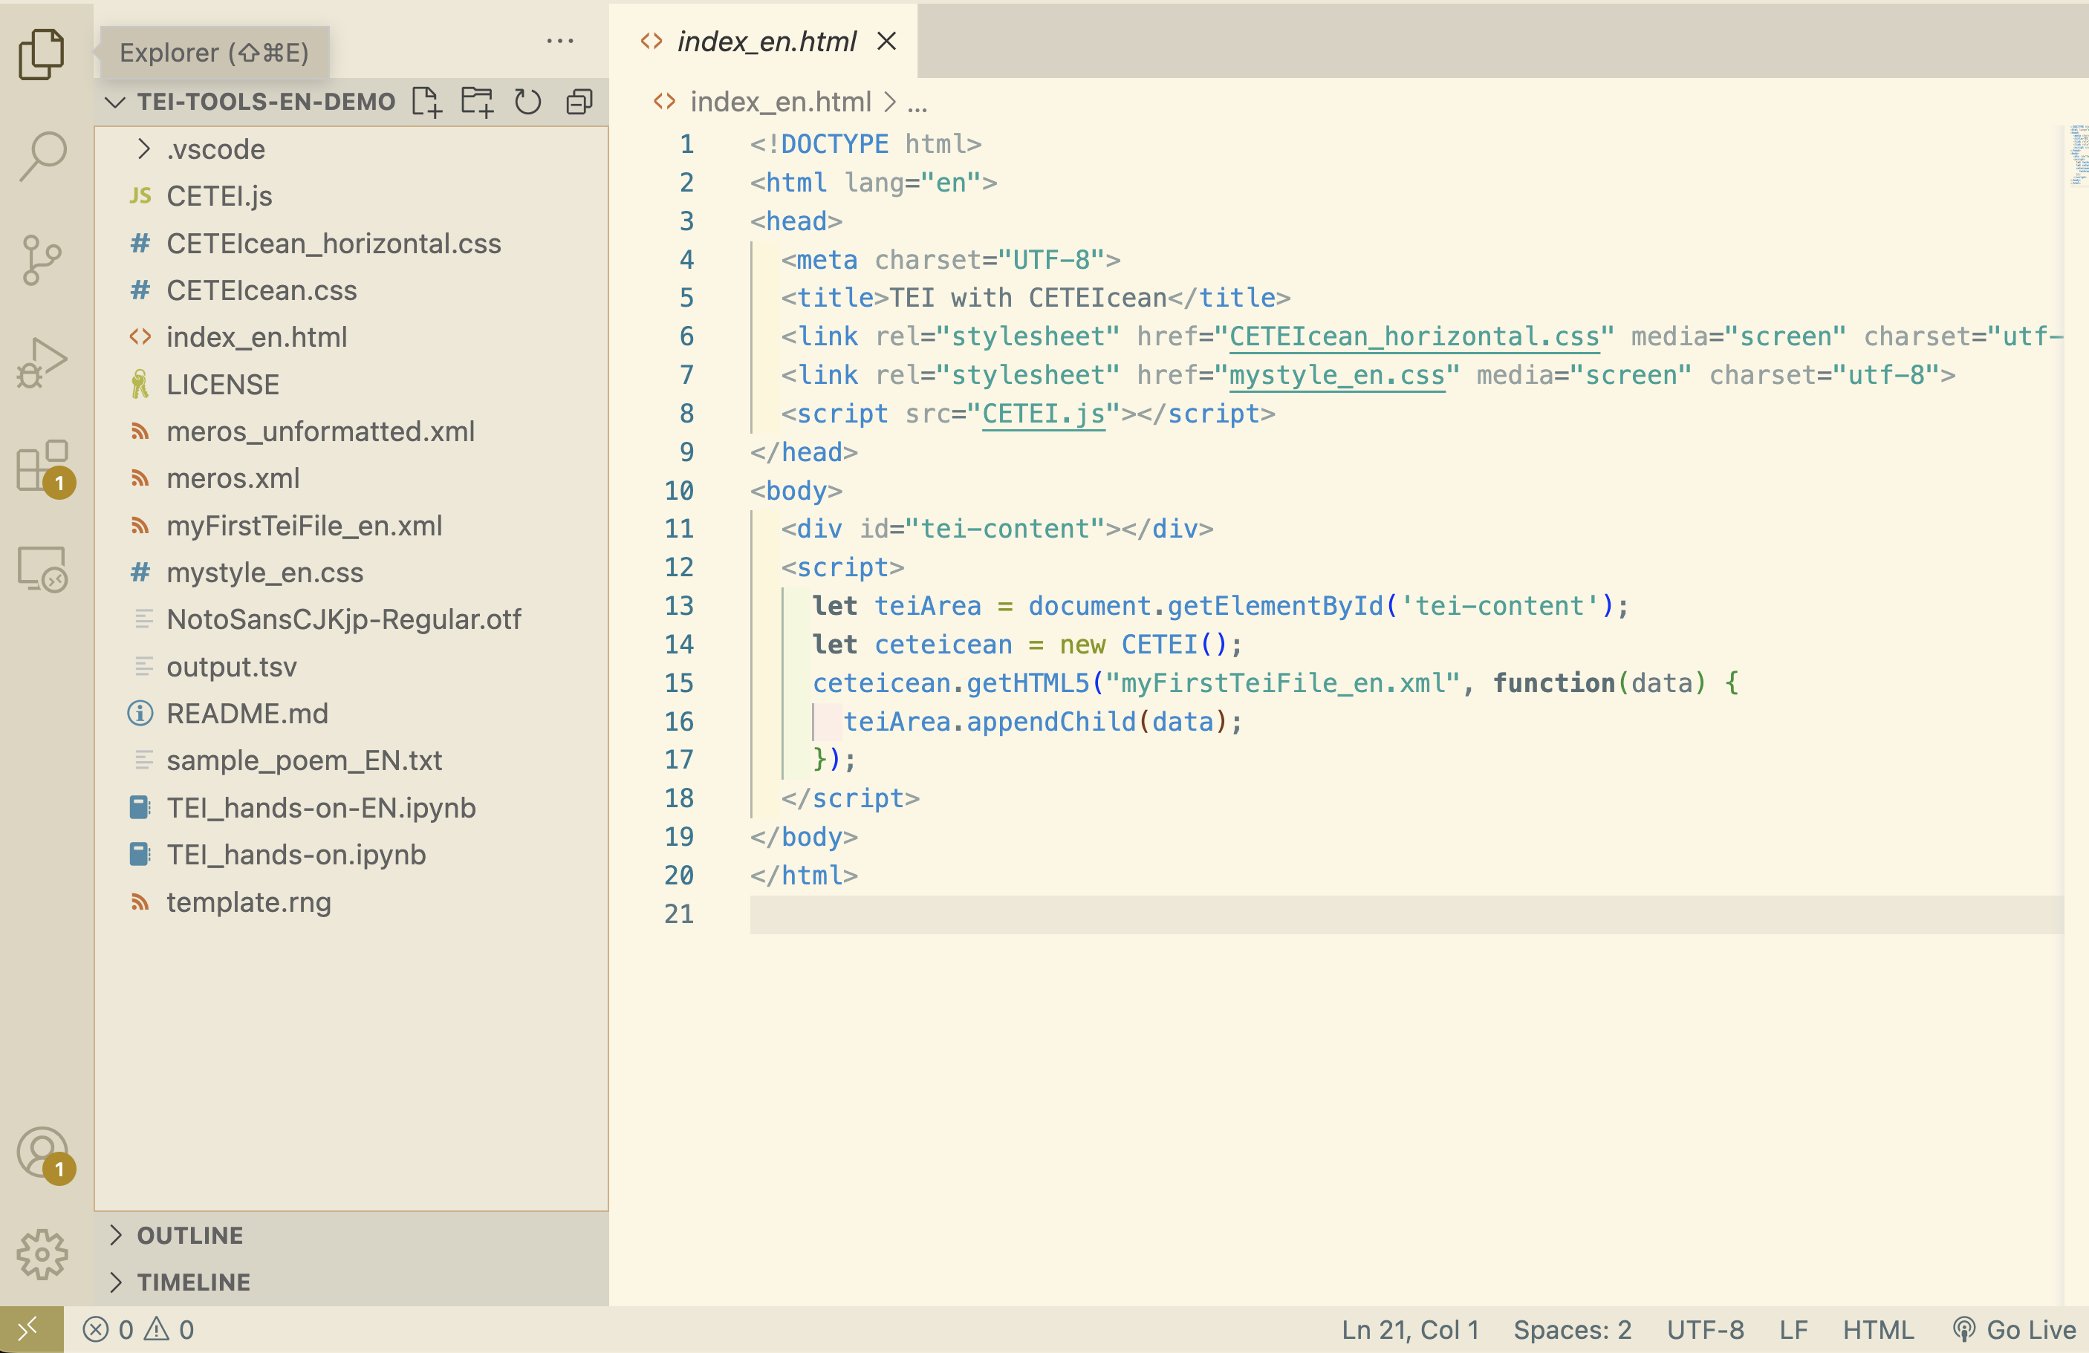
Launching the web browser
Choose “index_en.html”
Click: “Go Live”
Notes:
Topic:Changing the appearance of TEI files
Voice:Joanna
```text
Then, click “Go lyve” to open the page in your browser.
```
```description
Then, click “Go Live” to open the page in your browser.
```

Slide 16
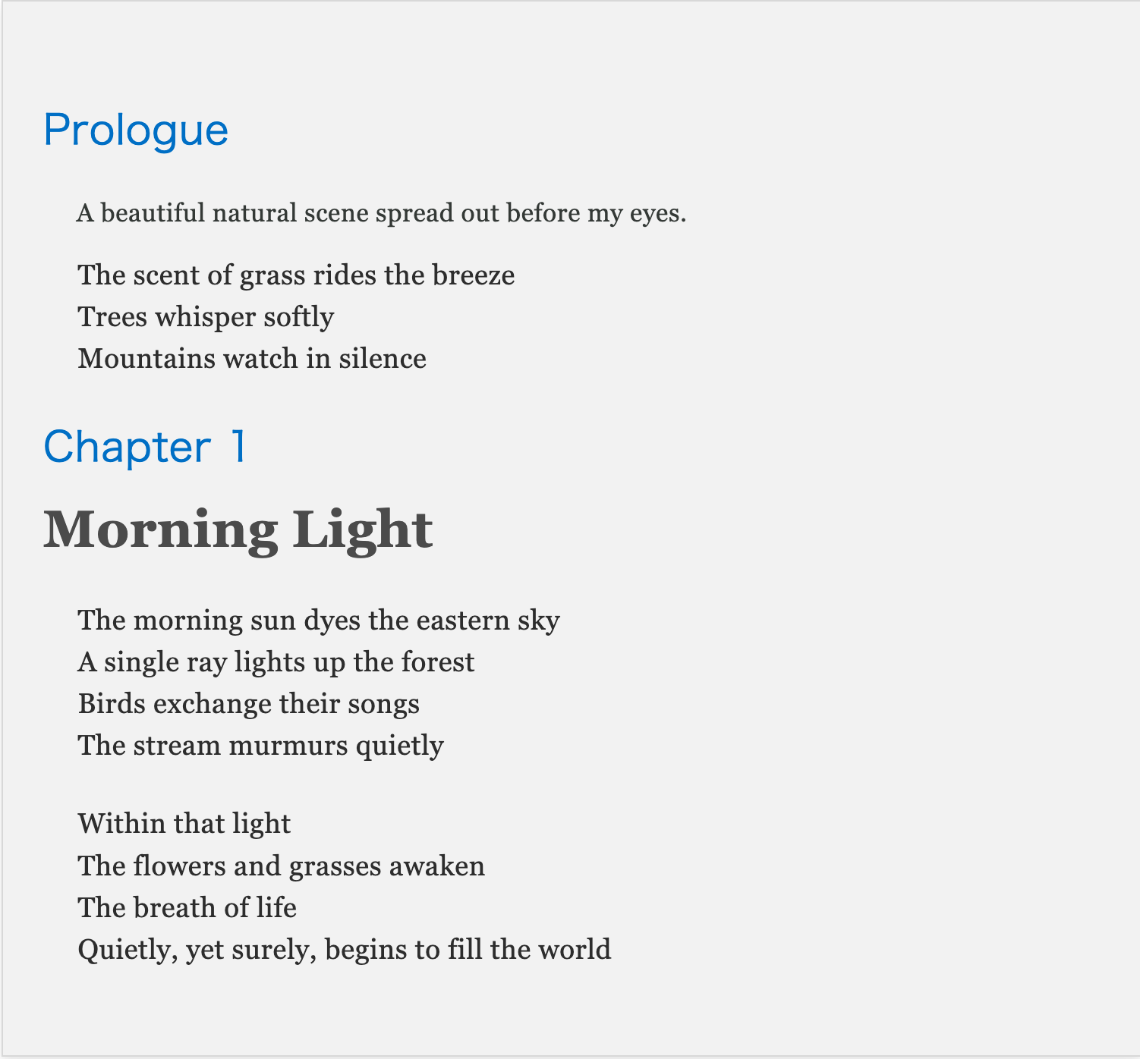
Displaying the Poem 1
Notes:
Topic:Displaying the poem
Voice:Joanna
```text
This should display the text as shown on the screen.
If you are working with Japanese text, you can use this feature to view the text vertically. The corresponding file for vertical display for Japanese text can be downloaded from GitHub.
In other words, using T E I to structure text as data allows you to present it in different ways on the web according to your needs, while preserving the original structure and format.
```
```description
This should display the text as shown on the screen.
If you are working with Japanese text, you can use this feature to view the text vertically. The corresponding file for vertical display for Japanese text can be downloaded from GitHub.
In other words, using TEI to structure text as data allows you to present it in different ways on the web according to your needs, while preserving the original structure and format.
```

Slide 17
Displaying the Poem 2
File in TEI format
Notes:
Topic:Displaying the poem
Voice:Joanna
```text
You can display your own T E I file by replacing “myFirst T e i File_en.xml” shown on screen, with the name of the file you created.
Feel free to choose any text, convert it into T E I format, and swap the file to see the result.
```
```description
You can display your own TEI file by replacing “myFirstTeiFile_en.xml” shown on screen with the name of the file you created.
Feel free to choose any text, convert it into TEI format, and swap the file to see the result.
```

Slide 18
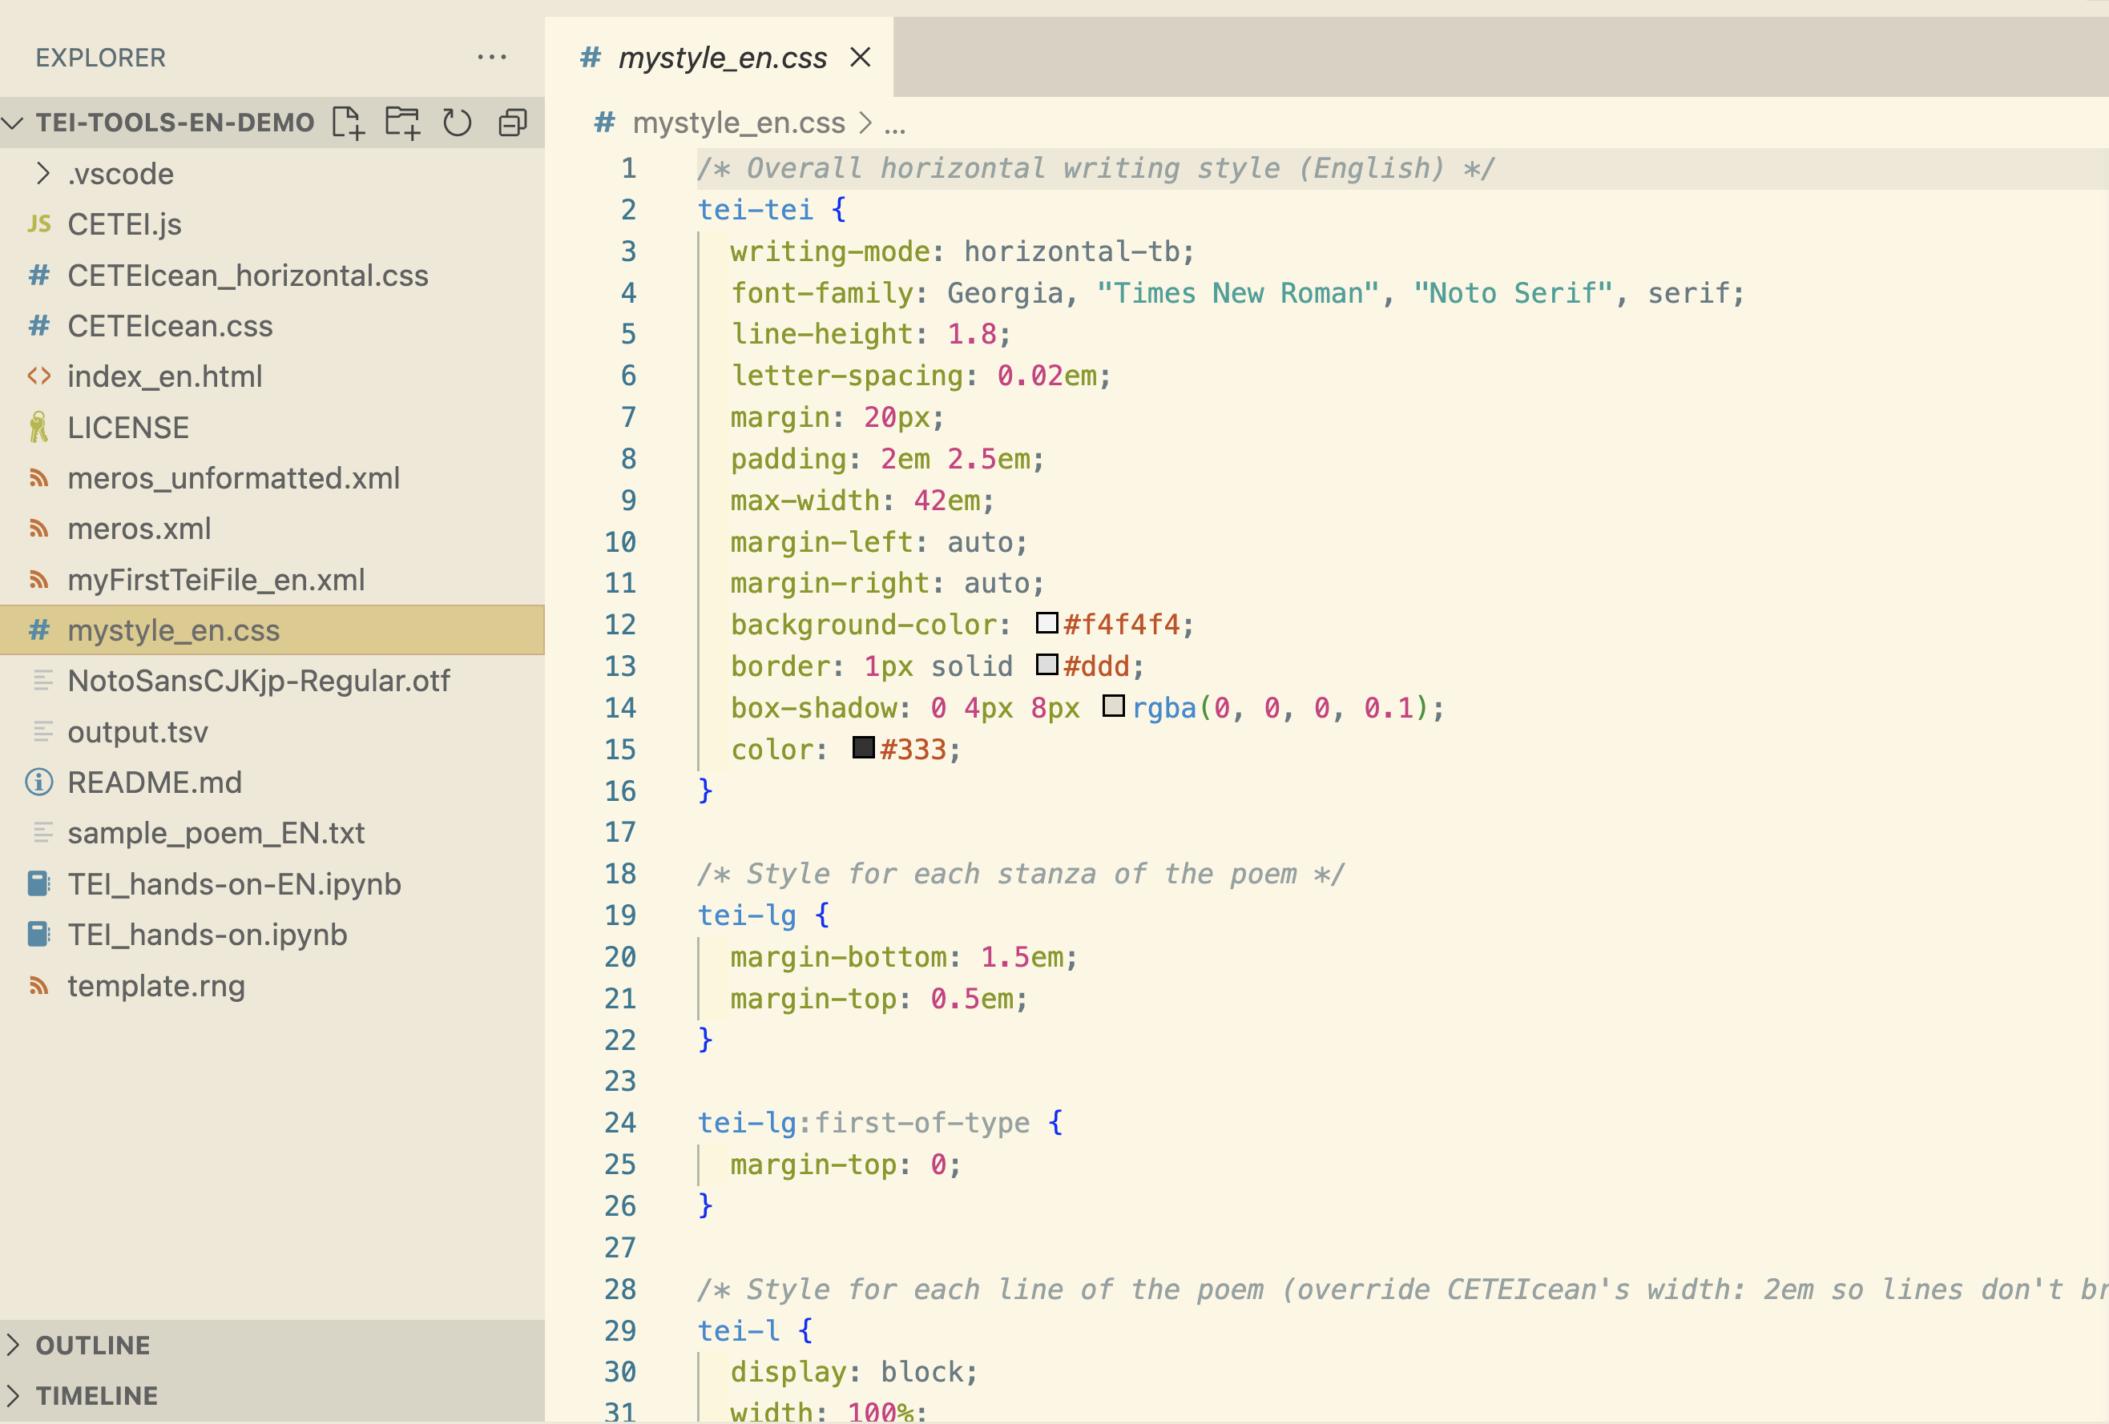
Displaying the Poem 3
CSS（Cascade Style Sheet）
Notes:
Topic:Displaying the poem
Voice:Joanna
```text
Also, by editing a stylesheet with the extension dot css, you can change the appearance of each tag.
CSS stands for Cascading Style Sheets. CSS plays an important role in controlling the appearance of web pages.
There is information on CSS available online, but for now, try opening the sample file mystyle_en.css and adjusting simple settings like font size to suit your preferences
```
```description
Also, by editing a stylesheet with the extension .css, you can change the appearance of each tag.
CSS stands for Cascading Style Sheets. CSS plays an important role in controlling the appearance of web pages.
There is information on CSS available online, but for now, try opening the sample file mystyle_en.css and adjusting simple settings like font size to suit your preferences.
```

Slide 19



In Conclusion
Converting any text into structured TEI format using VSCode allows for…
Flexible text display utilizing TEI data
Visualization of the appearance frequency of specific words
TEI
→
Notes:
Topic:Displaying the poem
Voice:Joanna
```text
With this, we have completed the preparation and practice for converting text into structured T E I format using VSCode.
By using the T E I format, flexible display using T E I data becomes possible.
Furthermore, it can be used in research to visualize the appearance frequency of specific words.
Next time will be a hands-on session about data visualization using T E I.
Please look forward to it!
```
```description
With this, we have completed the preparation and practice for converting text into structured TEI format using VSCode.
By using the TEI format, flexible display using TEI data becomes possible.
Furthermore, it can be used in research to visualize the appearance frequency of specific words.
Next time will be a hands-on session about data visualization using TEI.
Please look forward to it!
```

Slide 20
Note: Vertical & Horizontal Text
The same procedure can be applied for vertical text.
Please refer to the respective files in the GitHub repository that do not contain the suffix EN/en for Japanese vertical writing.
Notes:
Topic:Displaying the poem
Voice:Joanna
```text
These materials are structured to be applicable to English, and other horizontally written languages.
In the case of Japanese vertical writing, the same exact procedure is applicable to the files from the GitHub repository that do not contain the EN/en suffix. Please give it a try if you are interested.
```
```description
These materials are structured to be applicable to English, and other horizontally written languages.
In the case of Japanese vertical writing, the same exact procedure is applicable to the files from the GitHub repository that do not contain the EN/en suffix. Please give it a try if you are interested.
```

