Slide 1
TEI Hands-on
Text analysis with Run, Melos! (走れメロス)
Notes:
Topic:Google Colab
Voice:Joanna
```text
T E I hands-on.
Text analysis with Run, Melos!
```
```description
TEI hands-on.
Text analysis with Run, Melos!
```

Slide 2
Regarding this Section
Building on the knowledge from the TEI Hands-on: Introductory Edition,
we will introduce several examples of analyses using TEI-formatted research texts.
Items to prepare:
demo(TEI-tools) > TEI_hands-on-EN.ipynb
Google Chrome browser (recommended)
The demo/TEI-tools (GitHub) repository can be accessed through the link provided in this video
Google Colab
https://colab.research.google.com/
Notes:
Topic:Google Colab
Voice:Joanna
```text
In this section, we will introduce several examples of text analysis using research materials that have been converted into T E I format, based on the knowledge covered in the T E I Hands-on: Basic Edition.
First, locate the T E I hands-on E N dot eye p y n b file, either in the demo folder or from the T E I-tools repository on GitHub linked from the video guidance page, and download it.
This file contains programs that run on a web browser.
The file should already be inside your project folder.
Next, search for Google Colab using your web browser.
We recommend using Chrome as the browser.
```
```description
In this section, we will introduce several examples of text analysis using research materials that have been converted into TEI format, based on the knowledge covered in the TEI Hands-on: Basic Edition.
First, locate the TEI_hands-on.ipynb file, either in the demo folder or from the TEI-tools repository on GitHub linked from the video guidance page, and download it. (https://github.com/nikolito/TEI-tools/)
This file contains programs that run on a web browser.
The file should already be inside your project folder.
Next, search for Google Colab using your web browser.
We recommend using Chrome as the browser. (https://colab.research.google.com/)
```

Slide 3
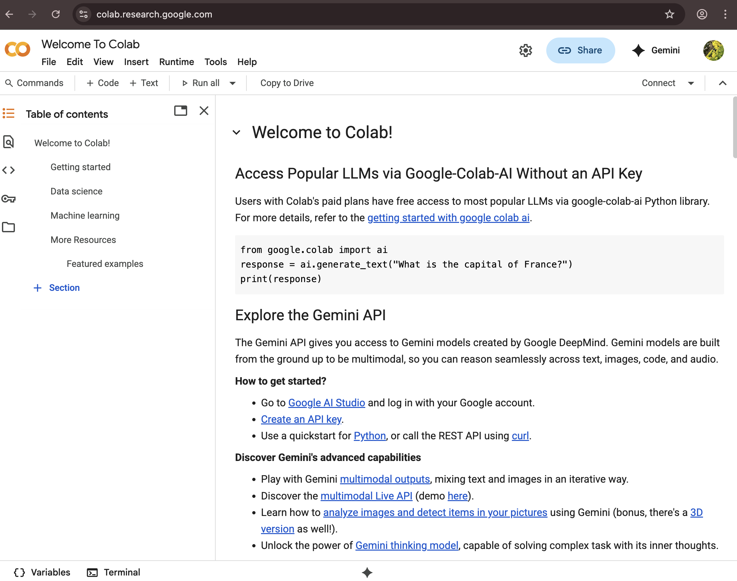
Google Colab’s Appearance
https://colab.research.google.com/
Notes:
Topic:Google Colab
Voice:Joanna
```text
In this video, we’ll proceed using the downloaded program and T E I data.
We’ll be using the programming support service called Google Colab.
Search for “Google Colab” using the Chrome browser and open the Google Colab website.
```
```description
In this video, we’ll proceed using the downloaded program and TEI data.
We’ll be using a programming support service called Google Colab.
Search for “Google Colab” using the Chrome browser and open the Google Colab website. (https://colab.research.google.com/
```

Slide 4
Google Colab (Colaboratory)
A simple programming tool that runs in a web browser
No need to worry about differences in OS (like macOS or Windows) or computer performance
Allows you to write explanatory text before and after code, or create outlines of topics
Makes it easy to understand how to write and run code
https://colab.research.google.com/
You need to be connected to the internet and have a Google account
To run programs, you connect to Google’s computers, but the connection cannot be maintained for long periods
If the connection is cut, any libraries or data you temporarily installed will be lost
Notes:
Topic:Google Colab
Voice:Joanna
```text
Let’s take another look at Google Colab. Google Colab is a simple programming tool that runs in your web browser.
It allows you to execute programs by making use of Google’s computing resources.
Because it runs in a browser, there’s no need to worry about your computer’s O S or specs.
It also supports sharing your code with others and lets you insert explanations or topic outlines before, and after each code block.
For beginners, it’s especially appealing because there’s no need to install any extra software—just press the run button and your code executes.
However, you do need to be connected to the internet and have a Google account. Also, you can’t keep the connection open for long periods.
When the connection is lost, the program itself will remain, but temporary files created during execution will disappear, unless saved to your local machine.
```
```description
(https://colab.research.google.com/) Let’s take another look at Google Colab. Google Colab is a simple programming tool that runs in your web browser.
It allows you to execute programs by making use of Google’s computing resources.
Because it runs in a browser, there’s no need to worry about your computer’s OS or specs.
It also supports sharing your code with others and lets you insert explanations or topic outlines before and after each code block.
For beginners, it’s especially appealing because there’s no need to install any extra software—just press the run button and your code executes.
However, you do need to be connected to the internet and have a Google account. Also, you can’t keep the connection open for long periods.
When the connection is lost, the program itself will remain, but temporary files created during execution will disappear unless saved to your local machine.
```

Slide 5
Creating a Google Account
To use the Google Colab service, you’ll need a Google account (a combination of username and password).
If you’re just creating an account and running programs on Colab, you can use it for free.
If you don’t have an account yet, please create one before continuing.
You can do this at: https://www.google.com/intl/account/about/
(Alternatively, try searching online for terms like “Create Google account.”)
Notes:
Topic:Google Colab
Voice:Joanna
```text
To use Google Colab, you need a Google account (a username and password).
Using Colab is free if you’re just creating an account and running programs.
If you don’t have an account yet, please create one before continuing.
You can either visit the link below or search the internet using keywords like “Create Google account.
```
```description
To use Google Colab, you need a Google account (a username and password).
Using Colab is free if you’re just creating an account and running programs.
If you don’t have an account yet, please create one before continuing.
You can either visit the link below or search the internet using keywords like “Create Google account. https://www.google.com/intl/account/about/
```

Slide 6
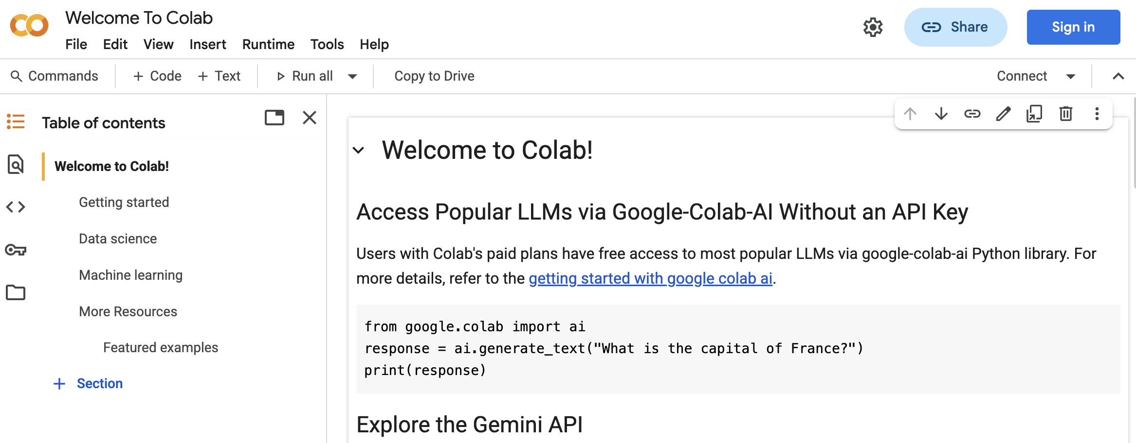
Let’s Log in to Google Colab
Click here to Log in
https://colab.research.google.com
Notebook Page
Notes:
Topic:Google Colab
Voice:Joanna
```text
Once you’ve created your Google account, go to the Google Colab site.
Then, log in using the login button near the top-right corner of the screen.
By the way, a “notebook” refers to the type of programming file used in Google Colab.
```
```description
Once you’ve created your Google account, go to the Google Colab site.
Then, log in using the login button near the top-right corner of the screen.
By the way, a “notebook” refers to the type of programming file used in Google Colab.
```

Slide 7
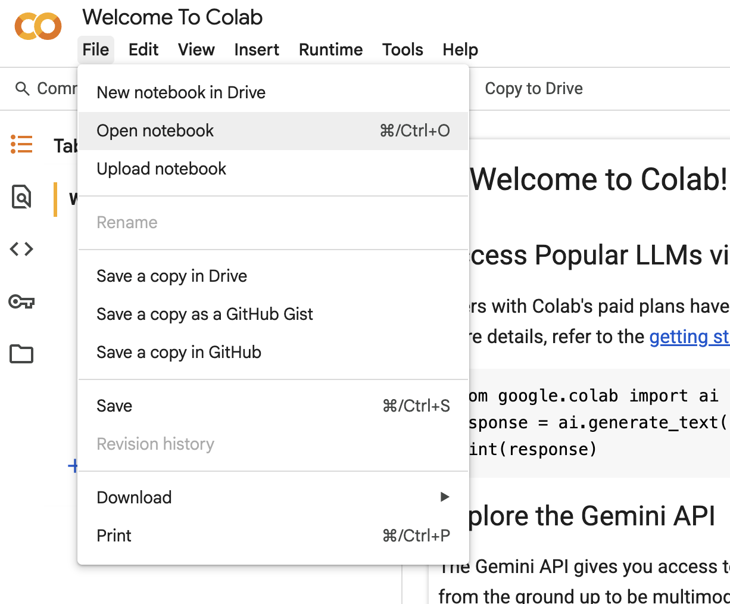
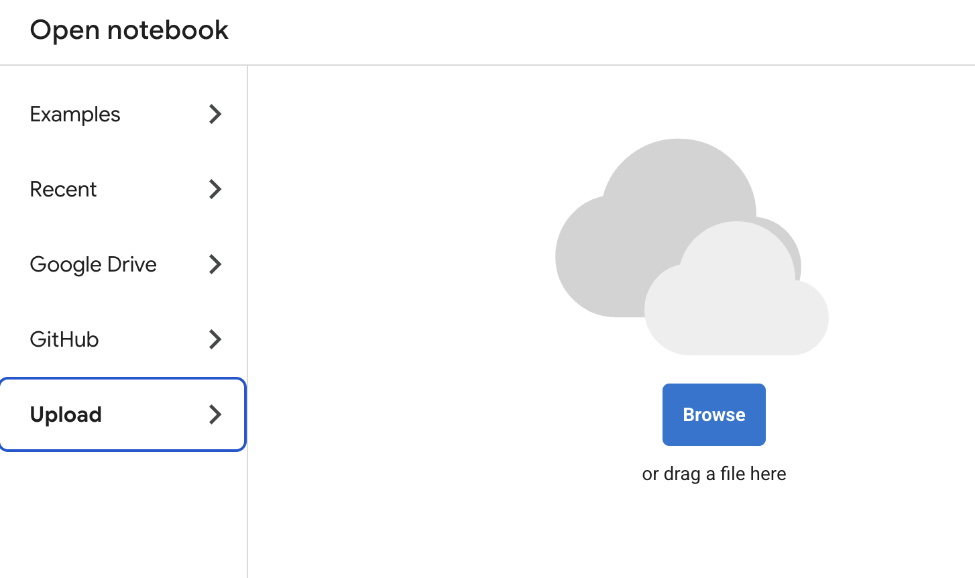
Let’s Open a Notebook
File > Upload notebook > Upload
select the downloaded file “TEI_hands-on-EN.ipynb”
You can download this file from CLE along with other sample files.
1
2
Notes:
Topic:Google Colab
Voice:Joanna
```text
Next, from the Google Colab menu, choose “File,” and your screen should look like the one on the right.
Select “Open notebook” from the file menu.
Then, in the dialog that appears, select ”upload”, and upload the T E I_hands-on E N, file to Google Colab.
```
```description
Next, from the Google Colab menu, choose “File,” and your screen should look like the one on the right.
Select “Open notebook” from the file menu.
Then, in the dialog that appears, select “upload” and upload the TEI_hands-on.ipynb file to Google Colab.
```

Slide 8
TEI_hands-on-EN.ipynb
Here is a sample code with explanations that can be run directly in Google Colab:
https://colab.research.google.com/drive/19eII4FMv1FAIU3AKctemFpzo1sc57-gd?usp=sharing (in English)
If you want to modify the code yourself, make sure to save a copy first.
The sample code is written in Python, a language with many available examples.
Notes:
Topic:Google Colab
Voice:Joanna
```text
This notebook provides sample code for text analysis using T E I files, along with explanations.
The code is fully functional, so please try running the notebook as you watch the video.
The programming language used is Python, which is easy to search for online when you run into questions.
```
```description
(https://colab.research.google.com/drive/19eII4FMv1FAIU3AKctemFpzo1sc57-gd?usp=sharing ) This notebook provides sample code for text analysis using TEI files, along with explanations.
The code is fully functional, so please try running the notebook as you watch the video.
The programming language used is Python, which is easy to search for online when you run into questions.
```

Slide 9
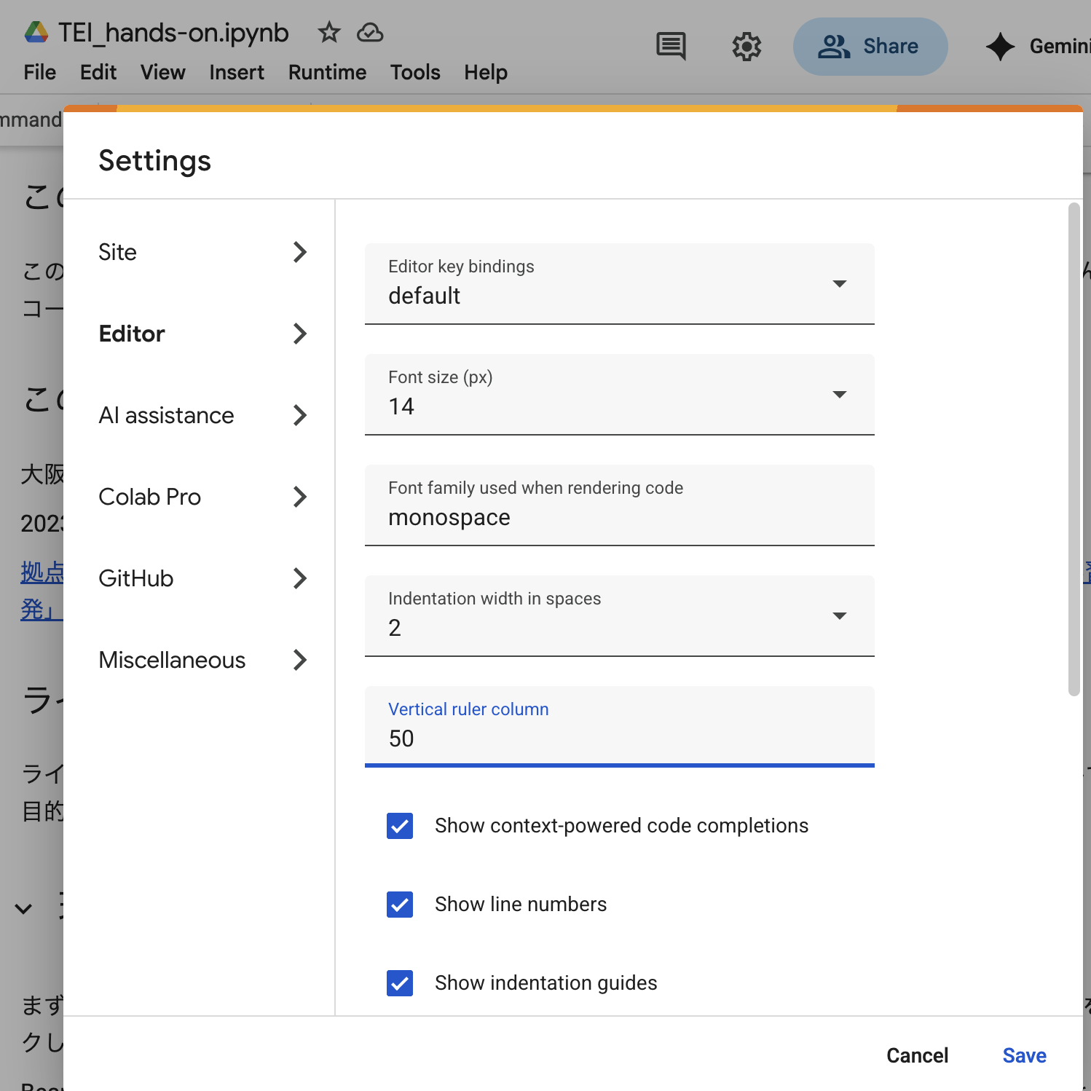
Google Colab Settings
To make it easier to explain using line numbers, click the gear icon for settings, then click “Editor,” and check “Show line numbers.”
Notes:
Topic:Google Colab
Voice:Joanna
```text
In this video, some explanations of the program will refer to line numbers.
So, just like on the screen, go to settings via the gear icon, click “Editor,” and check “Show line numbers.”
```
```description
In this video, some explanations of the program will refer to line numbers.
So, just like on the screen, go to settings via the gear icon, click “Editor,” and check “Show line numbers.”
```

Slide 10



Osamu Dazai’s: Run, Melos! - meros.xml
A lightly modified sample based on the Aozora Bunko text, converted into TEI format.
TEI-EAJ
aozora_tei
@Github
Original Book (paper)
TEI
Converted into TEI format by the TEI-C East Asia / Japanese Language Interest Group
Aozora Bunko volunteers digitize the text
meros.xml
(Original source recorded in meros.xml)
(We are here)
Notes:
Topic:Run, Melos! TEI version
Voice:Joanna
```text
The sample code we’ll be using is based on Run, Melos by Osamu Dazai, converted into T E I format and lightly modified.
These kinds of texts have long been supported by volunteer efforts.
Recently, more and more texts with clear usage permissions have become available online, making them easy to use for research and education.
```
```description
The sample code we’ll be using is based on Run, Melos by Osamu Dazai, converted into TEI format and lightly modified.
These kinds of texts have long been supported by volunteer efforts.
Recently, more and more texts with clear usage permissions have become available online, making them easy to use for research and education.
```

Slide 11
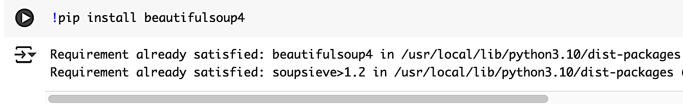
Setting up an Environment & Loading Data
BeautifulSoup: One of the libraries (a set of bundled programs) in Python for easily parsing XML files. You can extract data by specifying tags of your choice.
Clicking the run button executes the command
Note: Make sure to click on the next cell for it to run.
Notes:
Topic:Run, Melos! TEI version
Voice:Joanna
```text
Let’s now go over the program contained in the T E I_hands-on E N file.
First, as shown on the screen, install the necessary packages for the program to run. Then click the run button on the left side of the code.
This will connect the notebook to a computer and execute the program.
Beautiful Soup is a Python library, a set of bundled programs, that makes it easy to parse HTML and XML files.
It’s especially useful for extracting information or analyzing structure from web pages and XML files built with tags.
```
```description
Let’s now go over the program contained in TEI_hands-on.ipynb.
First, as shown on the screen, install the necessary packages for the program to run. Then click the run button on the left side of the code.
This will connect the notebook to a computer and execute the program.
BeautifulSoup is a Python library, a set of bundled programs, that makes it easy to parse HTML and XML files.
It’s especially useful for extracting information or analyzing structure from web pages and XML files built with tags.
```

Slide 12
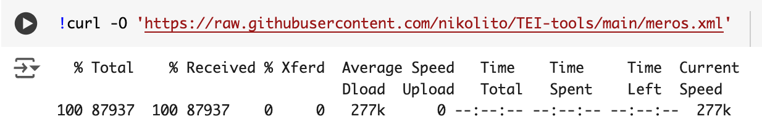
Downloading meros.xml
Next, we download the TEI data from a repository called GitHub.
Click→
Notes:
Topic:Run, Melos! TEI version
Voice:Joanna
```text
Next, we download the T E I data from a repository called GitHub.
```
```description
GitHub is an online platform that is mostly free and is commonly used to store and share research data and code.
```

Slide 13
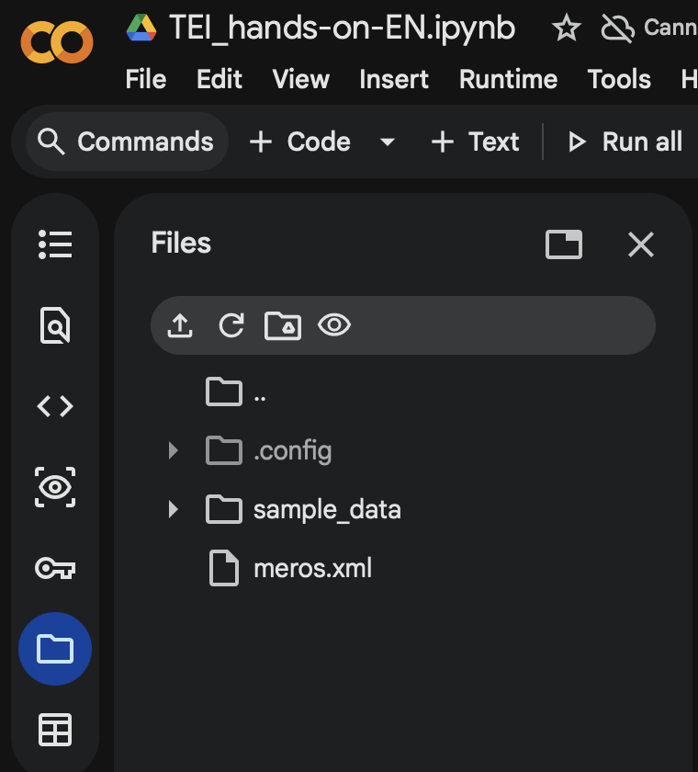
Where is the downloaded file?
Click on this folder icon
Notes:
Topic:Run, Melos! TEI version
Voice:Joanna
```text
The downloaded data is saved in a temporary storage location provided by Google Colab ,
This is a personal workspace where your files are stored while the session is running.
[break:"2s"]
```
```description
The downloaded data is saved in a temporary file space provided by Google Colab.
This is a place where you can store your own files temporarily.
```

Slide 14
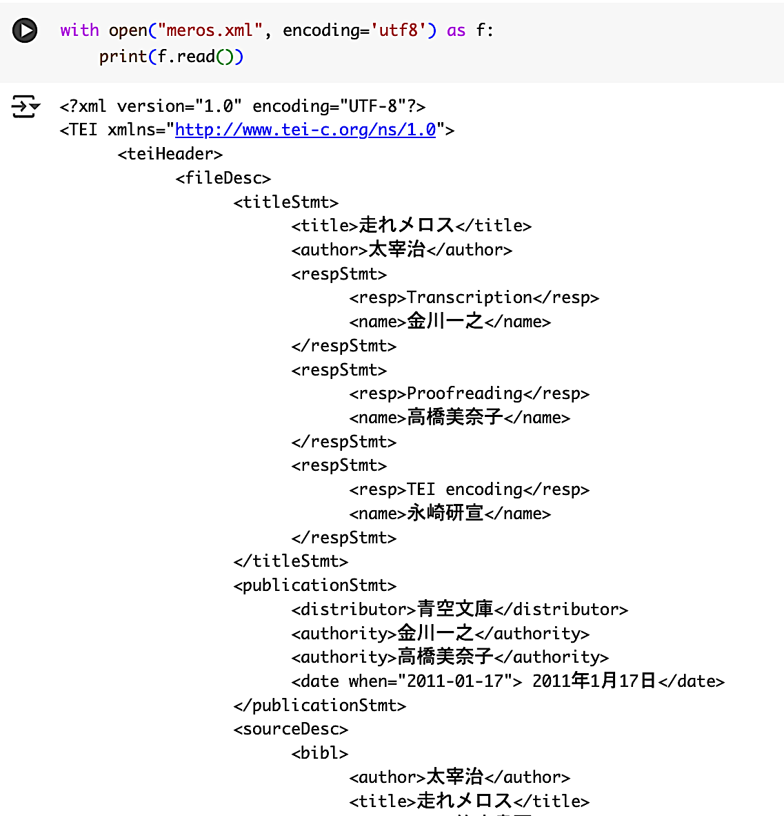
Contents of meros.xml
A commonly used programming pattern in Python is file input and output.
with open("meros.xml", encoding='utf8') as f:
print(f.read())
Notes:
Topic:Run, Melos! TEI version
Voice:Joanna
```text
Let’s use a program to easily display the contents of the meros dot xml file.
In Python programming, it is very common to read a file and output its contents to the screen or to another file.
The code block shown here on the top right corner safely opens the specified file and prints its contents to the screen.
The encoding used is UTF-eight.
This encoding is used to correctly read Japanese characters that are represented as sequences of zeros and ones.
In the meros dot xml file, bibliographic information and the main text of Run, Melos! are represented as data in XML format.
```
```description
Let’s use a program to easily display the contents of the meros.xml file.
In Python programming, it is common to read a file and output its contents to the screen or to another file.
The code shown on the screen safely opens the specified file and prints it to the screen.
UTF-8 encoding is used to correctly read Japanese characters that are converted into sequences of zeros and ones.
In the meros.xml file, bibliographic data and the main text of Run, Melos! are represented in XML format.
```

Slide 15
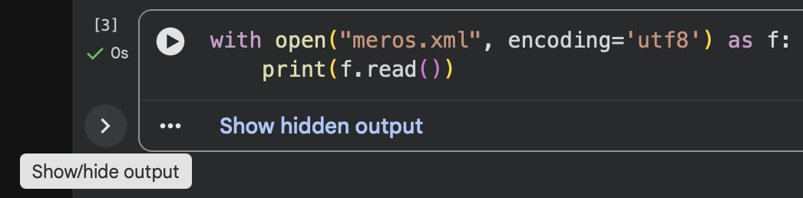
Toggle the display of output results
Toggle the output on/off from this symbol→
Notes:
Topic:Run, Melos! TEI version
Voice:Joanna
```text
You can choose to show or hide the output results by clicking the icon on the screen.
```
```description
Click the on-screen icon to choose whether the output results are shown or hidden.
```

Slide 16
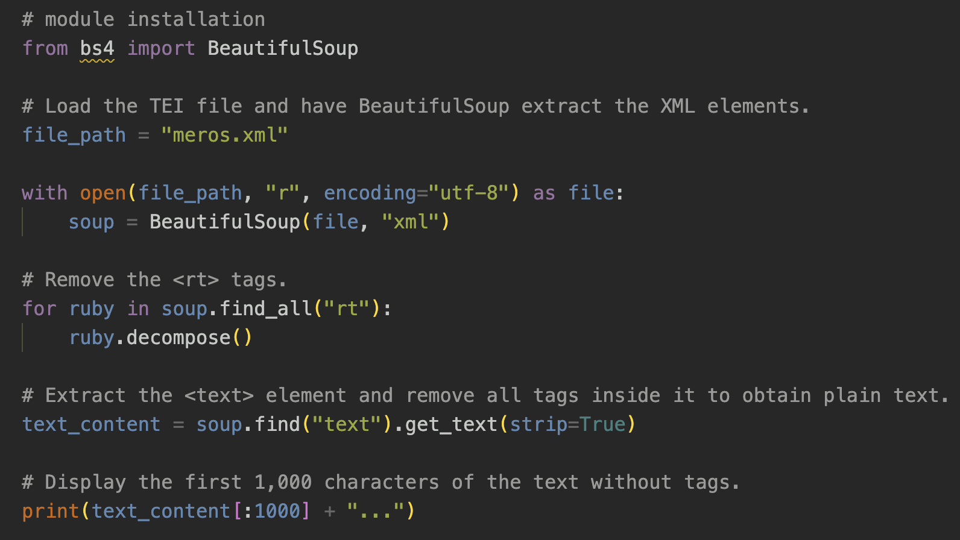
Displaying text with TEI tags removed (part one)
Strings such as file_path and soup are variables.
  A variable is a name that refers to a value or object in a program
The value on the right side of the equals sign is assigned to that name.
A function takes one or more values as input and may return a result.
2
5
Variable
8
Function
15
Notes:
Topic:Text Formatting
Voice:Joanna
```text
T E I is usually stored as an XML file, and the text is marked up using tags.
[break:"1s"]
BeautifulSoup is a library that makes it relatively easy to search for tags and edit an XML or HTML structure.
[break:"1s"]
With this in mind, please look at the notebook section titled, Let’s display the text with all T E I tags removed from the T E I file
[break:"1s"]
First, when you run this program, BeautifulSoup is imported on line two.
[break:"1s"]
Next, between lines five and eight, the meros dot xml file is opened and parsed as XML, creating a BeautifulSoup object called soup.
[break:"1s"]
Names such as file_path on line five, and soup on line eight are called variables.
[break:"1s"]
In Python, a variable is a name that refers to a value or object, so you can use it later in the program.
[break:"1s"]
Here, file is a file object created by open, and BeautifulSoup reads from it and parses the XML into a structured tree.
[break:"1s"]
A function is a tool that performs an operation when you call it with parentheses, and it may return a result.
[break:"1s"]
So, BeautifulSoup takes the opened file and produces soup, which represents the parsed XML structure.
[break:"1s"]
After that, all that remains is to extract the content we want from soup.
[break:"1s"]
Please look carefully at line fifteen.
[break:"1s"]
It finds the text tag, and then get_text extracts the plain text inside it, without including the tags in the output.
[break:"1s"]
When this program is run, the result printed is the text content with markup removed from the output.
```
```description
This is a recap of what we have covered so far.
TEI is usually stored as an XML file, and the text is marked up using tags.
BeautifulSoup is a library that makes it relatively easy to search for tags and edit an XML or HTML structure.
With this in mind, please look at the notebook section titled “Display text with tags removed from a TEI file.”
First, when you run this program, BeautifulSoup is imported on line two.
Next, between lines five and eight, the meros.xml file is opened and parsed as XML, creating a BeautifulSoup object called soup.
Incidentally, names such as file_path on line five and soup on line eight are called variables.
In Python, a variable is a name that refers to a value or object so it can be used later in the program.
Here, file is a file object created by open, and BeautifulSoup reads from it and parses the XML into a structured tree.
A function is a tool you call with parentheses to perform an operation, and it may return a result.
In other words, BeautifulSoup takes the opened file and produces soup, which represents the parsed XML structure.
After that, all that remains is to extract the content we want from soup.
Please look carefully at line fifteen.
It finds the <text> element, and then get_text extracts the plain text inside it, without including tags in the output.
When this program is run, the printed result is the text content with markup removed from the output.
```

Slide 17
Displaying text with TEI tags removed (part two)
A function that extracts all rt elements, which are tags used to display ruby text: find_all(“rt”)
An example of ruby annotation:
<ruby>
<rb>邪智暴虐</rb>
<rt>じゃちぼうぎゃく</rt>
</ruby>
11
Opening sentence: “Melos was enraged.”
0 1 2 3 4 5 6 7 8
The text data stored in a variable is numbered starting from zero.
15
Notes:
Topic:Text Formatting
Voice:Joanna
```text
After all XML elements are loaded into soup, we next use functions in BeautifulSoup to extract specific elements.
[break:"1s"]
This text contains ruby annotations, which provide reading guides for difficult kanji and foreign words.
[break:"1s"]
For this reason, even if all tags are removed from the meros T E I file using the function on line fifteen, the ruby parts will remain.
[break:"1s"]
To address this, a method for removing ruby annotations is added starting from line ten.
[break:"1s"]
On line eleven, the find_all function is connected to the soup variable using a dot, and all rt tags, which represent ruby text, are searched for.
[break:"1s"]
Each extracted rt element is then stored one by one in a variable called ruby, and all ruby elements are repeatedly removed using the decompose function.
[break:"1s"]
The four statement is a commonly used programming structure.
It instructs the program to repeatedly execute the code written inside the four loop, while the condition written to the right of four, is satisfied.
[break:"1s"]
By doing this, all rt elements contained in the soup data are removed.
[break:"1s"]
On line fifteen, the text element is extracted from the soup data that no longer contains rt elements, and only the text is retrieved using the get_text function.
[break:"1s"]
The option, strip equals True, removes line breaks, tabs, and extra spaces at the same time.
[break:"1s"]
In this way, the variable text_content stores text data with no tags and with ruby annotations removed.
[break:"1s"]
As a final step, the data in text_content is passed to the print function and displayed on the screen.
[break:"1s"]
At this point, characters in text_content are stored sequentially, starting from index zero.
Please confirm the output results.
```
```description
After all XML elements are loaded into soup, we next use the element-extraction functions included in BeautifulSoup.
This text contains ruby annotations, which provide readings for difficult kanji and foreign words.
For this reason, even if all tags are removed from the meros TEI file using the function on line fifteen, the ruby parts will remain.
To handle this, a method for removing ruby annotations is added starting from line ten.
On line eleven, the find_all function is connected to the soup variable using a dot, and all rt tags, which represent ruby text, are searched for.
Each extracted rt element is then placed one by one into a variable called ruby, and all ruby elements are repeatedly removed using the decompose function.
The for statement is a commonly used programming construct.
It instructs the program to repeatedly execute the code written inside the for loop while the condition written to the right of for is satisfied.
By doing this, all rt elements contained in the soup data are removed.
On line fifteen, the text element is extracted from the soup data that no longer contains rt elements, and only the text is retrieved using the get_text function.
The option strip equals True removes line breaks, tabs, and extra spaces at the same time.
In this way, the variable text_content stores text data with no tags and with ruby annotations removed.
As a final step, the data in text_content is passed to the print function and displayed on the screen.
At this point, characters in text_content are stored sequentially, starting from index zero.
That is, in the sentence “Melos was enraged,” index zero is メ, index one is ロ, index two is ス, and index three is は.
Incidentally, the character at index ten of text_content is ず.
Please check this in the output results.
```

Slide 18
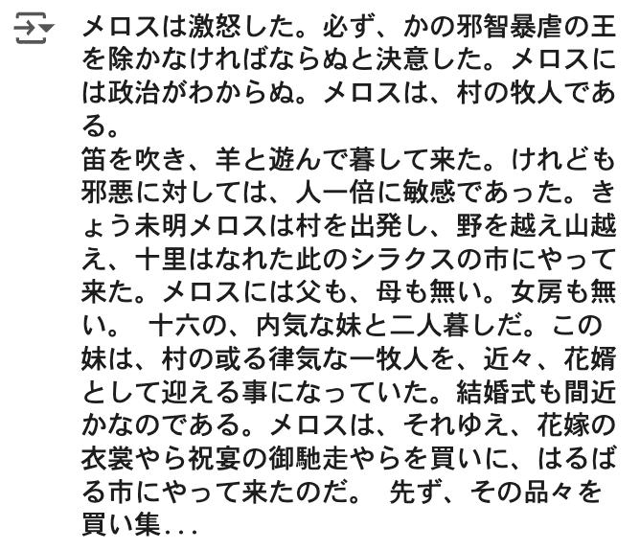
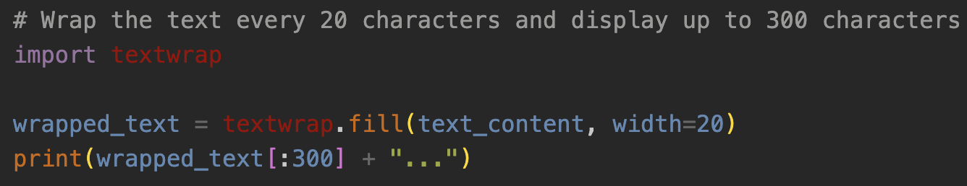
Use the textwrap library to format the text in a more readable way
Slice notation
wrapped_text contains the string from index 0 to index 299, which is 300 characters
Use the fill function from the textwrap library to wrap text_content to a width of 20 characters, up to 300 characters.
Notes:
Topic:Text Formatting
Voice:Joanna
```text
In fact, when the text_content variable from the previous slide is displayed, the text has no line breaks, so it is difficult to read. [break:"1s"]
For this reason, we use the textwrap library to format the text in a more readable way.
[break:"1s"]
When we use the fill function included in the textwrap library, text_content, that is, the text with tags removed, can be wrapped at a width of 20 characters.
[break:"1s"]
You can also see square brackets next to wrapped_text, with a colon and the number 300 inside.
[break:"1s"]
This represents the string from index zero to index 299, in other words, 300 characters of wrapped_text.
[break:"1s"]
This type of notation is specific to Python and is called slice notation.
[break:"1s"]
The output text on the right shows the result.
```
```description
In fact, when the text_content variable from the previous slide is displayed, the text has no line breaks, which makes it difficult to read.
For this reason, we use the textwrap library to format the text in a more readable way.
When we use the fill function included in the textwrap library, text_content can be wrapped at a width of 20 characters.
You can also see square brackets next to wrapped_text, with a colon and the number 300 inside.
This represents wrapped_text from index zero to index 299, in other words, 300 characters.
This type of notation is specific to Python and is called slice notation.
The output text on the right shows the result.
```

Slide 19
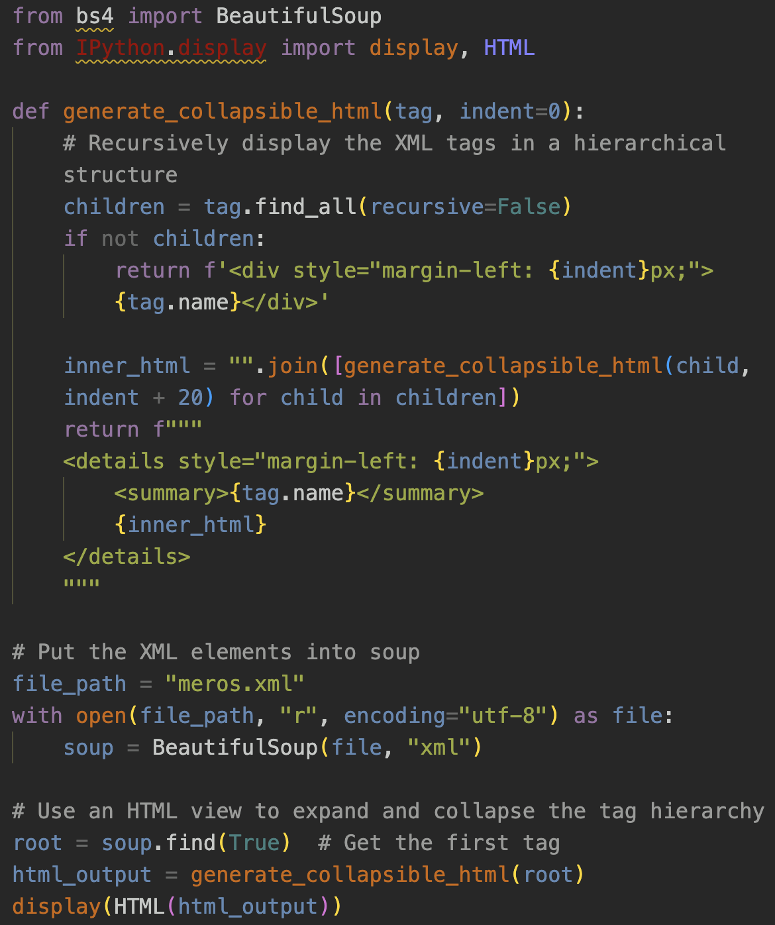
Checking the markup rules of this file
Which tags are used?
How are the tags structured hierarchically?
Notes:
Topic:Tag Hierarchy in meros.xml
Voice:Joanna
```text
From this point on, we will look at how to extract only the information you need from an XML file.
To do this, checking the markup rules is an extremely important step.
In other words, when outputting necessary information from a T E I file, you need to examine which tags are used and how they are structured hierarchically.
[break:"1s"]
For this purpose, we will introduce a convenient program that allows you to easily understand the hierarchical structure of tags.
Please proceed and run the program shown on the right side of the screen.
```
```description
From this point on, we will look at how to extract only the information you need from an XML file.
To do this, checking the markup rules is an extremely important step.
In other words, when outputting the required information from a TEI file, it is necessary to examine which tags are used and how they are structured hierarchically.
For this purpose, we will introduce a convenient program that makes it easy to understand the hierarchical structure of tags.
Please proceed to “To check the markup rules of this file” and run the program shown on the right side of the screen.
```

Slide 20
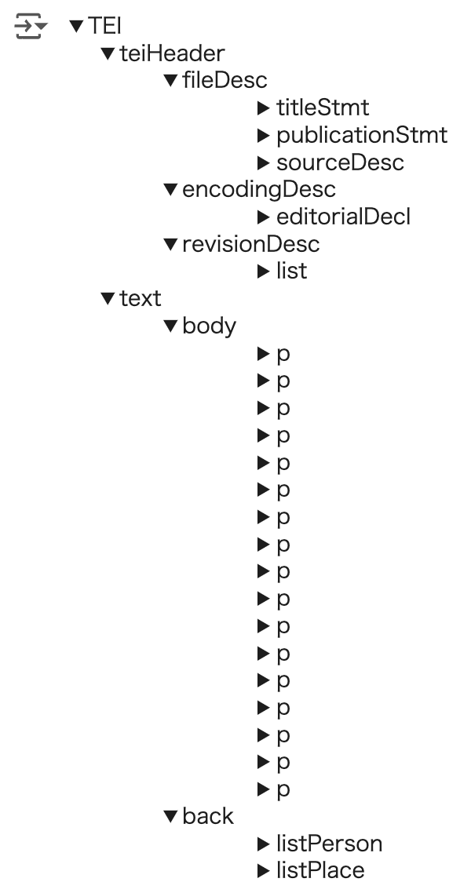
The tag hierarchy of meros.xml
Data in XML format is always structured as nested elements.
As explained so far, the TEI tag contains the teiHeader and text tags.
The teiHeader includes the fileDesc, encodingDesc, and revisionDesc tags.
The text tag contains the body, which is the main text, and the back, which includes elements other than the main text, such as supplementary material.
  The body contains seventeen p tags.
  The back contains the listPerson and listPlace tags, which store the names of characters and place names that appear in the story.
Notes:
Topic:Tag Hierarchy in meros.xml
Voice:Joanna
```text
When you run the cell, the hierarchical structure of the T E I tags is displayed in the output.
First, expand T E I, then T E I Header, and then encoding desk by clicking the triangle icons in order.
[break:"0.5s"]
You can see that the hierarchy proceeds as the encoding desk tag, the editorialDecl tag, the p tag, and the g i tag.
[break:"1s"]
Data in XML format is always nested.
For this reason, a program like this can display the tag hierarchy.
[break:"0.5s"]
From observing this XML hierarchy, we can say the following.
[break:"0.5s"]
First, as explained earlier, the T E I tag contains the T E I Header and text tags.
[break:"0.5s"]
Second, the T E I Header contains the file desk, encoding desk, and revision desk tags.
[break:"0.5s"]
Third, the text tag contains the body, which corresponds to the main text, and the back tag, which contains elements other than the main text, such as supplementary material.
[break:"0.5s"]
The body contains seventeen p tags.
[break:"0.5s"]
The back tag contains the listPerson and listPlace tags, which store the names of characters and place names that appear in the story.
```
```description
When you run the cell, the hierarchical structure of the TEI tags is displayed in the output.
Let’s click the triangle icons in order, from TEI to teiHeader, and then to encodingDesc.
You can see that the hierarchy proceeds as encodingDesc, then editorialDecl, then p, and then gi.
Data in XML format is always nested.
For this reason, a program like this can display the tag hierarchy.
From observing this XML hierarchy, we can say the following.
First, as explained earlier, the TEI tag contains the teiHeader and text tags.
Second, the teiHeader contains the fileDesc, encodingDesc, and revisionDesc tags.
Third, the text tag contains the body, which corresponds to the main text, and the back, which contains elements other than the main text, such as supplementary material.
The body contains seventeen p tags.
The back contains the listPerson and listPlace tags, which store the names of characters and place names that appear in the story.
```

Slide 21
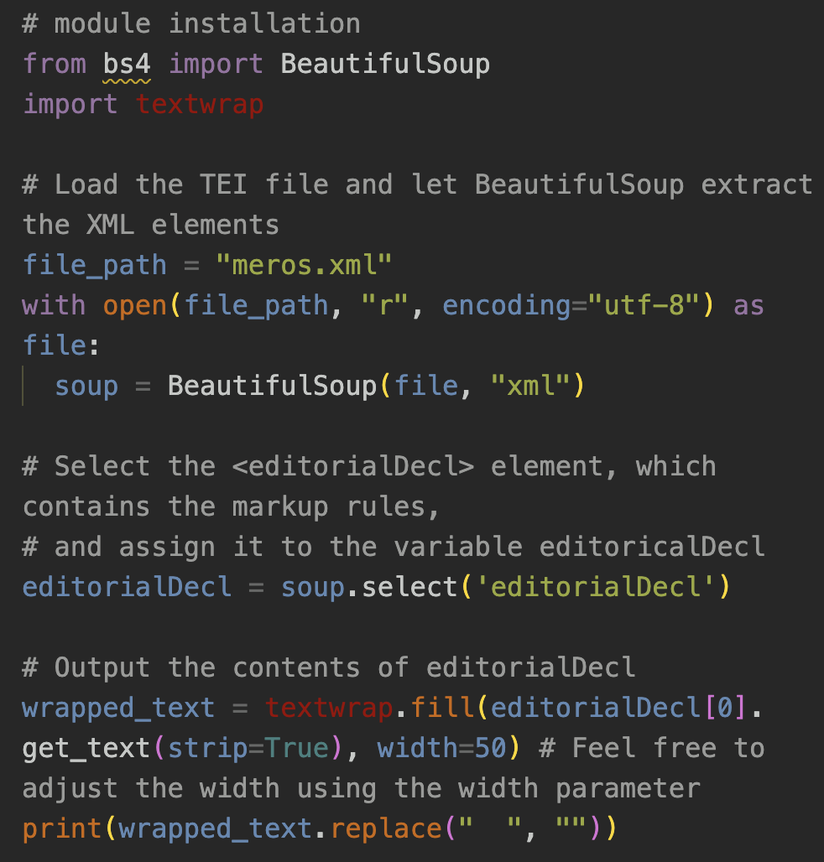
Examining the editorialDecl tag
What is editorialDecl?
A tag that describes markup rules
Results output
In the type attribute of placeName, locations that actually exist are classified as “real,” and locations that do not exist are classified as “unreal.”
The persName tag is assigned to nouns that refer to people or groups of people, excluding personal pronouns.
Personal pronouns are marked with the rs tag.
All of the tags mentioned above use the @corresp attribute to reference IDs.
Notes:
Topic:Tag Hierarchy in meros.xml
Voice:Joanna
```text
Let’s move on to the section titled “Examining the editorialDecl tag.”
If specific personal names and place names are marked up appropriately, they can be extracted mechanically even when their written forms differ.
In the editorialDecl tag of meros dot xml, markup rules are described, so let’s extract them.
When you run the program that is shown on the right side of the screen, the results are displayed based on the description on the left.
The key points of these results are as follows.
[break:"0.5s"]
First, placeName and persName are used to tag nouns referring to places and people.
[break:"0.5s"]
Second, personal pronouns are also tagged using r s.
[break:"0.5s"]
Third, all three of these tags have a corresp attribute, which allows name normalization by using their IDs.
More detailed explanations are also provided in Google Colab, so please refer to them.
```
```description
Let’s move on to the section titled “Examining the editorialDecl tag.”
If specific personal names and place names are marked up appropriately, they can be extracted mechanically even when their written forms differ.
In the editorialDecl tag of meros.xml, the markup rules are described, so let’s extract them.
When you run the program shown on the right side of the screen, the results are displayed as shown on the left.
The key points of these results are that placeName and persName are used to tag nouns referring to places and people, that personal pronouns are also tagged using rs, and that all three of these tags have a corresp attribute, which allows name normalization using their IDs.
More detailed explanations are also provided in Google Colab, so please refer to them.
```

Slide 22
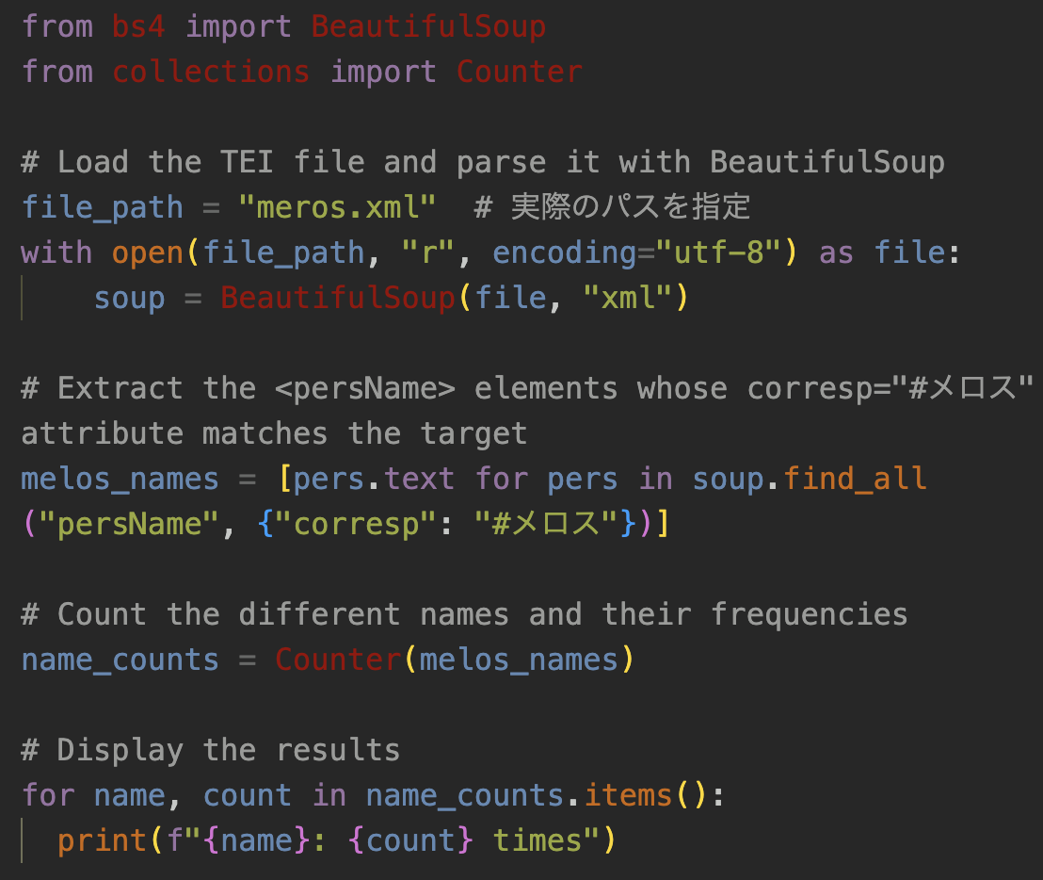
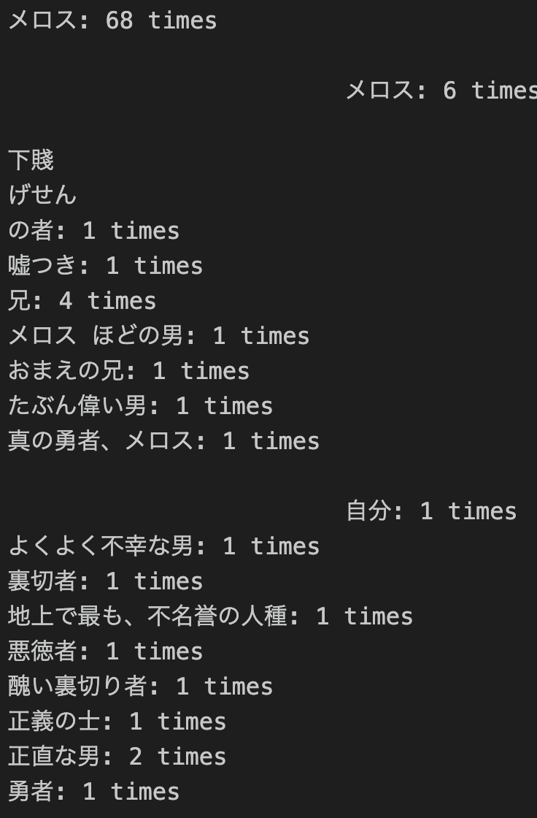
Let’s normalize names
Output→
Problematic sections
Notes:
Topic:Standardizing Personal and Place Names
Voice:Joanna
```text
In this T E I file, name normalization for personal names and place names has already been performed ,
Let’s start by making a list of how the main character, Melos, is referred to in the story.
We will also display the number of times each form of the name appears.
[break:"1s"]
The screen on the right shows the output of the program on the left.
However, the display and the counts look a little strange.
When tags are added directly to raw text, it is common for display issues like this to occur.
Let’s remove unnecessary spaces and line breaks from the names and recount them.
```
```description
In this TEI file, name normalization for personal names and place names has already been carried out.
Let’s begin by making a list of how the main character, Melos, is referred to in the story.
We will also display the number of times each form of the name appears.
The screen on the right shows the output of the program on the left.
However, the display and the counts look a little strange.
Because tags are added directly to the raw text, it is common for display issues like this to occur.
Let’s remove unnecessary spaces and line breaks from the names and then recount them.
```

Slide 23
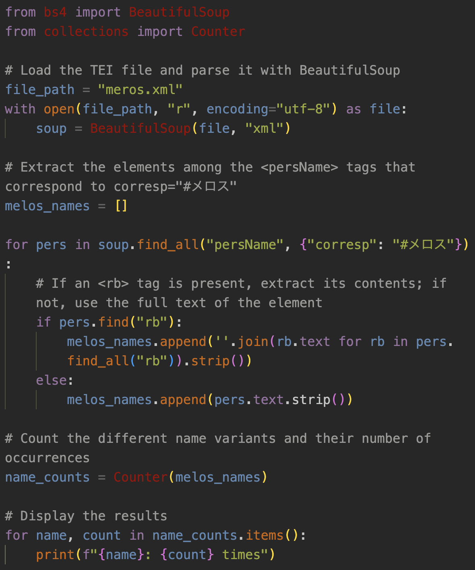
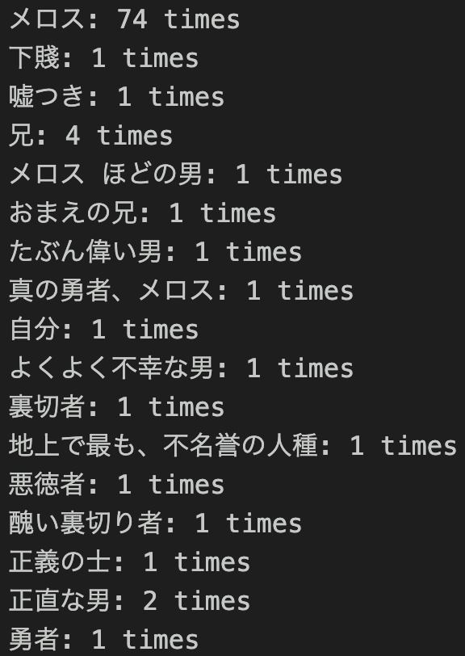
Let’s normalize names
（improved version）
12
Example of ruby annotation:
<ruby>
<rb>邪智暴虐</rb>
<rt>じゃちぼうぎゃく</rt>
</ruby>
Notes:
Topic:Standardizing Personal and Place Names
Voice:Joanna
```text
The processing from line twelve onward has been improved.
If a persName tag whose corresp attribute is Melos contains an rb tag, the text inside the rb tag is extracted and added to the melos_names variable as a personal name.
Using this improved code, the number of occurrences of each form of the name is counted correctly.
There are seventeen different forms used to refer to Melos, but all of them point to the same character.
By performing name normalization, it becomes possible to see how a character is perceived by others and how that perception changes over the course of the story.
```
```description
The processing from line twelve onward has been improved.
If a persName tag whose corresp attribute is Melos contains an rb tag, the text inside the rb tag is extracted and added to the melos_names variable as a personal name.
Using this improved code, the frequency of each form of the name is counted correctly.
There are seventeen different forms used to refer to Melos, but all of them refer to the same character.
By performing name normalization, it becomes possible to understand how a character is perceived by others and how that perception changes within the story.
```

Slide 24
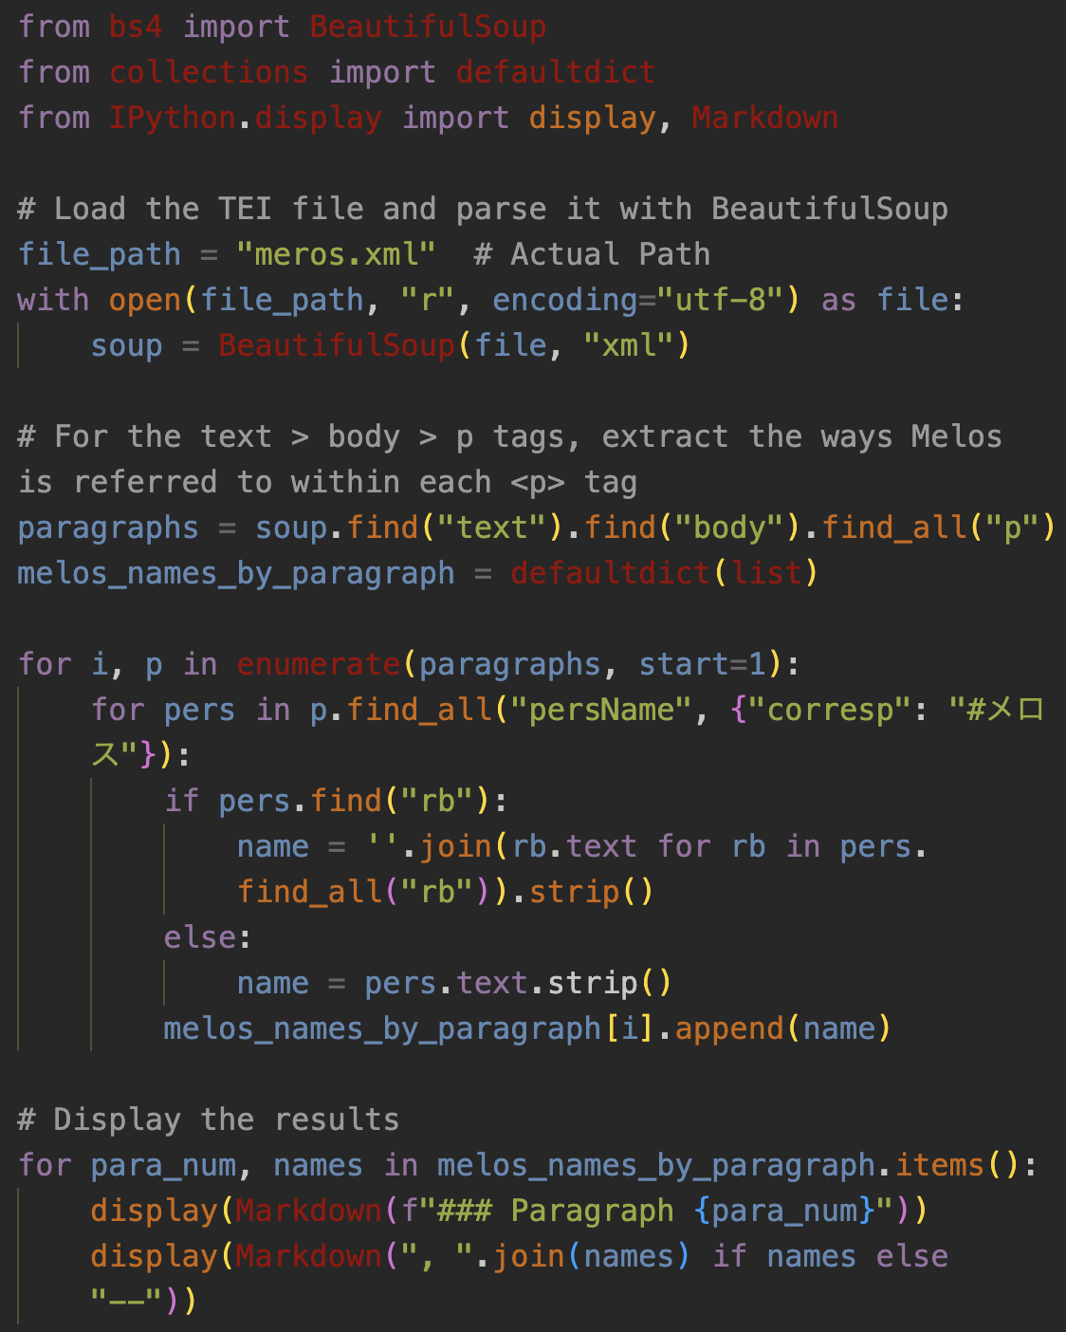
Let’s observe how Melos is referred to in each paragraph
Paragraph 1
メロス, メロス, メロス
Paragraph 2
メロス, メロス, メロス
Paragraph 3
メロス
Paragraph 4
メロス, メロス, メロス, メロス
Paragraph 5
メロス, メロス, メロス, メロス, メロス, メロス, 下賤, メロス, メロス, 嘘つき, メロス
Paragraph 6
メロス, メロス, メロス
Paragraph 7
メロス, メロス, 兄, 兄, 兄, メロス, メロス, メロス, メロス
Paragraph 8
メロス, メロス, メロス, メロス ほどの男, おまえの兄, 兄, たぶん偉い男, メロス, メロス, メロス
Paragraph 9
メロス, メロス
Paragraph 10
メロス, メロス, メロス
Paragraph 11
メロス, メロス, メロス, メロス, メロス, メロス
Paragraph 12
メロス
Paragraph 13
メロス, メロス, 真の勇者、メロス, 自分, よくよく不幸な男, 裏切者, 地上で最も、不名誉の人種, 悪徳者, 醜い裏切り者
Paragraph 14
メロス, メロス, メロス, 正義の士, 正直な男, 正直な男
Paragraph 15
メロス, メロス, メロス
Paragraph 16
メロス, メロス, メロス, メロス, メロス, メロス, メロス
Paragraph 17
メロス, メロス, メロス, メロス, メロス, メロス, メロス, メロス, メロス, メロス, メロス, メロス, 勇者
Notes:
Topic:Standardizing Personal and Place Names
Voice:Joanna
```text
This time, let’s look at how Melos is referred to in each paragraph.
Because the text may be difficult to read in the video, please refer to the output results in Google Colab as much as possible.
```
```description
This time, let’s look at how Melos is referred to in each paragraph.
Because the text may be difficult to read in the video, please refer to the output results in Google Colab as much as possible.
```

Slide 25
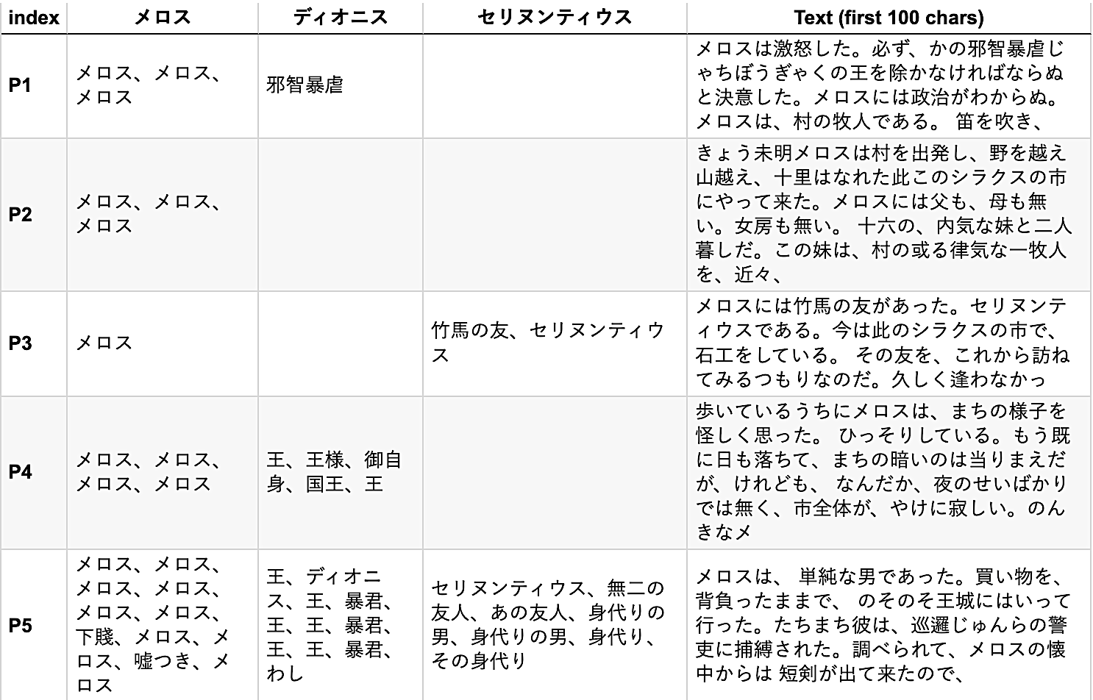
Extracting the names of Melos, Dionysius, and Selinuntius by paragraph
Notes:
Topic:Standardizing Personal and Place Names
Voice:Joanna
```text
The main characters in this story are Melos, King Dionysius, and Melos’s close friend, Selinuntius.
This time, let’s extract the ways Melos, Dionysius, and Selinuntius are referred to in each paragraph and create a table.
In this section, the program code is omitted.
The results are shown on the screen.
For detailed results up to paragraph seventeen, please refer to Google Colab.
It seems that the changes in how the characters are referred to across different scenes are most clearly visible in the case of Melos.
Next, we will introduce another useful hint that is specific to T E I.
```
```description
The main characters in this story are Melos, King Dionysius, and Melos’s close friend, Selinuntius.
This time, let’s extract the ways Melos, Dionysius, and Selinuntius are referred to in each paragraph and create a table.
In this section, the program code is omitted.
The results are shown on the screen.
For detailed results up to paragraph seventeen, please refer to Google Colab.
It appears that the changes in how the characters are referred to across different scenes are most clearly visible in the case of Melos.
Next, we will introduce another coding hint that is specific to TEI.
```

Slide 26
Co-occurrence network analysis of characters
Analyzing how often specific characters appear together (co-occurrence), paragraph by paragraph.
Steps：
Extract the characters that appear in each paragraph using the persName tag
Count pairs of character IDs that appear together in each paragraph
Create a network graph and represent co-occurrence frequency by the thickness of the edges
Selinuntius
Edge
Node
👑
Melos
Dionysius
A network graph is data that represents relationships using points, called nodes, and lines, called edges
Notes:
Topic:Co-occurrence Network Analysis of Characters
Voice:Joanna
```text
In this section, let’s analyze how often characters in the story appear together, paragraph by paragraph.
Appearing together is referred to by the technical term “co-occurrence.”
In addition, as shown in the diagram of Melos and the others on the right, a diagram that represents relationships by connecting points with lines is called a network graph.
The procedure is as follows.
First, we extract the characters that appear in each paragraph using the persName tag.
Next, for each paragraph, we count pairs of character IDs that appear together.
Finally, we create a network graph and represent the frequency of co-occurrence using the thickness of the edges.
```
```description
In this section, let’s analyze how often characters in the story appear together, paragraph by paragraph.
Appearing together is referred to by the technical term “co-occurrence.”
In addition, as shown in the diagram of Melos and the others on the right, a representation that connects points with lines to show relationships is called a network.
The procedure is as follows.
First, we extract the characters that appear in each paragraph using the persName tag.
Next, for each paragraph, we count pairs of character IDs that appear together.
Finally, we create a network graph and represent the frequency of co-occurrence using the thickness of the edges.
```

Slide 27
Preparing for character co-occurrence network analysis
Preparation
Load the required libraries
Necessary Libraries
NetworkX: This is a powerful Python library for working with network graph structures. It is designed to create, manipulate, analyze, and visualize networks composed of nodes, which are points, and edges, which are lines.
matplotlib: This is a representative Python library for data visualization. It is particularly strong in creating two-dimensional graphs and can draw a wide range of visualizations, from simple line graphs to complex heatmaps and three-dimensional plots.
Notes:
Topic:Co-occurrence Network Analysis of Characters
Voice:Joanna
```text
First, as preparation, we load the libraries that are required.
Here, we use NetworkX and Matplotlib.
NetworkX is a powerful library for working with network graph structures in Python.
It is designed to create, manipulate, analyze, and visualize network graphs composed of nodes, which are points, and edges, which are lines.
Matplotlib is a Python library for data visualization.
It is particularly well suited for creating two-dimensional graphs and can draw a wide variety of visualizations, from simple line graphs to complex heatmaps and three-dimensional plots.
```
```description
First, as preparation, we load the required libraries.
Here, we use NetworkX and Matplotlib.
NetworkX is a powerful library for working with network graph structures in Python.
It is designed to create, manipulate, analyze, and visualize network graphs composed of nodes, which are points, and edges, which are lines.
Matplotlib is a representative Python library for data visualization.
It is particularly well suited for creating two-dimensional graphs and can draw a wide variety of visualizations, from simple line graphs to complex heatmaps and three-dimensional plots.
```

Slide 28
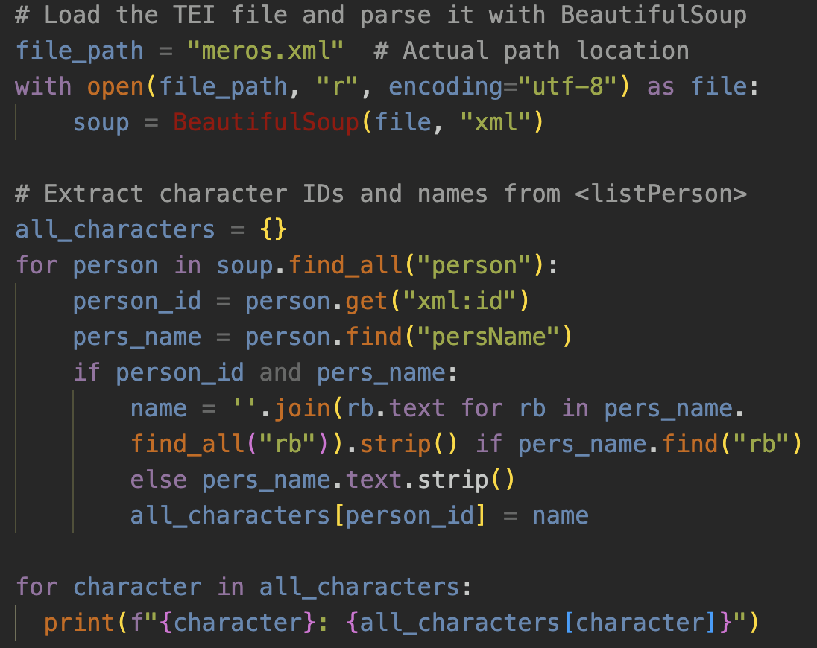
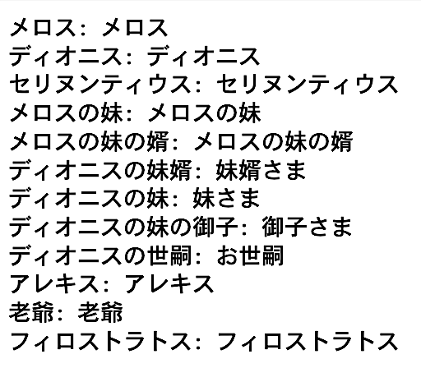
Extracting the characters that appear in the story
(meros.xmlより）
<listPerson>
<person xml:id="メロス">
<persName>メロス</persName>
<occupation>牧人</occupation>
</person>
8
Notes:
Topic:Co-occurrence Network Analysis of Characters
Voice:Joanna
```text
Next, we extract the characters that appear in the story.
Here, the IDs assigned to each character and their actual name forms are stored in the listPerson tag near the end of the meros xml file.
We organize this information into a variable called all_character and create a list, as shown on the right.
On line eight, all person tags are extracted from the data.
At the same time, on lines nine and ten, the name entered in xml I d, which serves as the ID, and the actual name entered in persName are combined into a single name set.
These name sets are then repeatedly added to the all_character variable.
```
```description
Next, we extract the characters that appear in the story.
Here, the IDs assigned to the characters and the actual names by which they are referred to are stored in the listPerson tag near the end of the meros.xml file.
We organize this information into a variable called all_character and create a list, as shown on the right.
On line eight, all person tags are extracted from the data.
At the same time, on lines nine and ten, the ID name entered in xml:id and the actual name entered in persName are combined into a single name set, which is then repeatedly added to all_character.
```

Slide 29
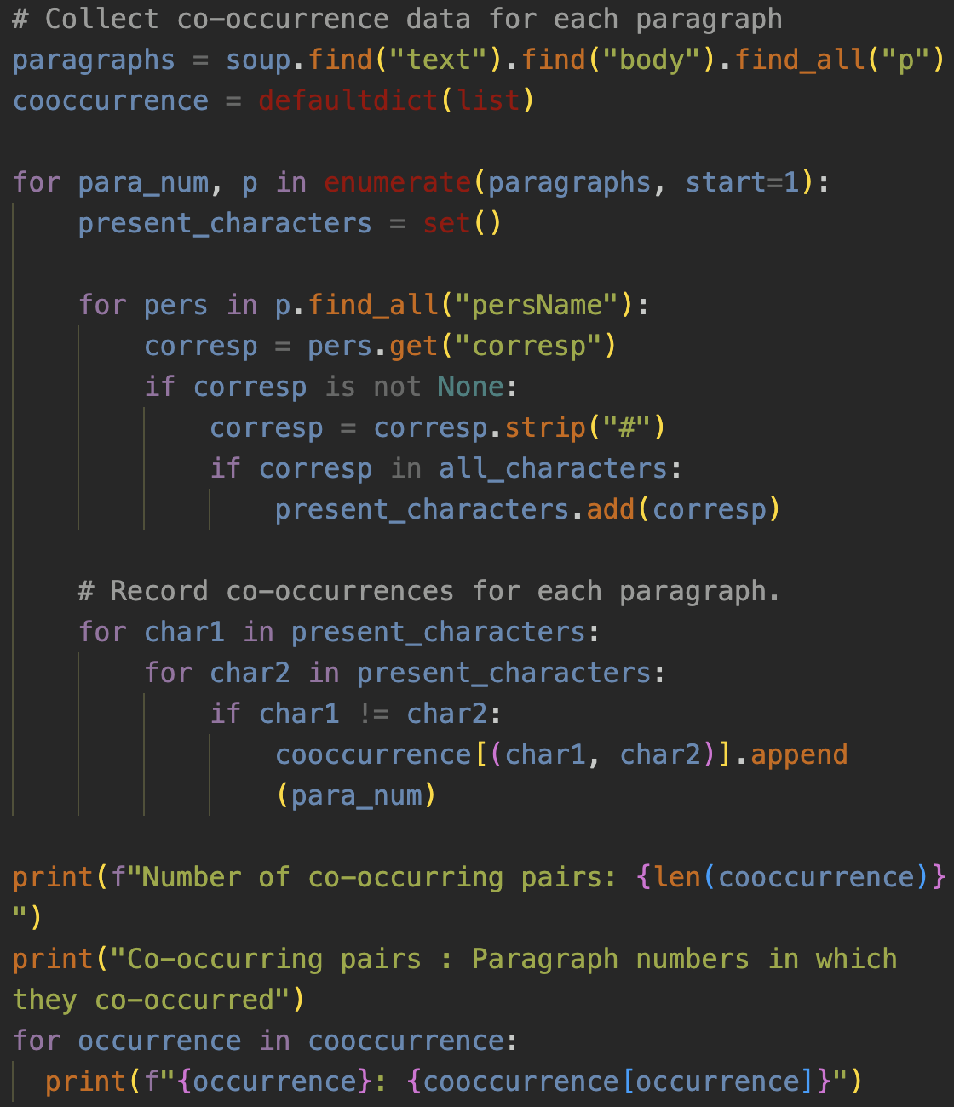
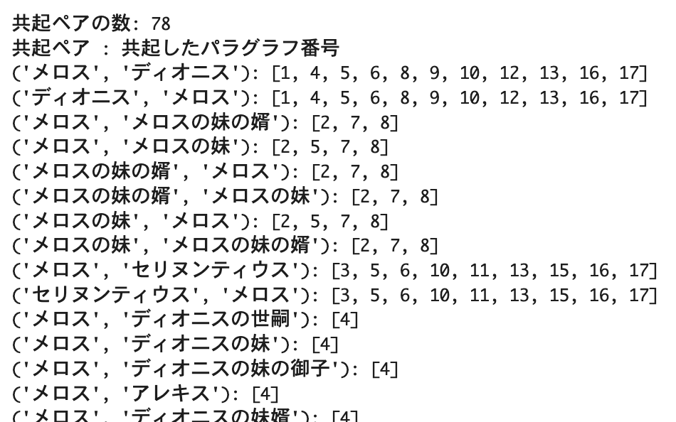
Name normalization using the ID in the corresp attribute
8
9
By checking the corresp attribute, we can identify whose name it is by its ID.
Notes:
Topic:Co-occurrence Network Analysis of Characters
Voice:Joanna
```text
Next, we check which paragraphs contain each combination of characters from the list shown above.
To do this, on line eight, we extract the character names that appear in each paragraph of the main text.
These names are enclosed by persName tags.
The character names have already been researched and tagged by the person who prepared this data.
In addition, on line nine, the value inside the corresp attribute corresponds to the xml I d shown on an earlier slide.
In other words, regardless of how a character is referred to in the text, we can identify which character it is by checking the ID in the corresp attribute.
When this program is run, the results shown on the right are produced, displaying the paragraph numbers in which each pair of characters co-occurs.
```
```description
Next, we examine which paragraphs contain each combination of characters from the list shown above.
To do this, on line eight, we extract the character names enclosed by persName tags that are used in each paragraph of the main text.
These character names were researched in advance and tagged by the person who prepared this data.
In addition, on line nine, the value inside the corresp attribute corresponds to the xml:id shown on an earlier slide.
In other words, no matter how a character is referred to in the text, we can identify which character it is by checking the ID in the corresp attribute.
When this program is run, the results shown on the right are displayed, showing each pair of characters and the paragraph numbers in which they co-occur.
```

Slide 30
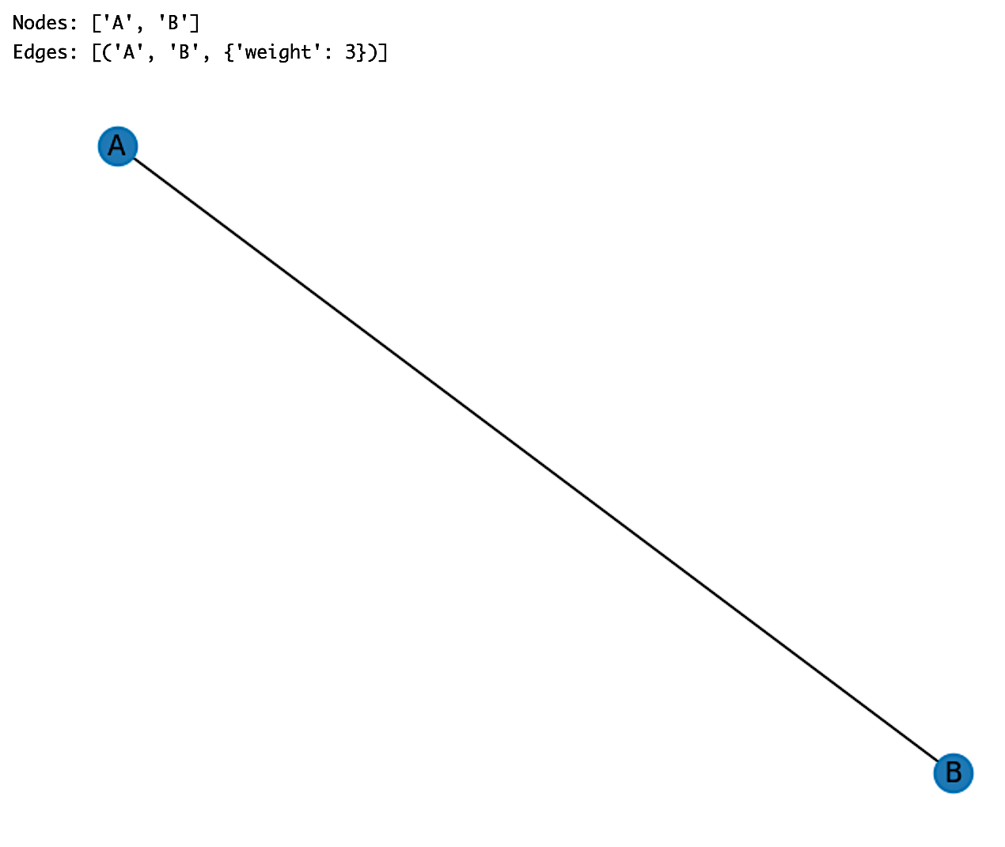
Fundamentals of NetworkX
Please refer directly to the sections from “What is NetworkX?” to “Code explanation” in the Google Colab notebook “TEI_hands-on-EN.ipynb”.
These sections explain the basics of drawing edges between nodes.
It’s okay to move on to the next video for now.
Notes:
Topic:Co-occurrence Network Analysis of Characters
Voice:Joanna
```text
Now that we know which pairs of characters co-occur and the paragraph numbers in which they appear, let’s use a library called NetworkX to draw them on the screen.
For an explanation of NetworkX itself, please refer directly to the sections from, “What is a Network”, to “Explanation of the Code”, in the Google Colab notebook titled T E I hands-on E N.
These sections explain the basics of drawing edges between nodes.
It is also fine to move on to the next video for now.
```
```description
Now that we know which pairs of characters co-occur and the paragraph numbers in which they appear, let’s use a library called NetworkX to draw them on the screen.
For an explanation of NetworkX itself, please refer directly to the sections from “What is a Network”, to “Explanation of the Code” in the Google Colab notebook titled T E I hands-on E N.
These sections explain the basics of drawing edges between nodes.
It is fine to move on to the next video for now.
```

Slide 31
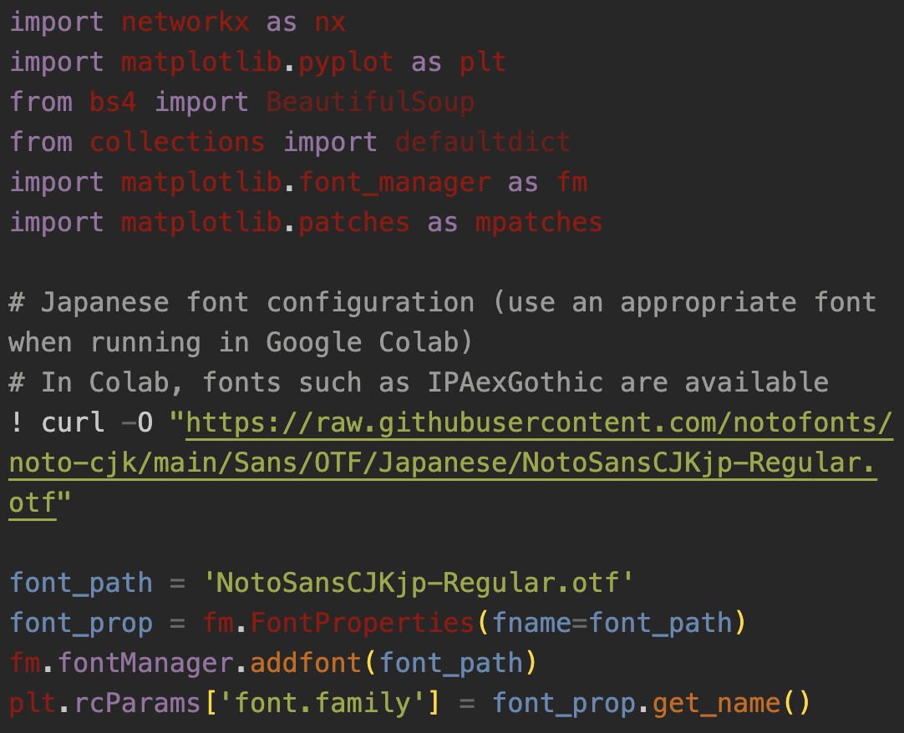
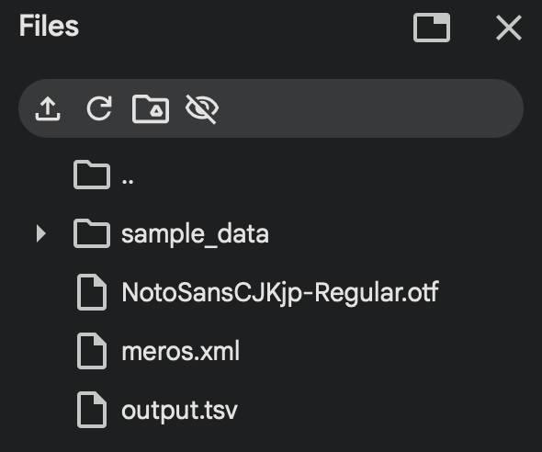
Visualizing character co-occurrence by paragraph using NetworkX (1)
Notes:
Topic:Co-occurrence Network Analysis of Characters
Voice:Joanna
```text
Now, we will finally use NetworkX to display the co-occurring character pairs in Run, Melos! and their co-occurrence frequencies, color-coded by paragraph.
In the notebook, the program is divided into two parts.
First, in order to display Japanese text, it is necessary to download a Japanese font.
Please run the first program in Colab in advance.
Like other data, the font will be downloaded to Colab’s temporary file storage.
```
```description
Now, we will finally use NetworkX to display the co-occurring character pairs in Run, Melos! and their co-occurrence frequencies, color-coded by paragraph.
In the notebook, the program is divided into two parts.
First, to display Japanese text, we need to download a Japanese font.
Please run the first program in Colab in advance.
Like other data, the font will be downloaded to Colab’s temporary file storage.
```

Slide 32
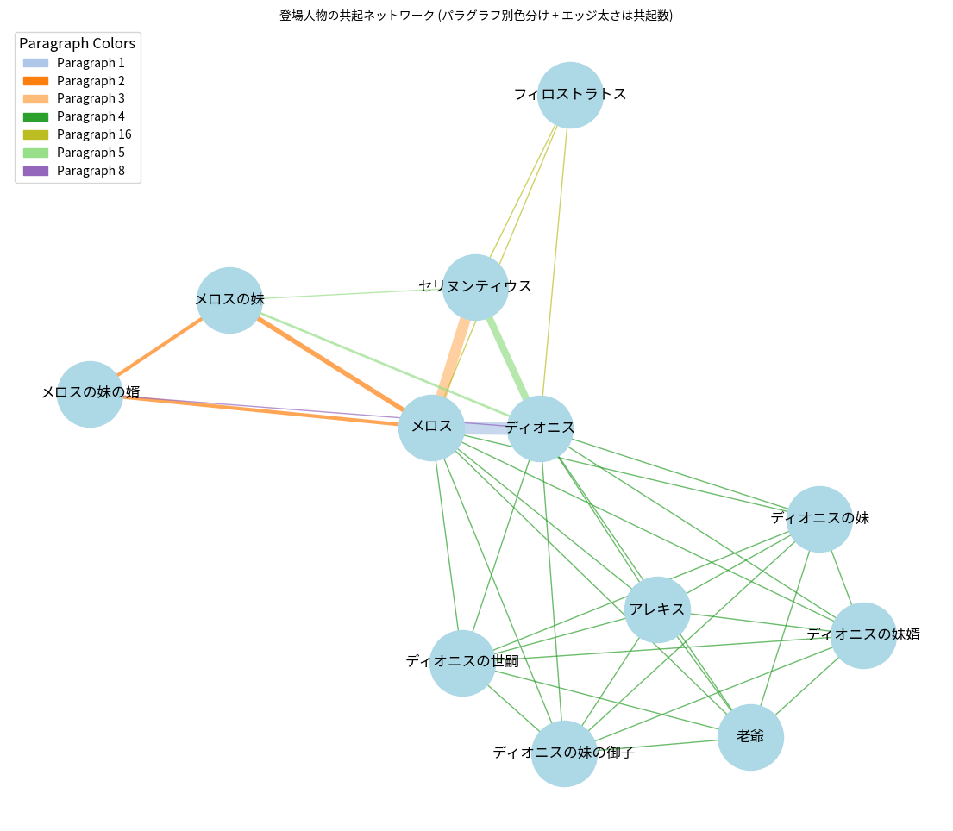
Visualizing character co-occurrence by paragraph using NetworkX (2)
How to read this graph:
Edges between characters
thickness
number
color variety
These reveal relationship importance, character importance, and changes in relationships over the course of the story.
For deeper analysis, compare the network with the content of each paragraph.
↑Legend
Overall view of the
co-occurrence graph
Notes:
Topic:Co-occurrence Network Analysis of Characters
Voice:Joanna
```text
After downloading the Japanese font, press the final run button to visualize the co-occurrence network.
Did you get a graph like the one shown on the screen?
The light blue nodes represent characters.
Each edge indicates that two characters appear together in the same paragraph, that is, their “co-occurrence.”
In addition, the thickness of each edge shows the frequency of co-occurrence.
The thicker the edge, the more often the characters appear together in the same paragraph.
The color of each edge indicates the paragraph in which the co-occurrence occurs.
The corresponding legend is shown on the graph.
For a more detailed explanation, please read the notebook.
For example, by clearly seeing the thickness of the edges,
[break:"0.5s"]
the number of edges,
[break:"0.5s"]
and the variety of colors,
[break:"0.5s"]
we can understand the importance of relationships between specific characters,
[break:"0.5s"]
the importance of characters within the story,
[break:"0.5s"]
and changes in human relationships as the narrative develops.
[break:"1s"]
If more detailed analysis is needed, these relationships can be explored further by comparing them with the specific content of each paragraph.
```
```description
After downloading the Japanese font, press the final run button to visualize the co-occurrence network.
Did you get a graph like the one shown on the screen?
The light blue nodes represent characters.
Each edge shows that two characters appear together in the same paragraph, in other words, their “co-occurrence.”
In addition, the thickness of each edge indicates the frequency of co-occurrence.
Thicker edges mean that the characters appear together more often in the same paragraph.
The color of each edge shows in which paragraph the co-occurrence occurs.
The corresponding legend is displayed on the graph.
For a more detailed explanation, please read the notebook.
For example, by clearly seeing the thickness of the edges, the number of edges, and the variety of colors, we can understand the importance of relationships between specific characters, the importance of characters within the story, and changes in relationships as the narrative develops.
If more detailed analysis is needed, these relationships can be explored further by comparing them with the specific content of each paragraph.
```

Slide 33
Summary
An introductory text analysis using Run, Melos
The notebook can be copied and adapted to TEI files of other works
Notes:
Topic:Co-occurrence Network Analysis of Characters
Voice:Joanna
```text
This video introduced text analysis using the T E I version of Run, Melos.
The notebook can be copied and adapted for creating T E I versions of other works.
```
```description
This video introduced text analysis using the TEI version of Run, Melos.
The notebook can be copied and adapted for creating TEI versions of other works.
```

