Slide 1
Case Studies: Applications of TEI in Humanities Research
Notes:
Topic: Case Studies
Voice:Joanna
```text
T E I isn’t just useful for making text easier to analyze.
Its most important role is helping researchers highlight and communicate what matters in their sources.
This section presents examples of how T E I has been applied in humanities research.
```
```description
TEI isn’t just useful for making text easier to analyze.
Its most important role is helping researchers highlight and communicate what matters in their sources.
This section presents examples of how TEI has been applied in humanities research.
```

Slide 2
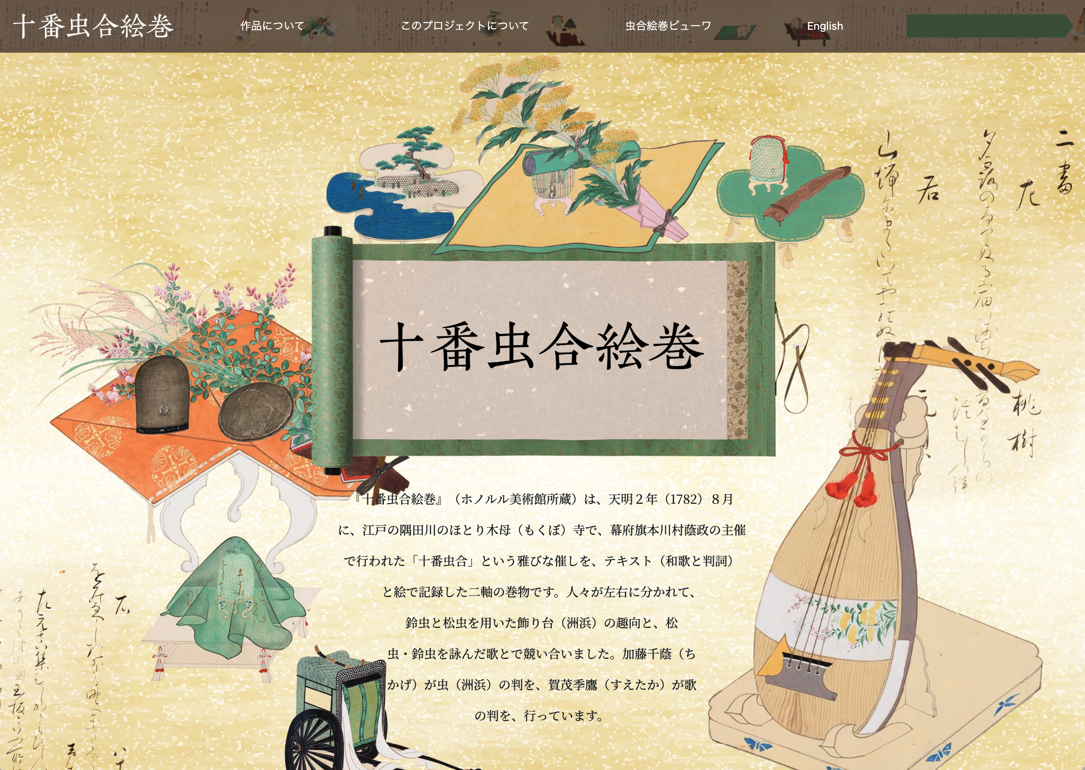
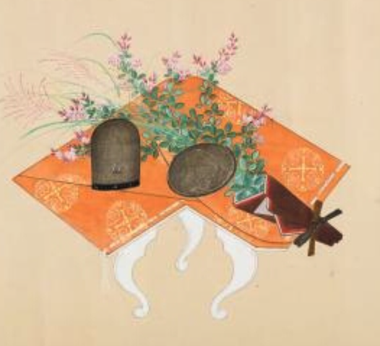
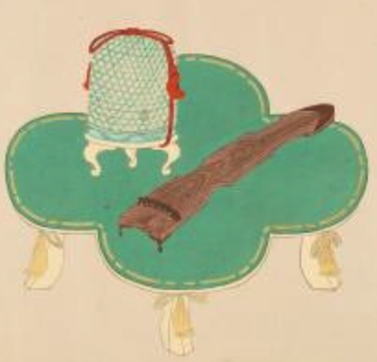
Jūban Mushi Awase Emaki (Held by the Honolulu Museum of Art)
https://juban-mushi-awase.dhii.jp/index.html
Jūban Mushi Awase Emaki (Held by the Honolulu Museum of Art)
A refined event called “Jūban Mushi Awase” was held in August of 1782 at Mokubo Temple in Edo (now Tokyo).
Participants split into two sides and showcased display stands arranged with bell crickets, pine crickets and various flowers, and competed by composing waka poems related to them.
Example of a kazari –dai（display stand）
Notes:
Topic: Case Studies in Japan
Voice:Joanna
```text
First, as a domestic Japanese example, we will introduce Jūban Mushi Awase Emaki. Emaki means a picture scroll.
Jūban Mushi Awase Emaki is a picture scroll, which is what Emaki means, held by the Honolulu Museum of Art, and it depicts an event called “Jūban Mushi Awase,” held in August of 1782 at Mokubo Temple on the banks of the Sumida River in Edo (what is now Tokyo).
Participants split into two sides and showcased decorative platforms arranged with bell crickets, pine crickets and various flowers, and competed by composing waka poems related to them.
```
```description
First, as a domestic Japanese example, we will introduce Jūban Mushi Awase Emaki. (https://juban-mushi-awase.dhii.jp/index.html)
Jūban Mushi Awase Emaki is a picture scroll, which is what Emaki means, held by the Honolulu Museum of Art, and it depicts an event called “Jūban Mushi Awase,” held in August of 1782 at Mokubo Temple on the banks of the Sumida River in Edo (what is now Tokyo).
Participants split into two sides and showcased display stands arranged with bell crickets, pine crickets and various flowers, and competed by composing waka poems related to them.
```

Slide 3
Expressing the World of Picture Scrolls with TEI
Led by the project “International Research on the Revival of Classical Texts in 18th- and 19th-Century Japan”
Characteristics of TEI Data
  The content of the picture scrolls (text, structure, content, people, kazari-dai (display stand) illustrations) is structured with TEI so that people around the world can engage with it
  The TEI data is divided into English, modern Japanese, and original text versions.
  https://juban-mushi-awase.dhii.jp/xmls/
  These versions are synchronized in the viewer, allowing users to view the same passage across all three simultaneously.
Notes:
Topic: Case Studies in Japan
Voice:Joanna
```text
To help people around the world engage with the content of this picture scroll, an international research team working on the revival of classical texts in 18th and 19th century Japan took the lead in creating T E I-formatted data.
This T E I data is available in three versions, English, modern Japanese, and the original text.
The custom viewer synchronizes the original, modern Japanese, and English T E I versions, allowing users to view the same passage across all three simultaneously.
```
```description
To help people around the world engage with the content of this picture scroll, an international research team working on the revival of classical texts in 18th and 19th century Japan took the lead in creating TEI-formatted data.
This TEI data is available in three versions, English, modern Japanese, and the original text.
The custom viewer synchronizes the original, modern Japanese, and English TEI versions, allowing users to view the same passage across all three simultaneously.
[Jūban Mushi Awase TEI Data](https://juban-mushi-awase.dhii.jp/xmls/)
```

Slide 4
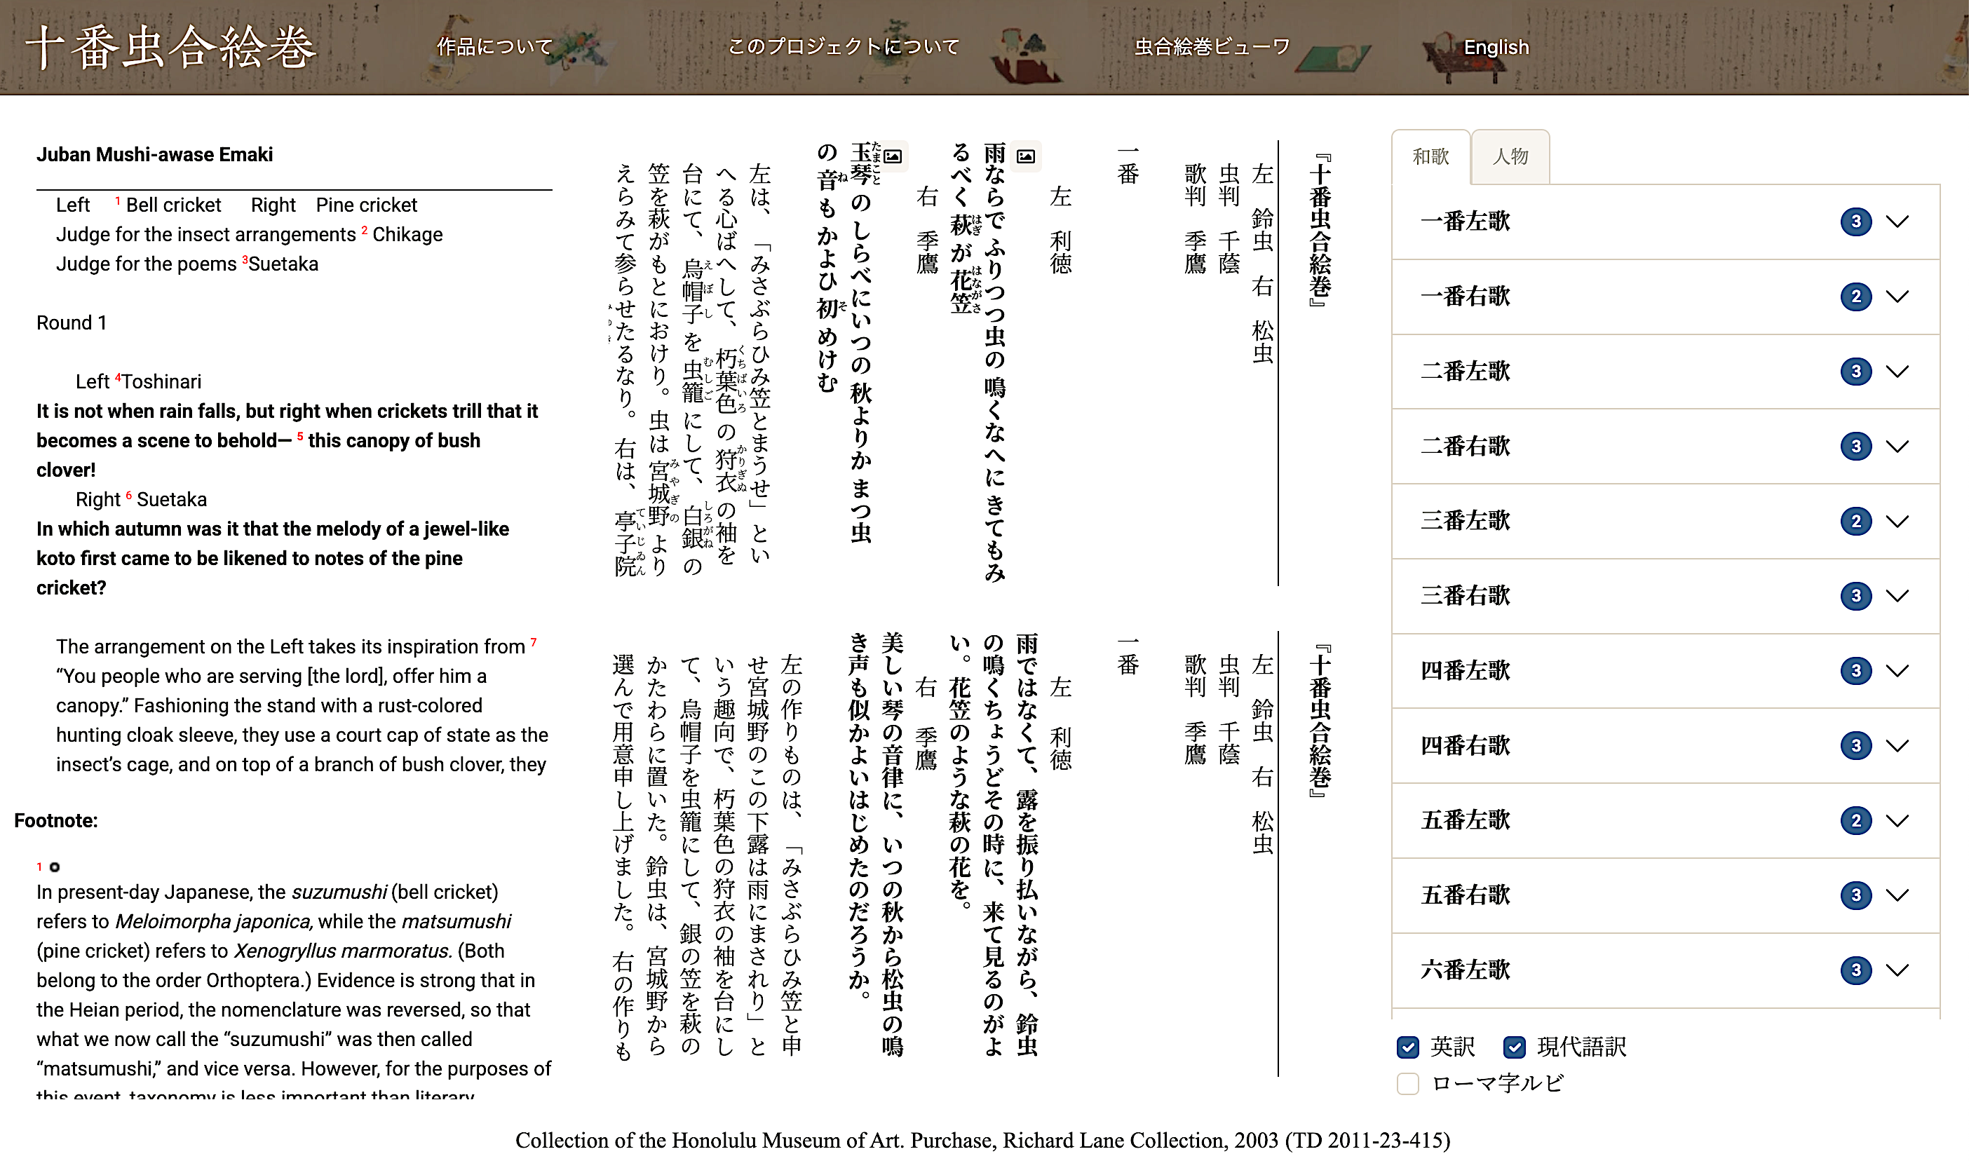
Notes:
Topic: Case Studies in Japan
Voice:Joanna
```text
Let’s take a closer look.
When you open the viewer in the website of Jūban Mushi Awase Emaki, it looks like this.
On the left is the English translation; in the center, the upper section shows the original text, and the lower section provides a modern Japanese explanation.
On the right side of the screen, you’ll find a table of contents for each poem contest and a list of characters.
```
```description
Let’s take a closer look.
When you open the viewer in the website of Jūban Mushi Awase Emaki, it looks like this.
On the left is the English translation; in the center, the upper section shows the original text, and the lower section provides a modern Japanese explanation.
On the right side of the screen, you’ll find a table of contents for each poem contest and a list of characters.
```

Slide 5
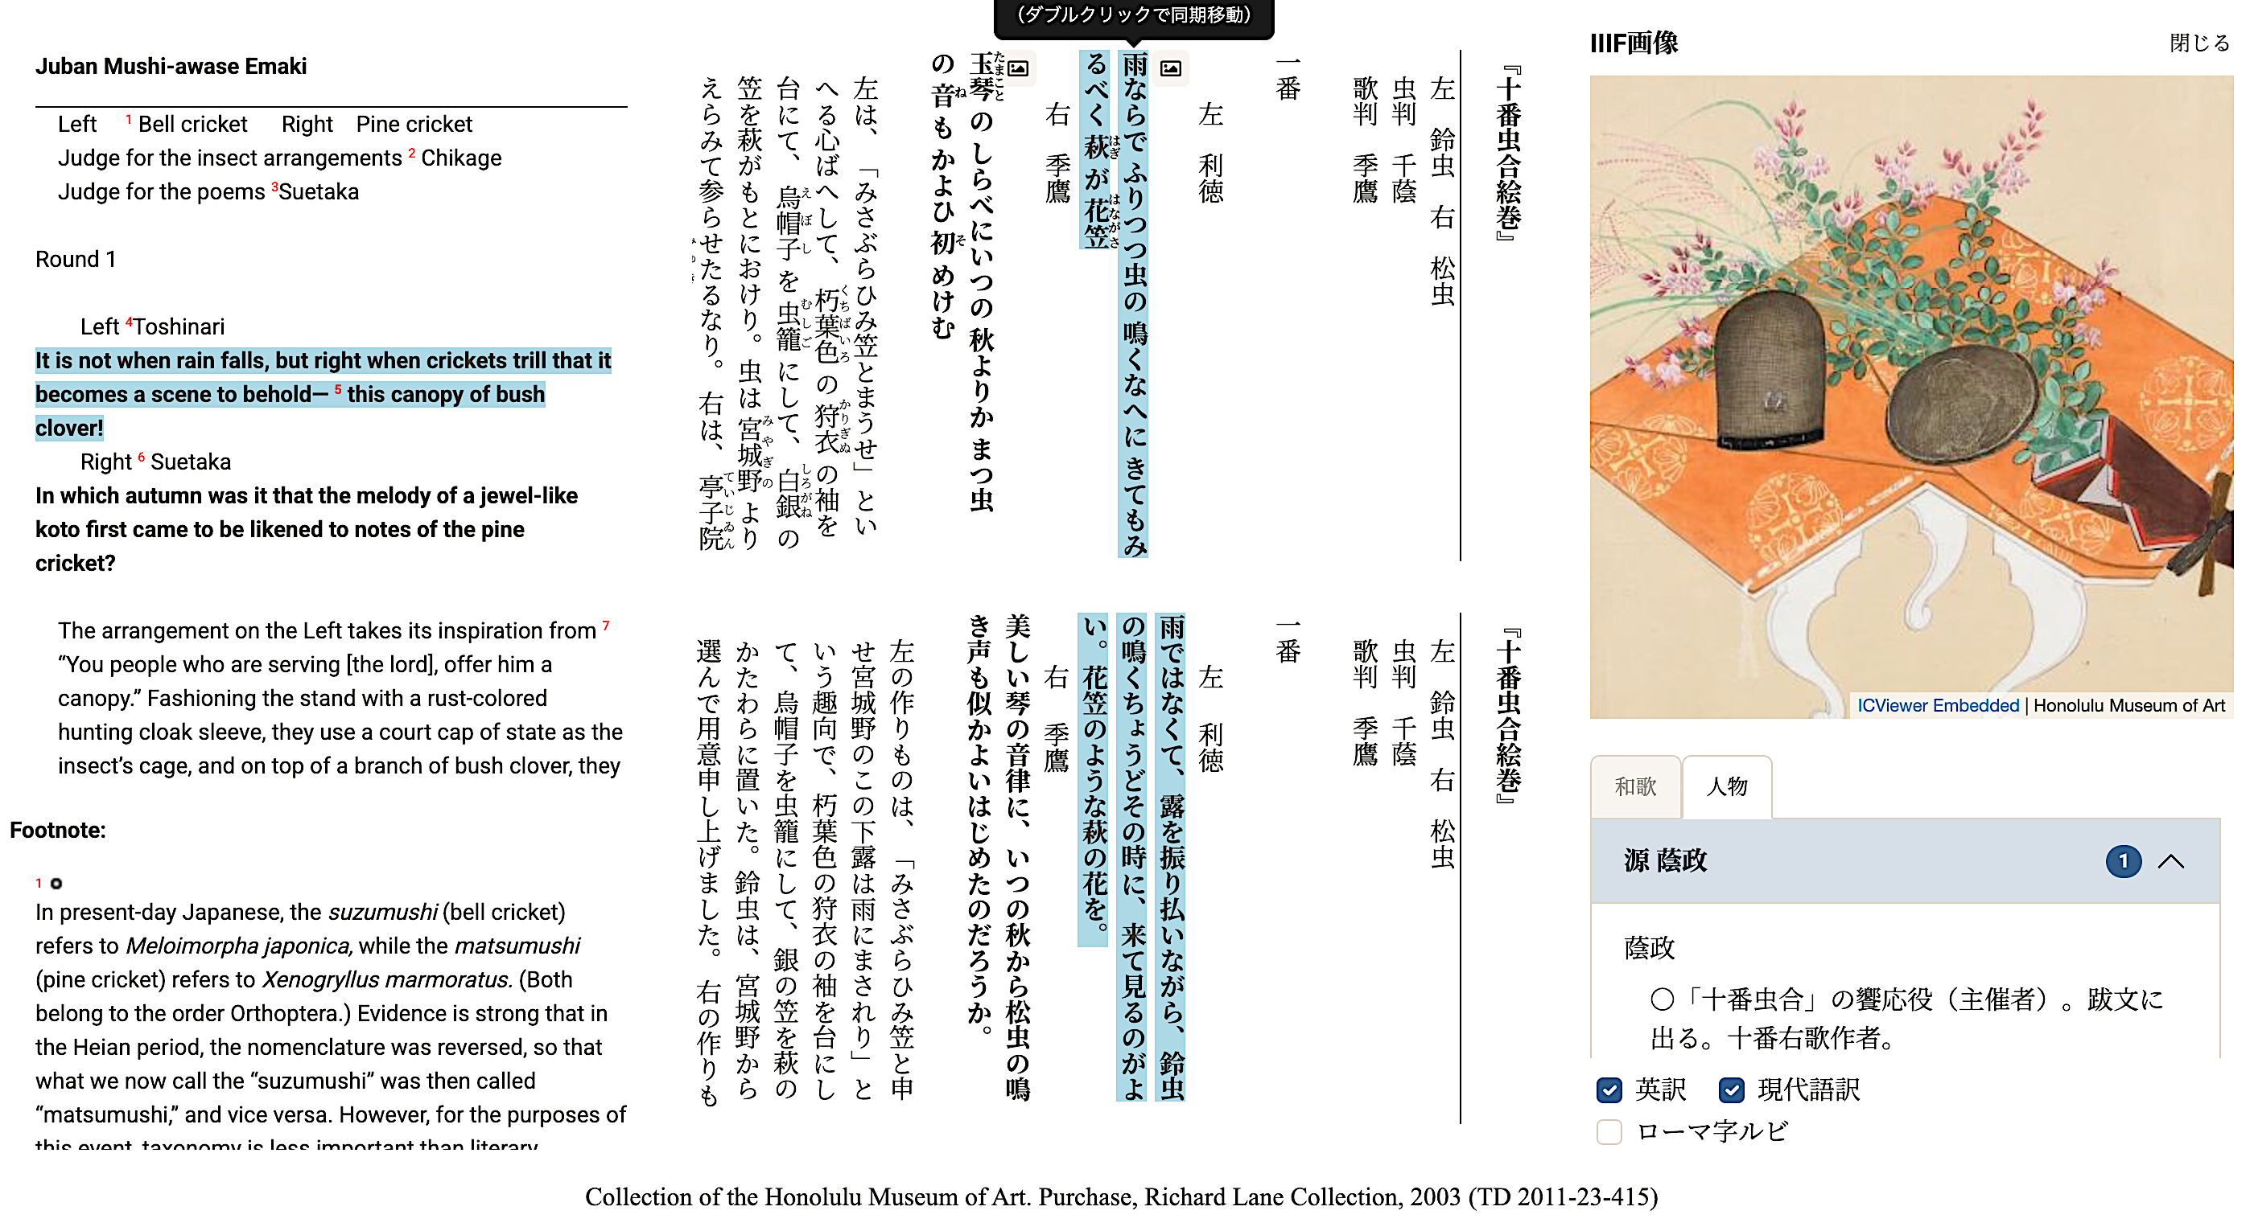


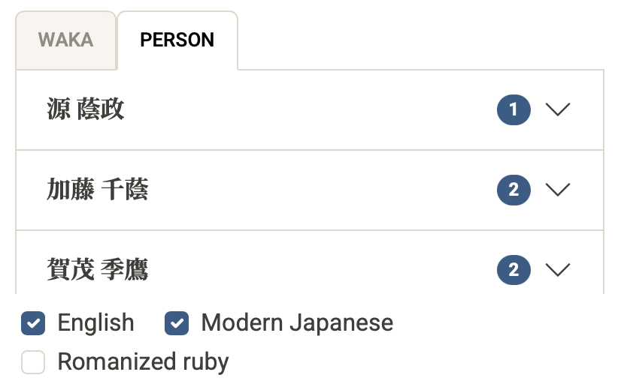
Double click to move in sync across all language versions
Display Image
Notes:
Topic: Case Studies in Japan
Voice:Joanna
```text
The red-framed area on the screen shows the content of each poetry match.
In the first round, the left side is represented by Doy Toshinari and the right by Kamo Suetaka. Each show a display stand, one for bell crickets, the other for pine crickets, and compose waka poems.
Double-clicking on a waka brings up synchronized views of the original text, modern Japanese, and English translations.
Clicking the icon marked with a red circle displays an illustration of the display stand on the right. You can also click the “People” tab in the bottom right corner to read explanations about the characters featured in the scroll.
```
```description
The red-framed area on the screen shows the content of each poetry match.
In the first round, the left side is represented by Doi Toshinari and the right by Kamo Suetaka. Each show a display stand, one for bell crickets, the other for pine crickets, and compose waka poems.
Double-clicking on a waka brings up synchronized views of the original text, modern Japanese, and English translations.
Clicking the icon marked with a red circle displays an illustration of the display stand on the right. You can also click the “People” tab in the bottom right corner to read explanations about the characters featured in the scroll.
```

Slide 6
The Benefits of the TEI Data created from Jūban Mushi Awase Emaki
In this way, the TEI data created from the Jūban Mushi Awase Emaki succeeds in clearly and concretely conveying the elegant nature of the contest, which combines cricket sounds, decorations, and waka poetry, to most people in the world who cannot read the original text.
Because TEI data is freely downloadable and reusable, anyone can develop an alternative viewer and experiment with new ways to present the material.
TEI makes it possible to specify exactly which parts of the scroll are being analyzed, which is useful for researchers.
Researchers can even customize the display to suit their own research needs.
Notes:
Topic: Case Studies in Japan
Voice:Joanna
```text
In this way, the T E I data created from the Jūban Mushi Awase Emaki succeeds in clearly and concretely conveying the elegant nature of the contest, which combines cricket sounds, decorations, and waka poetry, to most people in the world who cannot read the original text.
Because T E I data is freely downloadable and reusable, anyone can develop an alternative viewer and experiment with new ways to present the material.
For research use, it makes it possible to specify exactly which parts of the scroll are being analyzed.
Researchers can even customize the display to suit their own research needs.
```
```description
In this way, the TEI data created from the Jūban Mushi Awase Emaki succeeds in clearly and concretely conveying the elegant nature of the contest, which combines cricket sounds, decorations, and waka poetry, to most people in the world who cannot read the original text.
Because TEI data is freely downloadable and reusable, anyone can develop an alternative viewer and experiment with new ways to present the material.
For research use, it makes it possible to specify exactly which parts of the scroll are being analyzed.
Researchers can even customize the display to suit their own research needs.
```

Slide 7
TEI Viewer for EAJ
https://tei.dhii.jp/teiviewer4eaj
A tool that enables digitized classical texts to be imported in TEI format and easily viewed, searched, and annotated online.
It is freely available via the TEI古典籍ビューワ “TEI Classical Text Viewer” website (in Japanese).
Main Features
Displays not only text content but also transcriptions, annotations, and structural elements such as chapters and sections.
Allows synchronized viewing with image data (scanned originals of classical texts).
Notes:
Topic: Case Studies in Japan
Voice:Joanna
```text
Next, let’s look at the T E I Classical Text Viewer.
This viewer allows users to load T E I-formatted materials and easily view, search, and annotate them online.
It was also used for the Juban Mushi Awase picture scroll shown earlier, and is free to use.
Key features include support for displaying transcriptions, annotations, and structural elements like chapters and sections.
It also supports synchronized viewing with image data (scans of the original classical texts).
```
```description
Next, let’s look at the TEI Classical Text Viewer.
This viewer allows users to load TEI-formatted materials and easily view, search, and annotate them online.
[Classical Text Viewer, in Japanese](https://tei.dhii.jp/teiviewer4eaj)
It was also used for the Juban Mushi Awase picture scroll shown earlier, and is free to use.
Key features include support for displaying transcriptions, annotations, and structural elements like chapters and sections.
It also supports synchronized viewing with image data (scans of the original classical texts).
```

Slide 8
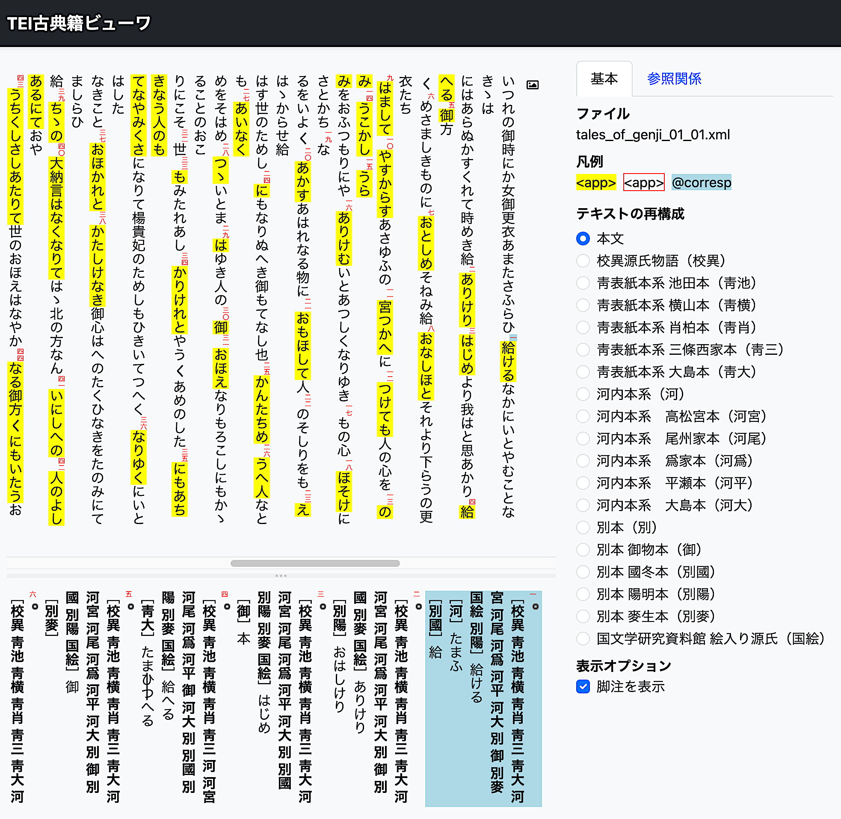

Beginning section of Koui Genji Monogatari (example)
Base Text
Comparative References
File
Legend
Beginning section of the Koui Genji Monogatari (Collated Genji Monogatari)
https://candra.dhii.jp/nagasaki/tei/tei_viewer/?file=tales_of_genji_01_01.xml
Textual variant (校異, koui) mark
Textual Variant: comparing differences among multiple textual sources.
Textual Differences and Annotation Section
Highlights where the same passage is written differently in each version of the text.
Notes:
Topic: Case Studies in Japan
Voice:Joanna
```text
Here, let’s take a look at the actual collation data from the beginning of Genji Mono gatari, or The Tale of Genji. Collation refers to comparing textual differences across multiple manuscripts.
On the left side of the screen, in the main text area, the famous opening line is displayed. If you click the annotation or collation markers scattered throughout the text, the differences and notes will appear.
For example, when a different manuscript has slightly different characters or uses a different notation, you can easily switch between them and check.
Such functions are very useful when writing papers and wanting to compare different manuscripts. In the case of The Tale of Genji, which survives in many versions, this viewer, which is based on T E I-formatted data, makes it easy to identify those differences.
Furthermore, because annotations and transcription information are also displayed alongside the text, it is easy to compare with modern translations or past research.
Try pressing the buttons or opening the annotation tab to see the detailed collation information for yourself. Examples like this clearly show how T E I contributes not just to digitizing texts, but also to deeper, multifaceted research.
```
```description
Here, let’s take a look at the actual collation data from the beginning of Genji Monogatari, or The Tale of Genji. Collation refers to comparing textual differences across multiple manuscripts.
On the left side of the screen, in the main text area, the famous opening line “Izure no oon-toki ni ka…” is displayed. If you click the annotation or collation markers scattered throughout the text, the differences and notes will appear.
For example, when a different manuscript has slightly different characters or uses a different notation, you can easily switch between them and check.
Such functions are very useful when writing papers and wanting to compare different manuscripts. In the case of The Tale of Genji, which survives in many versions, this viewer, which is based on TEI-formatted data, makes it easy to identify those differences.
Furthermore, because annotations and transcription information are also displayed alongside the text, it is easy to compare with modern translations or past research.
Try pressing the buttons or opening the annotation tab to see the detailed collation information for yourself. Examples like this clearly show how TEI contributes not just to digitizing texts, but also to deeper, multifaceted research.
Reference: [校異源氏物語冒頭部分の例](https://candra.dhii.jp/nagasaki/tei/tei_viewer/?file=tales_of_genji_01_01.xml)
```

Slide 9
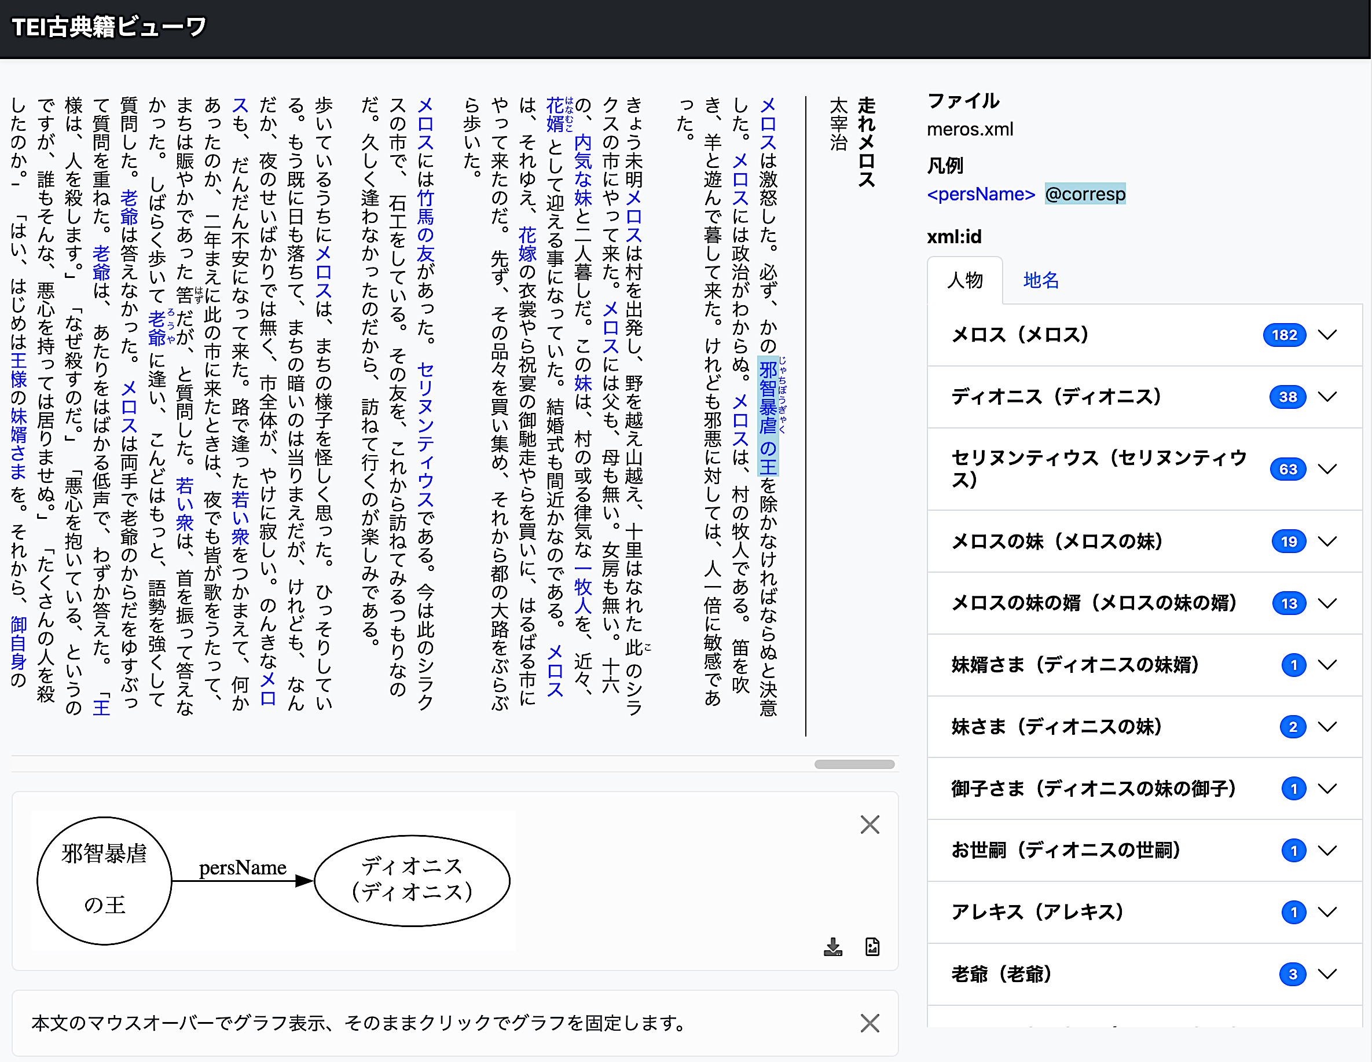

Run, Melos!
(example)
File
Legend
Run, Melos!
https://candra.dhii.jp/nagasaki/tei/tei_viewer_custom/?file=meros.xml
Characters
Place Names
Dionysius
This viewer also uses the TEI file from the hands-on session “Text Analysis with Run, Melos.”
Same Person↓
The tyrannical and cruel king
Dionysius
Notes:
Topic: Case Studies in Japan
Voice:Joanna
```text
Let us look at “Run, Melos” as an example showing that T E I can be applied not only to classical works but also to modern and contemporary literature.
This is one of Osamu Dazai’s representative works, and by applying the T E I Classical Text Viewer system, it becomes possible to extract characters and place names.
For example, as shown on the screen, even when the character Dionysius is referred to with a different expression, such as “the tyrannical and cruel king,” he can be recognized as the same person.
This means that, using the viewer, readers can search and extract key elements like major characters and easily spot relationships, unique expressions, or repetition—things that are harder to notice when reading on paper.
In this way, the T E I Classical Text Viewer has the flexibility to support not only classical literature but also a wide range of modern and contemporary literature.
```
```description
Let us look at “Run, Melos” as an example showing that TEI can be applied not only to classical works but also to modern and contemporary literature.
This is one of Osamu Dazai’s representative works, and by applying the TEI Classical Text Viewer system, it becomes possible to extract characters and place names.
For example, as shown on the screen, even when the character Dionysius is referred to with a different expression, such as “the tyrannical and cruel king,” he can be recognized as the same person.
This means that, using the viewer, readers can search and extract key elements like major characters and easily spot relationships, unique expressions, or repetition—things that are harder to notice when reading on paper.
In this way, the TEI Classical Text Viewer has the flexibility to support not only classical literature but also a wide range of modern and contemporary literature.
```

Slide 10
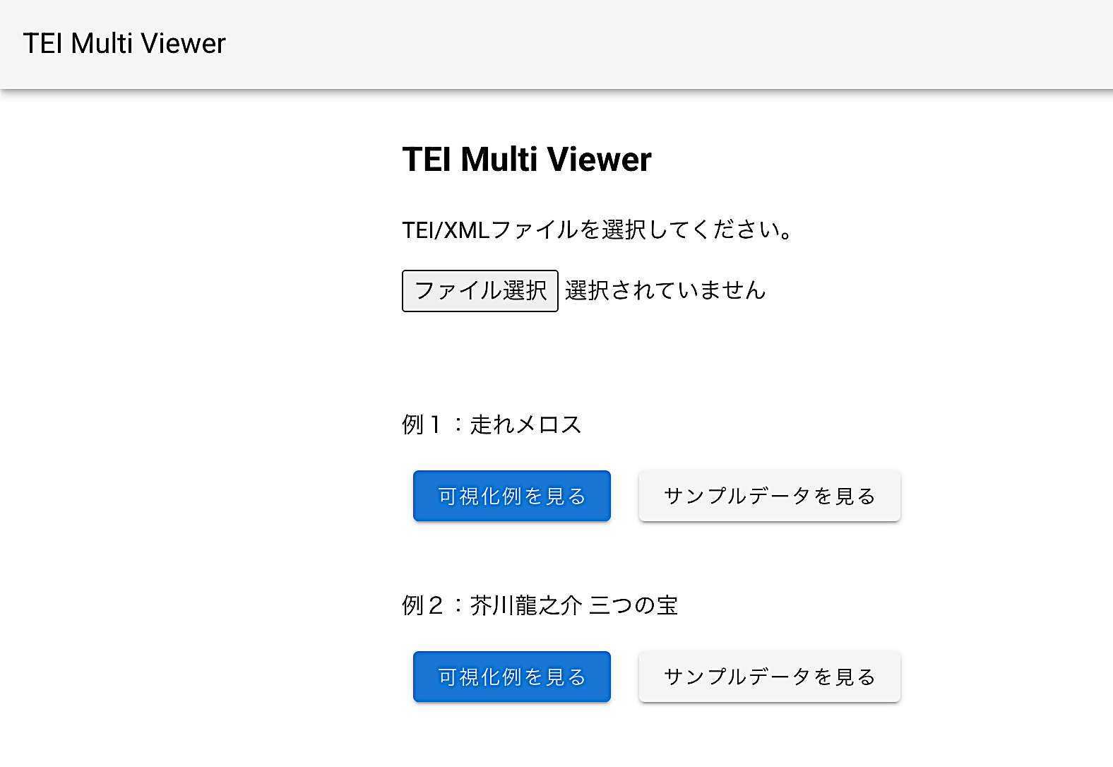

TEI Multi Viewer
https://tei-eaj.github.io/tei_viewer/
Click the “Visualization Example” (可視化例) button or click the “Select File” button and upload the meros.xml file (This is recommended)
Please select a TEI/XML file.
[Select File] No file selected
Example 1: Run, Melos!
You can download meros.xml from
CLE or GitHub
[View Visualization Example] [View Sample Data]
Example 2: Akutagawa Ryūnosuke, The Three Treasures
[View Visualization Example] [View Sample Data]
Notes:
Topic: Case Studies in Japan
Voice:Joanna
```text
Next, let’s take a look at the T E I Multi Viewer, a tool that visualizes T E I files with tags for elements such as people, places, and dialogue.
As mentioned earlier, we’ll use the T E I file of Run, Melos!, which is also used in the hands-on section of this video series.
Try uploading the melos xml T E I file to the T E I Multi Viewer.
You can get the file from CLE or GitHub.
```
```description
Next, let’s take a look at the TEI Multi Viewer, a tool that visualizes TEI files with tags for elements such as people, places, and dialogue.
As mentioned earlier, we’ll use the TEI file of Run, Melos! (or Hashire Melos), which is also used in the hands-on section of this video series.
Try uploading the meros.xml TEI file to the TEI Multi Viewer.
You can get meros.xml from CLE or GitHub.
[TEI Multi Viewer](https://tei-eaj.github.io/tei_viewer/)
[meros.xml availalbe on GitHub](https://github.com/nikolito/TEI-tools)
```

Slide 11
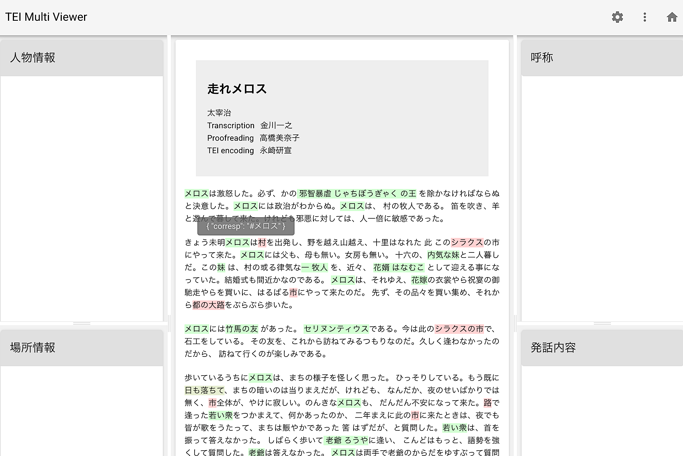
Character Information
Appellations
Run, Melos!
Place Information
Dialogue
Notes:
Topic: Case Studies in Japan
Voice:Joanna
```text
When you open meros dot x m l, you’ll see a viewer like the one shown here.
In the center is the main text, with names of characters and places highlighted.
These highlighted areas correspond to parts of the text marked with T E I tags that provide special functionality.
Often, the same person or thing is referred to in different ways.
For example, Dionisius is also described as “the tyrannical and cruel king.”
With T E I tags, it becomes possible to identify all the passages where Dionisius appears, even when referred to differently.
Try clicking on names like Melos, or “the tyrannical and cruel king”, to explore how this works.
```
```description
When you open meros.xml, you’ll see a viewer like the one shown here.
In the center is the main text, with names of characters and places highlighted.
These highlighted areas correspond to parts of the text marked with TEI tags that provide special functionality.
Often, the same person or thing is referred to in different ways.
For example, Dionysius is also described as “the tyrannical and cruel king.”
With TEI tags, it becomes possible to identify all the passages where Dionysius appears, even when referred to differently.
Try clicking on names like Melos or “the tyrannical and cruel king” to explore how this works.
```

Slide 12
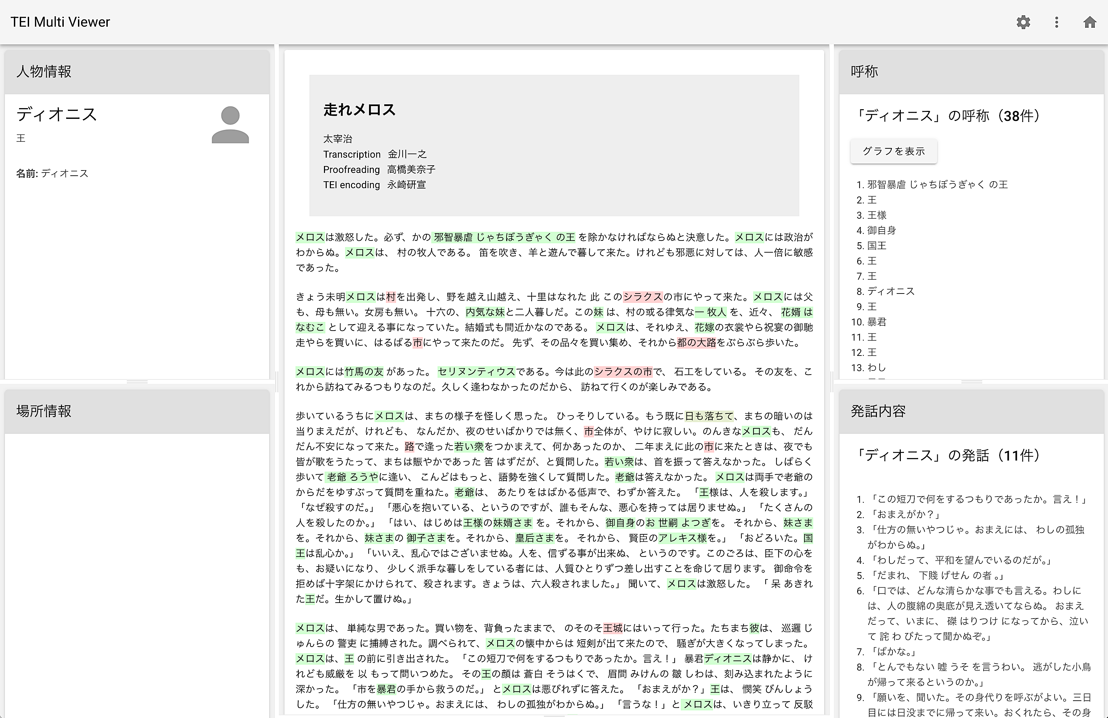
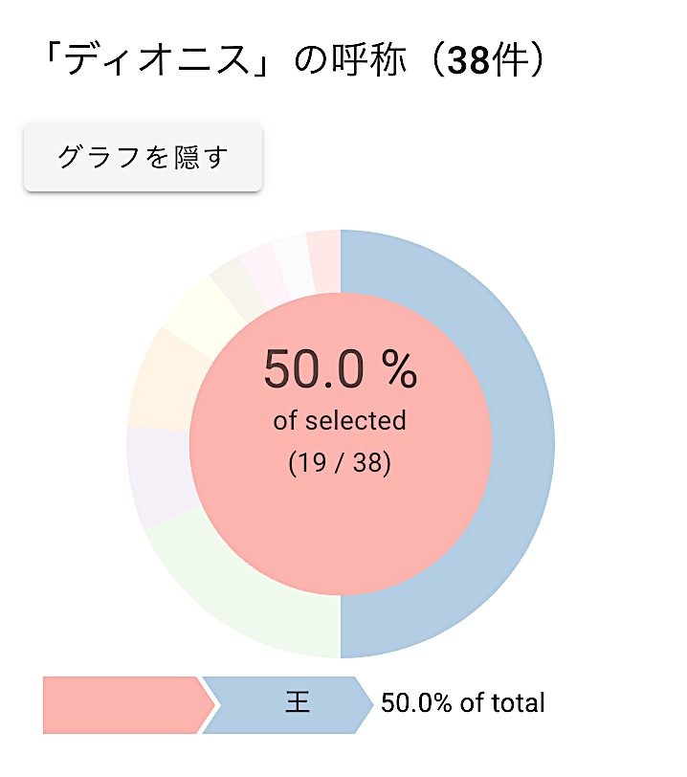
Character Information
Appellations
Dionysius
Run, Melos!
Other names ”Dionysius” is referred to
King
Display Graph
Place Information
Dialogue
Notes:
Topic: Case Studies in Japan
Voice:Joanna
```text
For example, click on “the tyrannical and cruel king.” The viewer will display that this character is Dionisius, in the upper left corner.
In the upper right, you’ll see the different names used to refer to Dionysius.
In the lower right, you’ll find a list of his lines of dialogue.
These visualizations are possible because the data has been prepared using T E I tags.
In short, by creating the data in T E I format, you can easily analyze each character’s speech and actions in Run Melos, with precise counts and clear visualizations like lists and graphs.
```
```description
For example, click on “the tyrannical and cruel king.” The viewer will display that this character is Dionysius in the upper left corner.
In the upper right, you’ll see the different names used to refer to Dionysius.
In the lower right, you’ll find a list of his lines of dialogue.
These visualizations are possible because the data has been prepared using TEI tags.
In short, by creating the data in TEI format, you can easily analyze each character’s speech and actions in Run, Melos!, with precise counts and clear visualizations like lists and graphs.
```

Slide 13
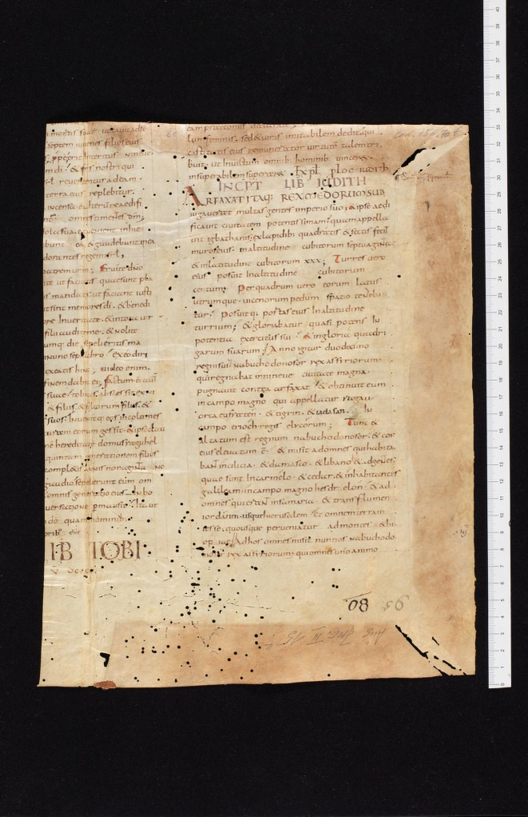
Medieval Manuscript Research Project
“e-codices” (Switzerland)
https://www.e-codices.unifr.ch/en
“Completed Sub-projects"
(https://www.e-codices.unifr.ch/en/about/completed)
Example: “Fragmenta Bongarsiana"
[sine loco], codices restituti, Cod. 5 (Biblia latina)
Parchment · 18 ff. · 15.5-46 x 10.5-33.5 · France: Tours · early 9th century
Biblia latina
Remnants of Alcuin’s Bible, produced in Tours in the early 9th century.
Notes:
Topic: Case Studies from Abroad
Voice:Joanna
```text
The first international example we would like to introduce is the use of T E I in the e-codices medieval manuscript research project.
Since 2005, e-codices has been converting almost 3000 manuscripts from 100 digital collections across Switzerland into T E I format.
Feel free to browse the variety of already completed sub-projects. Supported languages include English, German, French and Italian.
In manuscript studies, it’s essential to mark up fine details, like line breaks, chapters, annotations, etc. ,
The project doesn’t just provide access to high-resolution images of manuscripts from Swiss monasteries, universities, and libraries of all sizes,
but also includes carefully described page structures such as folio divisions and columns, as well as decorations, notes, and margin comments, all in T E I XML.
Bibliographic information, content summaries, and provenance metadata are also richly tagged.
```
```description
First, let’s look at an example of TEI in a medieval manuscript research project.
Since 2005, e-codices (https://www.e-codices.unifr.ch/en) has been converting almost 3000 manuscripts from 100 digital collections across Switzerland into TEI format.
Feel free to browse the variety of already completed sub-projects. Supported languages include English, German, French and Italian.
In manuscript studies, it’s essential to mark up fine details, like line breaks, chapters, annotations, etc.
The project doesn’t just provide access to high-resolution images of manuscripts from Swiss monasteries, universities, and libraries of all sizes,
but also includes carefully described page structures such as folio divisions and columns, as well as decorations, notes, and margin comments, all in TEI/XML.
Bibliographic information, content summaries, and provenance metadata are also richly tagged.
```

Slide 14
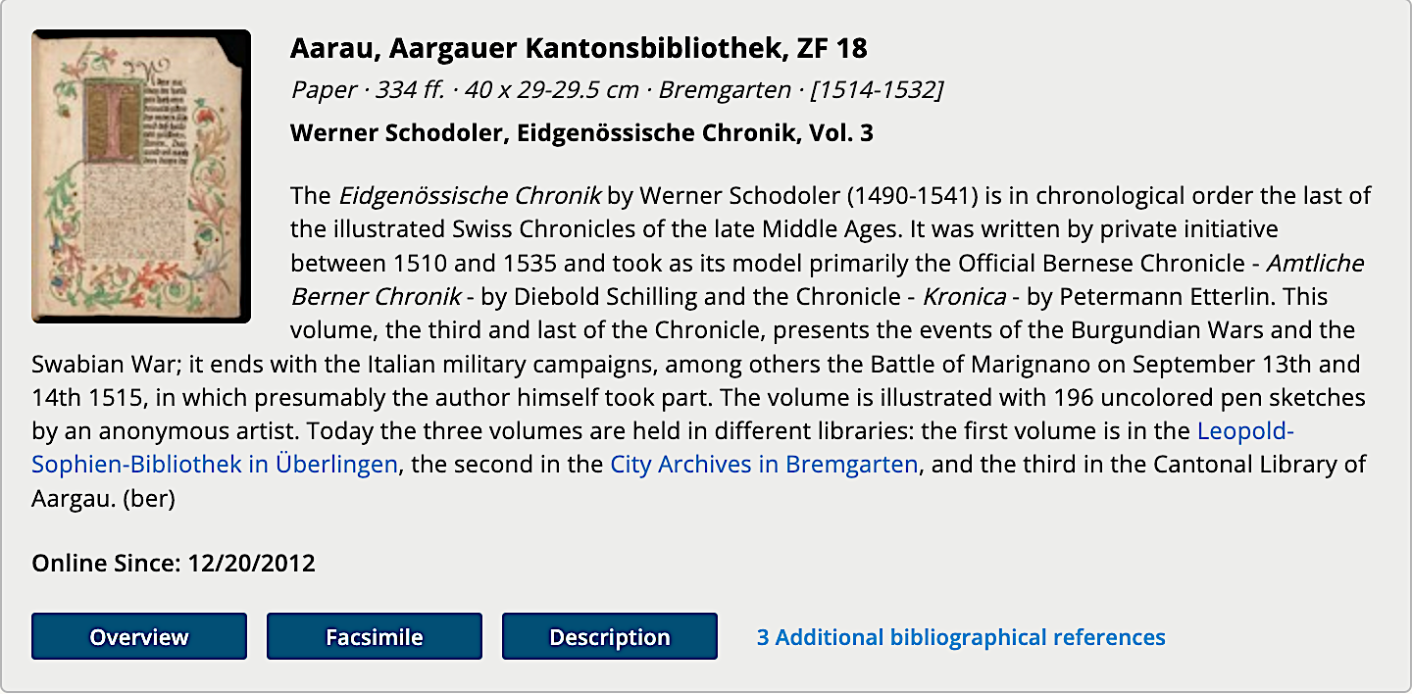
Sub-project: Switzerland’s illuminated treasures
https://www.e-codices.unifr.ch/en/list/subproject/exposition2020
You can access the TEI by clicking the “Show XML” button from either the “Show standard description” or “Description” buttons on the site.
Notes:
Topic: Case Studies from Abroad
Voice:Joanna
```text
So, how can you actually get started doing research using e-codices?
First, visit the official e-codices site.
From the list of manuscripts published online, choose one that interests you and begin by confirming its images and the structure of the T E I X M L.
For example, in the list view like the one shown here, you’ll find a “Description” section.
If you click it, on the next screen you will find a button labelled “Show X M L,” from which you can view the T E I file.
Alternatively, you can look for a “Show standard description” link within the metadata to access the same X M L.
If you want to do annotations or comparative research yourself, one way is to download the T E I file and open it in an editor like V S Code.
By referring to the existing transcriptions and annotations, and adding your own research perspective, you are more likely to make new discoveries.
Since e-codices is a globally recognized project, it’s also easy to share your findings in academic communities and conferences.
This is a great chance to explore the world of medieval manuscripts and get hands-on experience with T E I.
```
```description
So, how can you actually get started doing research using e-codices?
First, visit the official e-codices site. (https://www.e-codices.unifr.ch/en)
From the list of manuscripts published online, choose one that interests you and begin by confirming its images and the structure of the TEI/XML.
For example, in the list view like the one shown here, you’ll find a “Description” section.
If you click it, on the next screen you will find a button labelled “Show XML,” from which you can view the TEI file.
Alternatively, you can look for a “Show standard description” link within the metadata to access the same XML.
If you want to do annotations or comparative research yourself, one way is to download the TEI file and open it in an editor like VS Code.
By referring to the existing transcriptions and annotations, and adding your own research perspective, you are more likely to make new discoveries.
Since e-codices is a globally recognized project, it’s also easy to share your findings in academic communities and conferences.
This is a great chance to explore the world of medieval manuscripts and get hands-on experience with TEI.
```

Slide 15
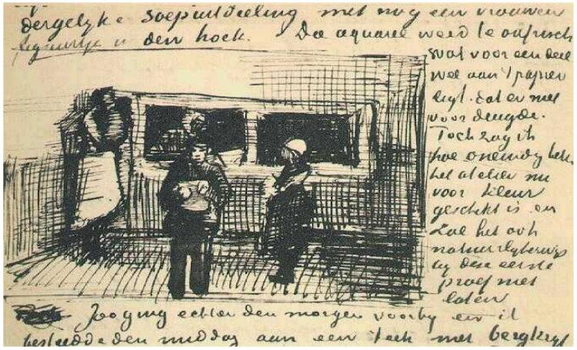
“Vincent van Gogh The Letters" 1
https://vangoghletters.org/
Operated by: A collaborative project between the Van Gogh Museum and Huygens ING (under the Royal Netherlands Academy of Arts and Sciences).
Contents: An extensive collection of around 900 letters written by Van Gogh, carefully transcribed, translated, and annotated, and freely accessible online.
The Public-Soup-Kitchen F272 Vincent van Gogh
Notes:
Topic: Case Studies from Abroad
Voice:Joanna
```text
Next, let’s look at a digital archive project of Van Gogh’s letters.
During his lifetime, Van Gogh wrote many letters to his brother Theo, his friend Gauguin, and others.
In this project, approximately 900 of Van Gogh’s letters are published along with high-resolution images.
Using T E I markup, the letters are meticulously organized by date, recipient, content, and more.
These are valuable materials that allow readers to learn more about Van Gogh’s thoughts on his art, his exchanges with fellow artists, and the evolution of his ideas over time.
```
```description
Next, let’s look at a digital archive project of Van Gogh’s letters. (https://vangoghletters.org/)
During his lifetime, Van Gogh wrote many letters to his brother Theo, his friend Gauguin, and others.
In this project, approximately 900 of Van Gogh’s letters are published along with high-resolution images.
Using TEI markup, the letters are meticulously organized by date, recipient, content, and more.
These are valuable materials that allow readers to learn more about Van Gogh’s thoughts on his art, his exchanges with fellow artists, and the evolution of his ideas over time.
```

Slide 16
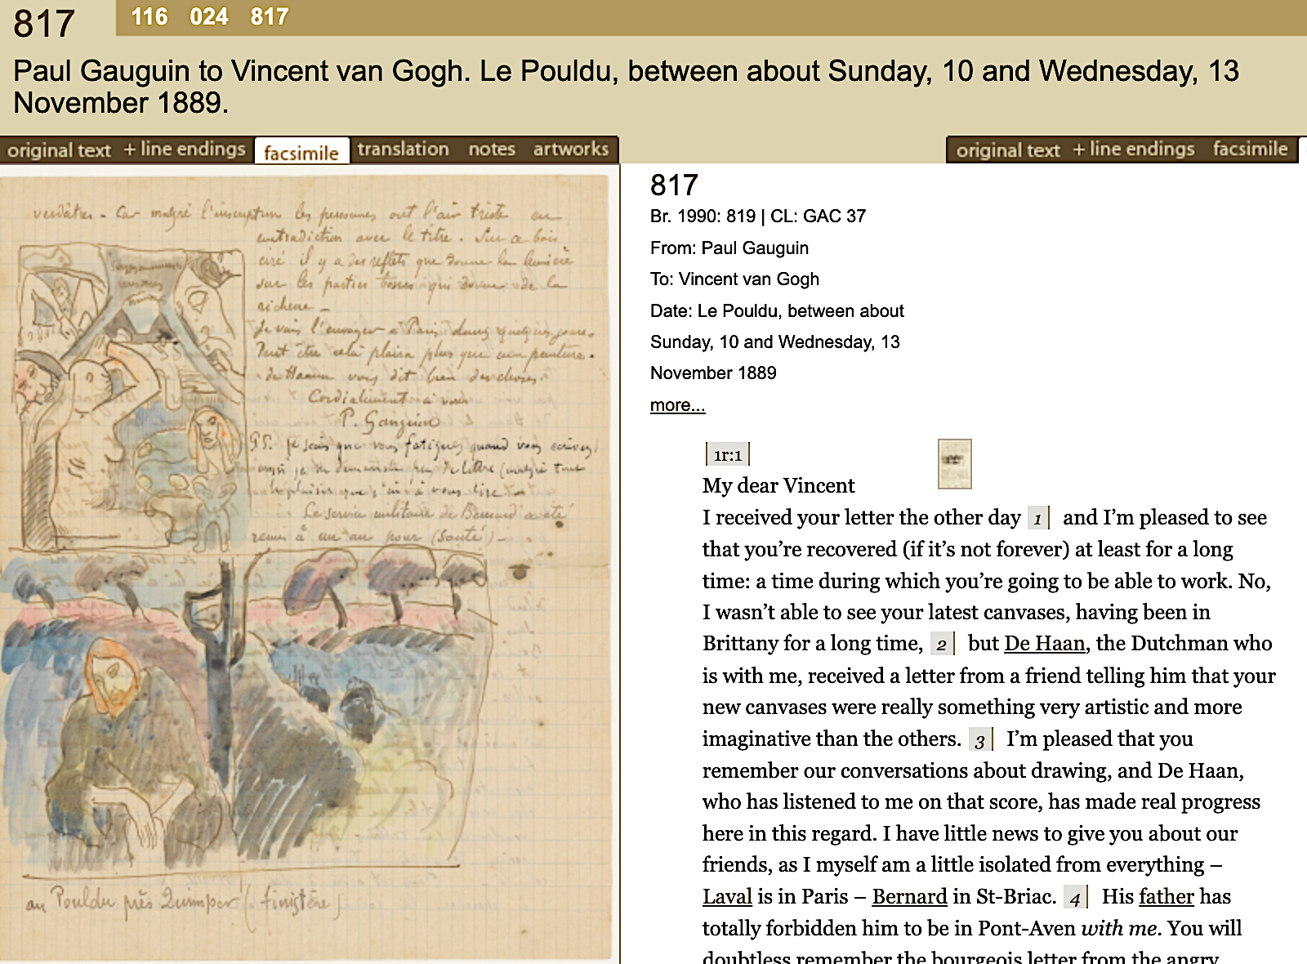
“Vincent van Gogh The Letters" 2
An XML document (in TEI format) is created for each of Van Gogh’s letters and related documents.
The XML data is available under the CC BY-NC-SA 4.0 license (non-commercial use, attribution, share alike): About this edition > 6.4. XML source files.
It includes metadata for each letter (title, number, date, correspondents, etc.), the full transcription, translation, annotations, textual commentary, and information that links transcribed pages to their page images (using the facsimile element).
Creative Commons
https://creativecommons.jp/
Notes:
Topic: Case Studies from Abroad
Voice:Joanna
```text
Many of Van Gogh’s letters have already been published, and this site provides each of his letters and related documents as X M L files in T E I format.
These X M L files can be freely used, as long as the rules specified by the Creative Commons license are followed: non-commercial use, proper attribution, and applying the same license to derivative works.
Each file contains letter-specific metadata (such as title, number, date, and correspondents), full transcriptions, translations, annotations, textual notes, and information linking each transcribed page to its corresponding image.
As shown on the right side of the screen, you can compare manuscript images and the T E I-format metadata and letter text side by side on the same screen.
```
```description
Many of Van Gogh’s letters have already been published, and this site provides each of his letters and related documents as XML files in TEI format.
These XML files can be freely used, as long as the rules specified by the Creative Commons license (https://creativecommons.org) are followed: non-commercial use, proper attribution, and applying the same license to derivative works.
Each file contains letter-specific metadata (such as title, number, date, and correspondents), full transcriptions, translations, annotations, textual notes, and information linking each transcribed page to its corresponding image (facsimile element).
As shown on the right side of the screen, you can compare manuscript images and the TEI-format metadata and letter text side by side on the same screen.
```

Slide 17
“Vincent van Gogh The Letters” 3
Most Commonly Used TEI tags
<correspDesc>: Element that manages letter-specific metadata; examples: sender (<correspAction type="sent">)、recipient(<correspAction type="received">) and date(<date>)
<persName>: Used to tag the names of people mentioned in the work (friends, family, fellow painters, etc.)
<placeName>: Used to mark up the places Van Gogh sent letters from or place names that were mentioned (e.g., Paris, Arles, Saint-Rémy)
<title>: Used to tag the titles of paintings or books mentioned in the letter
<note>: Used to insert editorial notes, explanations, and translator annotations
<pb> / <lb>: Indicates page or line breaks in the letter, reproducing the original layout
<hi> (Highlighting element): Used to mark emphasis, strikethroughs, or handwriting variations
Notes:
Topic: Case Studies from Abroad
Voice:Joanna
```text
This slide introduces the main T E I tags used in the Van Gogh letters project.
First, ”corresp Desk”, is an important tag that summarizes letter-specific metadata such as sender, recipient, and date.
Names of people are marked with “persName”, and places with “place-Name”.
Furthermore, works or book titles mentioned in the letter, are marked up with ”title”, and annotations or translator comments are managed with “note.”
To preserve layout structure, “p b”, and “l b”, mark page, and line breaks respectively.
The hi tag is used to express textual features like emphasis or strikethrough.
These tags help preserve the letters in a searchable and analyzable format, while staying true to their original structure.
```
```description
This slide introduces the main TEI tags used in the Van Gogh letter project.
First, <correspDesc> is an important tag that summarizes letter-specific metadata such as sender, recipient, and date.
Names of people are marked with <persName>, and places with <placeName>.
Furthermore, works or book titles mentioned in the letter are marked up with <title>, and annotations or translator comments are managed with <note>.
To preserve layout structure, <pb> and <lb> mark page and line breaks.
The <hi> tag is used to express textual features like emphasis or strikethrough.
These tags help preserve the letters in a searchable and analyzable format while staying true to their original structure.
```

Slide 18
Workflow & Tips
Select the text you want to study
Determine what kinds of information to mark up using TEI
Join an existing study group or project to learn the workflow
Notes:
Topic:Summary
Voice:Joanna
```text
Seeing these examples may have sparked your interest.
To get started, begin by selecting the text you want to work with and identifying what kinds of information you’d like to mark up using T E I.
You can also join existing domestic or international projects or study groups to familiarize with the workflow.
```
```description
Seeing these examples may have sparked your interest.
To get started, begin by selecting the text you want to work with and identifying what kinds of information you’d like to mark up using TEI.
You can also join existing domestic or international projects or study groups to familiarize with the workflow.
```

Slide 19
Summary
Using TEI makes text analysis more efficient, and makes it easier to convey “what is important” to other researchers and readers.
Bringing out the appeal of your research subject, organizing the key points, and sharing your results—this is the central concept of digital humanities.
Notes:
Topic:Summary
Voice:Joanna
```text
T E I, not only streamlines text analysis, but also helps you clearly communicate what’s important to other researchers and readers.
It helps highlight the appeal of your research, organize key points, and share your results.
This aligns with the core principles of digital humanities.
We encourage you to keep using T E I in ways that suit your research.
There are also many exciting T E I pro jects happening worldwide beyond those introduced today.
If you come up with ideas like ,“What if I tried this?”, I hope you’ll actively share and explore them with the community.
Thank you so much for watching!
```
```description
TEI not only streamlines text analysis, but also helps you clearly communicate what’s important to other researchers and readers.
It helps highlight the appeal of your research, organize key points, and share your results.
This aligns with the core principles of digital humanities.
We encourage you to keep using TEI in ways that suit your research.
There are also many exciting TEI projects happening worldwide beyond those introduced today.
If you come up with ideas like “What if I tried this?”, I hope you’ll actively share and explore them with the community.
Thank you so much for watching!
```

