Slide 1
Essential Material for Humanities Researchers: An Introduction to Research Data Management and Publishing and Utilizing IIIF Images with OUKA
Developing a Research Data Ecosystem for the Promotion of Data-Driven Science Research Data Management Teaching Materials – Practical Edition
The University of Osaka Global Japanese Studies Education and Research Incubator
[Incubator-Supported Project]
- Developing Digital Humanities Educational Materials to Enhance Research Data Management in the Humanities
Notes:
Topic:Purpose of This Material
Voice:Joanna
```text
This material introduces “Publishing and Utilizing triple I F Images via OUKA”, as one example of research data management practices, expected of humanities researchers.
```
```description
This material introduces “Publishing and Utilizing IIIF Images via OUKA” as one example of research data management practices expected of humanities researchers.
```

Slide 2
1. Objective of this Material
Notes:
Topic:Objective of This Material
Voice:Joanna

Slide 3
Q: Is data management and sharing necessary for research in the humanities?
In the humanities, individual insight and the accumulation of long-term research are essential, so isn’t sharing data perhaps unrealistic?
Many people don’t know how to properly manage or publish humanities-based research data.
?
Notes:
Topic:Objective of This Material
Voice:Joanna
```text
Data management and sharing, are they necessary for research in the humanities?
The humanities value individual insight and the accumulation of steady, long-term research. Therefore, many people may think that creating research data and sharing results doesn’t apply to this field.
Even when engineering or information science methods are used in the humanities, many people don’t know how to manage or publish research data, and it ends up being dealt with on an ad hoc basis. ```
```description
Data management and sharing, are they necessary for research in the humanities?
The humanities value individual insight and the accumulation of steady, long-term research. Therefore, many people may think that creating research data and sharing results doesn’t apply to this field.
Even when engineering or information science methods are used in the humanities, many people don’t know how to manage or publish research data, and it ends up being dealt with on an ad hoc basis. ```

Slide 4
A: Yes. It’s a necessary foundation to revitalize research in the humanities
Advances one‘s own research
Revitalizes outreach efforts and student advising
Notes:
Topic:Objective of This Material
Voice:Joanna
```text
However, even in the humanities, properly managing and sharing your research data can help advance your research, as well as revitalize outreach efforts and student advising.
```
```description
However, even in the humanities, properly managing and sharing your research data can help advance your research, as well as revitalize outreach efforts and student advising.
```

Slide 5
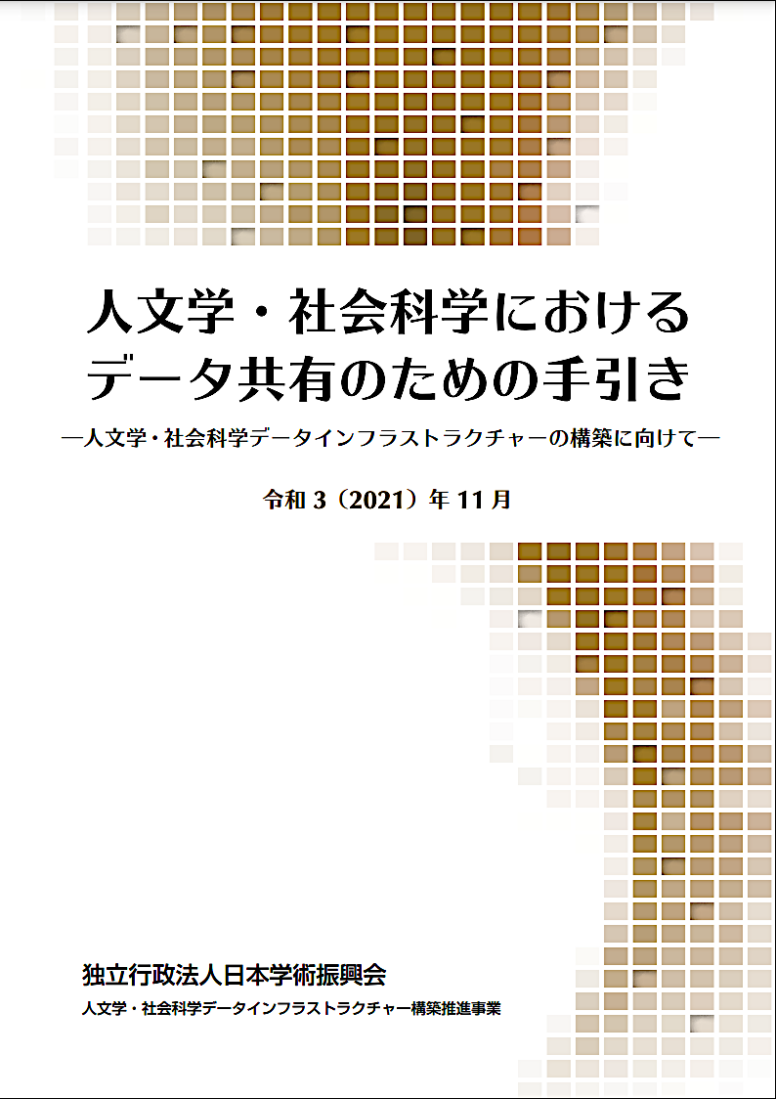
A Guide to Data Sharing in the Humanities and Social Sciences Japan Society for the Promotion of Science (JSPS) https://www.jsps.go.jp/j-di/data/guide/tebiki_p.pdf (in Japanese)
From [Column for the Humanities 1: The Significance of Data Sharing in the Humanities] (p.4):
Organizing research materials increases awareness
Enables long-term preservation of highly transparent research materials that anyone can reproduce
Promotes further research through secondary analysis and reuse
Notes:
Topic:The need for data sharing in the humanities and social sciences
Voice:Joanna
```text
These reasons are explained in detail in the Guide for Data Sharing in the Humanities and Social Sciences, published in November 2021, by the Japan Society for the Promotion of Science, JSPS.
According to “Humanities Column 1 (The Significance of Data Sharing in the Humanities)”, sharing data helps researcher awareness, through the process of organizing their research materials.
It also allows for the long-term preservation of research materials that are highly transparent and reproducible by anyone.
Furthermore, by releasing materials in a reusable format, it becomes more possible that secondary analysis and reuse by many people will lead to further research development.
Therefore, just as in the natural sciences, engineering, medicine, dentistry, and life sciences, it is necessary to consider data-sharing-oriented research practices, in order to make your research more useful, and impactful over the long term.
```
```description
These reasons are explained in detail in the Guide for Data Sharing in the Humanities and Social Sciences, published in November 2021 by the Japan Society for the Promotion of Science, JSPS.
According to “Humanities Column 1 (The Significance of Data Sharing in the Humanities)”, sharing data helps researcher awareness, through the process of organizing their research materials.
It also allows for the long-term preservation of research materials that are highly transparent and reproducible by anyone.
Furthermore, by releasing materials in a reusable format, it becomes more possible that secondary analysis and reuse by many people will lead to further research development.
Therefore, just as in the natural sciences, engineering, medicine, dentistry, and life sciences, it is necessary to consider data-sharing-oriented research practices, in order to make your research more useful and impactful over the long term.
```

Slide 6
Open Science Gains Momentum Worldwide
Open Science
An effort to practice research data sharing as much as possible
In principle: Research activities through international joint research and engagement with the general public
In policy: Returning research outcomes to society from publicly funded research, fair use of research funding, transparency in research, and open access
Reference: National Institute of Informatics, Research Center for Open Science and Data Platform
https://rcos.nii.ac.jp/en/document/openscience/
Sustaining open science activities as an individual is challenging.
Notes:
Topic:The need for data sharing in the humanities and social sciences
Voice:Joanna
```text
The momentum for data sharing is increasing on a global scale. This reflects the growing trend of Open Science.
Open science refers to the effort to practice data sharing as thoroughly as possible.
According to the overview by the Research Center for Open Science and Data Platform at the National Institute of Informatics, open science refers to the principle of promoting research, through international joint research, and engagement with the general public, especially in today’s world, where data sharing online has become easier.
It also refers to administrative initiatives based in the idea that publicly funded research should benefit society, including fair use of research funding, transparency, and open access to publications and other research results.
However, it is extremely difficult for individual researchers to sustain open science activities, while simultaneously conducting their own research.
```
```description
Momentum for data sharing—that is, open science—is growing globally.
As discussed earlier, open science refers to the effort to practice research data sharing as much as possible.
According to the overview by the Research Center for Open Science and Data Platform at the National Institute of Informatics, open science refers to the principle of promoting research through international joint research and engagement with the general public, especially in today’s world where data sharing online has become easier.
It also refers to administrative initiatives based in the idea that publicly funded research should benefit society, including fair use of research funding, transparency, and open access to publications and other research results.
However, it is extremely difficult for individual researchers to sustain open science activities while simultaneously conducting their own research. ```

Slide 7
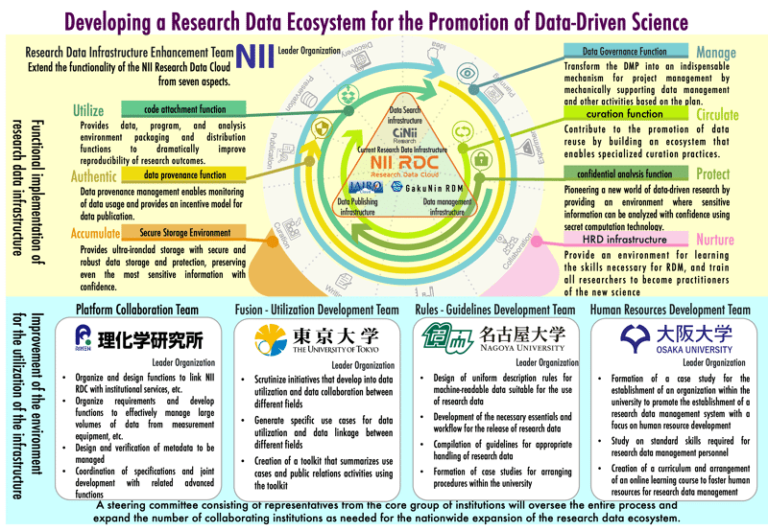
National Institute of Informatics (NII): Building a Research Data Ecosystem for the Promotion of Data-Driven Science
https://www.nii.ac.jp/creded/project_e.html
Notes:
Topic:The need for data sharing in the humanities and social sciences
Voice:Joanna
```text
To that end, the Ministry of Education, Culture, Sports, Science and Technology, launched in 2022, the Developing a Research Data Ecosystem for the Promotion of Data-Driven Science initiative, with the National Institute of Informatics as a central hub, aiming to create a concrete path toward open science implementation.
```
```description
To that end, the Ministry of Education, Culture, Sports, Science and Technology, launched in 2022, the Developing a Research Data Ecosystem for the Promotion of Data-Driven Science initiative, with the National Institute of Informatics as a central hub, aiming to create a concrete path toward open science implementation.
Within this initiative, Osaka University participates as the lead institution for human resource development, working to promote open science by developing and distributing educational materials nationwide.
This material was developed as part of the Developing a Research Data Ecosystem for the Promotion of Data-Driven Science initiative, with the goal of promoting open science on a university-wide level.
```

Slide 8
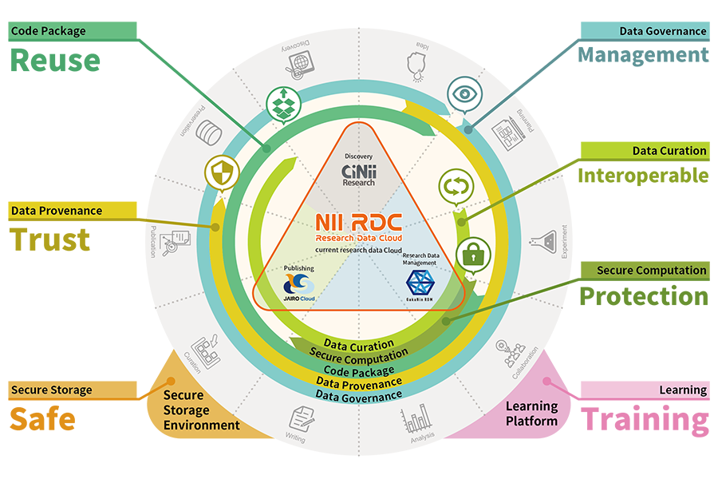




Developing a Research Data Ecosystem for the Promotion of Data-Driven Science
AI等の活用を推進する
研究データエコシステム構築事業
AI等の活用を推進する
研究データエコシステム構築事業
Provides data, program, and analysis environment packaging and distribution functions to dramatically improve reproducibility of research outcomes
Supports data management planning, transforming Data Management Plans (DMPs) into an essential part of project management
Contribute to the promotion of data reuse by building an ecosystem that enables specialized curation practices
Data provenance management enables monitoring of data usage and provides an incentive model for data publication
Uses secure computation technology to safely analyze sensitive information, supporting new data-driven research
Provides ultra-secure storage with secure and robust data storage and protection, preserving sensitive information with confidence
Provides an environment to learn skills necessary for Research Data Management (RDM), educating researchers to practice new scientific approaches
Platform Integration Team
Integration & Utilization Development Team
Rules & Guidelines Development Team
Human Resource Development Team
RIKEN
Organize and design functions to link NII RDC with institutional services
Organize requirements and develop functions to effectively manage, use, and disseminate research data
Central organization of metadata to be registered
Coordination of specifications and joint development with related organizations
The University of Tokyo
Scrutinize initiatives that develop into data utilization and data collaboration between different fields.
Generate specific use cases for data utilization and data linkage between different fields
Creation of a toolkit that summarizes use cases and public relations activities with the toolkit
Nagoya University
• Designing standardized descriptions for machine-readable data suitable for research data utilization
• Preparing necessary requirements and workflows for publishing research data
• Compiling guidelines for proper handling of research data
• Developing best practices for internal institutional frameworks
The University of Osaka
• Promoting the development of a research data management system centered on human resource development
• Examining the standard skills required for research data management personnel
• Creating curricula and developing online learning courses
National Institute of Informatics (NII) Developing a Research Data Ecosystem for the Promotion of Data-Driven Science https://www.nii.ac.jp/creded/project_e.html
Notes:
Topic:The need for data sharing in the humanities and social sciences
Voice:Joanna
```text
Within this initiative, The University of Osaka participates as the lead institution for human resource development, working to promote open science by developing and distributing educational materials nationwide.
This material was developed as part of the Developing a Research Data Ecosystem for the Promotion of Data-Driven Science initiative, with the goal of promoting open science on a university-wide level.
```
```description
Within this initiative, The University of Osaka participates as the lead institution for human resource development, working to promote open science by developing and distributing educational materials nationwide.
This material was developed as part of the Developing a Research Data Ecosystem for the Promotion of Data-Driven Science initiative, with the goal of promoting open science on a university-wide level.
```

Slide 9
Toward Promoting Open Science in the Humanities through Digital Humanities
Osaka University Research Data Policy (March 2023) https://www.osaka-u.ac.jp/ja/research/files/e30yqd (Japanese)
https://www.osaka-u.ac.jp/ja/research/files/Osaka-University-Research-Data-Policy.pdf (English)
Issue: Limited opportunities to learn the foundations, practical methods and benefits of publishing & managing research data in the humanities
Digital Humanities
An interdisciplinary field that supports research in the humanities through information technologies (IT).
It explores methods for introducing a degree of transparency into the research process and for enabling the possibility of data sharing in the humanities.
Notes:
Topic:The need for data sharing in the humanities and social sciences
Voice:Joanna
```text
The University of Osaka established its Research Data Policy in March 2023.
The policy outlines key principles to guide researchers at the university, particularly from the perspectives of research integrity, and open science.
However, in the humanities, there are limited opportunities to learn the foundations, practical methods, and benefits of research data publication and management.
Humanities researchers need to understand the importance of research data construction and management, and learn concrete methods for doing so.
So, as a practical entry point, this material focuses on digital humanities.
Digital humanities is an interdisciplinary field that supports humanities research through information technology.
The reason for this focus is that digital humanities research promotes transparency in the research process, and actively explores methods for data sharing, making it highly compatible with the goals of this material.
```
```description
The University of Osaka established its Research Data Policy in March 2023.
The policy outlines key principles to guide researchers at the university, particularly from the perspectives of research integrity, and open science.
However, in the humanities, there are limited opportunities to learn the foundations, practical methods, and benefits of research data publication and management.
Humanities researchers need to understand the importance of research data construction and management, and learn concrete methods for doing so.
So, as a practical entry point, this material focuses on digital humanities.
Digital humanities is an interdisciplinary field that supports humanities research through information technology.
The reason for this focus is that digital humanities research promotes transparency in the research process, and actively explores methods for data sharing, making it highly compatible with the goals of this material.
```

Slide 10
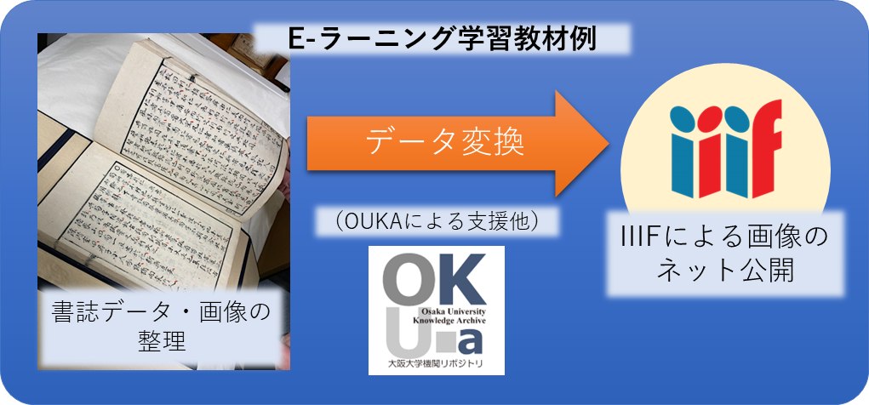
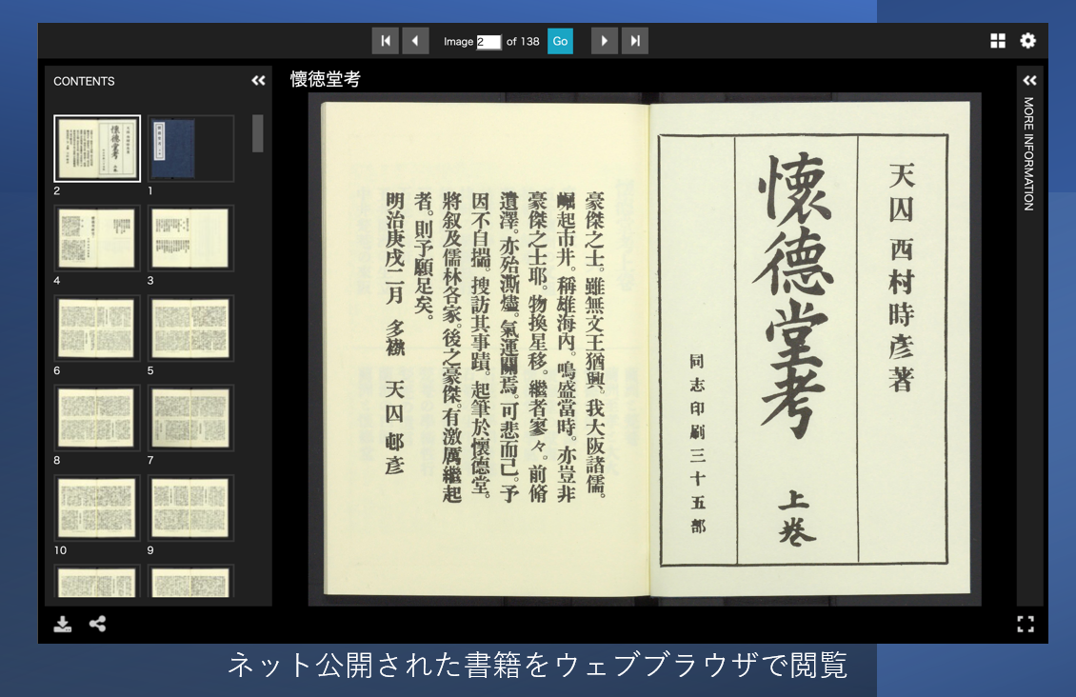

Managing and Publishing Research Results: Image Data
IIIF （International Image Interoperability Framework） https://iiif.io/
a set of open standards for delivering high-quality, attributed digital objects online at scale, enabling to promote the online publication and reuse of original images of cultural heritage materials, such as rare books.
E-learning Study Material Example
Data Conversion
OUKA support
Online publication of images via IIIF
Organizing book & image data
View published books in your web browser
Notes:
Topic:Management and Publication of Research Results/Structure of the Teaching Materials
Voice:Joanna
```text
Among the various areas within the digital humanities, the handling of images, where the need for data sharing in the humanities is particularly high, has seen the most progress in both research and practical applications.
Specifically, the International Image Interoperability Framework, commonly known as triple I F, is a set of open standards for delivering high-quality, attributed digital objects online at scale, enabling to promote the online publication and reuse of original images of cultural heritage materials, such as rare books. Image publication based on that standard is already taking place worldwide.
This material is designed to not only teach the methods for managing and publishing data included in papers and presentations as research results, but also the use and reuse of images through the triple I F framework.
It also introduces the basics of working with triple I F, and examples of applied use that may serve as inspiration for research or classroom activities.
We hope this material serves as a helpful reference.
```
```description
Among the various areas within the digital humanities, the handling of images, where the need for data sharing in the humanities is particularly high, has seen the most progress in both research and practical applications.
Specifically, the International Image Interoperability Framework, commonly known as IIIF, is a set of open standards for delivering high-quality, attributed digital objects online at scale, enabling to promote the online publication and reuse of original images of cultural heritage materials, such as rare books. Image publication based on that standard is already taking place worldwide.
This material is designed to not only teach the methods for managing and publishing data included in papers and presentations as research results, but also the use and reuse of images through the IIIF framework.
It also introduces the basics of working with IIIF and examples of applied use that may serve as inspiration for research or classroom activities.
We hope this material serves as a helpful reference.
```

Slide 11
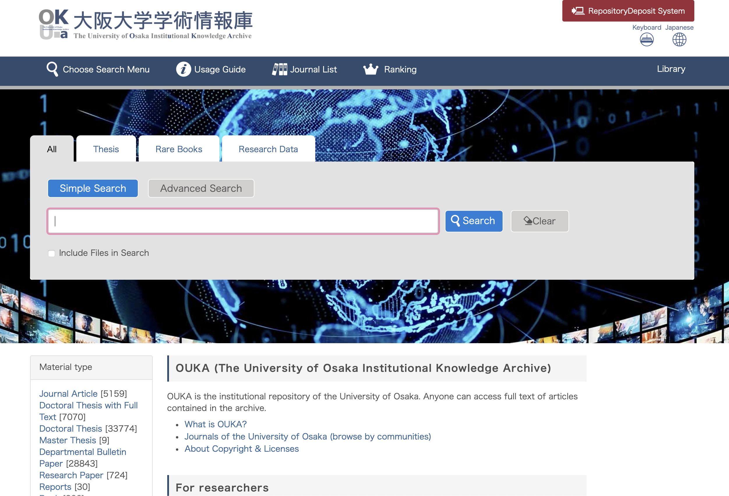
The University of Osaka Institutional Knowledge Archive OUKA
The University of Osaka Institutional Repository
A platform for disseminating the university’s research and educational output
All faculty and staff (including former members) can register their research output
Registered works are preserved and remain publicly accessible permanently
No cost to the user
Types of registerable content
Journal articles
Conference papers
Doctoral dissertations
Bulletin papers
Research reports
Books, conference presentations, teaching materials
Other (e.g., supporting data for publications)
Registration support:
Support for digitizing bulletins and university journals
Research on publisher copyright policies
Assignment of persistent identifiers (DOIs)
OUKA Top Page
https://ir.library.osaka-u.ac.jp/repo/ouka/all/?lang=1
Notes:
Topic:Management and Publication of Research Results/Structure of the Teaching Materials
Voice:Joanna
```text
At The University of Osaka, research output data can be published through the institutional repository OUKA.
OUKA, as the university’s repository, allows any University of Osaka faculty member to register and publish their research outputs.
The university ensures long-term preservation and public access, so there is no cost incurred.
In addition to journal articles, various types of research reports and presentation materials from academic conferences can also be registered.
It is also possible to register publication supporting data, including triple I F images used in publications.
The library provides support for digitizing bulletins and university journals, investigating publisher copyright policies, and assigning persistent identifiers such as D O eyes.
```
```description
At The University of Osaka, research output data can be published through the institutional repository OUKA.
OUKA, as the university’s repository, allows any University of Osaka faculty member to register and publish their research outputs.
The university ensures long-term preservation and public access, so there is no cost incurred.
In addition to journal articles, various types of research reports and presentation materials from academic conferences can also be registered.
It is also possible to register publication supporting data, including IIIF images used in publications.
The library provides support for digitizing bulletins and university journals, investigating publisher copyright policies, and assigning persistent identifiers such as D O Is.
```

Slide 12

Structure of this Material
Objective of this material
Research data management
What are IIIF images?
Basic usage of IIIF images
Potential of IIIF
Materials and methods for creating IIIF-compatible images using OUKA
Summary
(Reading note: “Triple-I-F”)
Notes:
Topic:Management and Publication of Research Results/Structure of the Teaching Materials
Voice:Joanna
```text
This program is composed of seven videos, and the content is as shown.
In Section 1, we explain the purpose and objective of this material; in Section 2, we focus on research data management.
Sections 3 to 6, cover an overview of triple I F, and the steps up to publishing triple I F images.
```
```description
This program is composed of seven videos, and the content is as shown.
In Section 1, we explain the purpose and objective of this material; in Section 2, we focus on research data management.
Sections 3 to 6, cover an overview of IIIF and the steps up to publishing IIIF images.
```

Slide 13

Research Data Management Fundamentals
“Fundamentals of Research Data Management in the Open Science Era” https://doi.org/10.18910/101974 (educational materials, in English,
Available in on demand video, pdf and ppt format)
OUKA-chan
Notes:
Topic:Management and Publication of Research Results/Structure of the Teaching Materials
Voice:Joanna
```text
As a resource for understanding the background of this material, educational materials titled Fundamentals of research data management in the open science era, can be found available online at the university of Osaka’s repository, OUKA. The material is available as on demand videos, pdf and powerpoint format. We encourage you to take a look at them, alongside this material.
```
```description
As a resource for understanding the background of this material, educational materials titled Fundamentals of research data management in the open science era, can be found available online at the university of Osaka’s repository, OUKA. The material is available as on demand videos, pdf and powerpoint format. We encourage you to take a look at them, alongside this material.
```

