Slide 1
3. What are IIIF Images?
Notes:
Topic:Introduction
Voice:Joanna
```text
This chapter provides an overview of triple I F.
```
```description
This chapter provides an overview of IIIF.
```

Slide 2
Contents
What are Digital Archives?
Overview of IIIF
Benefits of the IIIF framework
Examples of IIIF images published in the University of Osaka Institutional Knowledge Archive OUKA
Notes:
Topic:Introduction
Voice:Joanna
```text
Before that, we will briefly explain what a digital archive is, and highlight some of the recent challenges regarding the construction and use of digital archives.
Next, we will provide an overview of the triple i f framework, which allows for the effective use of images and videos over the internet, and briefly introduce what it can do.
Finally, we will present examples of triple I F images currently published in the University of Osaka’s institutional repository OUKA, particularly in the humanities.
```
```description
Before that, we will briefly explain what a digital archive is and highlight some of the recent challenges regarding the construction and use of digital archives.
Next, we will provide an overview of the triple i f framework, which allows for the effective use of images and videos over the internet, and briefly introduce what it can do.
Finally, we will present examples of IIIF images currently published in the University of Osaka’s institutional repository OUKA, particularly in the humanities.
```

Slide 3
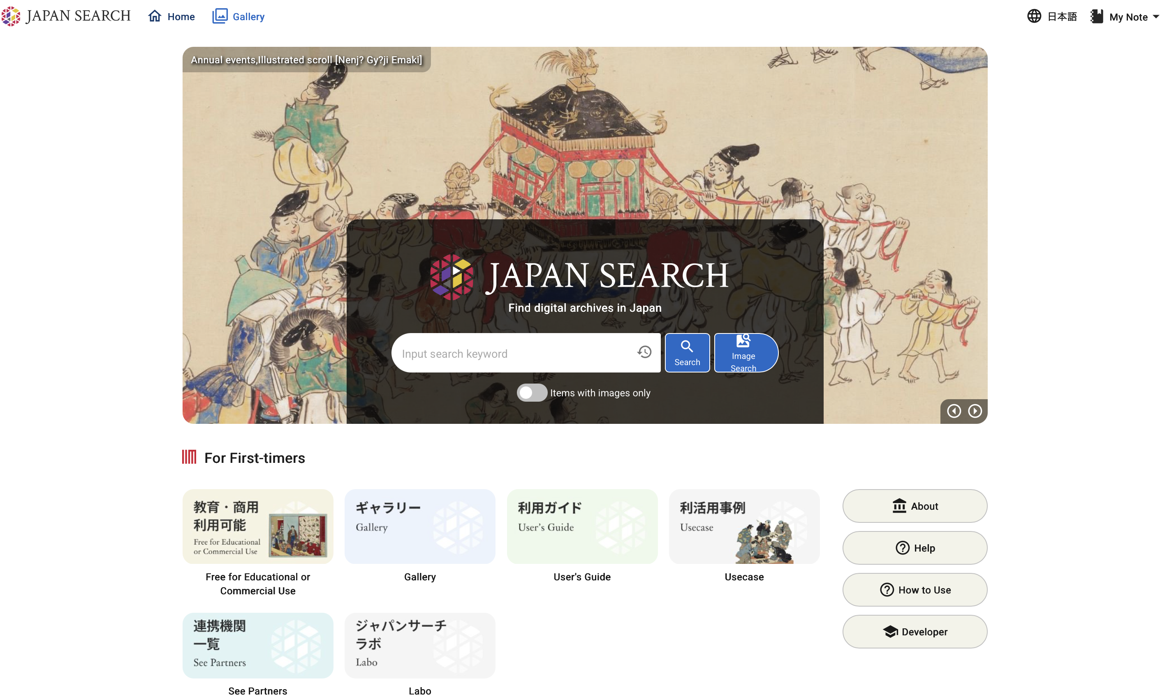
What are Digital Archives?
Websites that digitize and publish materials that are historically and academically valuable (important documents, cultural assets etc)
Published by companies or research institutions.
Avoid the risk of exhibiting the original materials.
Allow for many people to discover them
From Japan Search: https://jpsearch.go.jp
Notes:
Topic:What are digital archives?
Voice:Joanna
```text
There are websites known as “digital archives”, where many companies and research institutions are digitizing and publishing materials, such as important documents and cultural assets. Exhibiting the originals poses risks such as theft and damage, so on-site exhibitions were inevitably limited, leading to reduced accessibility and recognition by the public. However, by publishing digital archives online, the materials become accessible by anyone, allowing a wider audience to view them and therefore increasing public awareness.
```
```description
There are websites known as “digital archives”, where many companies and research institutions are digitizing and publishing materials, such as important documents and cultural assets. Exhibiting the originals poses risks such as theft and damage, so on-site exhibitions were inevitably limited, leading to reduced accessibility and recognition by the public. However, by publishing digital archives online, the materials become accessible by anyone, allowing a wider audience to view them and therefor increasing public awareness.
```

Slide 4

User Issues
The methods of digital content access are inconsistent across institutions
Users need to learn how to operate each institution’s interface
A complicated interface can discourage users
Notes:
Topic:What are digital archives?
Voice:Joanna
```text
From a user’s perspective, one issue with digital archives is the inconsistency in how content is made available across different institutions. This lack of standardization leads to further complications.
When trying to access materials across multiple institutional archives, users are forced to learn different systems for each one. This additional effort can discourage users and reduce their motivation to access the materials.
```
```description
From a user’s perspective, one issue with digital archives is the inconsistency in how content is made available across different institutions. This lack of standardization leads to further complications.
When trying to access materials across multiple institutional archives, users are forced to learn different systems for each one. This additional effort can discourage users and reduce their motivation to access the materials.
```

Slide 5
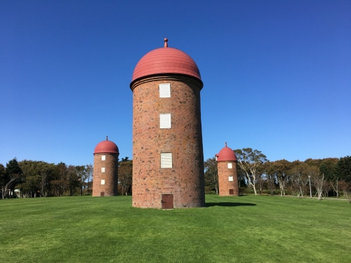
Publisher Issues
The Silo Effect
Information released by each organization is not standardized, making it difficult for users to effectively use and interconnect their data
No standard for interface or publication format
Different organizations use different systems, leading to a confusing variety of interfaces, increasing the burden on users to learn and share information.
As technological advances render the current interfaces outdated, updating them can incur significant technical and financial costs.
Japan Heritage Portal Site “Silos of Meiji Park”
https://japan-heritage.bunka.go.jp/ja/culturalproperties/result/6355/
Notes:
Topic:What are digital archives?
Voice:Joanna
```text
From the perspective of the data publisher, when building a digital archive and setting up the viewing functionality, the lack of a standardized methodology creates extra work in defining the specifications themselves.
As a result, inconsistent methods are used across different organizations, increasing the time spent learning and information sharing for users.
And when technological progress renders the features obsolete after a few years, updating them entails substantial costs, both technical and financial.
In fact, there have been many cases where archives used viewing software from a certain company, only for development to stop, making the materials completely inaccessible, and with no funding, the archives were left abandoned.
This situation, where each organization publishes information in its own way, without standardization, resulting in users being unable to access or use it collaboratively, is called the silo effect.
```
```description
From the perspective of the data publisher, when building a digital archive and setting up the viewing functionality, the lack of a standardized methodology creates extra work in defining the specifications themselves.
As a result, inconsistent methods are used across different organizations, increasing the time spent learning and information sharing for users.
And when technological progress renders the features obsolete after a few years, updating them entails substantial costs—both technical and financial.
In fact, there have been many cases where archives used viewing software from a certain company, only for development to stop, making the materials completely inaccessible, and with no funding, the archives were left abandoned.
This situation, where each organization publishes information in its own way, without standardization, resulting in users being unable to access or use it collaboratively, is called the silo effect.
```

Slide 6
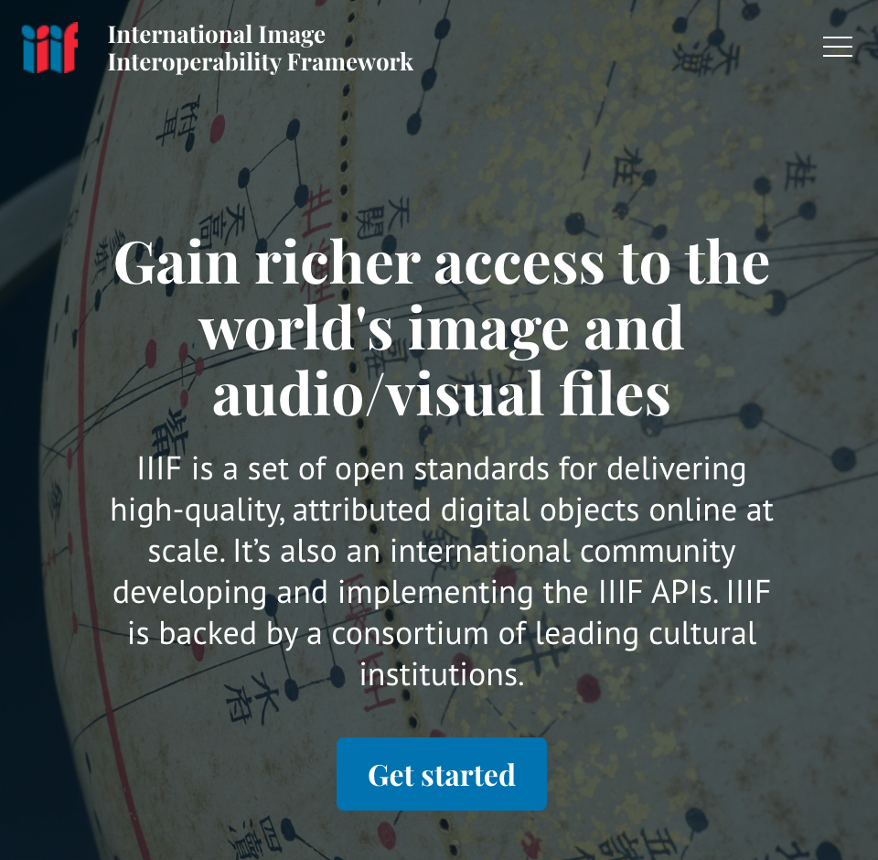
Overview of IIIF
IIIF (Triple-I-F) https://iiif.io/
(International Image Interoperability Framework)
International standard (framework and protocol) for sharing, displaying, and annotating images on the internet.
Used mainly by libraries, museums, archives, and other cultural institutions.
Main goal: to improve interoperability among image collections held by different institutions.
Easier to access, compare, and study diverse collections from around the world.
Notes:
Topic:Overview of IIIF
Voice:Joanna
```text
That’s where Triple I F comes in. The International Image Interoperability Framework, or triple i f, for short, is an international framework for digital archives that solves two major issues: the silo effect caused by the various differing standards, and the issue of “historical materials not being known”.
It is a global standard, a framework, for sharing, displaying, and annotating images on the internet.
It is especially used by libraries, museums, archives, and other cultural institutions around the world.
The main goal of triple I F, is to improve interoperability among image collections held by different institutions.
This makes it easier to access, compare, and study diverse collections from around the world.
The image on the right, shows the top page of the triple I f official website.
```
```description
That’s where IIIF comes in. IIIF is an international framework for digital archives that solves two major issues: the silo effect caused by the various differing standards, and the issue of “historical materials not being known”.
The International Image Interoperability Framework, or IIIF, for short, is a global standard, a framework, for sharing, displaying, and annotating images on the internet.
It is especially used by libraries, museums, archives, and other cultural institutions around the world.
The main goal of IIIF is to improve interoperability among image collections held by different institutions.
This makes it easier to access, compare, and study diverse collections from around the world.
The image on the right shows the top page of the IIIF official website.
```

Slide 7
Overview of IIIF (2)
User’s Perspective
Once a user learns how to operate one IIIF-compliant digital archive, they can basically understand how to use other IIIF-compatible archives as well
Publisher’s Perspective
By using programs and systems that follow the IIIF standard, there’s no need to develop a viewing system from scratch
Users can choose their preferred viewer (image browsing app)
Since system developers face less burden, development costs are reduced
Notes:
Topic:Overview of IIIF
Voice:Joanna
```text
Since triple I F uses a globally unified standard, once users learn how to operate one triple I F compliant digital archive, they can basically operate any other triple I f compliant archive as well.
They can also choose their preferred viewer.
On the other hand, for publishers, using triple I F compliant programs or systems means there’s no need to develop a viewing system from scratch.
This also reduces the burden on system developers, leading to reduced costs.
```
```description
Since IIIF uses a globally unified standard, once users learn how to operate one IIIF-compliant digital archive, they can basically operate any other IIIF-compliant archive as well.
They can also choose their preferred viewer.
On the other hand, for publishers, using IIIF-compliant programs or systems means there’s no need to develop a viewing system from scratch.
This also reduces the burden on system developers, leading to reduced costs.
```

Slide 8
Benefits of the IIIF Framework
1. Standardized Access
Because access methods are standardized, users can view images from different sources in the same way
2. Support for High-Resolution Images
Even large images can be displayed efficiently, and their details can be viewed clearly
3. Flexible Display Features
Users can zoom in, rotate, or compare images side by side
4. Annotation and Sharing
Users can add annotations to images and share them with others
Notes:
Topic:Benefits of the IIIF Framework
Voice:Joanna
```text
Next, let’s look at the benefits of using the triple I F framework.
Cultural institutions, universities, research organizations, or individuals that distribute images or videos online can offer the following features by adopting this framework.
The first is standardized access.
Since access methods to images are defined in specifications agreed by cultural, educational, and research institutions participating in the triple I F community, users can view images from different sources using the same method.
```
```description
Next, let’s look at the benefits of using the IIIF framework.
Cultural institutions, universities, research organizations, or individuals that distribute images or videos online can offer the following features by adopting this framework.
The first is standardized access.
Since access methods to images are defined in specifications agreed by cultural, educational, and research institutions participating in the IIIF community, users can view images from different sources using the same method.
```

Slide 9
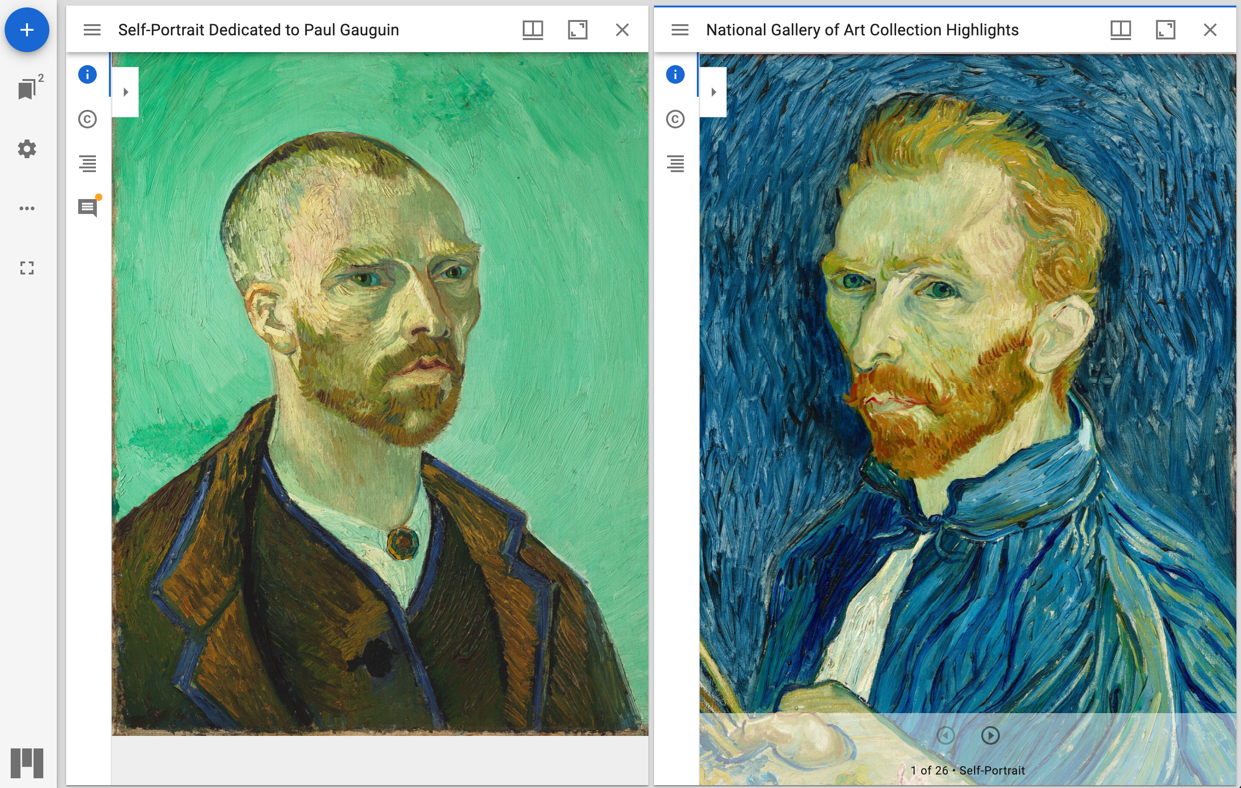
Standardized Access
This image viewer is an example of the software ”Mirador” and is accessible from the official website.
Harvard Art Museums (Massachusetts)
National Gallery of Art (Washington)
Mirador Viewer: https://mirador-dev.netlify.app/__tests__/integration/mirador/
Notes:
Topic:Benefits of the IIIF Framework
Voice:Joanna
```text
This is an example screen of a triple I F-compatible image viewer.
Nearly all triple I F-compatible viewers can be displayed in a web browser.
If the viewer supports displaying multiple images simultaneously, you can, for instance, load an image from one source on the left and one from another on the right, and compare them side-by-side within your browser.
```
```description
This is an example screen of a IIIF-compatible image viewer.
Nearly all IIIF-compatible viewers can be displayed in a web browser.
If the viewer supports displaying multiple images simultaneously, you can, for instance, load an image from one source on the left and one from another on the right, and compare them side-by-side within your browser.
```

Slide 10
Benefits of the IIIF Framework
1. Standardized Access
Because access methods are standardized, users can view images from different sources in the same way
2. Support for High-Resolution Images
Even large images can be displayed efficiently, and their details can be viewed clearly
3. Flexible Display Features
Users can zoom in, rotate, or compare images side by side
4. Annotation and Sharing
Users can add annotations to images and share them with others
Notes:
Topic:Benefits of the IIIF Framework
Voice:Joanna
```text
The second is the support for high-resolution images.
Even large images can be displayed efficiently, and their details are clearly visible.
```
```description
The second is the support for high-resolution images.
Even large images can be displayed efficiently, and their details are clearly visible
```

Slide 11
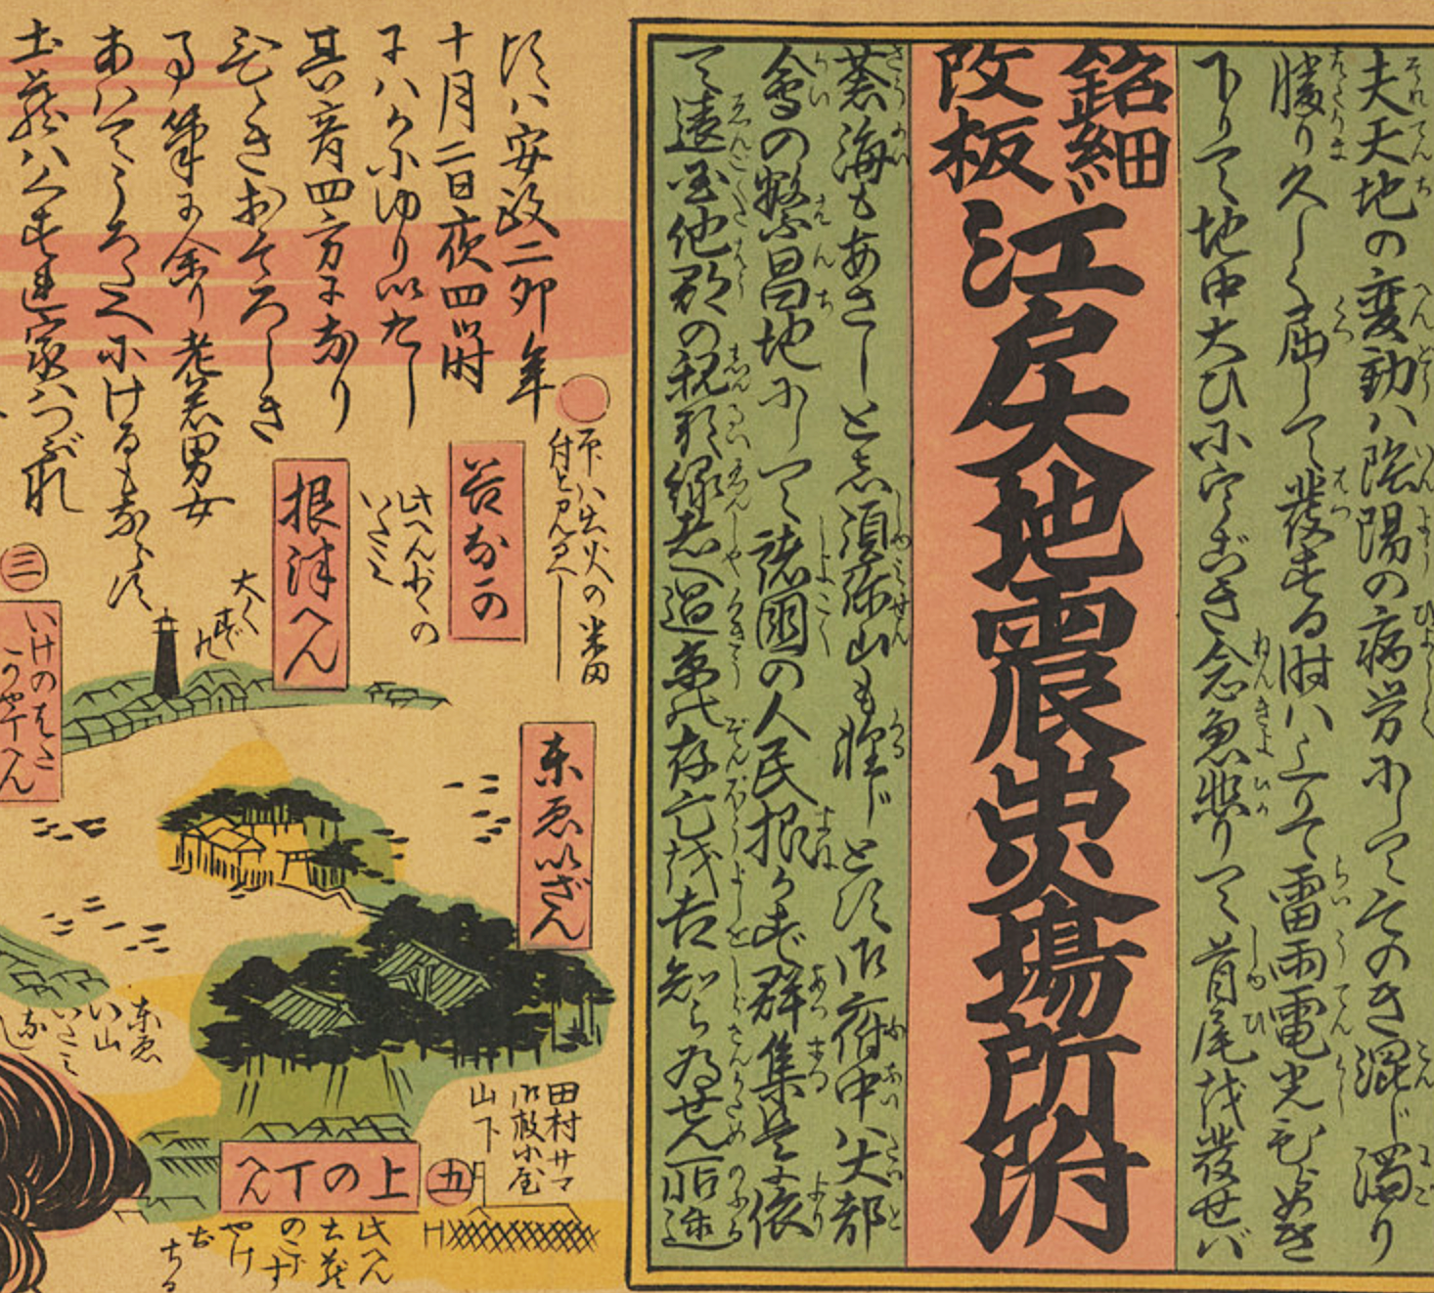
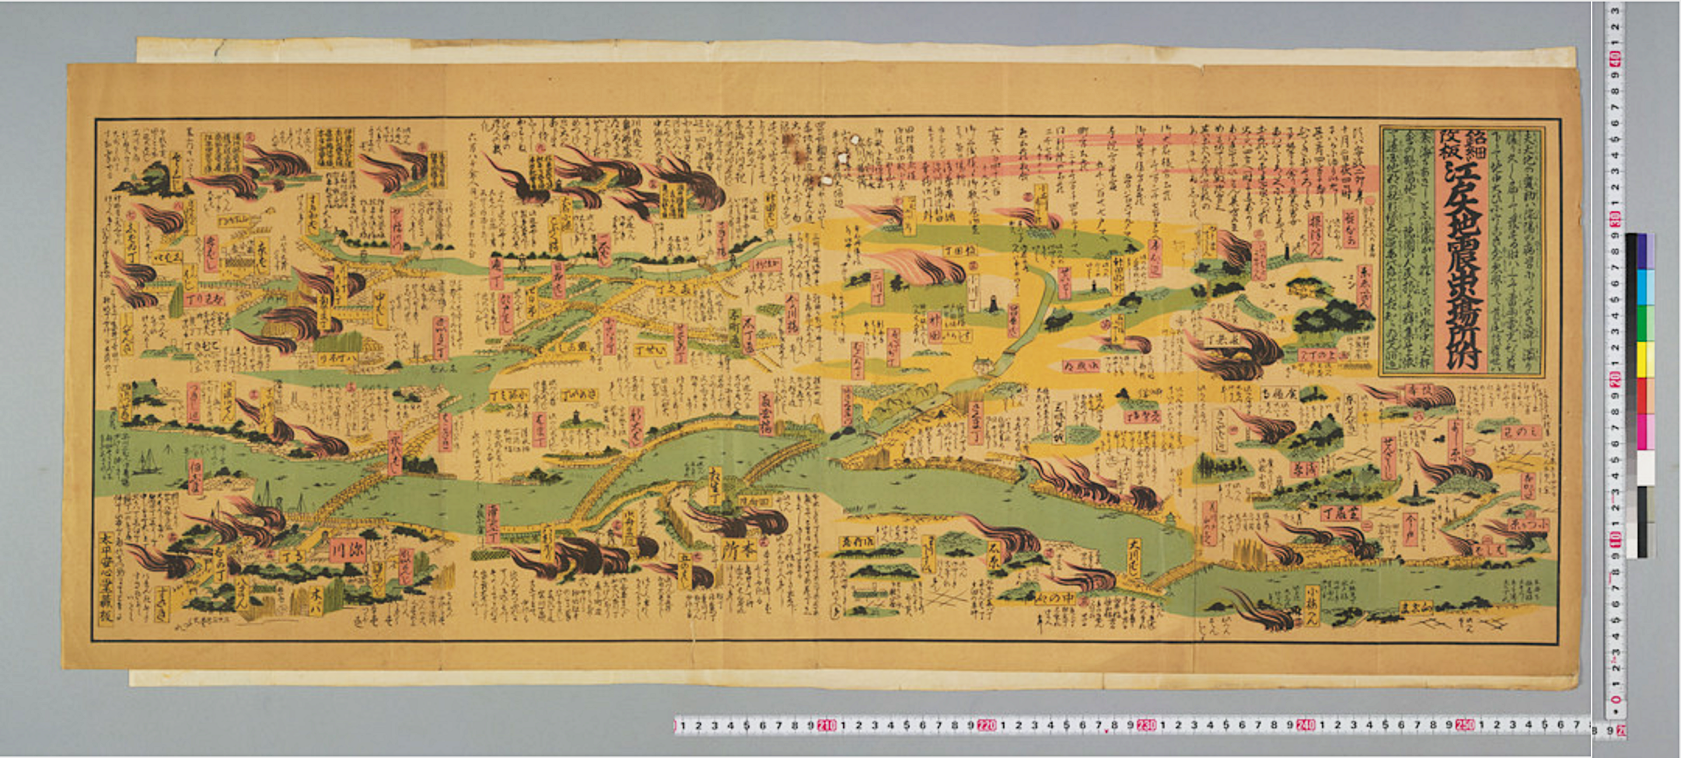

High-resolution Image Support
“Detailed Revised Map of Fire Outbreak Locations from the Great Edo Earthquake” – University of Tokyo General Library
Notes:
Topic:Benefits of the IIIF Framework
Voice:Joanna
```text
Even large-sized materials like maps, which are difficult to view on a monitor screen, can be closely examined by zooming in, if they are stored as high-resolution images.
```
```description
Even large-sized materials like maps, which are difficult to view on a monitor screen, can be closely examined by zooming in, if they are stored as high-resolution images.
```

Slide 12
Benefits of the IIIF Framework
1. Standardized Access
Because access methods are standardized, users can view images from different sources in the same way
2. Support for High-Resolution Images
Even large images can be displayed efficiently, and their details can be viewed clearly
3. Flexible Display Features
Users can zoom in, rotate, or compare images side by side
4. Annotation and Sharing
Users can add annotations to images and share them with others
Notes:
Topic:Benefits of the IIIF Framework
Voice:Joanna
```text
The third benefit is flexible display features.
Users can zoom in, rotate or compare images side by side.
```
```description
The third benefit is flexible display features.
Users can zoom in, rotate or compare images side by side.
```

Slide 13
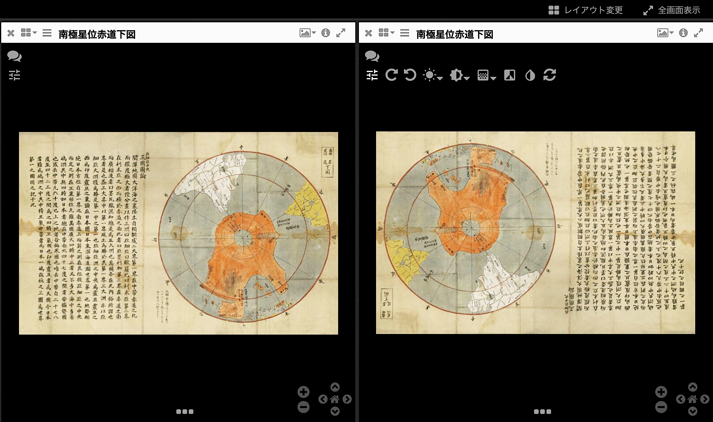
Flexible Image Display Features
Display options (viewer dependant)
Saga Prefectural Library, Southern Hemisphere Diagram Centered on the South Pole
Notes:
Topic:Benefits of the IIIF Framework
Voice:Joanna
```text
Some viewers include the flexible image display features that are defined in the triple I f standard.
In the example on screen, the map is being rotated.
```
```description
Some viewers include the flexible image display features that are defined in the IIIF standard.
In the example on screen, the map is being rotated.
```

Slide 14
Benefits of the IIIF Framework
1. Standardized Access
Because access methods are standardized, users can view images from different sources in the same way
2. Support for High-Resolution Images
Even large images can be displayed efficiently, and their details can be viewed clearly
3. Flexible Display Features
Users can zoom in, rotate, or compare images side by side
4. Annotation and Sharing
Users can add annotations to images and share them with others
Notes:
Topic:Benefits of the IIIF Framework
Voice:Joanna
```text
The fourth benefit is annotation and sharing.
Users can add annotations to images and share them with others.
```
```description
The fourth benefit is annotation and sharing.
Users can add annotations to images and share them with others.
```

Slide 15
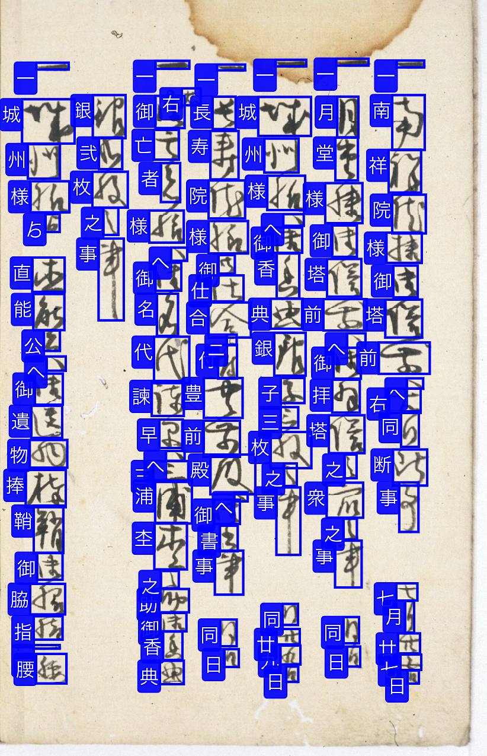
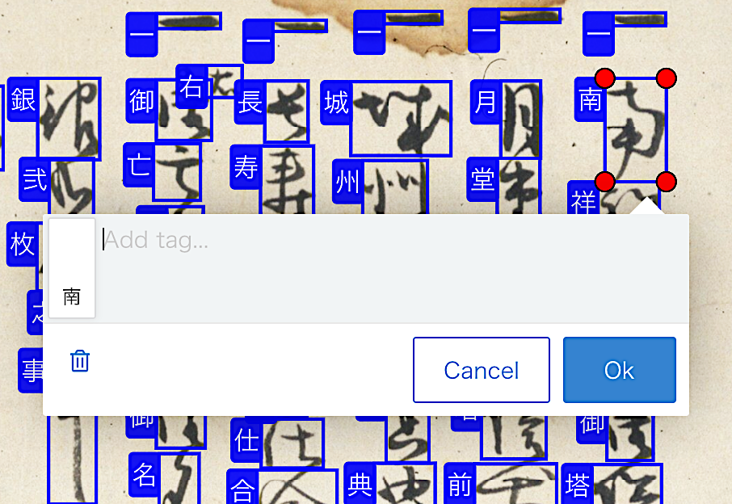
Annotation and Sharing
An example of assigning standard script characters to cursive script characters. (source: Kuzushiji.work)
Notes:
Topic:Benefits of the IIIF Framework
Voice:Joanna
```text
In this example, cursive characters are displayed alongside their standard printed equivalents. This way, users can overlay annotations on the original image to assist with reading or interpretation, and can also edit them if needed.
```
```description
In this example, cursive characters are displayed alongside their standard printed equivalents. This way, users can overlay annotations on the original image to assist with reading or interpretation, and can also edit them if needed.
```

Slide 16
Examples of IIIF images published in OUKA
https://ir.library.osaka-u.ac.jp/repo/ouka/rare/
Notes:
Topic:Examples of IIIF images published in OUKA
Voice:Joanna
```text
Next, let us introduce several humanities-related historical materials currently published on OUKA that support triple I F.
```
```description
Next, let us introduce several humanities-related historical materials currently published on OUKA that support IIIF.
```

Slide 17
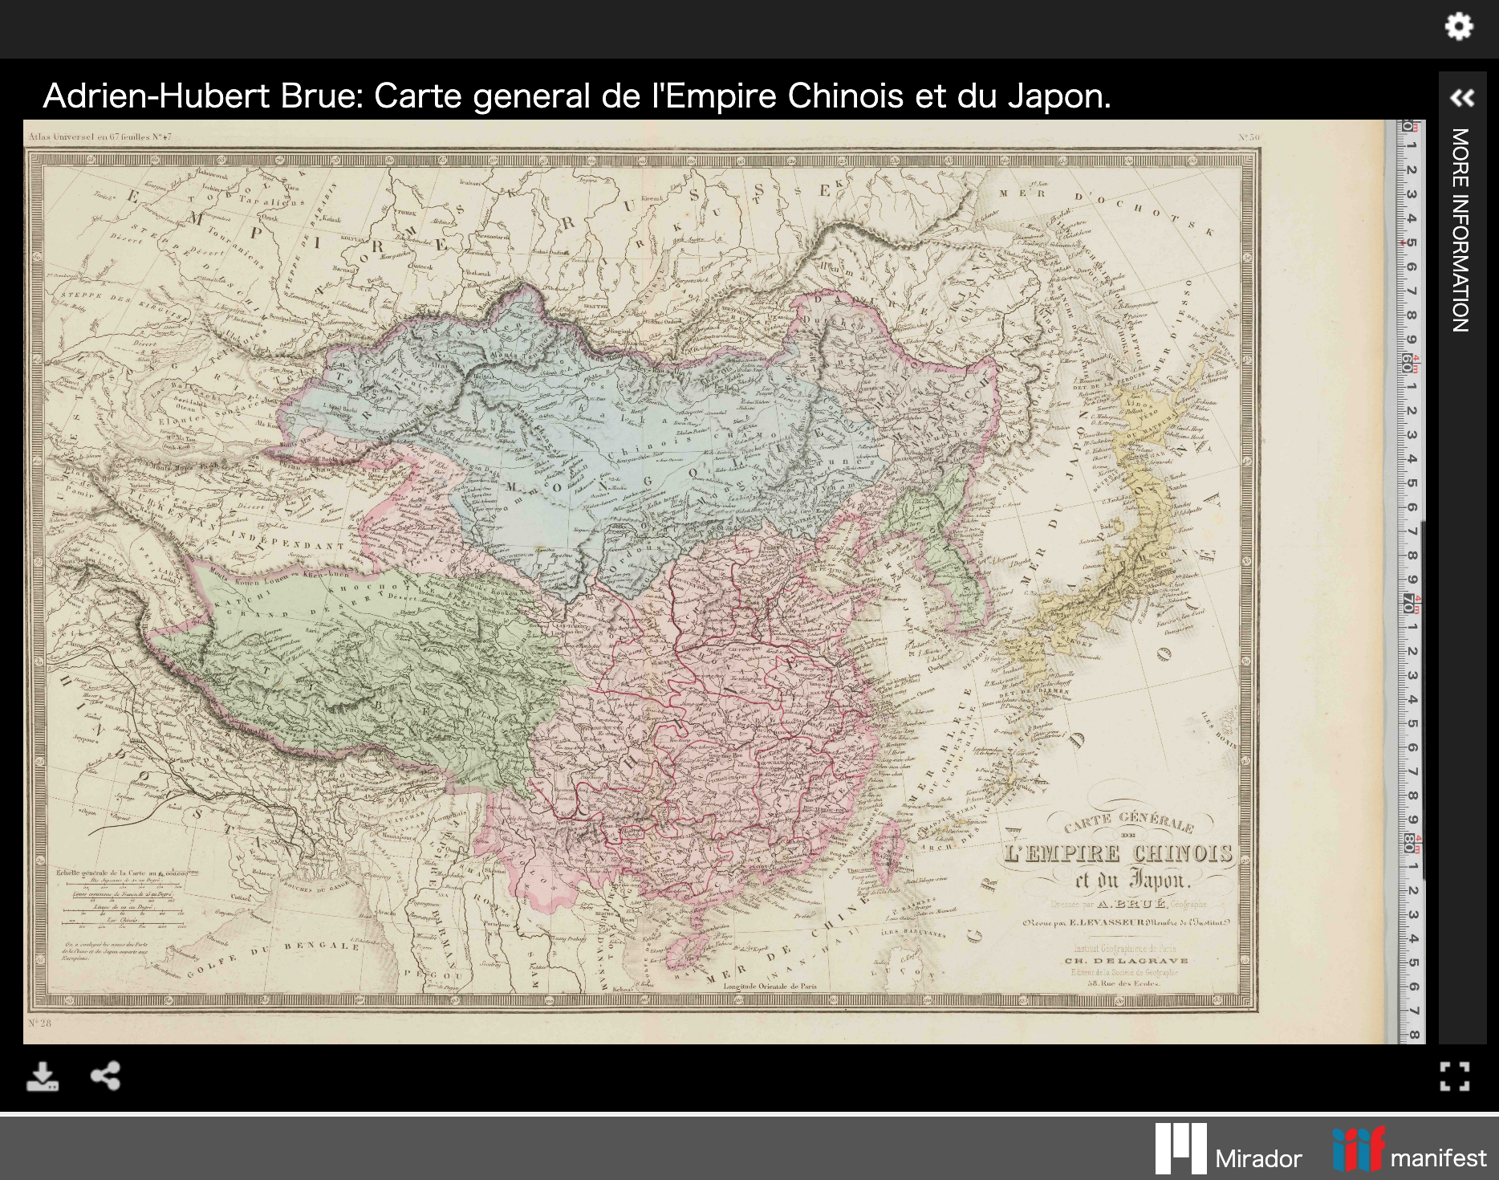
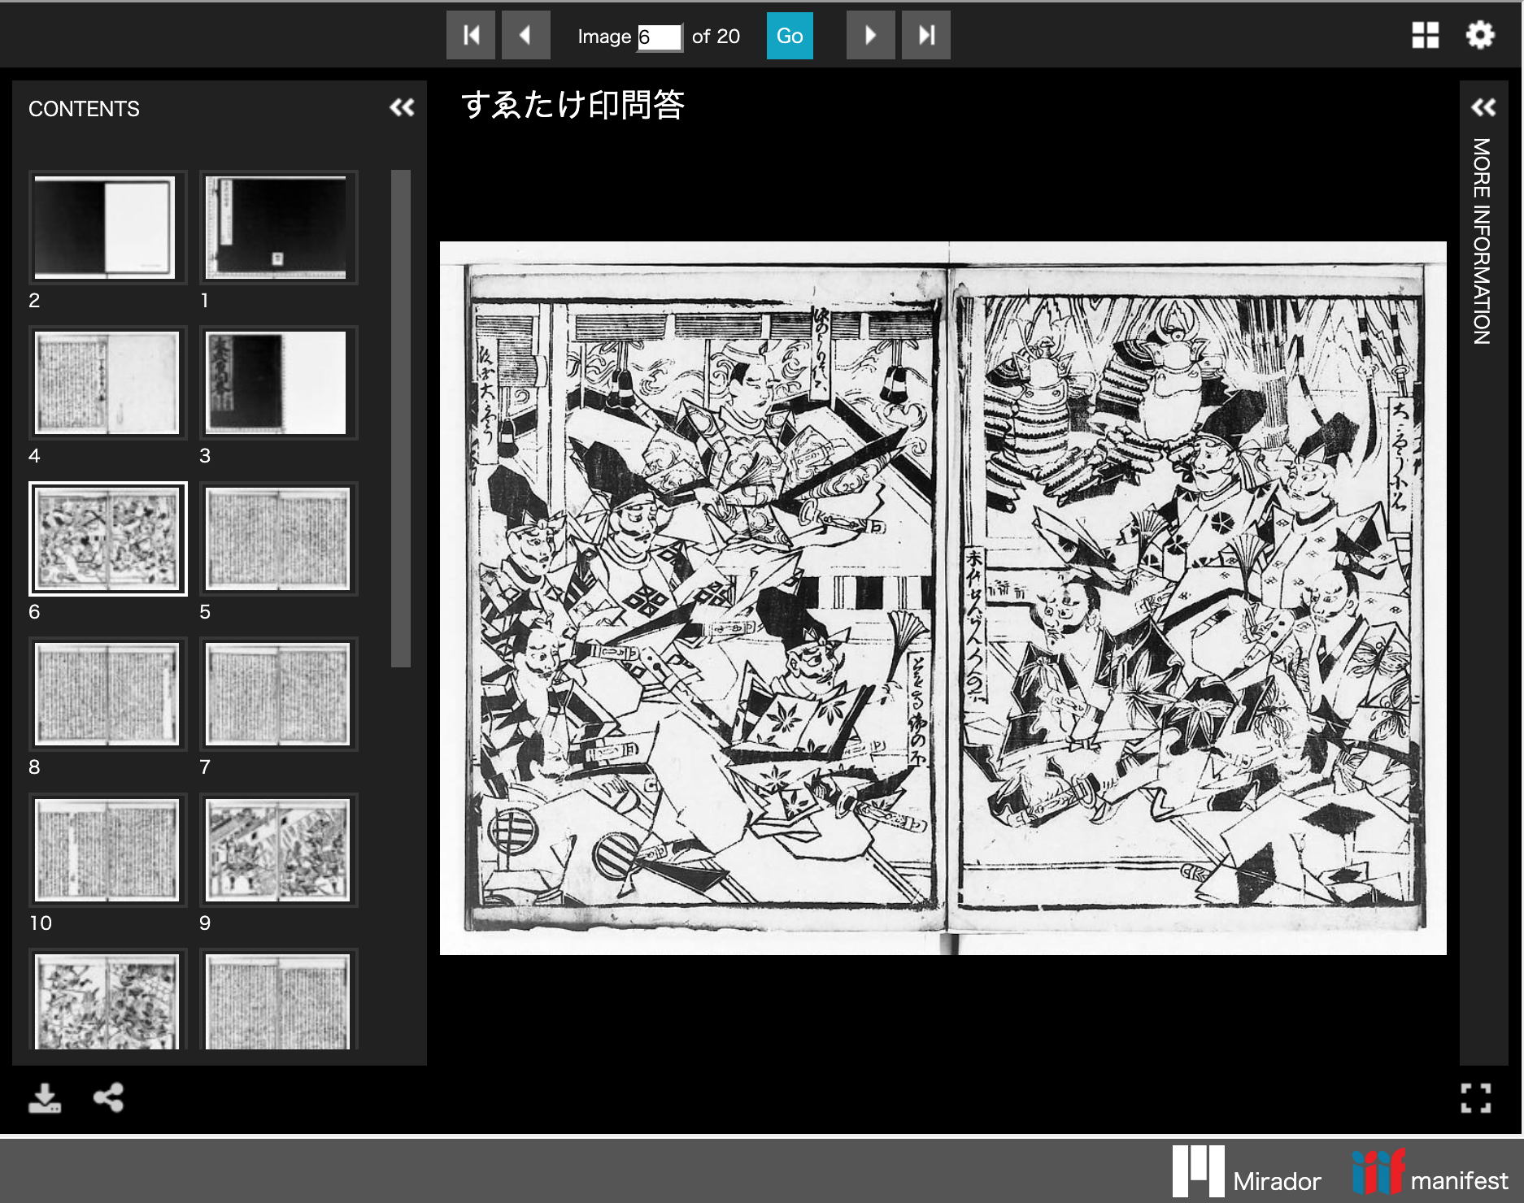
Collections Published in OUKA
Source: Old Western Maps of Asia “西洋古版アジア地図”
Source: The Akagi Library’s Collection of Early Jōruri Editions “赤木文庫蔵古浄瑠璃コレクション”
Notes:
Topic:Examples of IIIF images published in OUKA
Voice:Joanna
```text
OUKA has already made a number of historical materials available as triple I F images.
For example, the Old Western Maps of Asia is a collection of maps of Asia, published in the West over a span of 300 years, from the 1570s to the 1870s.
The Akagi ぶんこ Early じょう るり Collection is a large set of around 100 original scripts, published between 1633 and 1719.
```
```description
OUKA has already made a number of historical materials available as IIIF images.
For example, the Old Western Maps of Asia is a collection of maps of Asia published in the West over a span of 300 years, from the 1570s to the 1870s.
The Akagi Bunko Early Jōruri Collection is a large set of around 100 original Kojōruri (early jōruri scripts), published between 1633 and 1719.
```

Slide 18
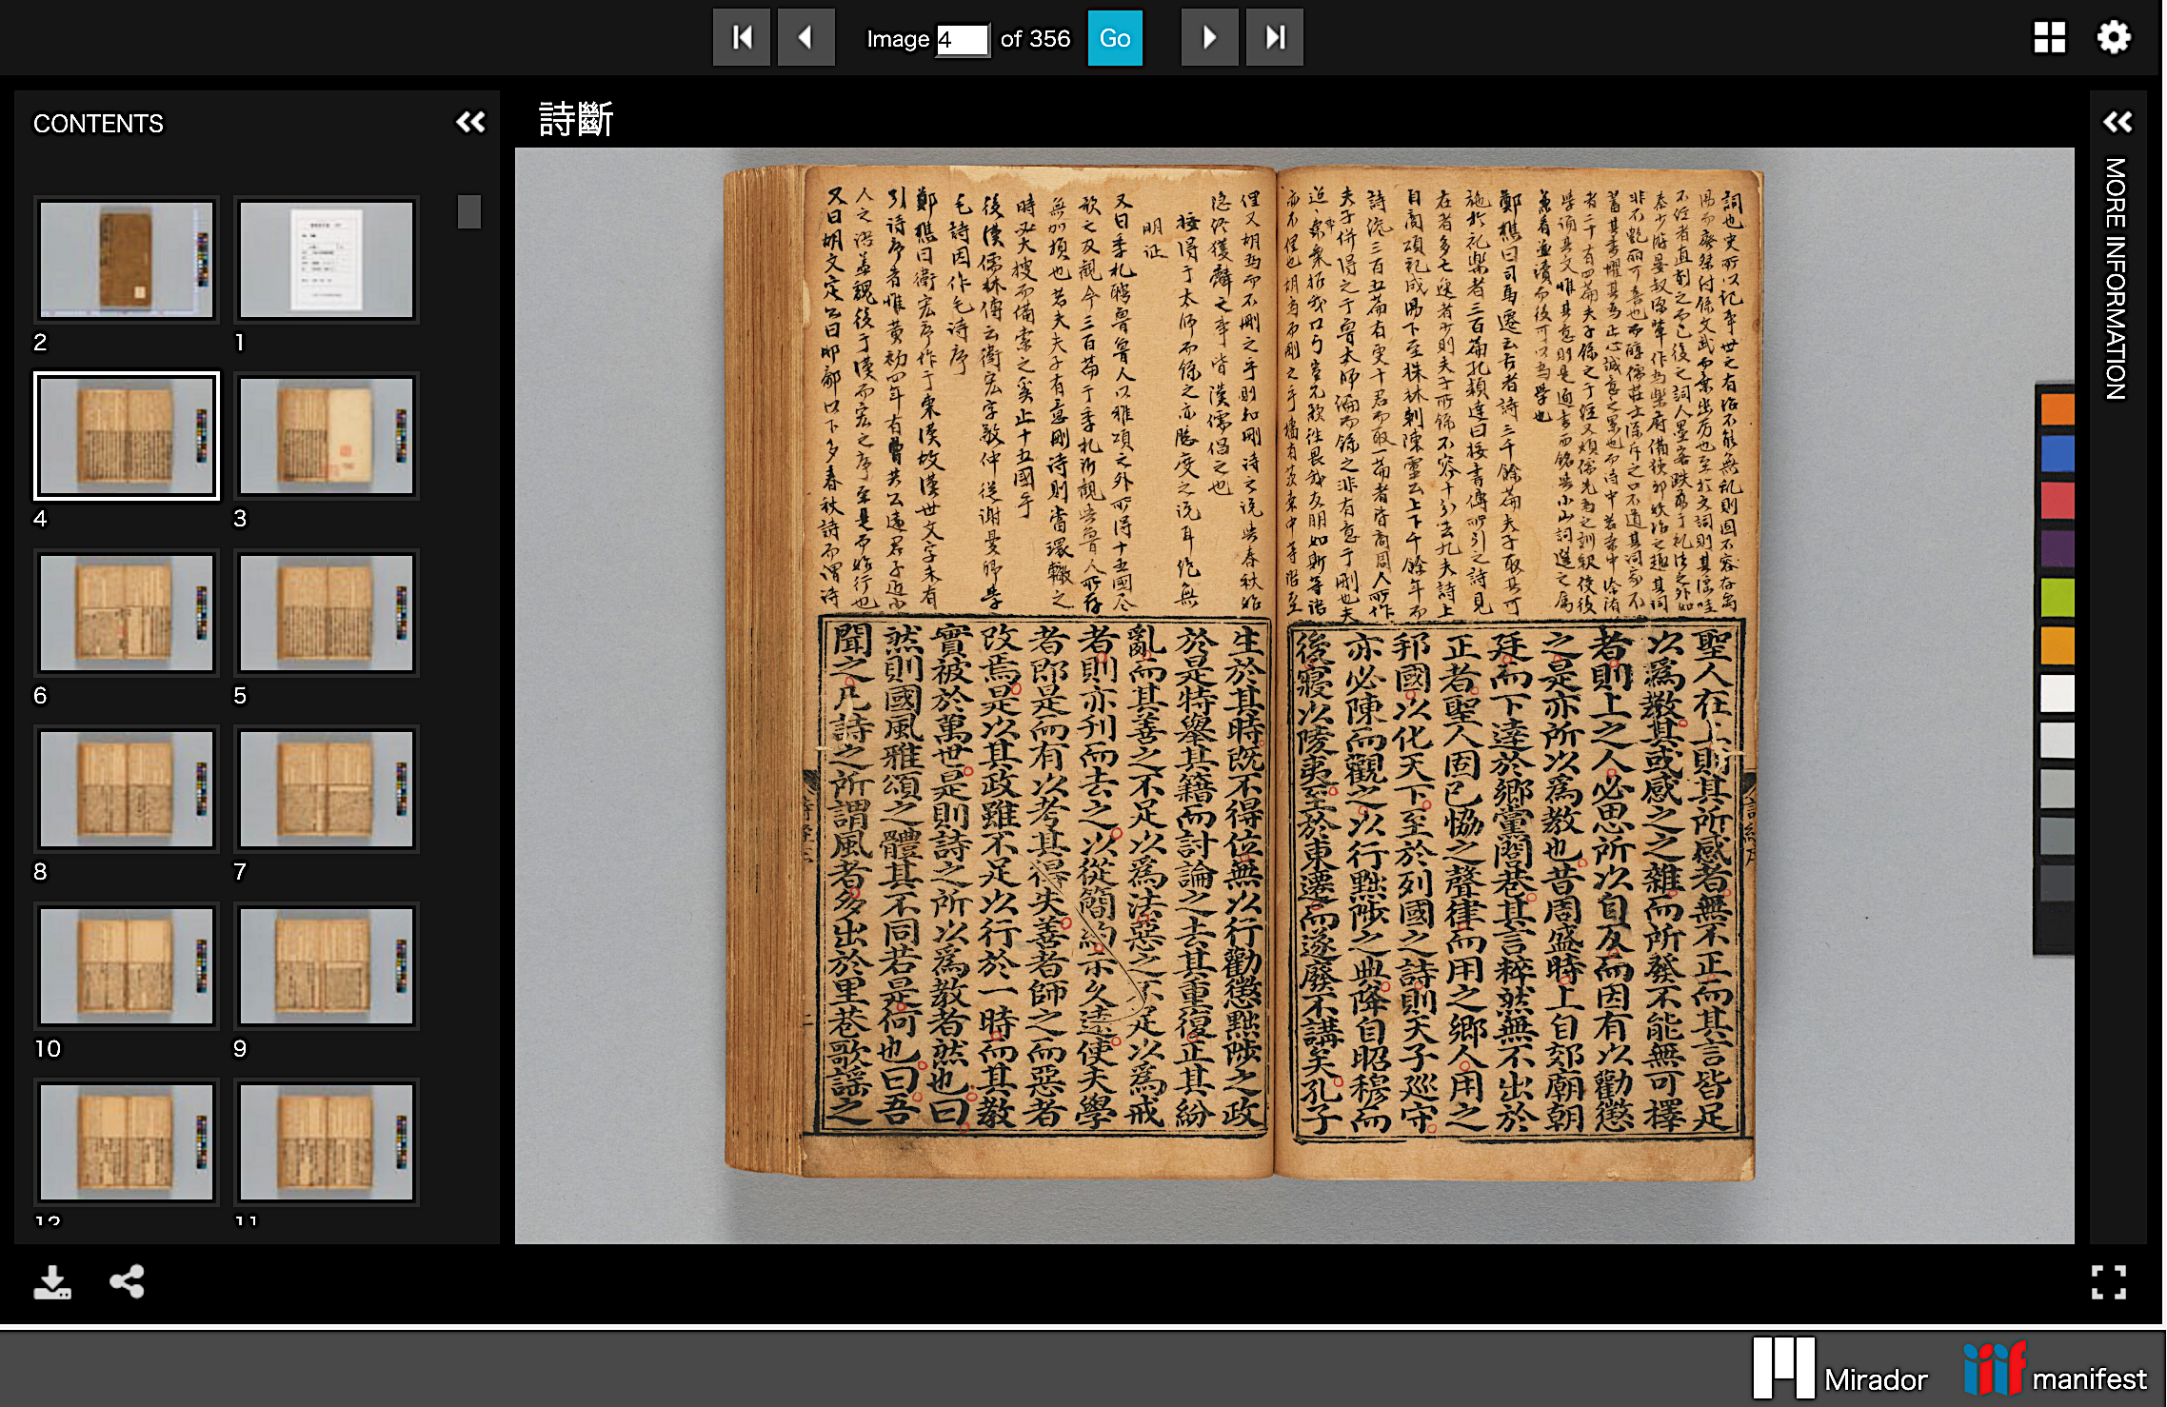
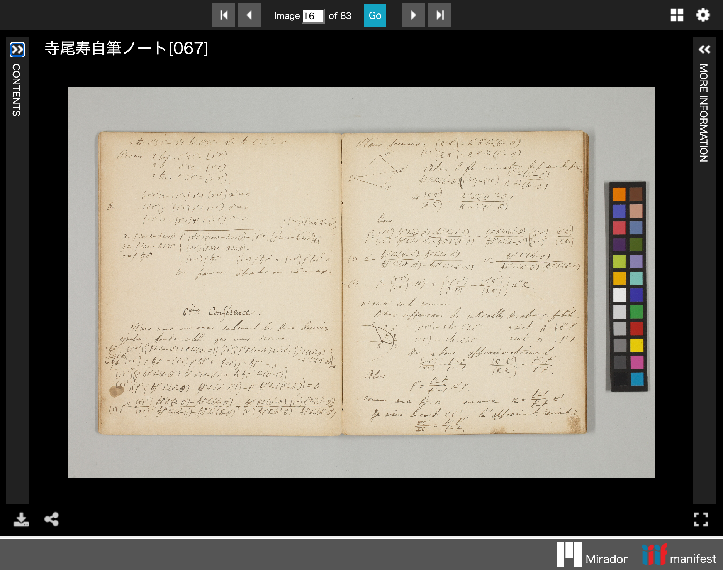
Collections Published in OUKA (2)
Source: The Kaitokudō Collection
Source: Toshihisa Terao’s Personal Notebooks
Notes:
Topic:Examples of IIIF images published in OUKA
Voice:Joanna
```text
The かいとくどう Library also features rare books related to the かいとくどう academy, held by the University of Osaka’s Library, including original manuscripts by Nakai Chikuzan, a prominent scholar during the Kansei era.
The Terao Hisashi Manuscript Notebooks are a collection of handwritten notes by Dr. Terao Hisashi, an astronomer active in the Meiji and Taishō periods and the first director of the Tokyo Astronomical Observatory. Nine volumes from the Mathematics Department Library are publicly available.
In addition, many rare historical materials that are otherwise difficult for the public to access are gradually being made available through triple I F.
We encourage you to visit the OUKA website and explore them yourself.
```
```description
The Kaitokudō Library also features rare books related to the Kaitokudō academy, held by the Osaka University Library, including original manuscripts by Nakai Chikuzan, a prominent scholar during the Kansei era.
The Terao Hisashi Manuscript Notebooks are a collection of handwritten notes by Dr. Terao Hisashi, an astronomer active in the Meiji and Taishō periods and the first director of the Tokyo Astronomical Observatory. Nine volumes from the Mathematics Department Library are publicly available.
In addition, many rare historical materials that are otherwise difficult for the public to access are gradually being made available through IIIF.
We encourage you to visit the OUKA website and explore them yourself.
```

