Slide 1
4．Basic Usage of IIIF Images
Notes:
Topic:Introduction
Voice:Joanna
```text
This section introduces the basic usage of triple I F images, including step-by-step instructions.
```
```description
This section introduces the basic usage of IIF images, including step-by-step instructions.
```

Slide 2
4-1. Basics of Universal Viewer
Notes:
Topic:Introduction
Voice:Joanna
```text
At The University of Osaka, two triple I F image viewers are used: Universal Viewer and Mirador.
There is also another triple I F compatible viewer known as the triple I F Curation Viewer.
Universal Viewer and Mirador are often used by other institutions as well.
Here, we will first introduce the basics of Universal Viewer.
```
```description
At The University of Osaka, two IIIF image viewers are used: Universal Viewer and Mirador.
There is also another IIIF-compatible viewer known as the IIIF Curation Viewer.
Universal Viewer and Mirador are often used by other institutions as well.
Here, we will first introduce the basics of Universal Viewer.
```

Slide 3
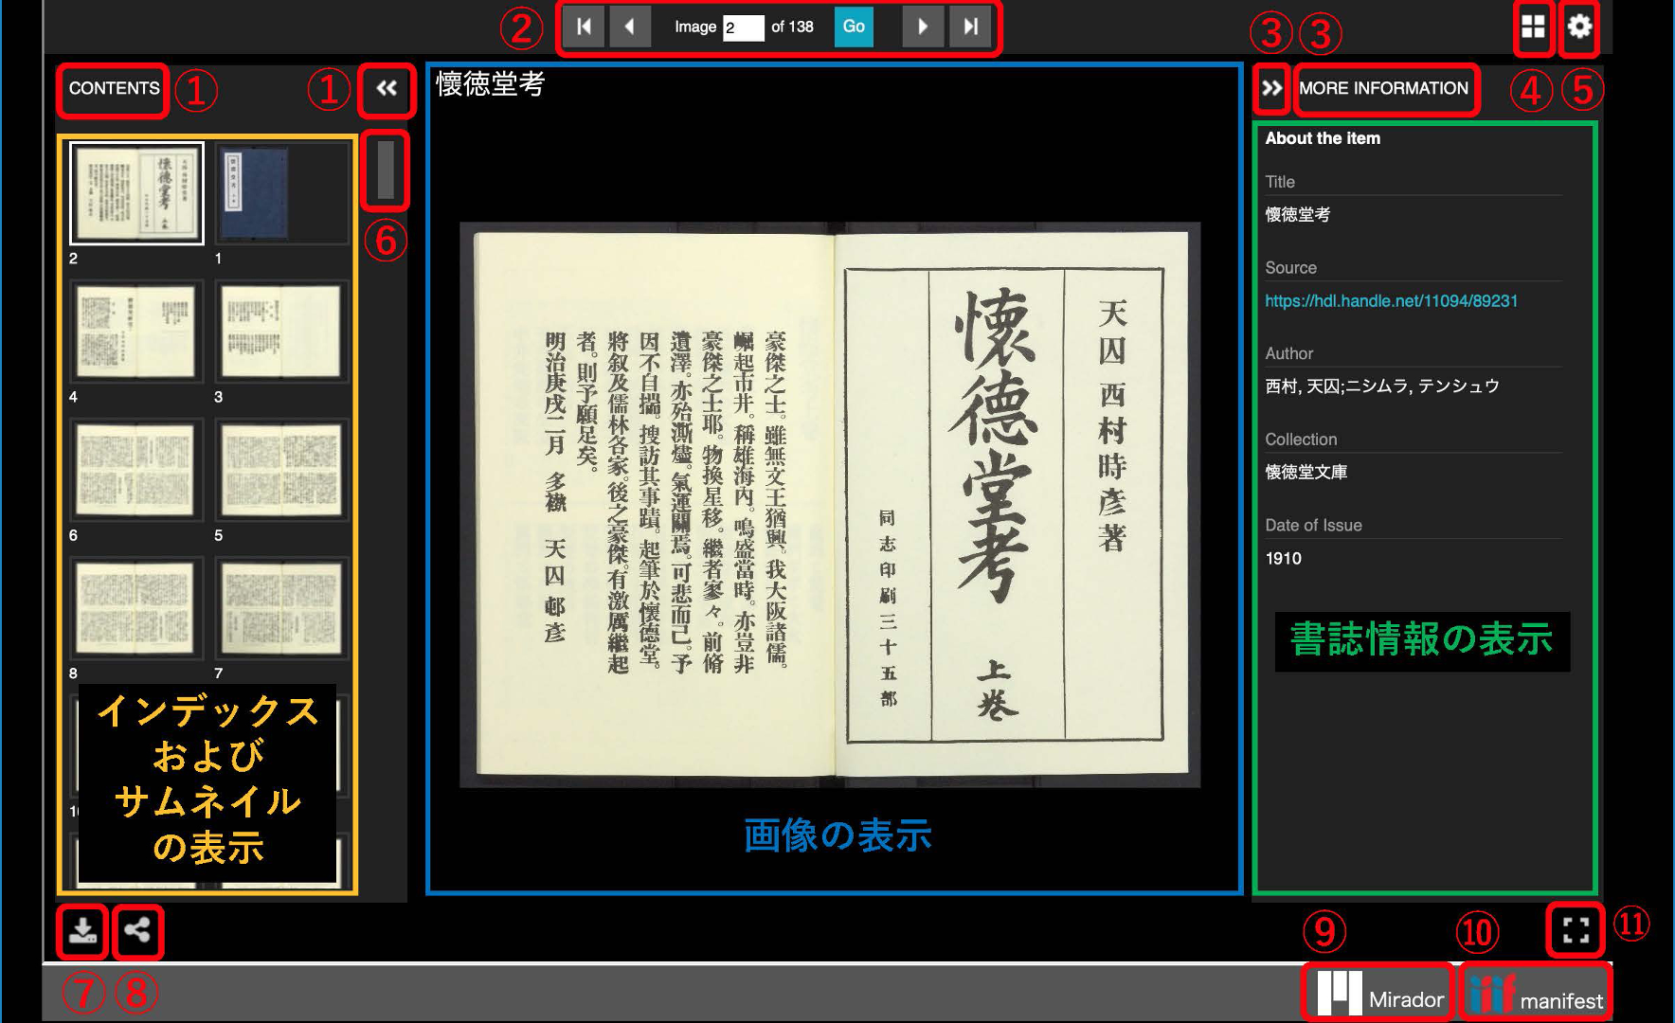
Bibliographic Information
Index & Thumbnails
Image Viewer
Notes:
Topic:Basics of Universal Viewer
Voice: Joanna
```text
This is the screen that appears when Universal Viewer is opened.
The index and thumbnails are displayed on the left, the selected image in the center and the bibliographical information on the right.
Here, we will introduce each feature in order.
```
```description
This is the screen that appears when Universal Viewer is opened.
The index and thumbnails are displayed on the left, the selected image in the center and the bibliographical information on the right.
Here, we will introduce each feature in order.
```

Slide 4
Notes:
Topic:Basics of Universal Viewer
Voice: Joanna
```text
The circled 1 on the top left of the screen controls the display of the index and thumbnails.
Click the left pointing arrow icon to show the index and thumbnails.
```
```description
The ① on the top left of the screen controls the display of the index and thumbnails.
Click the left pointing arrow icon to show the index and thumbnails.
```

Slide 5
Notes:
Topic:Basics of Universal Viewer
Voice: Joanna
```text
The circled 2 at the top of the screen is a feature for navigating through the pages. You can move forward or backward one page at a time, or jump to the first or last page.
```
```description
The ② at the top of the screen is a feature for navigating through the pages. You can move forward or backward one page at a time, or jump to the first or last page.
```

Slide 6
Bibliographic Information
Notes:
Topic:Basics of Universal Viewer
Voice: Joanna
```text
The circled 3 at the top right of the screen is a function for displaying the bibliographic information.
Click the right pointing arrow to view the title of the item you are viewing, its URL, the author, holding institution and year of publication.
The URL can be used for research data management, or to share the item with others.
```
```description
The ③ at the top right of the screen is a function for displaying the bibliographic information.
Click the right pointing arrow to view the title of the item you are viewing, its URL, the author, holding institution and year of publication.
The URL can be used for research data management or to share the item with others.
```

Slide 7
Bibliographic Information
Notes:
Topic:Basics of Universal Viewer
Voice: Joanna
```text
The circled 4 at the top right of the screen lets you switch the display mode. You can toggle between single-page view (showing a specific page) and gallery view (showing multiple pages at once).
```
```description
The ④ at the top right of the screen lets you switch the display mode. You can toggle between single-page view (showing a specific page) and gallery view (showing multiple pages at once).
```

Slide 8
Bibliographic Information
Notes:
Topic:Basics of Universal Viewer
Voice: Joanna
```text
The circled 5 next to number 4, are the settings. You can confirm or change settings, such as zooming in, when using a mouse.
```
```description
The ⑤ next to the ④, are the settings. You can confirm or change settings, such as zooming in when using a mouse.

Slide 9
Notes:
Topic:Basics of Universal Viewer
Voice: Joanna
```text
The circled 6 on the left side of the screen, lets you move around within the index and thumbnail panel. By hovering your cursor over this area and dragging it, you can move within the index and thumbnail panel.
```
```description
The ⑥ on the left side of the screen, lets you move around within the index and thumbnail panel. By hovering your cursor over this area and dragging it, you can move within the index and thumbnail panel.
```

Slide 10
Index & Thumbnails
Image Viewer
Notes:
Topic:Basics of Universal Viewer
Voice: Joanna
```text
The circled 7 at the bottom left is for downloading. You can download the image of the material you are currently viewing.
```
```description
The ⑦ at the bottom left is for downloading. You can download the image of the material you are currently viewing.
```

Slide 11
Index & Thumbnails
Image Viewer
Notes:
Topic:Basics of Universal Viewer
Voice: Joanna
```text
The circled 8 on the right of the 7, can be used to share the content.
You can obtain the URL of this material in the form of an HTML tag that can be embedded in a website.
```
```description
The ⑧ on the right of the ⑦, can be used to share the content.
You can obtain the URL of this material in the form of an HTML tag that can be embedded in a website.
```

Slide 12
Bibliographic Information
Image Viewer
Notes:
Topic:Basics of Universal Viewer
Voice: Joanna
```text
The circled 9 on the bottom right is for switching to Mirador. You can switch the viewer from the currently displayed Universal Viewer to Mirador.
```
```description
The ⑨ on the bottom right is for switching to Mirador. You can switch the viewer from the currently displayed Universal Viewer to Mirador.
```

Slide 13
Bibliographic Information
Image Viewer
Notes:
Topic:Basics of Universal Viewer
Voice: Joanna
```text
The circled 10 on the right of 9, is a feature that can display the triple I F manifest. You can open the triple I F manifest json file associated with the current item.
```
```description
The ⑩ on the right of ⑨, is a feature that can display the IIIF manifest. You can open the IIIF manifest json file associated with the current item.
```

Slide 14
Bibliographic Information
Image Viewer
Notes:
Topic:Basics of Universal Viewer
Voice: Joanna
```text
The circled 11 in the bottom right corner is the ”switch to fullscreen” feature.
By clicking it, you can switch to full screen mode.
To exit full screen, click the icon in the bottom right.
```
```description
The ⑪ in the bottom right corner is the ”switch to fullscreen” feature.
By clicking it, you can switch to full screen mode.
To exit full screen, click the icon in the bottom right.
```

Slide 15
Bibliographic Information
Index & Thumbnails
Image Viewer
Notes:
Topic:Basics of Universal Viewer
Voice: Joanna
```text
This concludes the basics of the Universal Viewer.
```
```description
This concludes the basics of the Universal Viewer.
```

Slide 16
4-2．Mirador Basics
Notes:
Topic:Mirador Basics
Voice:Joanna
```text
Next, we will introduce the basics of Mirador.
```
```description
Next, we will introduce the basics of Mirador.
```

Slide 17
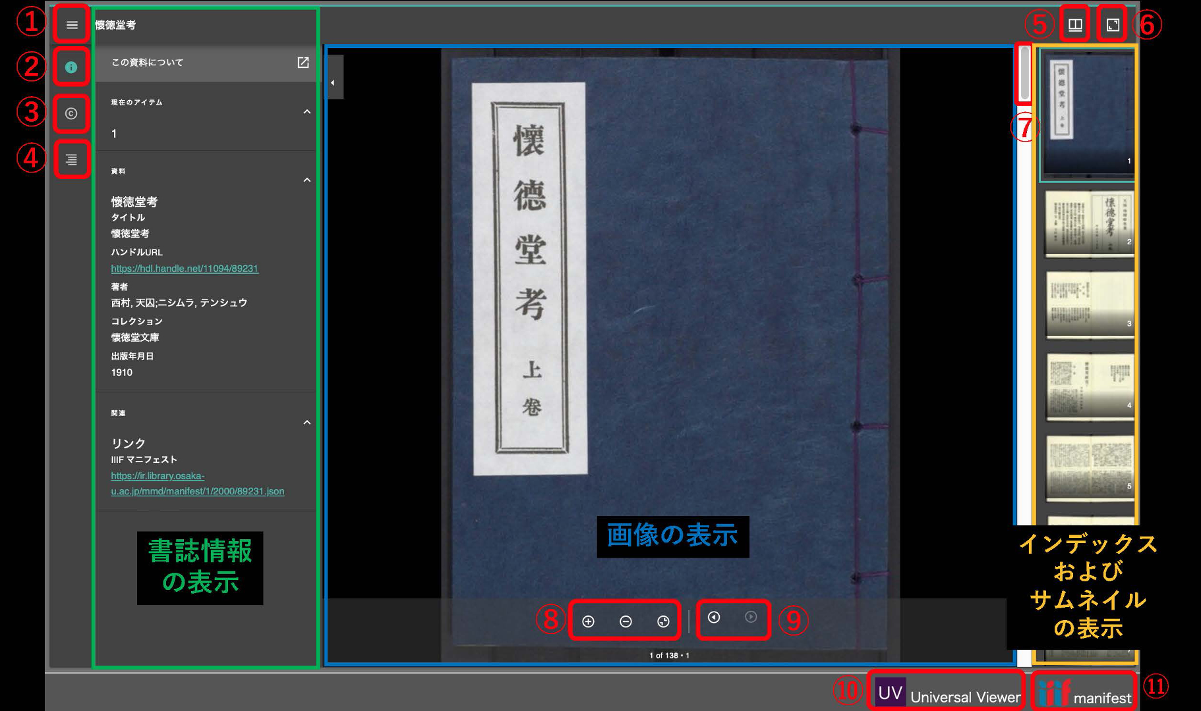
Image Viewer
Bibliographic Information
Index & Thumbnails
Notes:
Topic:Mirador Basics
Voice:Joanna
```text
This is the screen that appears when you open Mirador.
In Mirador, bibliographic information is displayed on the left, the selected image in the center, and the index and thumbnails on the right.
Here, we will go over each feature of Mirador in order.
```
```description
This is the screen that appears when you open Mirador.
In Mirador, bibliographic information is displayed on the left, the selected image in the center, and the index and thumbnails on the right.
Here, we will go over each feature of Mirador in order.
```

Slide 18
Image Viewer
Bibliographic Information
Notes:
Topic:Mirador Basics
Voice:Joanna
```text
The circled 1 at the top left of the screen is used to toggle the sidebar.
You can show or hide the sidebar, which displays information like bibliographic details, rights, index, and thumbnails.
```
```description
The ① at the top left of the screen is used to toggle the sidebar.
You can show or hide the sidebar, which displays information like bibliographic details, rights, index, and thumbnails.
```

Slide 19
Image Viewer
Bibliographic Information
Notes:
Topic:Mirador Basics
Voice:Joanna
```text
The circled 2 below the 1 is used to display bibliographic information.
You can view the title of the item, its URL, the author, holding institution, publication year, and the associated triple I F manifest json file.
```
```description
The ② below ① is used to display bibliographic information.
You can view the title of the item, its URL, the author, holding institution, publication year, and the associated IIIF manifest json file.
```

Slide 20
Image Viewer
Bibliographic Information
Notes:
Topic:Mirador Basics
Voice:Joanna
```text
The circled 3 located below that, is used to display information regarding the rights associated with the file.
It appears when rights-related descriptions are available.
```
```description
The ③ located below that, is used to display information regarding the rights associated with the file.
It appears when rights-related descriptions are available.
```

Slide 21
Image Viewer
Bibliographic Information
Notes:
Topic:Mirador Basics
Voice:Joanna
```text
The circled 4 below that, is used to display the index and thumbnails.
The index and thumbnails will be shown on the right side of the screen.
```
```description
The ④ below that, is used to display the index and thumbnails.
The index and thumbnails will be shown on the right side of the screen.
```

Slide 22
Notes:
Topic:Mirador Basics
Voice:Joanna
```text
The circled 5 at the top right lets you change the display format.
You can switch between single-page and gallery view, and also move the index and thumbnails from the right side of the page to the bottom or hide them entirely.
```
```description
The ⑤ at the top right lets you change the display format.
You can switch between single-page and gallery view, and also move the index and thumbnails from the right side of the page to the bottom or hide them entirely.
```

Slide 23
Notes:
Topic:Mirador Basics
Voice:Joanna
```text
The circled 6 next to 5 is used to maximize the window.
Clicking it is supposed to maximize the window, but since the window is usually already maximized by default, clicking it usually results in no visible change.
```
```description
The ⑥ next to ⑤ is used to maximize the window.
Clicking it is supposed to maximize the window, but since the window is usually already maximized by default, clicking it usually results in no visible change.
```

Slide 24
Notes:
Topic:Mirador Basics
Voice:Joanna
```text
The circled 7 on the right lets you move around within the index and thumbnail panel. By hovering your cursor over this area and dragging it, you can move within the index and thumbnail panel.
```
```description
The ⑦ on the right lets you move around within the index and thumbnail panel. By hovering your cursor over this area and dragging it, you can move within the index and thumbnail panel.
```

Slide 25
Image Viewer
Index & Thumbnails
Notes:
Topic:Mirador Basics
Voice:Joanna
```text
The circled 8 at the bottom center allows you to zoom in, zoom out, and undo the previous action.
```
```description
The ⑧ at the bottom center allows you to zoom in, zoom out, and undo the previous action.
```

Slide 26
Image Viewer
Index & Thumbnails
Notes:
Topic:Mirador Basics
Voice:Joanna
```text
The circled 9 next to 8, is a feature for moving between pages.
You can move to the next or the previous page.
```
```description
The ⑨ next to ⑧, is a feature for moving between pages.
You can move to the next or the previous page.
```

Slide 27
Image Viewer
Index & Thumbnails
Notes:
Topic:Mirador Basics
Voice:Joanna
```text
The circled 10 at the bottom right is for switching to Universal Viewer. You can switch the viewer from the currently displayed Mirador, to Universal Viewer.
```
```description
The ⑩ at the bottom right is for switching to Universal Viewer. You can switch the viewer from the currently displayed Mirador to Universal Viewer.
```

Slide 28
Image Viewer
Index & Thumbnails
Notes:
Topic:Mirador Basics
Voice:Joanna
```text
The circled 11 next to the 10 is a feature that can display the triple I F manifest. You can open the triple I F manifest json file associated with the current item.
```
```description
The ⑪ next to ⑩ is a feature that can display the IIIF manifest. You can open the IIIF manifest json file associated with the current item.
```

Slide 29
Image Viewer
Bibliographic Information
Index & Thumbnails
Notes:
Topic:Mirador Basics
Voice:Joanna
```text
This concludes the basics of Mirador.
```
```description
This concludes the basics of Mirador.
```

