Slide 1
5. Potential of IIIF
Notes:
Topic:Features of Images Made with the IIIF Framework
Voice:Joanna
```text
By using the triple I F framework, what kinds of possibilities arise in humanities research?
In this section, we will briefly review the Features of triple I F images and present several examples.
```
```description
By using the IIIF framework, what kinds of possibilities arise in humanities research?
In this section, we will briefly review the Features of IIIF images and present several examples.
```

Slide 2


Features of Images made with the IIIF Framework
Viewer Applications
That follow the published specifications
Viewers: Universal Viewer, Mirador, etc.
Viewers are generally usable on sites that provide IIIF images.
As of 2023, OUKA offers two types of viewers that support IIIF images.
Manifests
Data including information on image source access and permissions
To view IIIF images using a viewer, you need to load a manifest file into the viewer.
Individuals can easily download the data and load it into various applications to perform more advanced operations.
Notes:
Topic:Features of Images Made with the IIIF Framework
Voice:Joanna
```text
Images created using the triple I F framework have the following features.
First, basically anyone can access high-resolution images as long as they use an application that follows the published specifications.
Universal Viewer and Mirador are examples of such applications.
These applications are often embedded in websites that provide triple I F images.
```
```description
Images created using the IIIF framework have the following features.
First, basically anyone can access high-resolution images as long as they use an application that follows the published specifications.
Universal Viewer and Mirador are examples of such applications.
These applications are often embedded in websites that provide IIIF images.
```

Slide 3
Features of Images made with the IIIF Framework
Viewer Applications
That follow the published specifications
Viewers: Universal Viewer, Mirador, etc.
Viewers are generally usable on sites that provide IIIF images.
As of 2025, OUKA offers two types of viewers that support IIIF images.
Manifests
Data including information on image source access and permissions
To view IIIF images using a viewer, you need to load a manifest file into the viewer.
Individuals can easily download the data and load it into various applications to perform more advanced operations.
Notes:
Topic:Features of Images Made with the IIIF Framework
Voice:Joanna
```text
As of 2025, OUKA offers two viewers for browsing triple I F images: Universal Viewer and Mirador.
Their basic usage was explained in the previous section, “Basic Usage of triple I F Images.”
Each triple I F image is assigned a data file called a “manifest,” which contains information such as access details and usage permissions.
To view a triple I F image in a viewer, you need to load its manifest file.
These manifest files can also be easily downloaded, and used in various applications for even more advanced operations.
```
```description
As of 2025, OUKA offers two viewers for browsing IIIF images: Universal Viewer and Mirador.
Their basic usage was explained in the previous section, “Basic Usage of IIIF Images.”
Each IIIF image is assigned a data file called a “manifest,” which contains information such as access details and usage permissions.
To view a IIIF image in a viewer, you need to load its manifest file.
These manifest files can also be easily downloaded and used in various applications for even more advanced operations.
```

Slide 4
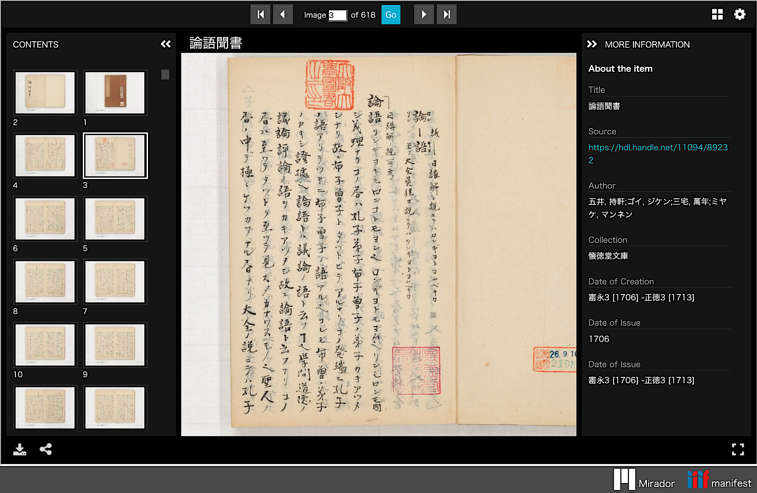
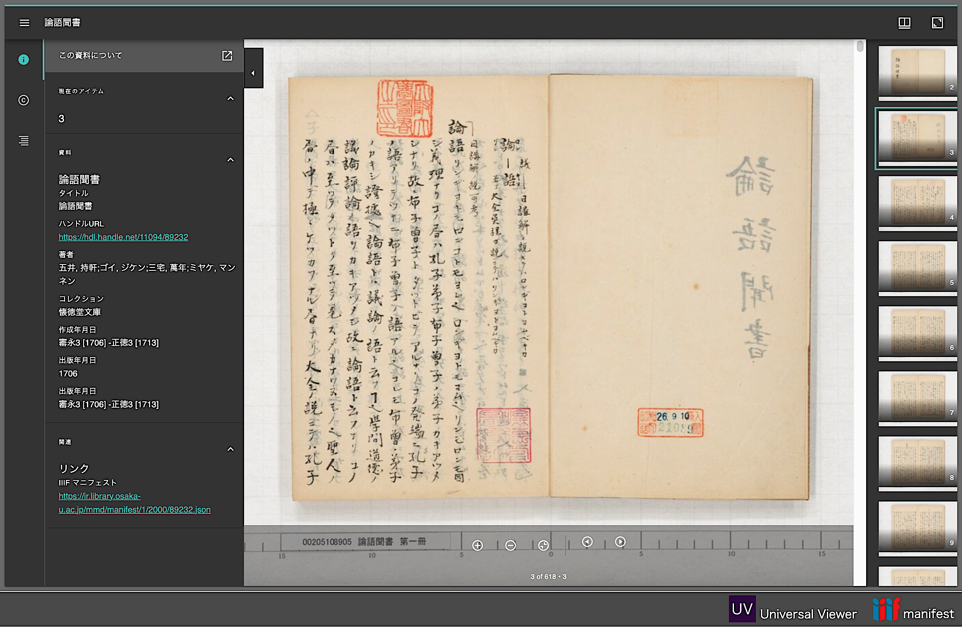
Loading a Manifest in the Viewer
Universal Viewer
Mirador
Manifest reference location
Notes:
Topic:Loading a Manifest in the Viewer
Voice:Joanna
```text
When you view triple I F images on OUKA using a viewer, there is always some part of the viewer where information about the manifest is displayed.
```
```description
When you view IIIF images on OUKA using a viewer, there is always some part of the viewer where information about the manifest is displayed.
```

Slide 5
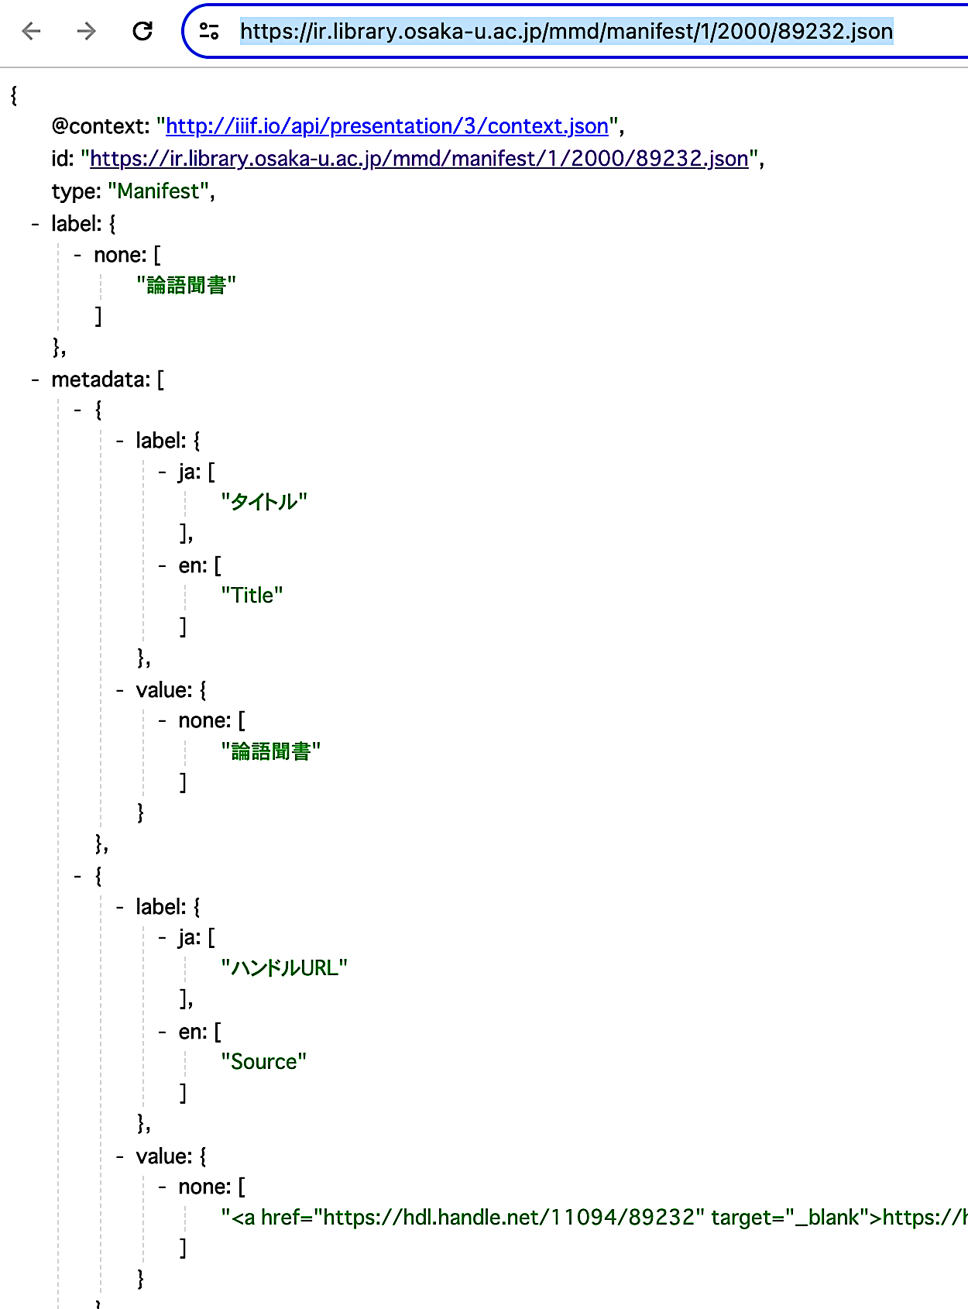
Manifest Contents
Manifest link example:
https://ir.library.osaka-u.ac.jp/mmd/manifest/1/2000/89232.json
↑A manifest contains information about the image, such as:
Title
Access source
Publisher
Image order
Usage permissions, etc.
Image information is displayed in the red-outlined section
Notes:
Topic:Loading a Manifest in the Viewer
Voice:Joanna
```text
When you click on a manifest, data like what’s shown on the right will appear.
This manifest contains basic information such as the title, access source, publisher, image order, and usage permissions.
In other words, the viewer is simply displaying the images and their basic information by retrieving them from the manifest in accordance with the triple I F framework.
```
```description
When you click on a manifest, data like what’s shown on the right will appear.
This manifest contains basic information such as the title, access source, publisher, image order, and usage permissions.
In other words, the viewer is simply displaying the images and their basic information by retrieving them from the manifest in accordance with the IIIF framework.
```

Slide 6
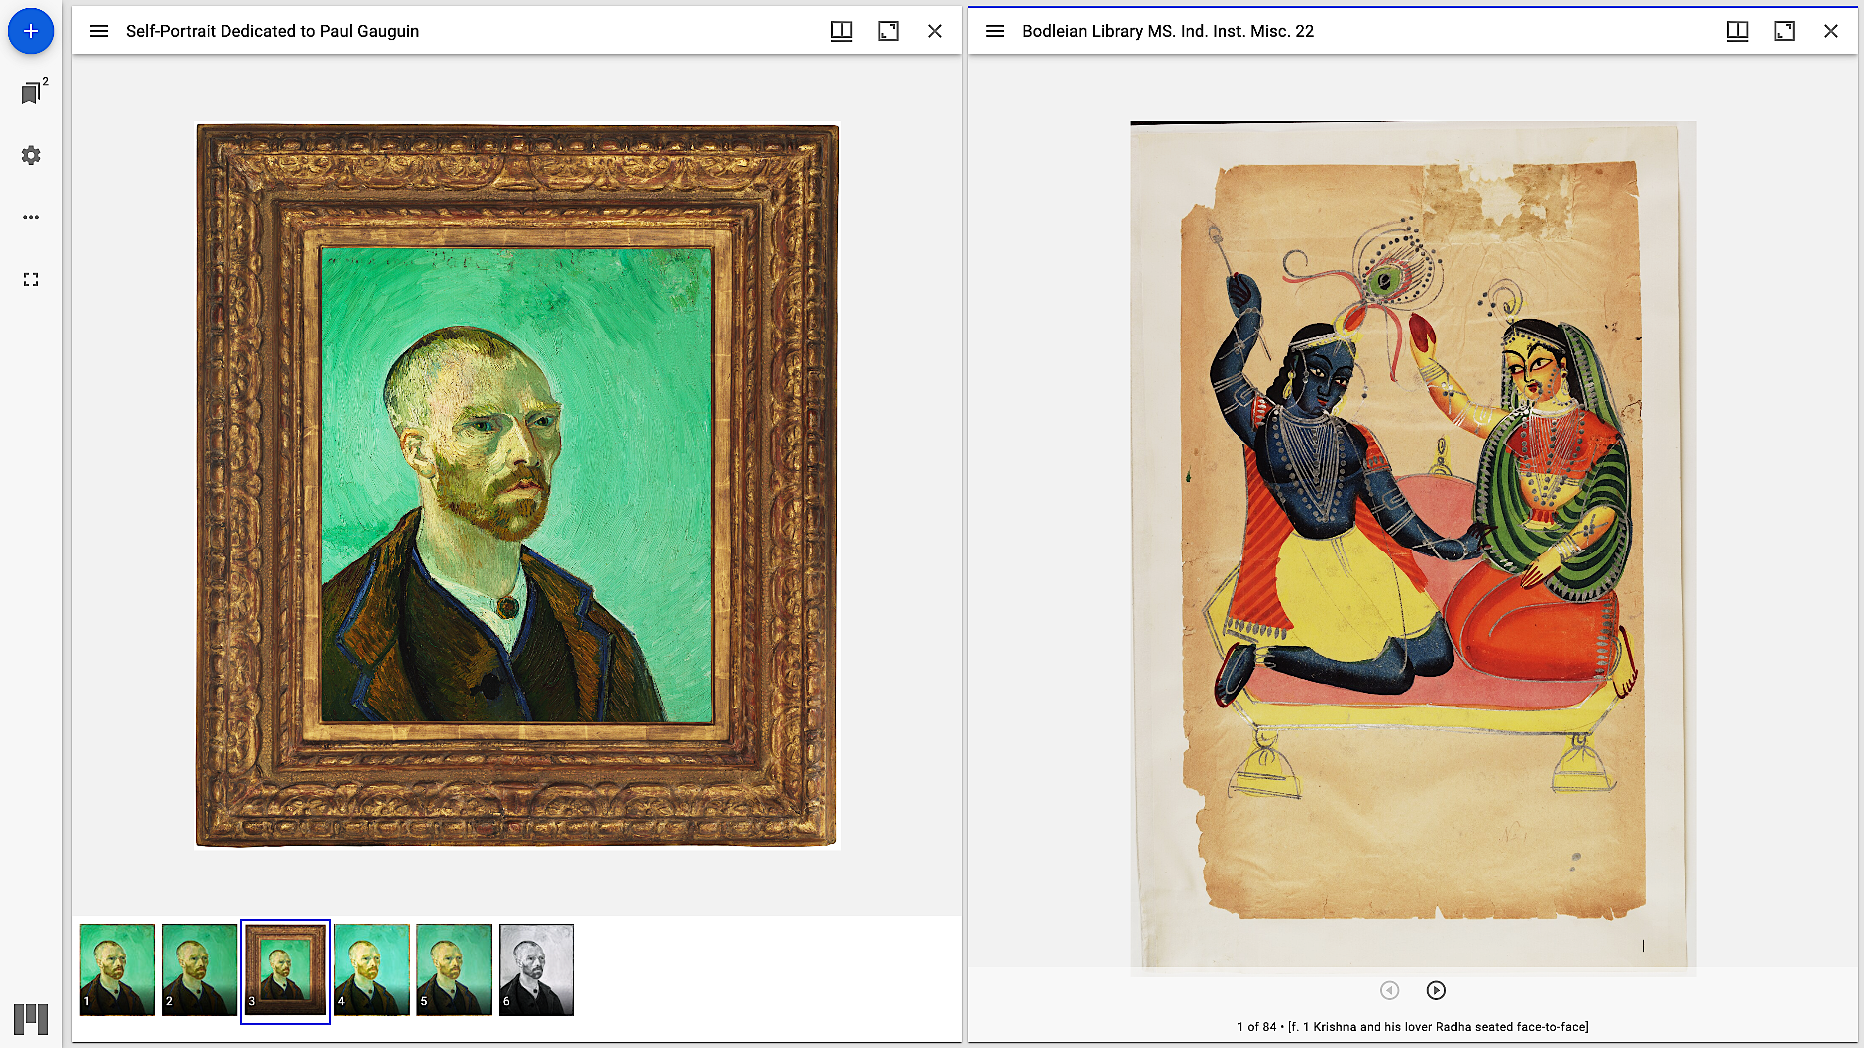
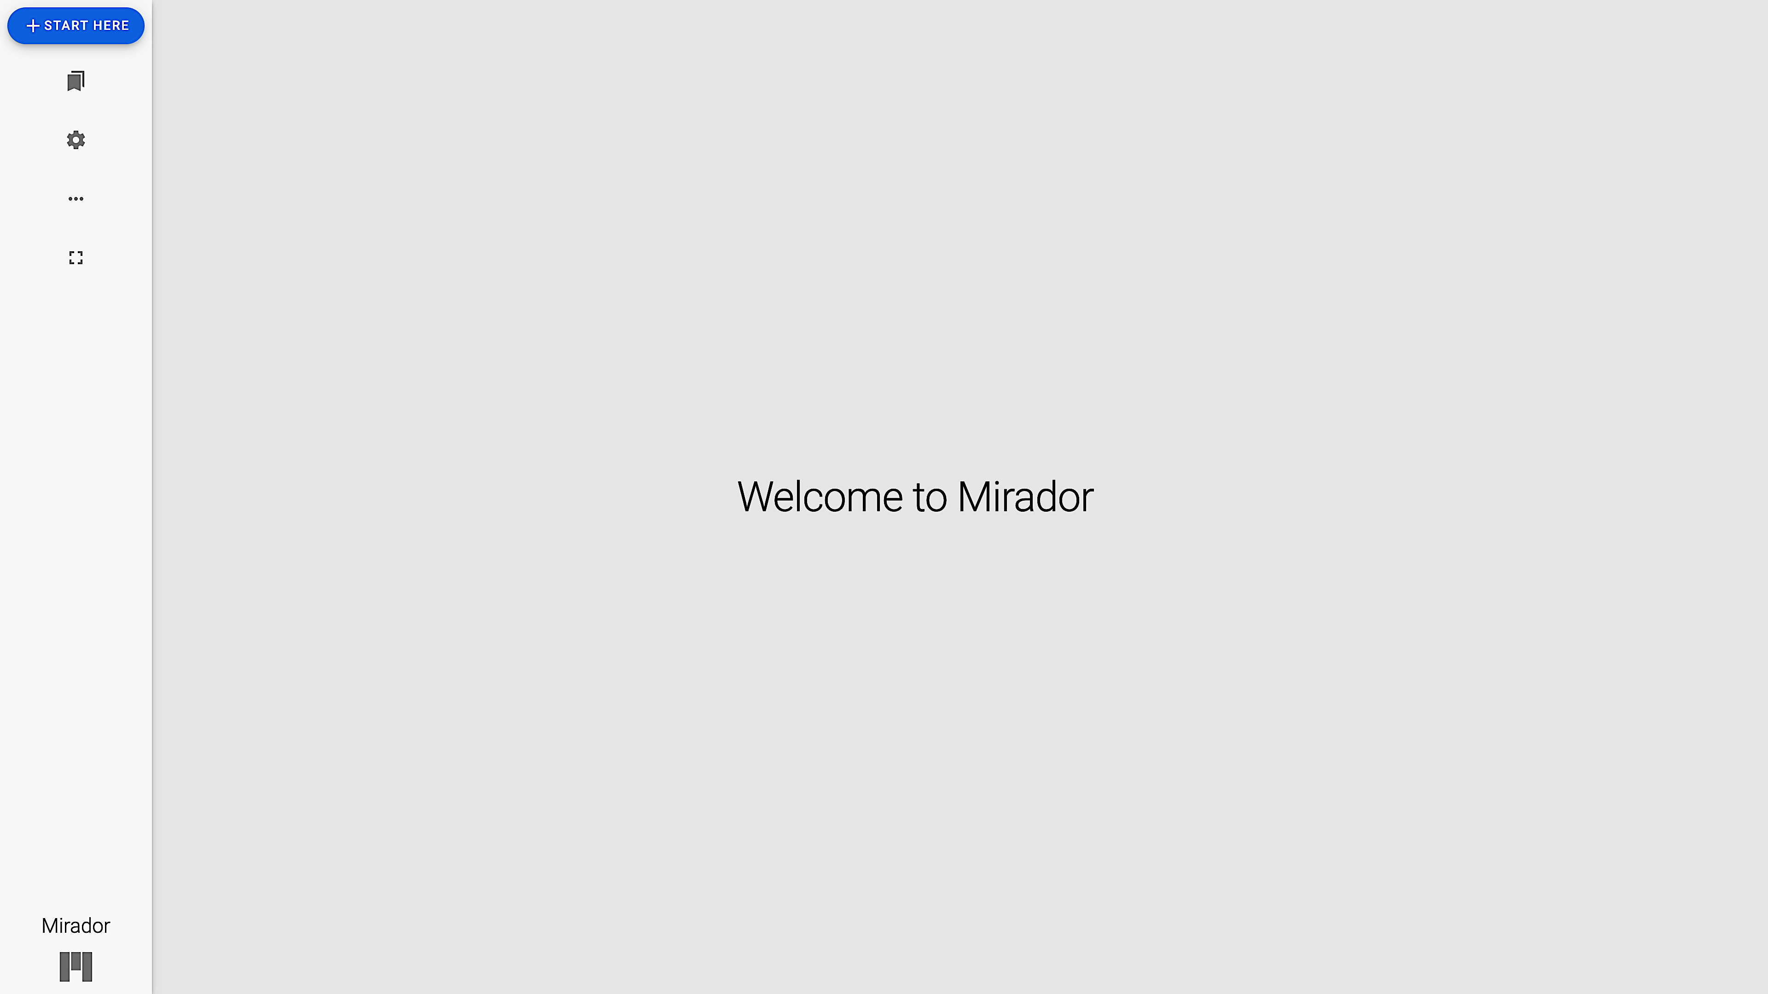
Loading a Manifest 1
Viewer on the official Mirador demo site
When you click all the × icons to close the images, the viewer returns to its initial state, as shown below.
Demo Viewer↓：You can find it by scrolling through the top page of the official site.
Initial state of the viewer↓
Official website: Mirador
https://projectmirador.org/
※You can find it easily by searching for “Mirador IIIF”
Notes:
Topic:Loading a Manifest in the Viewer
Voice:Joanna
```text
Manifests follow the triple I F framework, so they can also be loaded into viewers hosted on other websites.
If a manifest doesn’t load, it’s often because the viewer is not compatible due to a version update.
In that case, try using a different viewer.
As an example, let’s try using a manifest to display an image from the かいどくどう Library in the demo viewer, on Mirador’s official site.
First, open the demo viewer shown on the left image.
You can find Mirador’s official site by searching “Mirador Triple I F” in your browser, and from there, look for a viewer like the one shown in the left image on the demo page.
Next, remove all the preloaded images in the demo viewer.
Once all images are removed, the viewer will return to the initial state shown on the right.
```
```description
Manifests follow the IIIF framework, so they can also be loaded into viewers hosted on other websites.
If a manifest doesn’t load, it’s often because the viewer is not compatible due to a version update.
In that case, try using a different viewer.
As an example, let’s try using a manifest to display an image from the Kaitokudō Library in the demo viewer on Mirador’s official site.
First, open the demo viewer shown on the left image.
You can find Mirador’s official site by searching “Mirador IIIF” in your browser, and from there, look for a viewer like the one shown in the left image on the demo page.
Next, remove all the preloaded images in the demo viewer.
Once all images are removed, the viewer will return to the initial state shown in the image on the right.
```

Slide 7
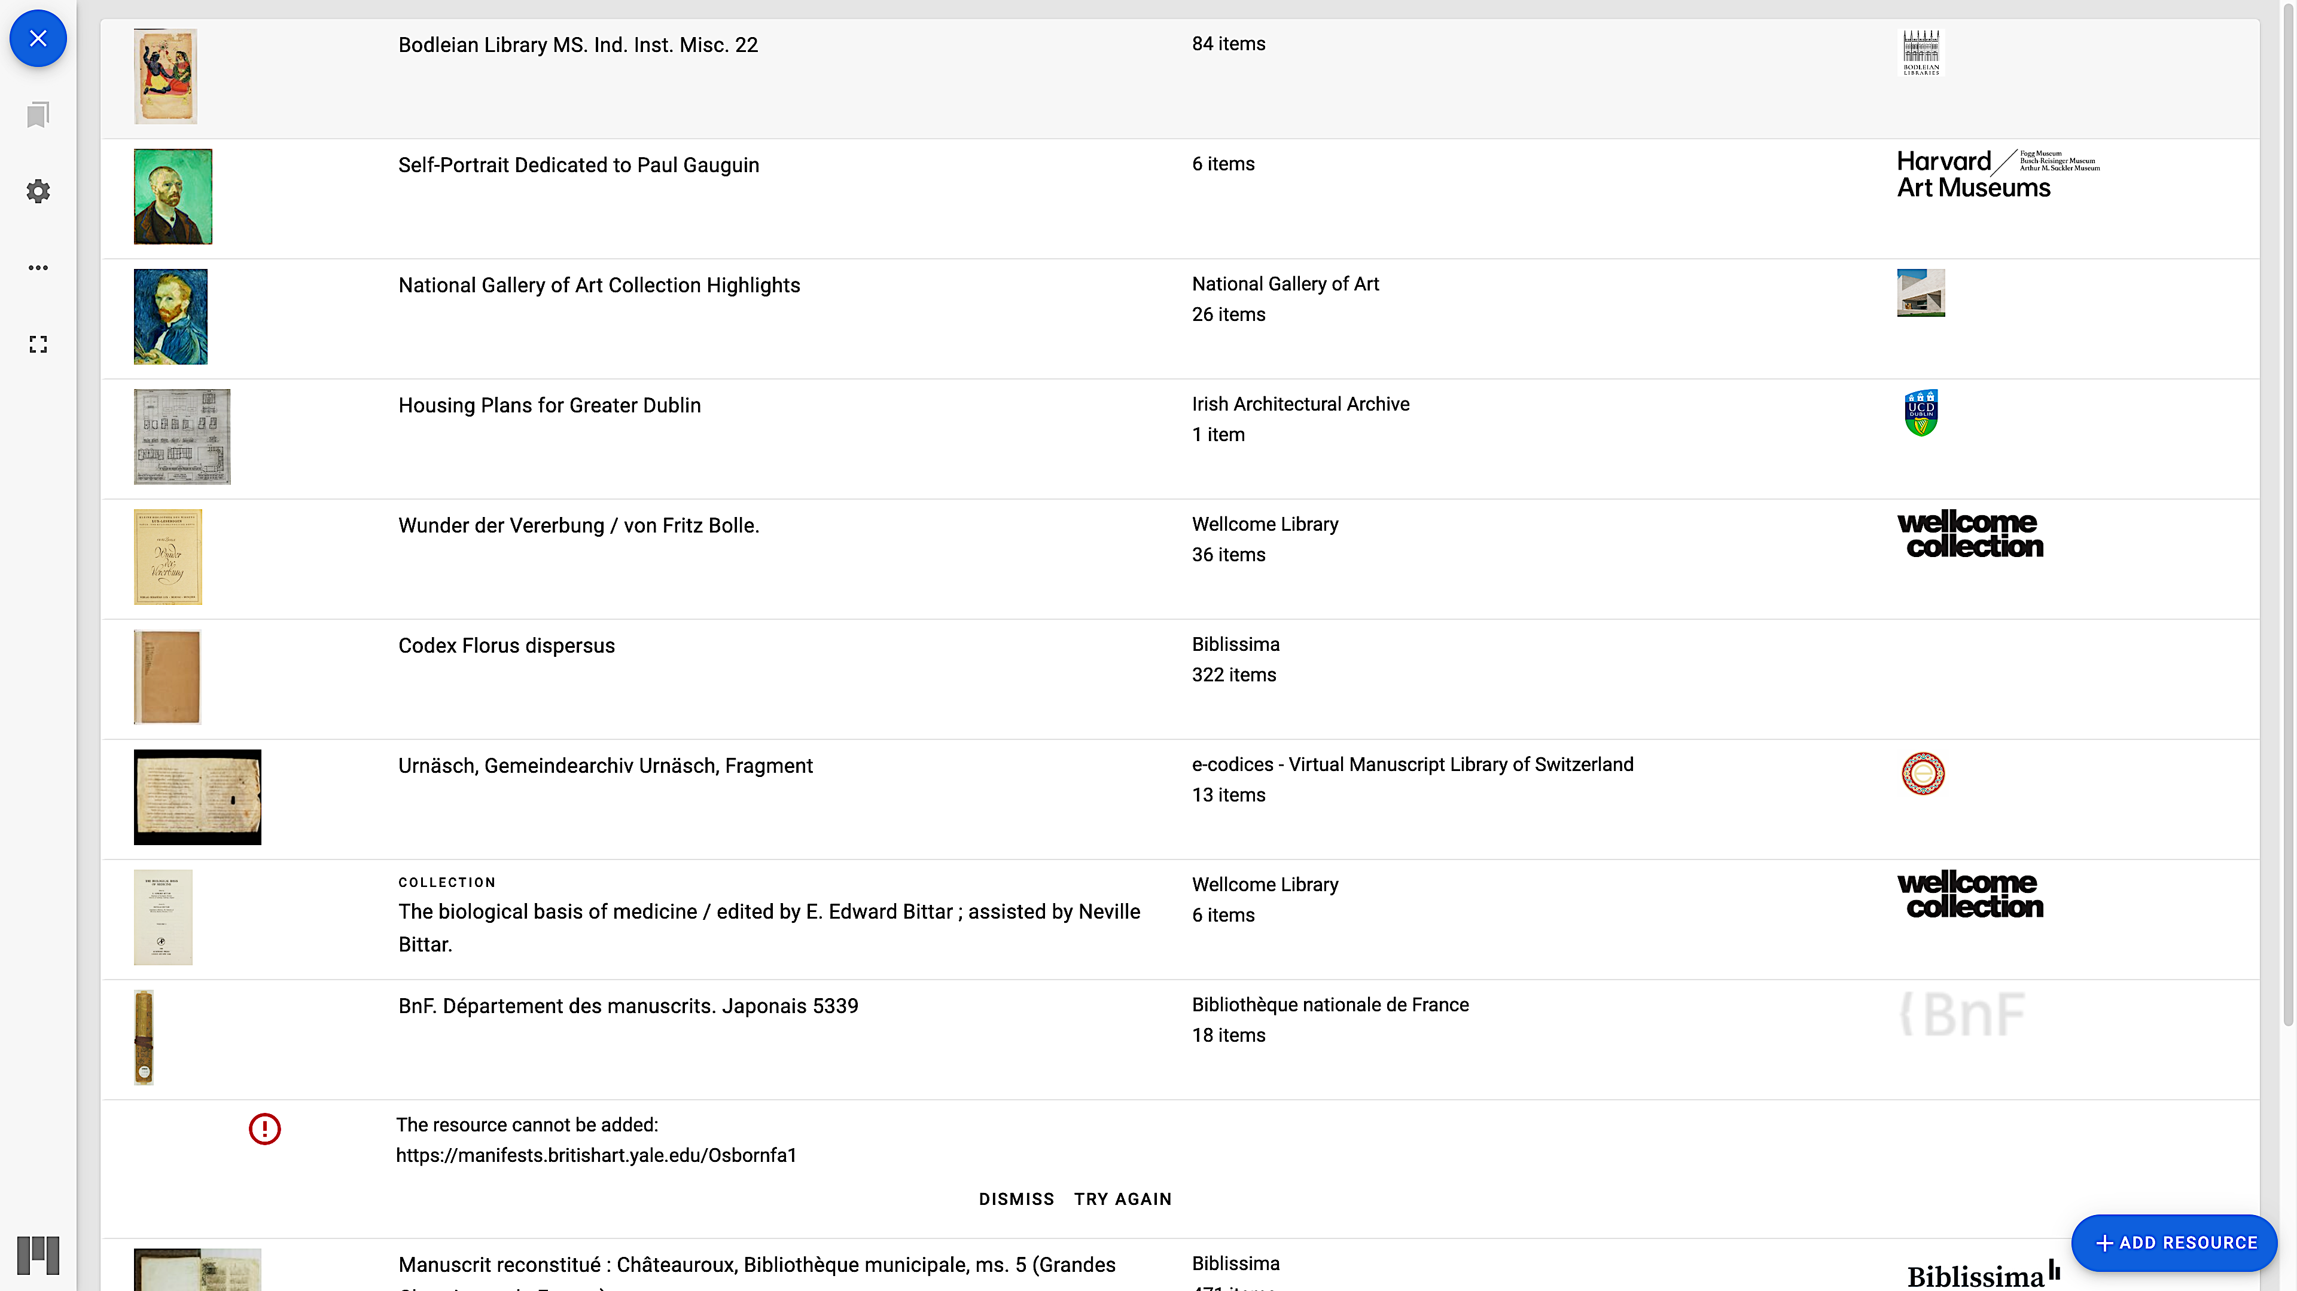
Loading a Manifest 2
Click the ”+” or the ”+ START HERE” button
Click the ”+ ADD RESOURCE” button
Notes:
Topic:Loading a Manifest in the Viewer
Voice:Joanna
```text
Once you’ve removed all the preloaded images, click the “Start Here” button in the top left corner of the viewer, as shown in the left image.
Clicking it will bring up the screen shown on the right.
This screen lists various IIIF images from different institutions that are preloaded into this demo viewer.
If you want to load a manifest link that you have found, click the “Add Resource” button in the bottom right of the screen, shown in the right image.
```
```description
Once you’ve removed all the preloaded images, click the “Start Here” button in the top left corner of the viewer, as shown in the left image.
Clicking it will bring up the screen shown on the right.
This screen lists various IIIF images from different institutions that are preloaded into this demo viewer.
If you want to load a manifest link that you have found, click the “Add Resource” button in the bottom right of the screen shown in the right image.
```

Slide 8
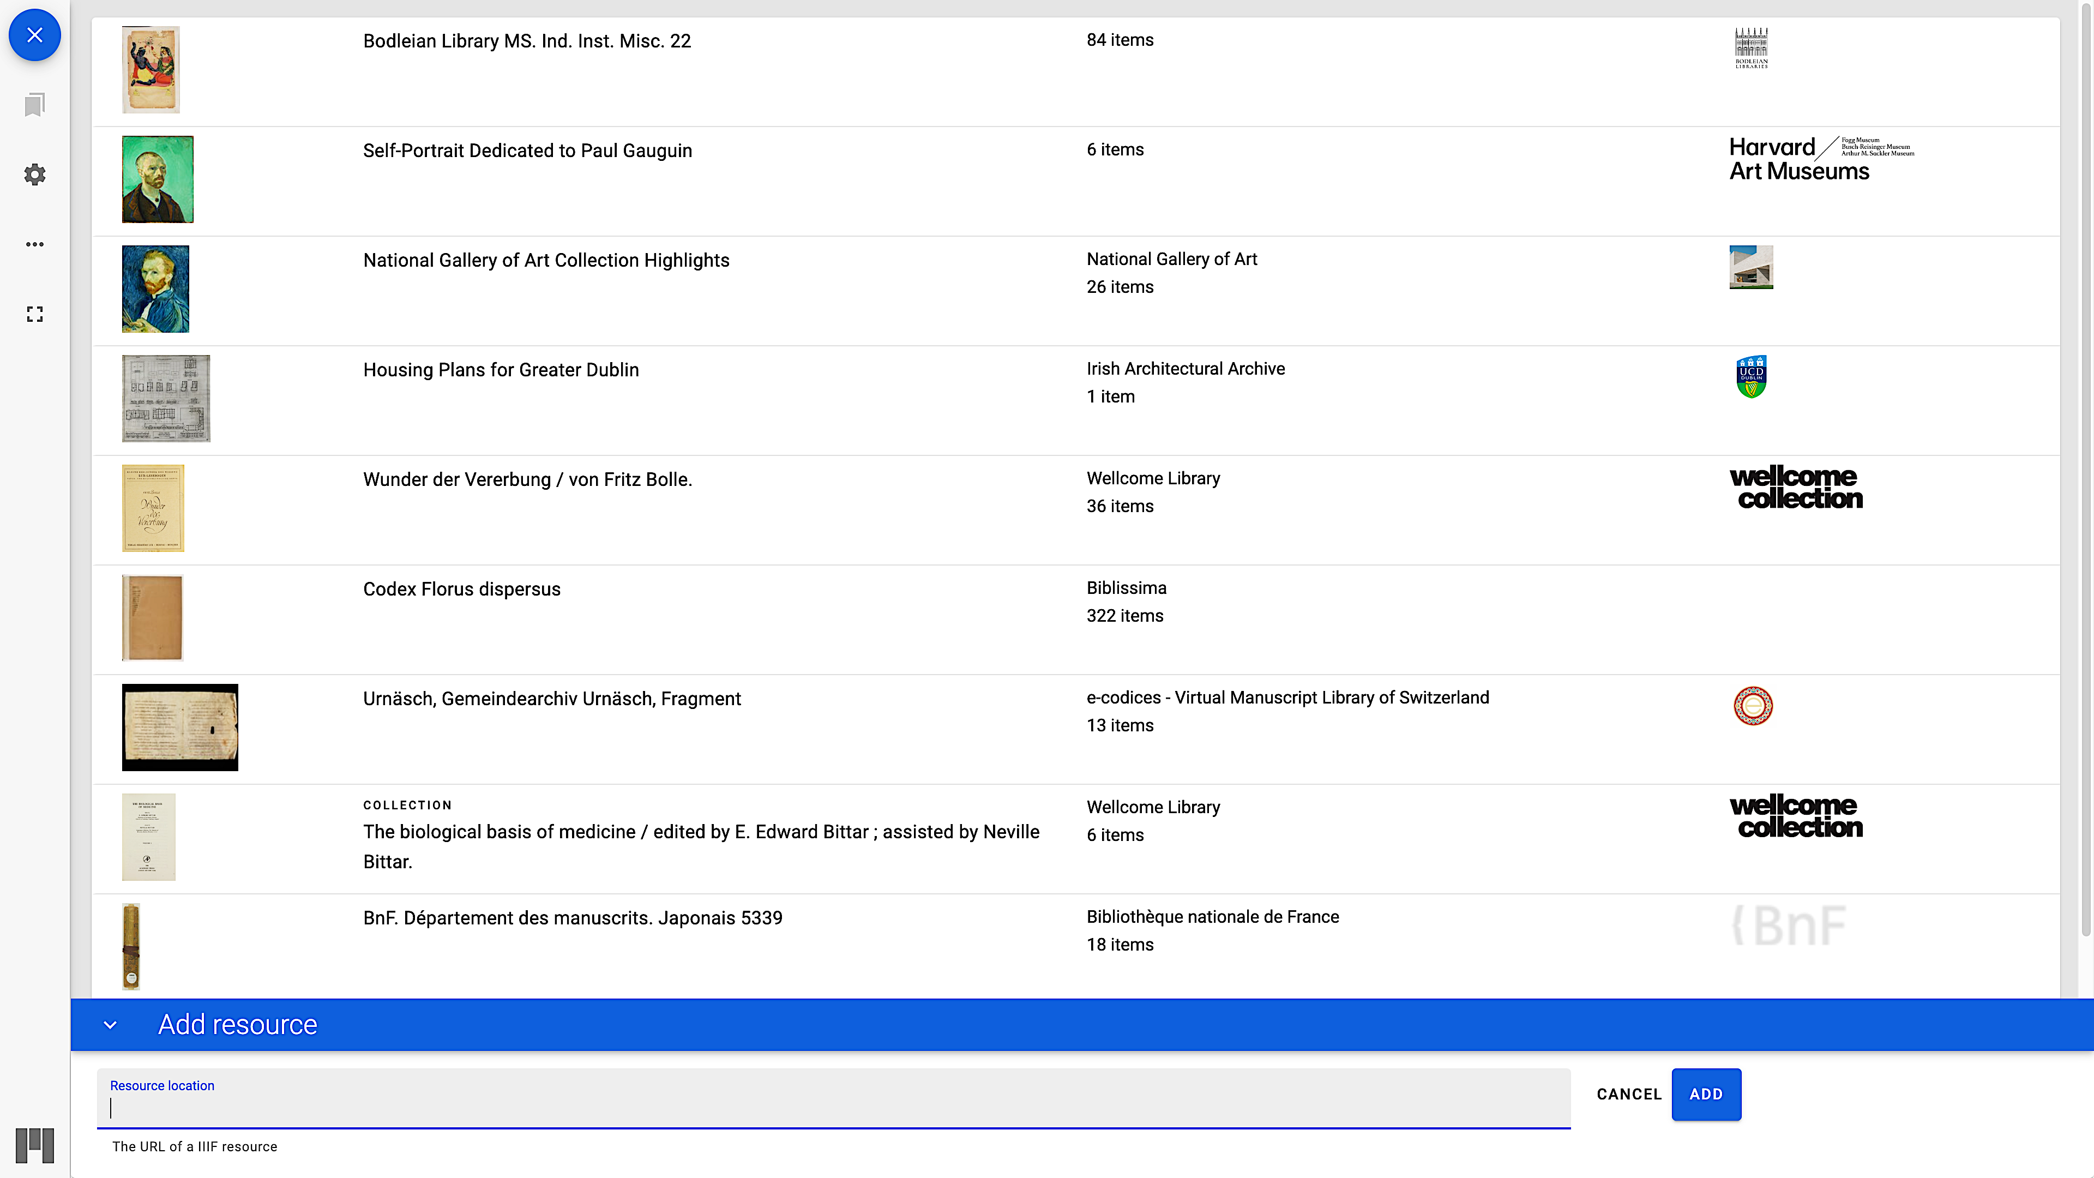
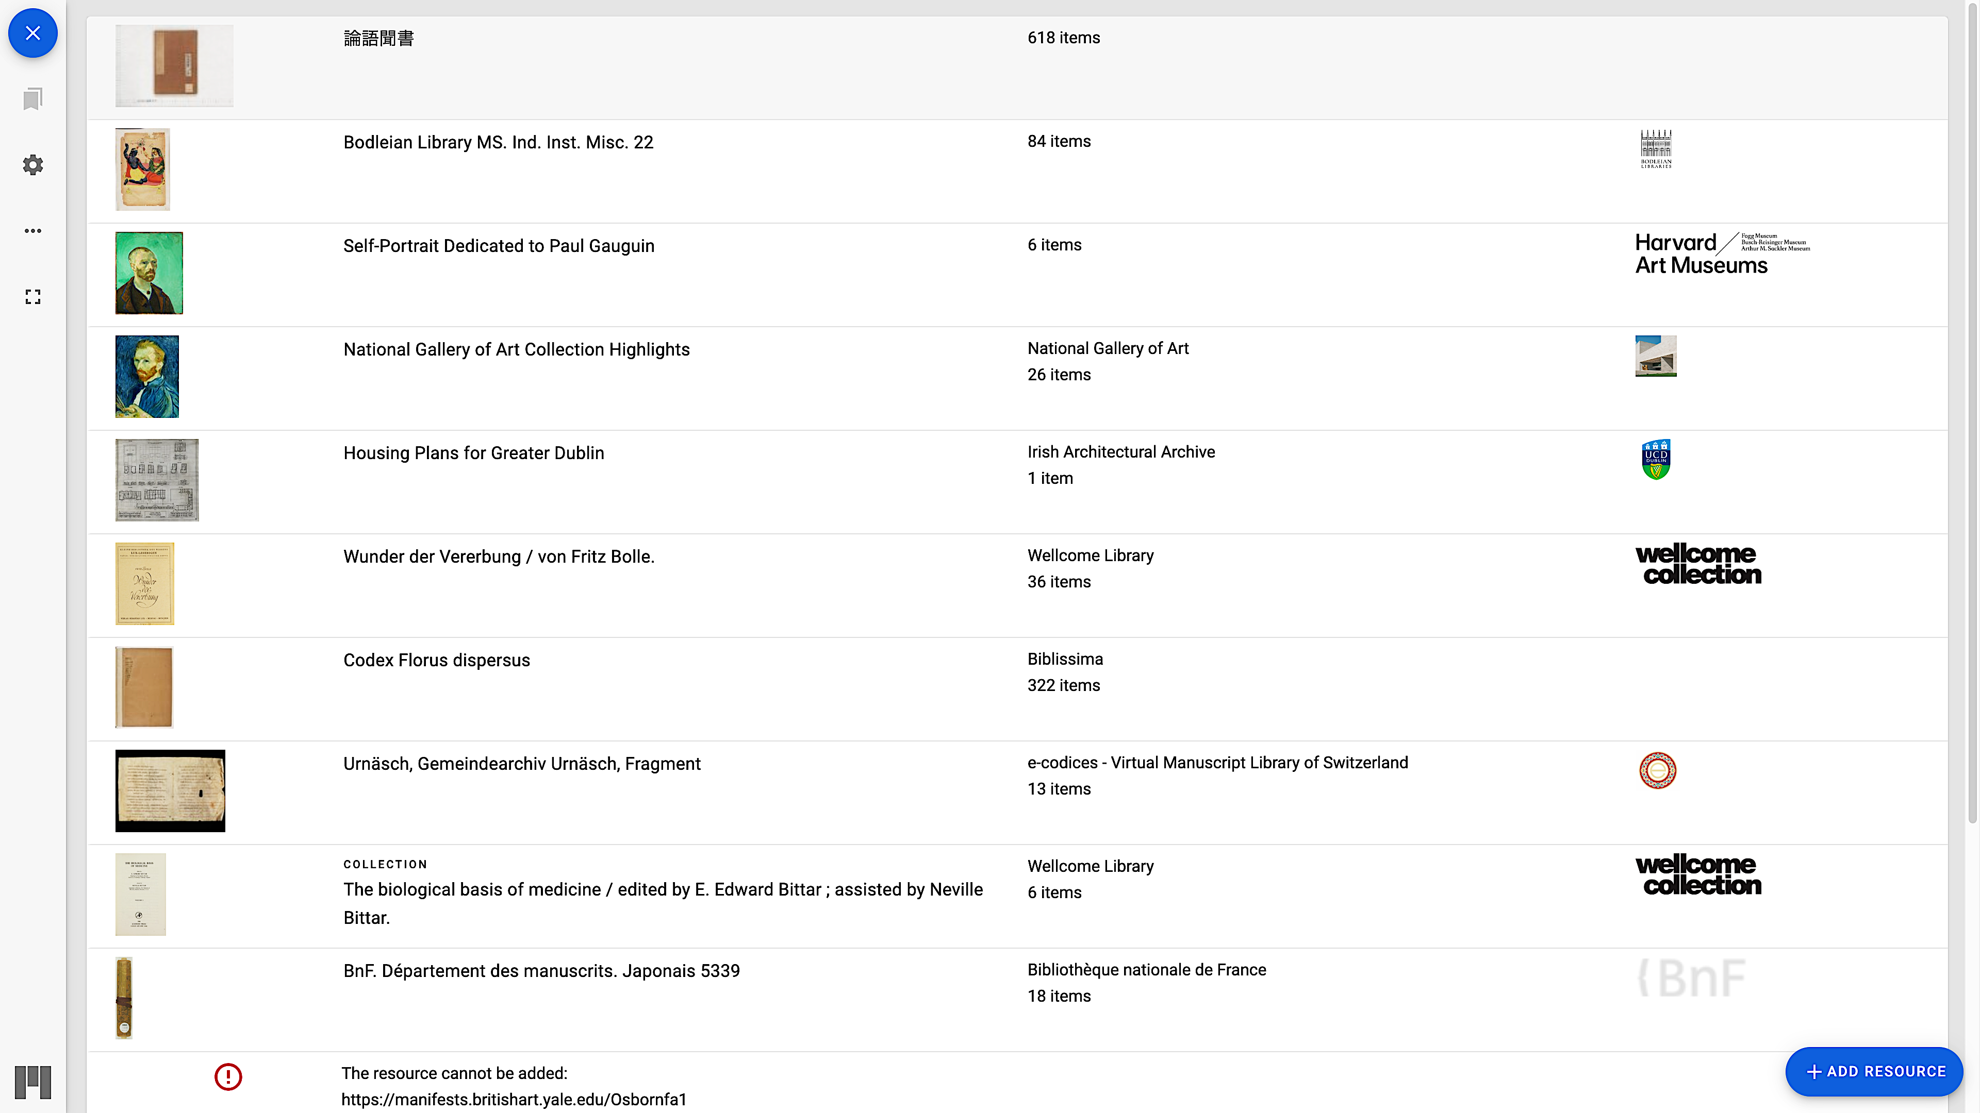
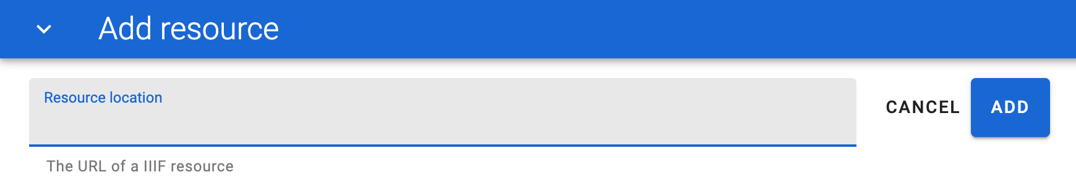
Loading a Manifest 3
Before inputting the manifest URL
After inputting the manifest URL
「論語聞書」(The Analects) appears in the list
Type the URL of the manifest
Example: https://ir.library.osaka-u.ac.jp/mmd/manifest/1/2000/89232.json （「論語聞書」 (A hearing note of the Analects, Rongokikigaki）
Notes:
Topic:Loading a Manifest in the Viewer
Voice:Joanna
```text
Now, enter the manifest link we explained earlier on the “Manifest Contents” slide.
Usually, the manifest link is clearly shown on the page where the triple I F image is displayed.
Copy and paste that link into the “Resource Location” field.
Since the link is long, copying and pasting is convenient.
Once you’ve pasted the link and clicked the add button, your selected manifest will be added to the list, as shown on the right.
After it’s been successfully added, click the item in the list to open it.
```
```description
Now, enter the manifest link we explained earlier on the “Manifest Contents” slide.
Usually, the manifest link is clearly shown on the page where the IIIF image is displayed.
Copy and paste that link into the “Resource Location” field.
Since the link is long, copying and pasting is convenient.
Once you’ve pasted the link and clicked the ADD button, your selected manifest will be added to the list, as shown on the right.
After it’s been successfully added, click the item in the list to open it.
```

Slide 9
Loading a Manifest 3
Before inputting the manifest URL
After inputting the manifest URL
「論語聞書」(The Analects) appears in the list
Type the URL of the manifest
Example: https://ir.library.osaka-u.ac.jp/mmd/manifest/1/2000/89232.json （「論語聞書」 (A hearing note of the Analects, Rongokikigaki）
Notes:
Topic:Loading a Manifest in the Viewer
Voice:Joanna
```text
Sometimes, a manifest may not be added to the list, and this is because the viewer is not compatible with the older format of the manifest.
In that case, look for another viewer that can add the image, and enter the manifest in the same way.
The method of entering a manifest is similar across all viewers.
```
```description
Sometimes, a manifest may not be added to the list, and this is because the viewer is not compatible with the older format of the manifest.
In that case, look for another viewer that can add the image and enter the manifest in the same way.
The method of entering a manifest is similar across all viewers.
```

Slide 10
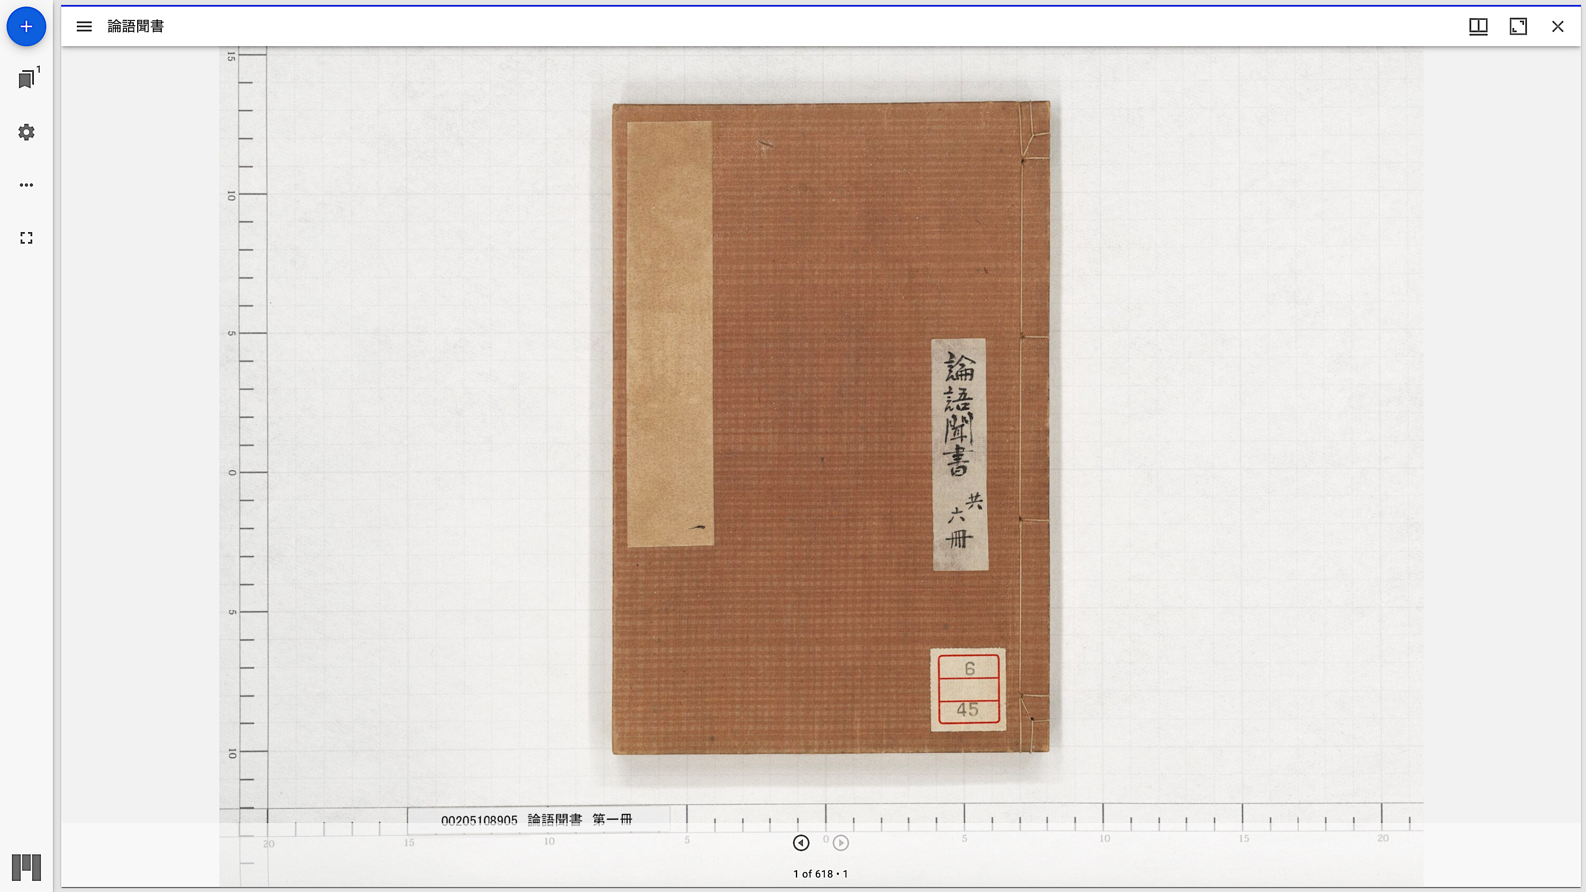
Loading a Manifest 4
Click on the list of books
Notes:
Topic:Loading a Manifest in the Viewer
Voice:Joanna
```text
When you click on a manifest in the list, the triple I F image will be displayed, as shown in on the left.
You can now display any manifest you like.
From here, you can browse the image using the basic features.
Let’s try adding one more triple I F image to the right side of the screen.
Click the plus button at the top left of the screen.
This will bring up the manifest input screen again, as shown in the image on the right.
To add the book data shown earlier, simply click the book title in the list once more.
```
```description
When you click on a manifest in the list, the IIIF image will be displayed, as shown in the image on the left.
You can now display any manifest you like.
From here, you can browse the image using the basic features.
Let’s try adding one more IIIF image to the right side of the screen.
Click the “+” button at the top left of the screen.
This will bring up the manifest input screen again, as shown in the image on the right.
To add the book data shown earlier, simply click the book title in the list once more.
```

Slide 11
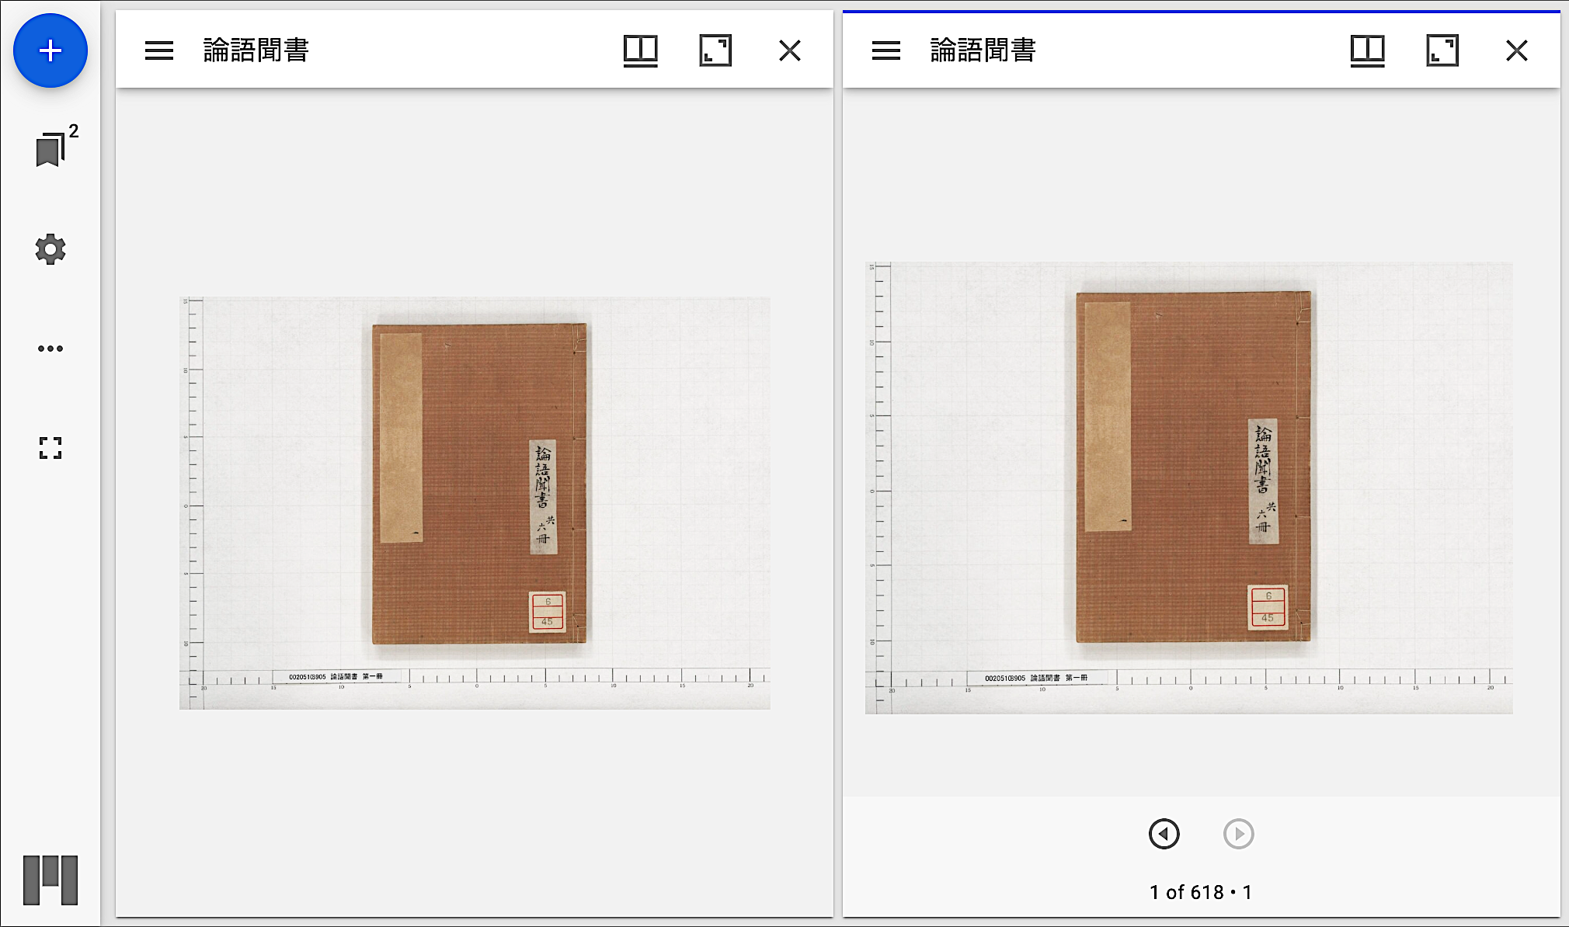
Loading a Manifest 5
Notes:
Topic:Loading a Manifest in the Viewer
Voice:Joanna
```text
Then, as shown here, you can add a display panel and view images from the same book, side by side.
```
```description
Then, as shown here, you can add a display panel and view images from the same book, side by side.
```

Slide 12
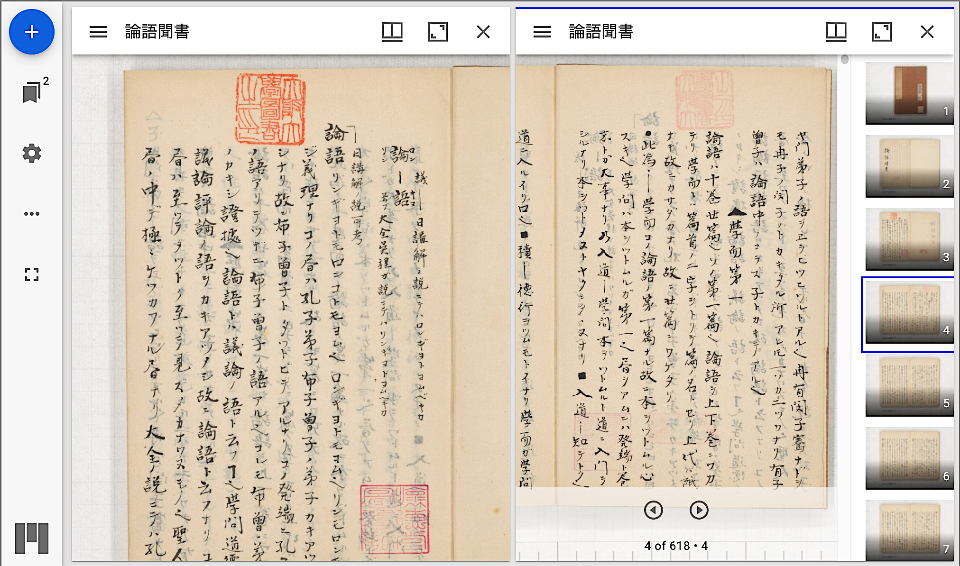
Loading a Manifest 6
Notes:
Topic:Loading a Manifest in the Viewer
Voice:Joanna
```text
As shown here, this is convenient when comparing different parts of the same book.
The display style can also be slightly adjusted, as shown on the right.
```
```description
As shown here, this is convenient when comparing different parts of the same book.
The display style can also be slightly adjusted, as shown on the right.
```

Slide 13
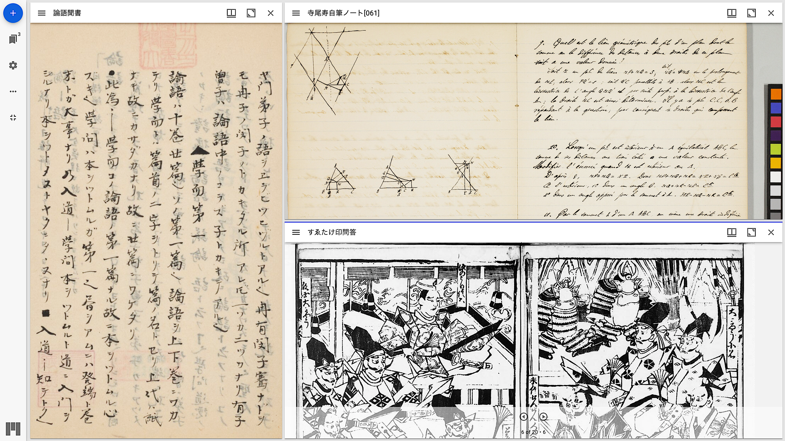
Loading a Manifest 7
Notes:
Topic:Loading a Manifest in the Viewer
Voice:Joanna
```text
Of course, you can also load different manifests into the list or click the “plus” button to add more comparison panels.
In this example, we’ve displayed rare books registered in OUKA side by side.
In general, being able to compare many images at once is useful for research.
Using triple I F-compatible viewers like Mirador lets you create multiple viewing panels within the same browser window, so please make good use of them.
As you’ve seen, once you understand how to load manifests into a viewer, the potential of triple I F applications expands greatly.
```
```description
Of course, you can also load different manifests into the list or click the “plus” button to add more comparison panels.
In this example, we’ve displayed rare books registered in OUKA side by side.
In general, being able to compare many images at once is useful for research.
Using IIIF-compatible viewers like Mirador lets you create multiple viewing panels within the same browser window, so please make good use of them.
As you’ve seen, once you understand how to load manifests into a viewer, the potential of IIIF applications expands greatly.
```

Slide 14
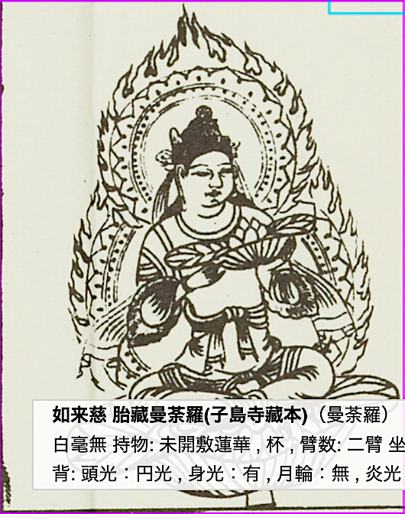
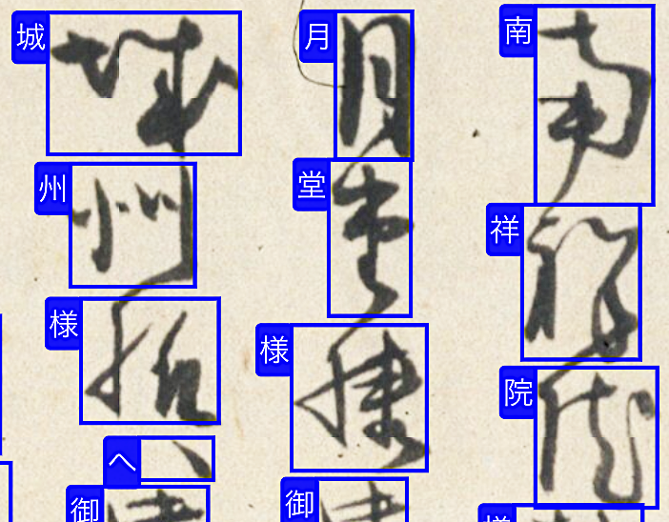
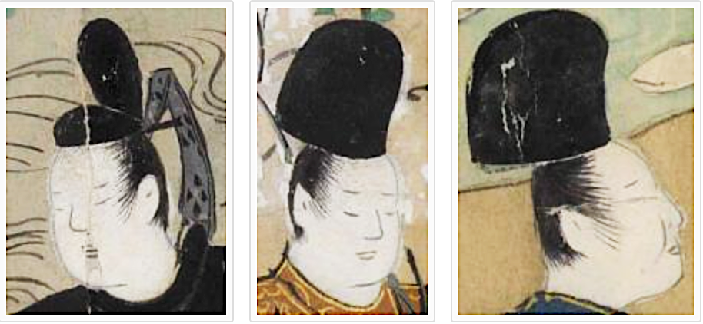
Examples of web applications with various features
Cutting out part of an image to collect data (Curation)
Overlaying marks or text on images to display additional information (Annotation)
Search systems using image annotations, etc.
Notes:
Topic:Examples of web applications with various features
Voice:Joanna
```text
Additionally, many web applications have been developed, that add various features to triple I F viewers.
For example, you can cut out parts of an image, and use it to collect data.
You can also use a feature called annotation, to overlay marks, or text on images, to display additional information.
Furthermore, search systems that make use of image annotations have also been developed.
```
```description
Additionally, many web applications have been developed that add various features to IIIF viewers.
For example, you can cut out parts of an image and use it to collect data.
You can also use a feature called annotation to overlay marks or text on images to display additional information.
Furthermore, search systems that make use of image annotations have also been developed.
```

Slide 15
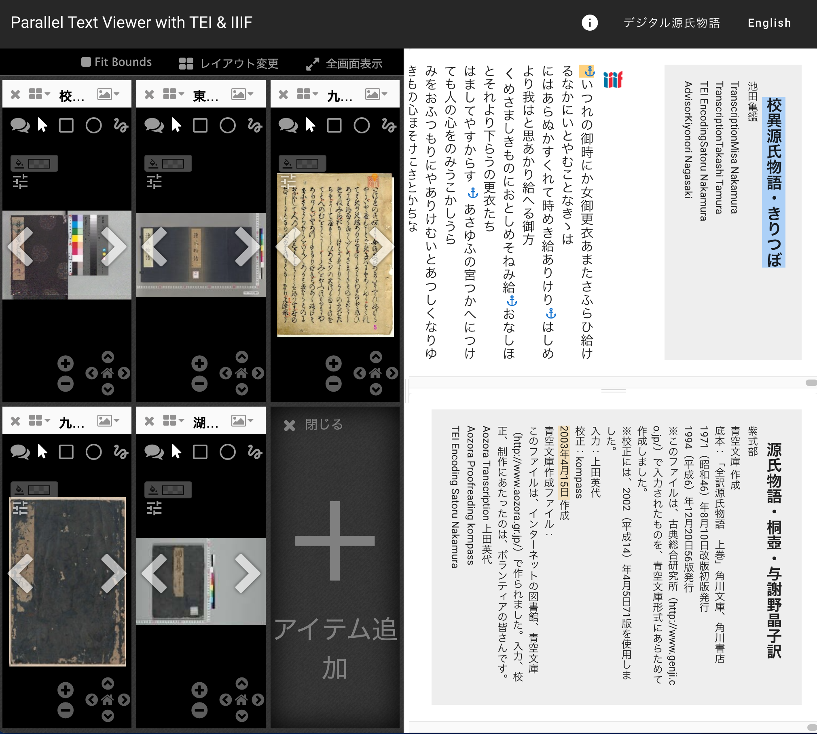
An Example of Reconstructing Materials Scattered Across Different Collections
Digital Tale of Genji Ver. YUMENOUKIHASHI (The University of Tokyo)
Variant Text of The Tale of Genji: Kiritsubo
https://tei-eaj.github.io/parallel_text_viewer/v2?u=https%3A%2F%2Fgenji.dl.itc.u-tokyo.ac.jp%2Fdata%2Fvol%2F01%2Fconfig.json
Notes:
Topic:Examples of web applications with various features
Voice:Joanna
```text
For reference, here are some examples that make use of the triple I F framework.
For example, the University of Tokyo General Library has published digital images of The Tale of Genji, and a platform has been developed that allows users to view and compare these alongside Tales of Genji materials from other institutions, such as Kyushu University.
Moreover, the platform can display text data of the original and a modern Japanese translation from Aozora Bunko in the web browser.
```
```description
For reference, here are some examples that make use of the IIIF framework.
For example, the University of Tokyo General Library has published digital images of The Tale of Genji, and a platform has been developed that allows users to view and compare these alongside Genji Monogatari materials from other institutions, such as Kyushu University.
Moreover, the platform can display text data of the original and a modern Japanese translation from Aozora Bunko in the web browser.
```

Slide 16
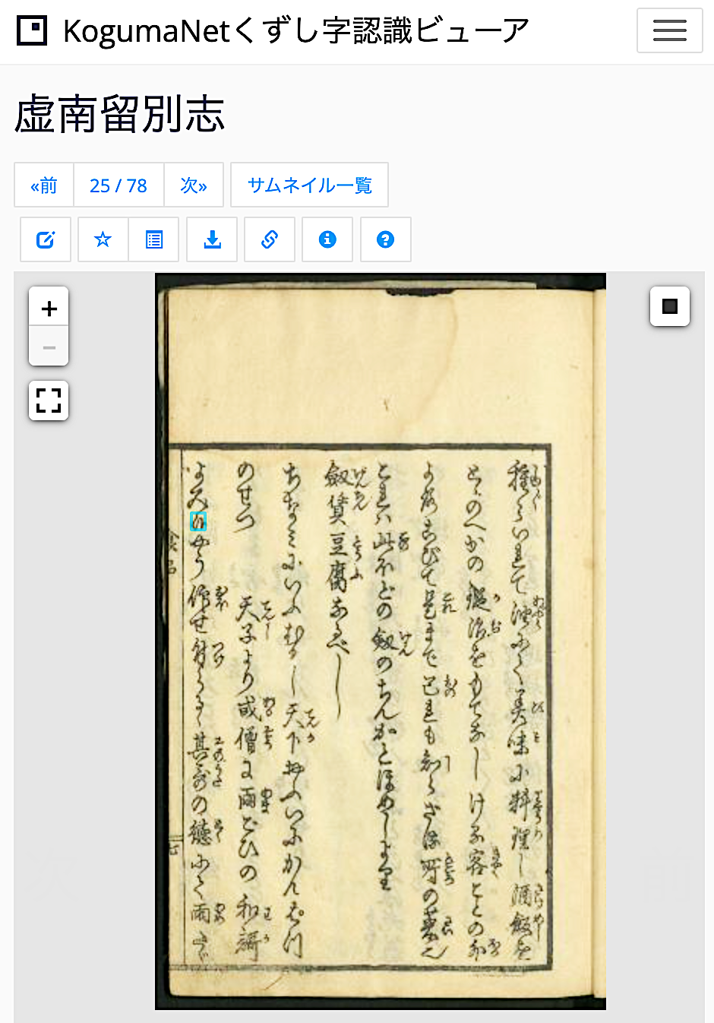
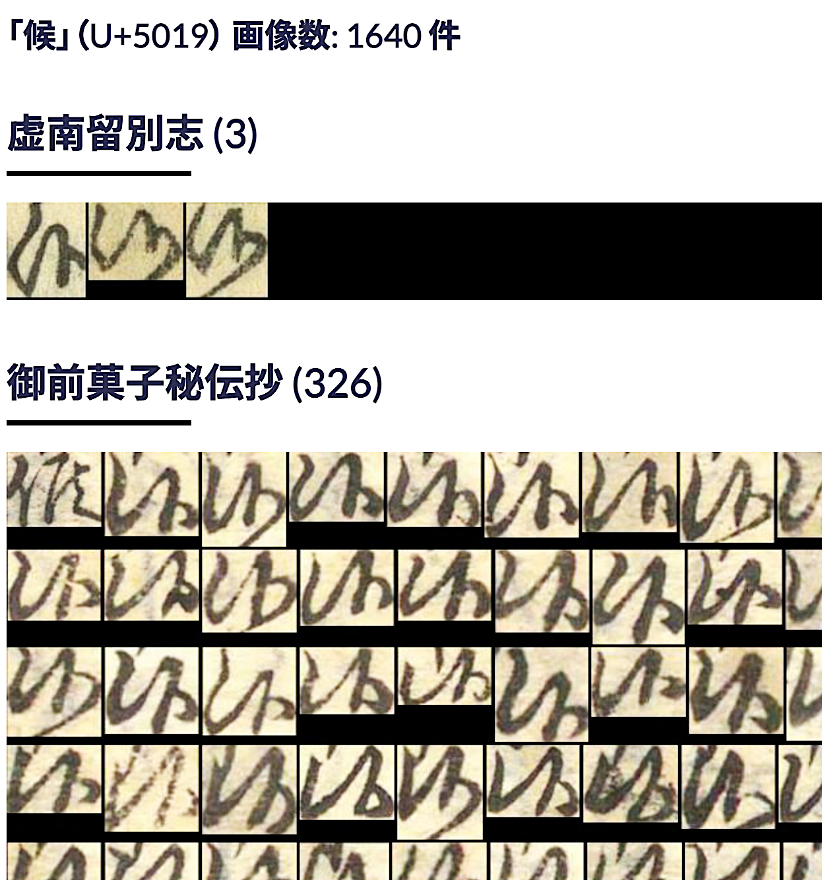
Example of Annotating a IIIF Image
CODH Kuzushiji Character Database Search
(Hiragana [variant forms], Katakana, Kanji)
Notes:
Topic:Examples of web applications with various features
Voice:Joanna
```text
Next, we will introduce an example of adding annotations to triple I F images.
C O D H (Center for Open Data in the Humanities) offers a service where users can search the Kuzushiji data set of Japanese classical books by character, or character code, and view the shapes of hiragana (hentaigana), katakana, and kanji.
As of November 2019, a little over a million character data entries for over 4000 Kuzushiji character types, cropped from around 6000 frames of image data from 44 classical books, have been assigned both text information and positional information on the original text.
In other words, by using triple I F’s annotation feature, it becomes possible to identify characters in classical texts and display their readings.
As shown in the image on the left, characters collected from several classical books can be organized, and compared side-by-side.
```
```description
Next, we will introduce an example of adding annotations to IIIF images.
CODH (Center for Open Data in the Humanities) offers a service where users can search the Kuzushiji dataset of Japanese classical books by character or character code and view the shapes of hiragana (hentaigana), katakana, and kanji.
As of November 2019, 1,086,326 character data entries for 4,328 Kuzushiji character types, cropped from 6,151 frames of image data from 44 classical books, have been assigned both text information and positional information on the original text.
In other words, by using IIIF’s annotation feature, it becomes possible to identify characters in classical texts and display their readings.
As shown in the image on the left, characters collected from several classical books can be organized and compared side-by-side.
```

Slide 17
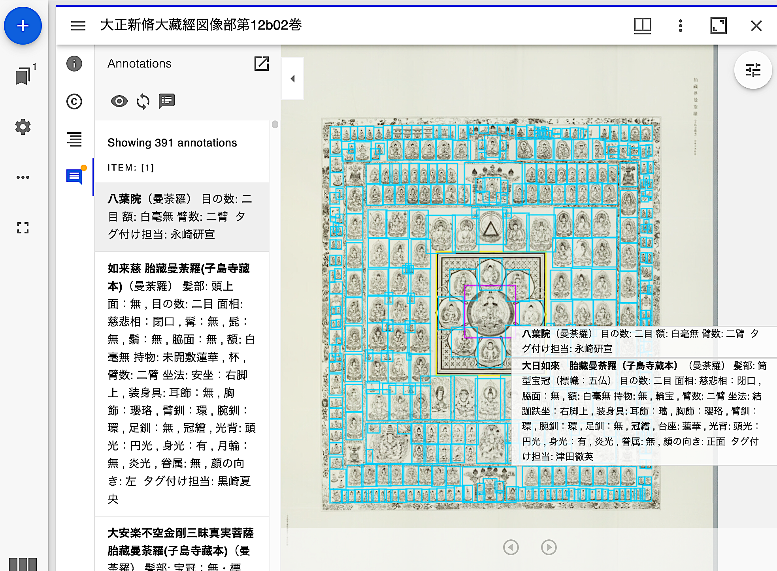
Example: SAT Taishō Image Database
The SAT Daizōkyō Text Database Research Group has published all 12 volumes of the illustrated section of the Taishō Shinshū Daizōkyō (published by Daizō Shuppan Co., Ltd.), an essential resource for Buddhist studies, as IIIF images.
https://dzkimgs.l.u-tokyo.ac.jp/SATi/images.php
To enable image-based search, each Buddhist figure has been tagged with keywords
The usage license is Creative Commons CC BY-SA (requires appropriate attribution and sharing any modified or adapted data under the same license).
Notes:
Topic:Examples of web applications with various features
Voice:Joanna
```text
Next, let us look at a large-scale database initiative by the S A T, Taishō Text Database Research Group.
The group began by transcribing the full text of volumes 1 through 85, of the たいしょう しんしゅう die zo kyo, an essential resource for Buddhist studies, starting in 1998.
Later, by 2016, they became one of the first in Japan to adopt triple I F for image distribution. With the publisher’s permission, they made all 12 volumes of the illustrated section of the たいしょう しんしゅう die zo kyo, available as triple I F images.
Furthermore, they didn’t just publish the images, they also tagged each Buddhist figure with keywords to enable image-based search.
These data are provided under the appropriate Creative Commons license, with permission from the publisher.
Thanks to the publisher’s cooperation and the many years of effort by the research group, anyone can now easily view the contents of the books in a web browser, and as long as the license terms are respected, the data can be freely shared and modified.
```
```description
Next, let us look at a large-scale database initiative by the SAT Taishō Text Database Research Group.
The group began by transcribing the full text of volumes 1 through 85 of the Taishō Shinshū Daizōkyō, an essential resource for Buddhist studies, starting in 1998.
Later, by 2016, they became one of the first in Japan to adopt IIIF for image distribution. With the publisher’s permission, they made all 12 volumes of the illustrated section of the Taishō Shinshū Daizōkyō available as IIIF images.
Furthermore, they didn’t just publish the images, they also tagged each Buddhist figure with keywords to enable image-based search.
These data are provided under the Creative Commons license CC BY-SA, with permission from the publisher.
Thanks to the publisher’s cooperation and the many years of effort by the research group, anyone can now easily view the contents of the books in a web browser, and as long as the license terms are respected, the data can be freely shared and modified.
```

Slide 18
Supporting User-driven Activities
Effectively Using the IIIF Framework
Users can create image collections from materials dispersed across different institutions.
Specific portions of images can be selected, allowing users to tag them with keywords or retrieve positional data.
Not image publishers, but users take lead in creating image collections
Can also be used in activities such as inquiry-based learning, curation, and ideathons.
Notes:
Topic:Examples of web applications with various features
Voice:Joanna
```text
Up to now, we have introduced that by effectively using the triple I F framework, users can gather images dispersed across different organizations into their own collections; and that, as in the kuzushiji database or the SAT data base, portions of images can be selected and keyword tags or information regarding the positions of these parts can be obtained.
Furthermore, with triple I F compatible images, users, not just the data publishers, can take the lead in creating image collections.
For this reason, triple I F can also be used for activities such as inquiry-based learning, curation, and ideathons.
```
```description
Up to now, we have introduced that by effectively using the IIIF framework, users can gather images dispersed across different organizations into their own collections; and that, as in the kuzushiji database or the SAT Taishō database, portions of images can be selected and keyword tags or information regarding the positions of these parts can be obtained.
Furthermore, with IIIF-compatible images, users, not just the data publishers, can take the lead in creating image collections.
For this reason, IIIF can also be used for activities such as inquiry-based learning, curation, and ideathons.
```

Slide 19
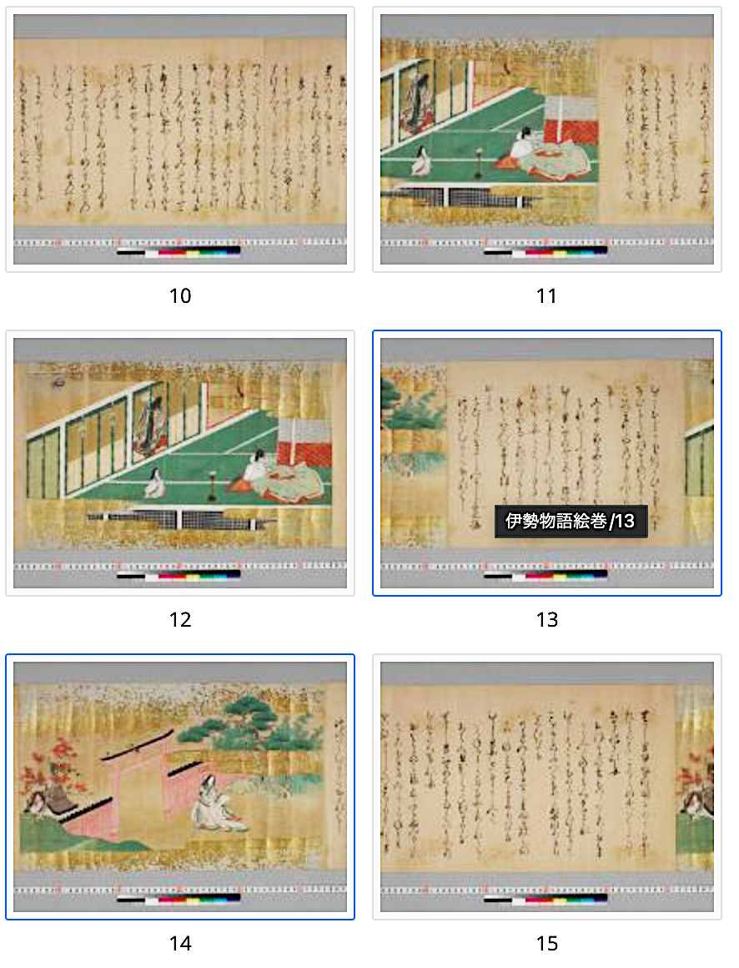
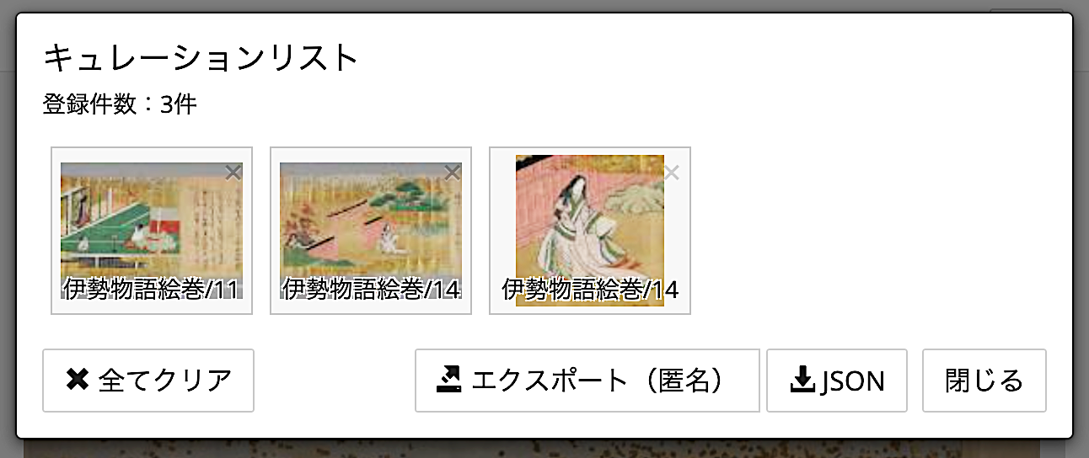
Applications in Education and Creative Idea Generation
IIIF Curation Platform http://codh.rois.ac.jp/icp/
Features a “curation” function
Users can collect specific image parts from IIIF images around the world.
In the demo on the official site, users can try collecting image parts from The Illustrated Ise Monogatari Scrolls (held by the National Institute of Japanese Literature).
Curation List
(It is also possible to clip and collect IIIF images from other websites.)
Notes:
Topic:Examples of web applications with various features
Voice:Joanna
```text
C O D H’s triple F Curation Platform, is a tool with many uses.
This platform allows users to collect the specific parts of triple I F images they want from around the world.
For that reason, it is often used as a tool for education and idea generation, allowing individuals to create their own image collections, and present them to others.
The official site features demos and use cases that make full use of the platform’s functions, so we encourage you to take a look.
```
```description
CODH’s IIIF Curation Platform is a tool with many uses.
This platform allows users to collect the specific parts of IIIF images they want from around the world.
For that reason, it is often used as a tool for education and idea generation, allowing individuals to create their own image collections and present them to others.
The official site features demos and use cases that make full use of the platform’s functions, so we encourage you to take a look.
```

Slide 20
Summary
IIIF offers many advantages and opportunities for researchers in the humanities.
Effective use of IIIF begins with mastering how to work with manifests.
It can help streamline workflows by eliminating complex administrative procedures and the need for large-scale downloads.
Publishing content on the web using IIIF increases the likelihood that it will be utilized in web applications like those shown earlier.
In humanities research, image materials are essential sources of information.
Consider publishing IIIF-compatible images through repositories such as OUKA.
Notes:
Topic:Examples of web applications with various features
Voice:Joanna
```text
As we’ve seen, triple I F is a framework that offers many benefits and opportunities for researchers in the humanities.
Making full use of triple I F begins with mastering how to work with manifests.
Until now, citing or using images provided by outside institutions often required complicated administrative procedures, and large-scale downloads.
However, by publishing triple I F compatible images and their manifests online through repositories, there is a higher possibility they will be reused in applications like the examples shown earlier.
Image materials remain an essential source of information in humanities research.
Once you are familiar with handling triple I F images, why not consider publishing your own images through the OUKA repository?
```
```description
As we’ve seen, IIIF is a framework that offers many benefits and opportunities for researchers in the humanities.
In particular, making full use of IIIF begins with mastering how to work with manifests.
Until now, citing or using images provided by outside institutions often required complicated administrative procedures and large-scale downloads.
However, by publishing IIIF-compatible images and their manifests online through repositories, there is a higher possibility they will be reused in web applications like the examples shown earlier.
Image materials remain an essential source of information in humanities research.
Once you are familiar with handling IIIF images, why not consider publishing your own images through the OUKA repository?
```

