Slide 1
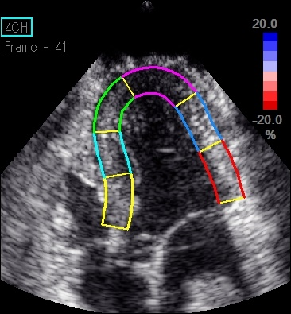
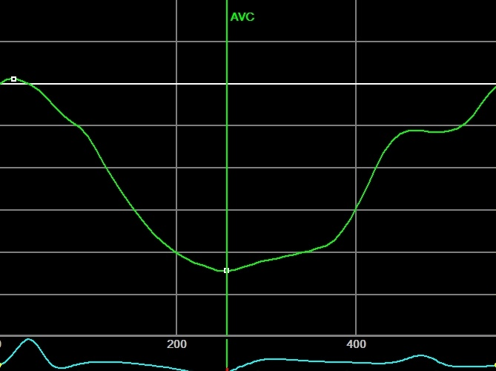
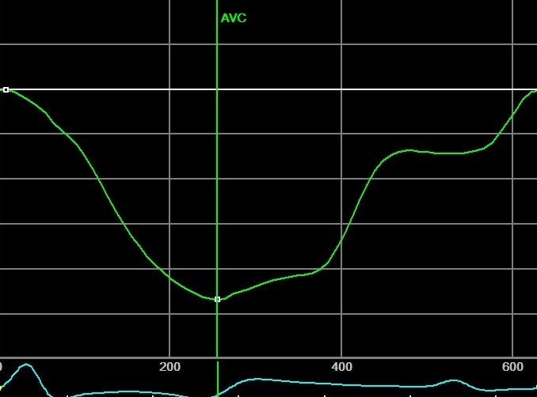
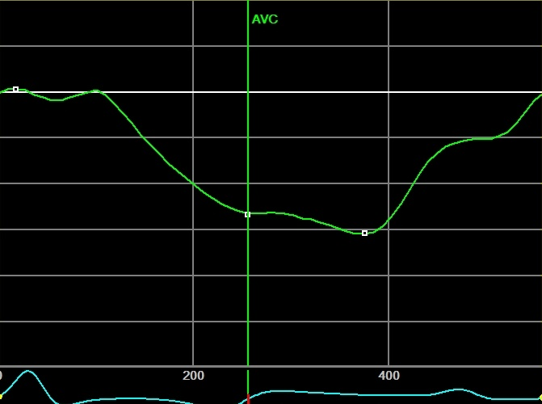
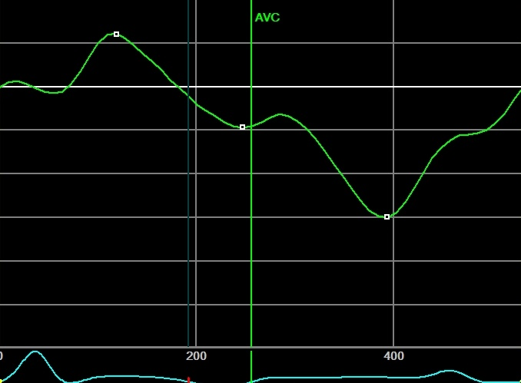
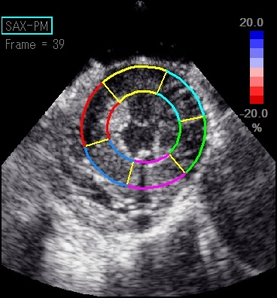
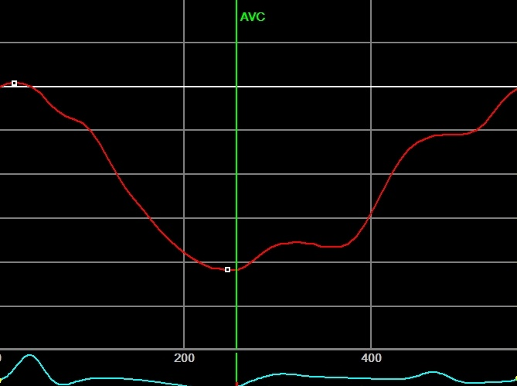
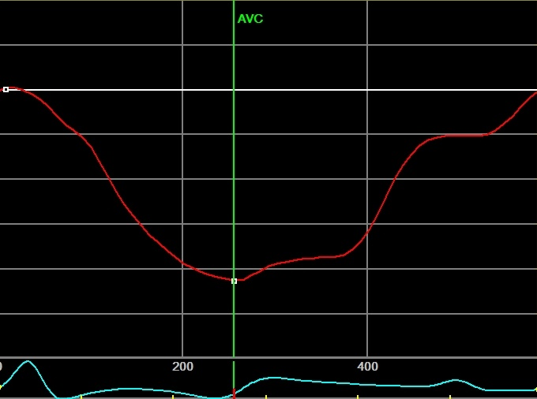
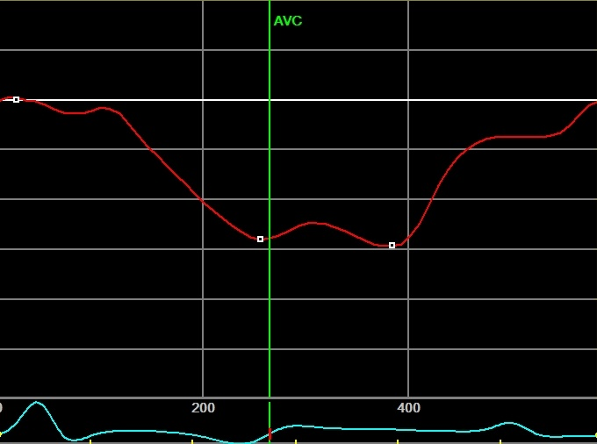
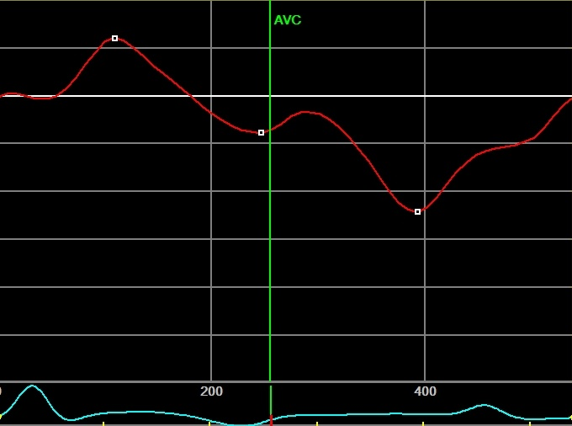
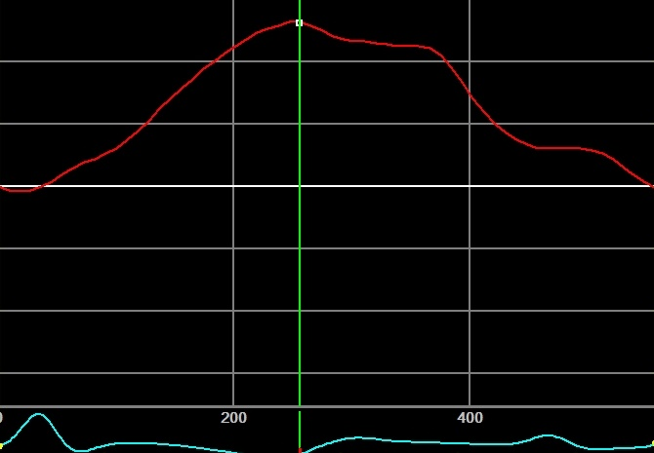
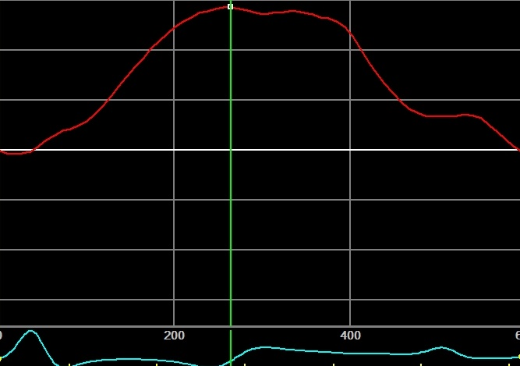
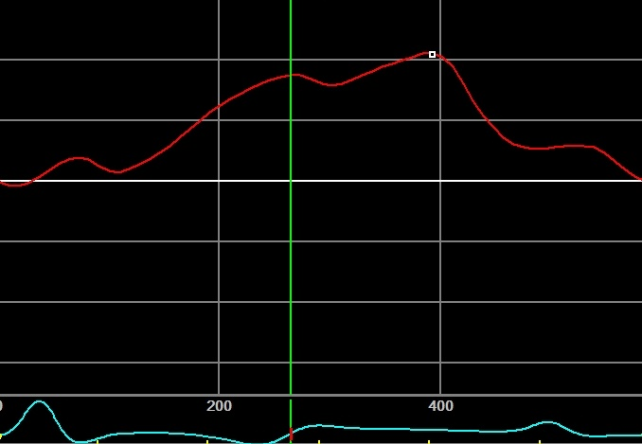
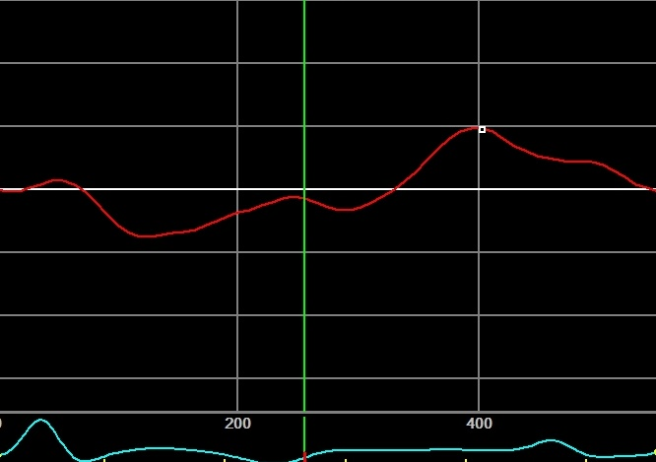
Baseline
Coronary flow reduction
Mild
Moderate
Severe
AVC
Time (ms)
Longitudinal strain
Electrocardiogram
Circumferential strain
Radial strain
Figure 1

Slide 2
Whole wall
Subendocardial layer
Longitudinal
Circumferential
Radial
Longitudinal
Circumferential
Coronary flow reduction (%)
Coronary flow reduction (%)
Coronary flow reduction (%)
Coronary flow reduction (%)
Coronary flow reduction (%)
40
40
40
40
40
0
0
0
0
0
Peak systolic strain
−40
−40
−40
−40
−40
−80
y = −2.39e^{0.045x}
r² = 0.59
−80
−80
−80
y = −0.02e^{0.045x}
r² = 0.56
−80
y = −0.01e^{0.051x}
r² = 0.63
y = −2.10e^{0.046x}
r² = 0.65
y = −0.31e^{0.069x}
r² = 0.47
−120
−120
−120
−120
−120
Decreasing rate from baseline (%)
40
40
40
40
40
0
0
0
0
0
−40
−40
−40
−40
−40
End-systolic strain
−80
−80
−80
−80
−80
−120
−120
−120
−120
−120
−160
y = −1.76e^{0.053x}
r² = 0.65
−160
y = −1.80e^{0.051x}
r² = 0.63
−160
y = −0.40e^{0.069x}
r² = 0.54
−160
y = −0.02e^{0.052x}
r² = 0.61
−160
y = −0.01e^{0.056x}
r² = 0.64
−200
−200
−200
−200
−200
Figure 2

Slide 3
Whole wall
Subendocardial layer
Coronary flow reduction
Coronary flow reduction
40
Mild
Moderate
Severe
40
Mild
Moderate
Severe
0
0
−40
0.98
0.25
−40
0.23
Peak systolic strain
0.18
1.00
0.59
0.72
−80
0.59
−80
−120
longitudinal
1.00
0.90
−120
0.90
circumferential
0.87
longitudinal
−160
radial
−160
circumferential
Decreasing rate from baseline (%)
40
40
0
0
−40
0.98
0.32
−40
0.23
End-systolic strain
0.24
1.00
0.72
−80
−80
0.71
0.72
−120
−120
−160
1.00
0.89
−160
0.90
−200
0.90
−200
Figure 3

Slide 4
Whole wall
Subendocardial layer
Longitudinal
Circumferential
Radial
Longitudinal
Circumferential
Coronary flow reduction (%)
Coronary flow reduction (%)
Coronary flow reduction (%)
Coronary flow reduction (%)
Coronary flow reduction (%)
1
y = 0.011e^{0.052x}
r² = 0.60
1
y = 0.007e^{0.055x}
r² = 0.53
y = 0.007e^{0.057x}
r² = 0.61
y = 0.014e^{0.049x}
r² = 0.57
y = 0.006e^{0.057x}
r² = 0.55
PSI
0.5
0.5
0
0
y = 0.088e^{0.027x}
r² = 0.38
y = 0.054e^{0.032x}
r² = 0.41
y = 0.027e^{0.042x}
r² = 0.56
y = 0.088e^{0.027x}
r² = 0.40
y = 0.047e^{0.034x}
r² = 0.46
ESI
Figure 4

Slide 5
Whole wall
Subendocardial layer
Baseline
Coronary flow reduction
Baseline
Coronary flow reduction
Mild
Moderate
Severe
Mild
Moderate
Severe
longitudinal
1.00
longitudinal
circumferential
0.94
0.95
circumferential
0.73
radial
PSI
0.97
0.22
0.93
0.99
0.52
0.93
1.00
0.09
0.13
0.99
0.98
0.50
0.96
0.62
0.89
0.98
ESI
0.81
0.70
0.48
0.32
0.96
0.94
0.62
0.97
0.70
0.78
0.38
0.46
Figure 5

Slide 6
Peak systolic strain
End-systolic strain
Moderate flow reduction
Severe flow reduction
Moderate flow reduction
Severe flow reduction
100
100
100
100
80
80
80
80
60
60
60
60
Sensitivity
Sensitivity
Sensitivity
Sensitivity
40
40
40
40
20
20
20
20
0
0
20
40
60
80
100
0
0
20
40
60
80
100
0
0
20
40
60
80
100
0
0
20
40
60
80
100
100-Specificity
100-Specificity
Whole wall
100-Specificity
95% CI
100-Specificity
Whole wall
AUC
95% CI
Whole wall
AUC
95% CI
AUC
Whole wall
AUC
95% CI
longitudinal
0.651
0.440-0.826
longitudinal
0.865
0.647-0.973
longitudinal
0.651
0.440-0.826
longitudinal
0.865
0.647-0.973
circumferential
0.686
0.476-0.852
circumferential
0.856
0.635-0.969
circumferential
0.704
0.494-0.865
circumferential
0.856
0.635-0.969
radial
0.580
0.372-0.769
radial
0.712
0.475-0.885
radial
0.586
0.378-0.774
radial
0.712
0.475-0.885
Subendocardial layer
0.686
0.476-0.852
Subendocardial layer
Subendocardial layer
Subendocardial layer
longitudinal
longitudinal
0.894
0.683-0.985
longitudinal
0.692
0.482-0.857
longitudinal
0.904
0.695-0.988
circumferential
0.615
0.406-0.798
circumferential
0.865
0.647-0.973
circumferential
0.633
0.423-0.812
circumferential
0.865
0.647-0.973
Moderate flow reduction
PSI
Severe flow reduction
Moderate flow reduction
ESI
Severe flow reduction
100
100
100
100
80
80
80
80
60
60
60
60
Sensitivity
Sensitivity
Sensitivity
Sensitivity
40
40
40
40
20
20
20
20
0
0
20
40
60
80
100
0
0
20
40
60
80
100
0
0
20
40
60
80
100
0
0
20
40
60
80
100
100-Specificity
100-Specificity
Whole wall
100-Specificity
100-Specificity
Whole wall
AUC
95% CI
Whole wall
AUC
95% CI
AUC
95% CI
Whole wall
AUC
95% CI
longitudinal
0.654
0.443-0.828
longitudinal
0.784
0.552-0.931
longitudinal
0.533
0.328-0.729
longitudinal
0.846
0.623-0.964
circumferential
0.592
0.383-0.779
circumferential
0.764
0.531-0.919
circumferential
0.586
0.378-0.774
circumferential
0.769
0.536-0.922
radial
0.550
0.345-0.744
radial
0.731
0.495-0.898
radial
0.598
0.389-0.783
radial
0.779
0.547-0.928
Subendocardial layer
Subendocardial layer
Subendocardial layer
Subendocardial layer
longitudinal
0.716
0.507-0.874
longitudinal
0.827
0.601-0.955
longitudinal
0.503
0.302-0.703
longitudinal
0.846
0.623-0.964
circumferential
0.577
0.369-0.766
circumferential
0.712
0.475-0.885
circumferential
0.592
0.383-0.779
circumferential
0.846
0.623-0.964
Figure 6

