Slide 1
Anterior
Ant- septal
Ant-lateral
LV
Inf-septal
Inf-
lateral
Inferior
Fig. 1

Slide 2
%
a: baseline
%
b: aortic banding
AVC
AVC
GCS
Inferior
Inf-lateral
Ant-lateral
Anterior
Ant-septal
Inf-septal
Fig. 2

Slide 3
∗
Absolute decrease in the peak systolic strain (Δɛ) (%)
Inferior
Inf- lateral
Ant- lateral
Anterior
Ant- septal
Inf- septal
Fig. 3

Slide 4
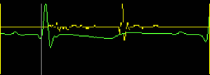
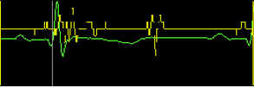
a: baseline
b: aortic banding
Fig. 4

Slide 5
Rate of increase
in the endocardial length (%)
Septum
Free wall
Fig. 5

