Slide 1
A
B
C
Figure 1

Slide 2
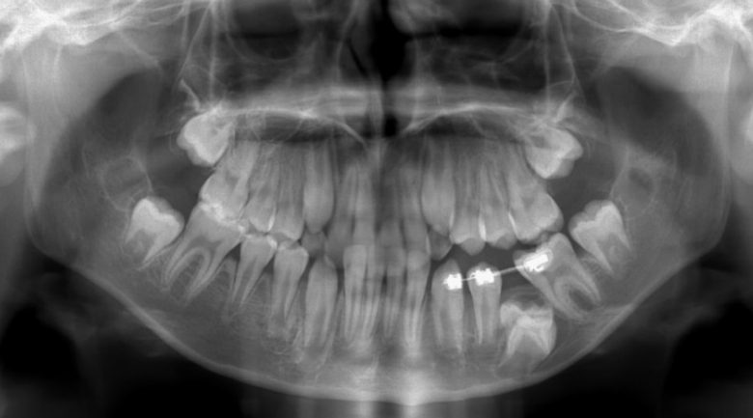
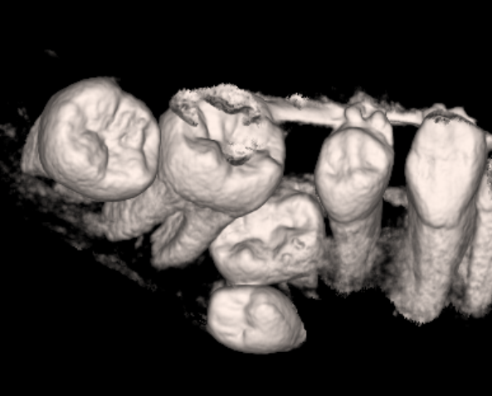
A
B
C
D
E
F
G
Figure 2

Slide 3
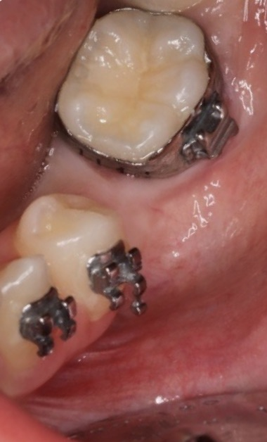
Figure 3

Slide 4
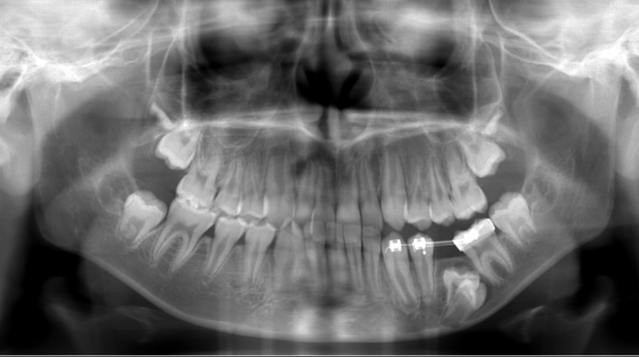
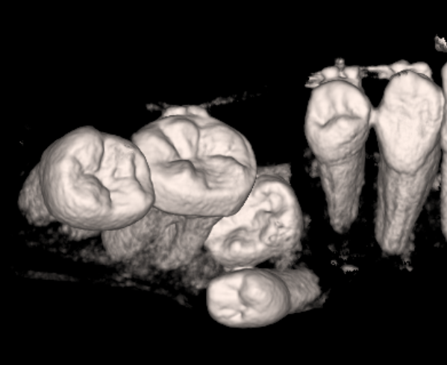
A
B
C
D
E
F
G
Figure 4

Slide 5
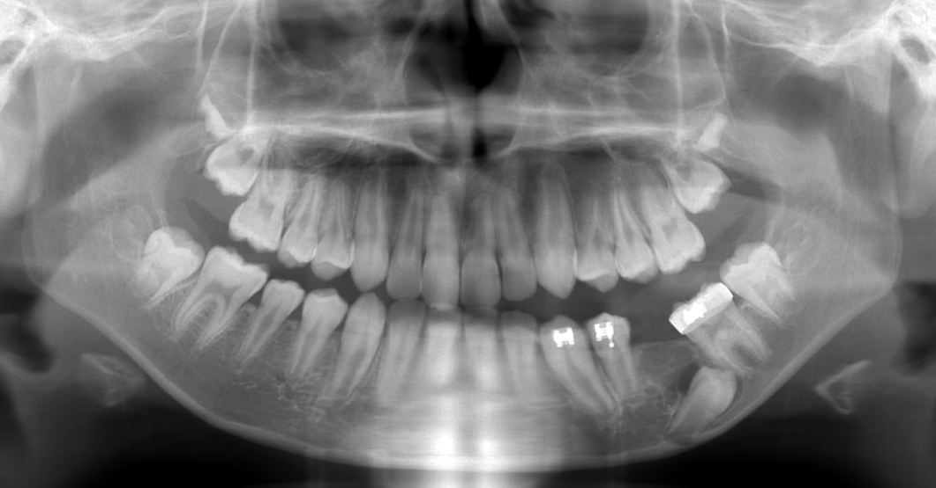
A
B
C
D
E
Figure 5

