Slide 1
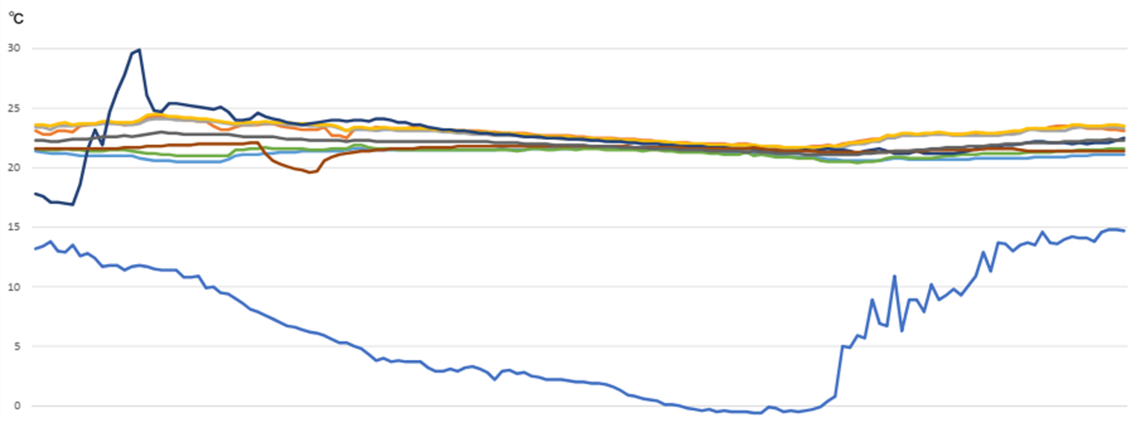
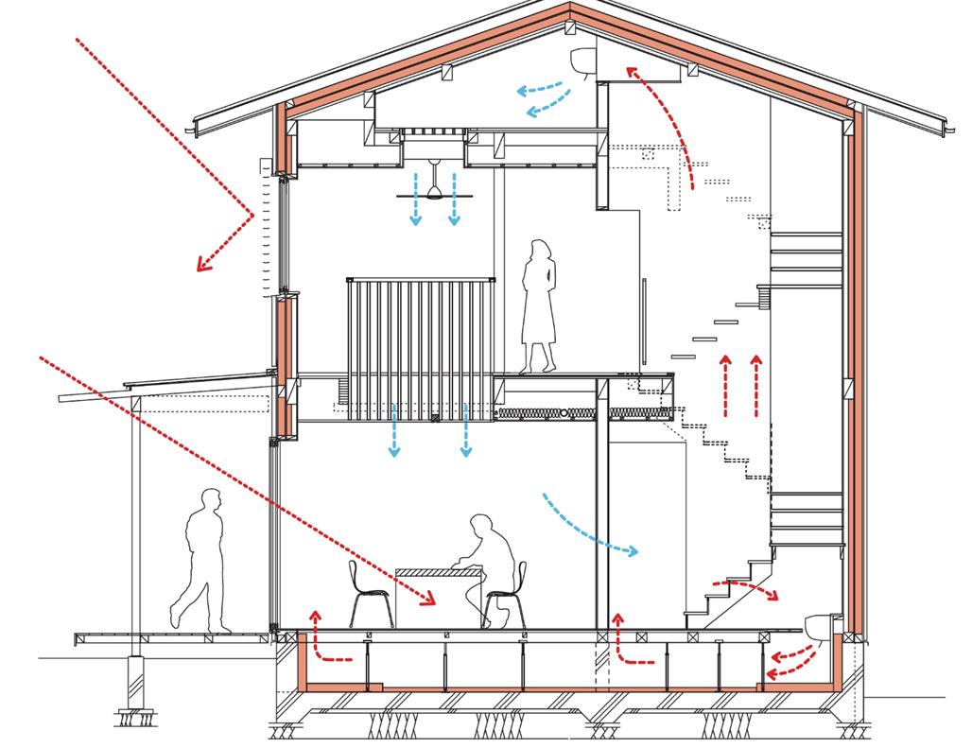
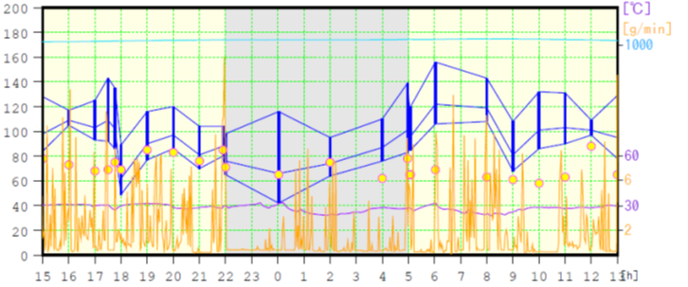
Indoor environment
highly insulated and airtight model house
Stable indoor temperature
outside temperature
Blood pressure fluctuations

