Slide 1
Height
(cm)
130
Height
+2.0SD
120
+1.0SD
Average
110
-1.0SD
-2.0SD
100
Weight
(kg)
90
60
80
50
70
40
Weight
+2.0SD
60
30
+1.0SD
50
Average
20
-1.0SD
-2.0SD
40
10
30
0
0
1
2
3
4
5
6
Age
(years)
Figure 1

Slide 2
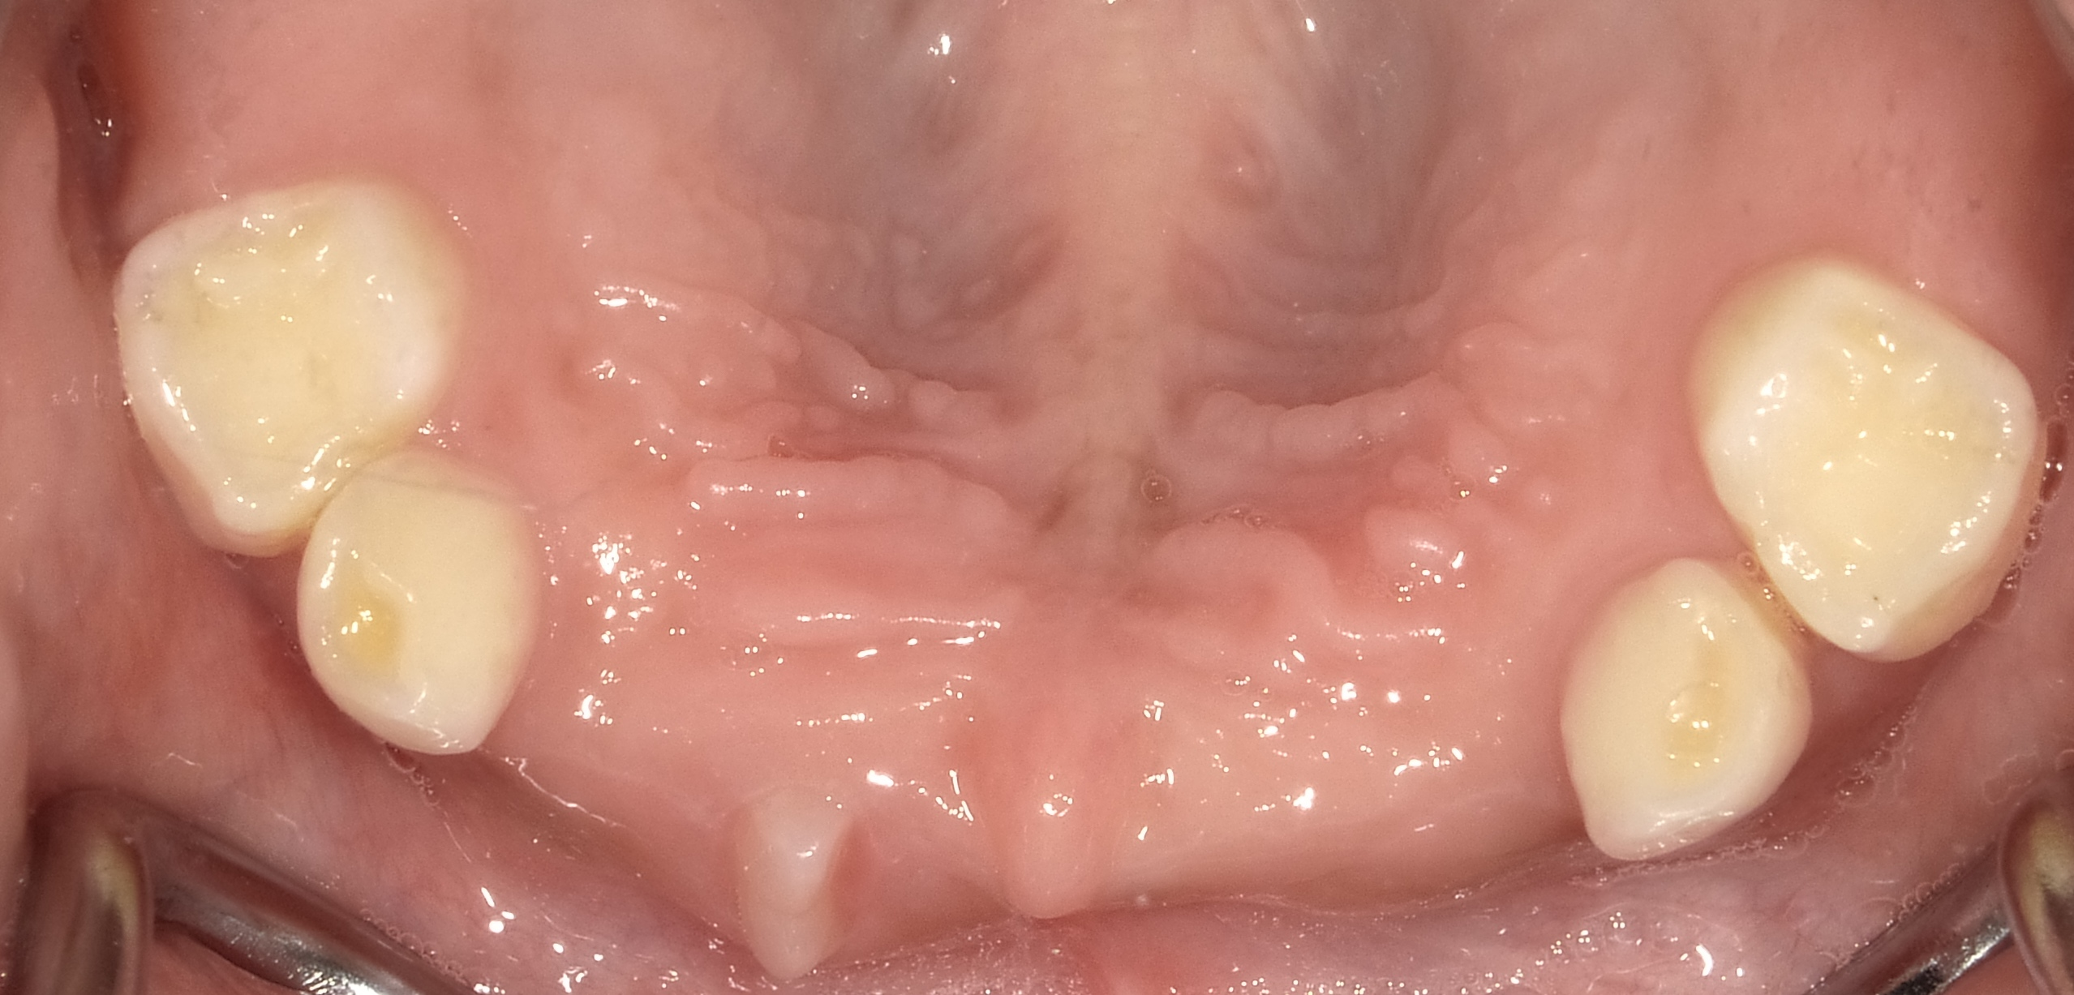
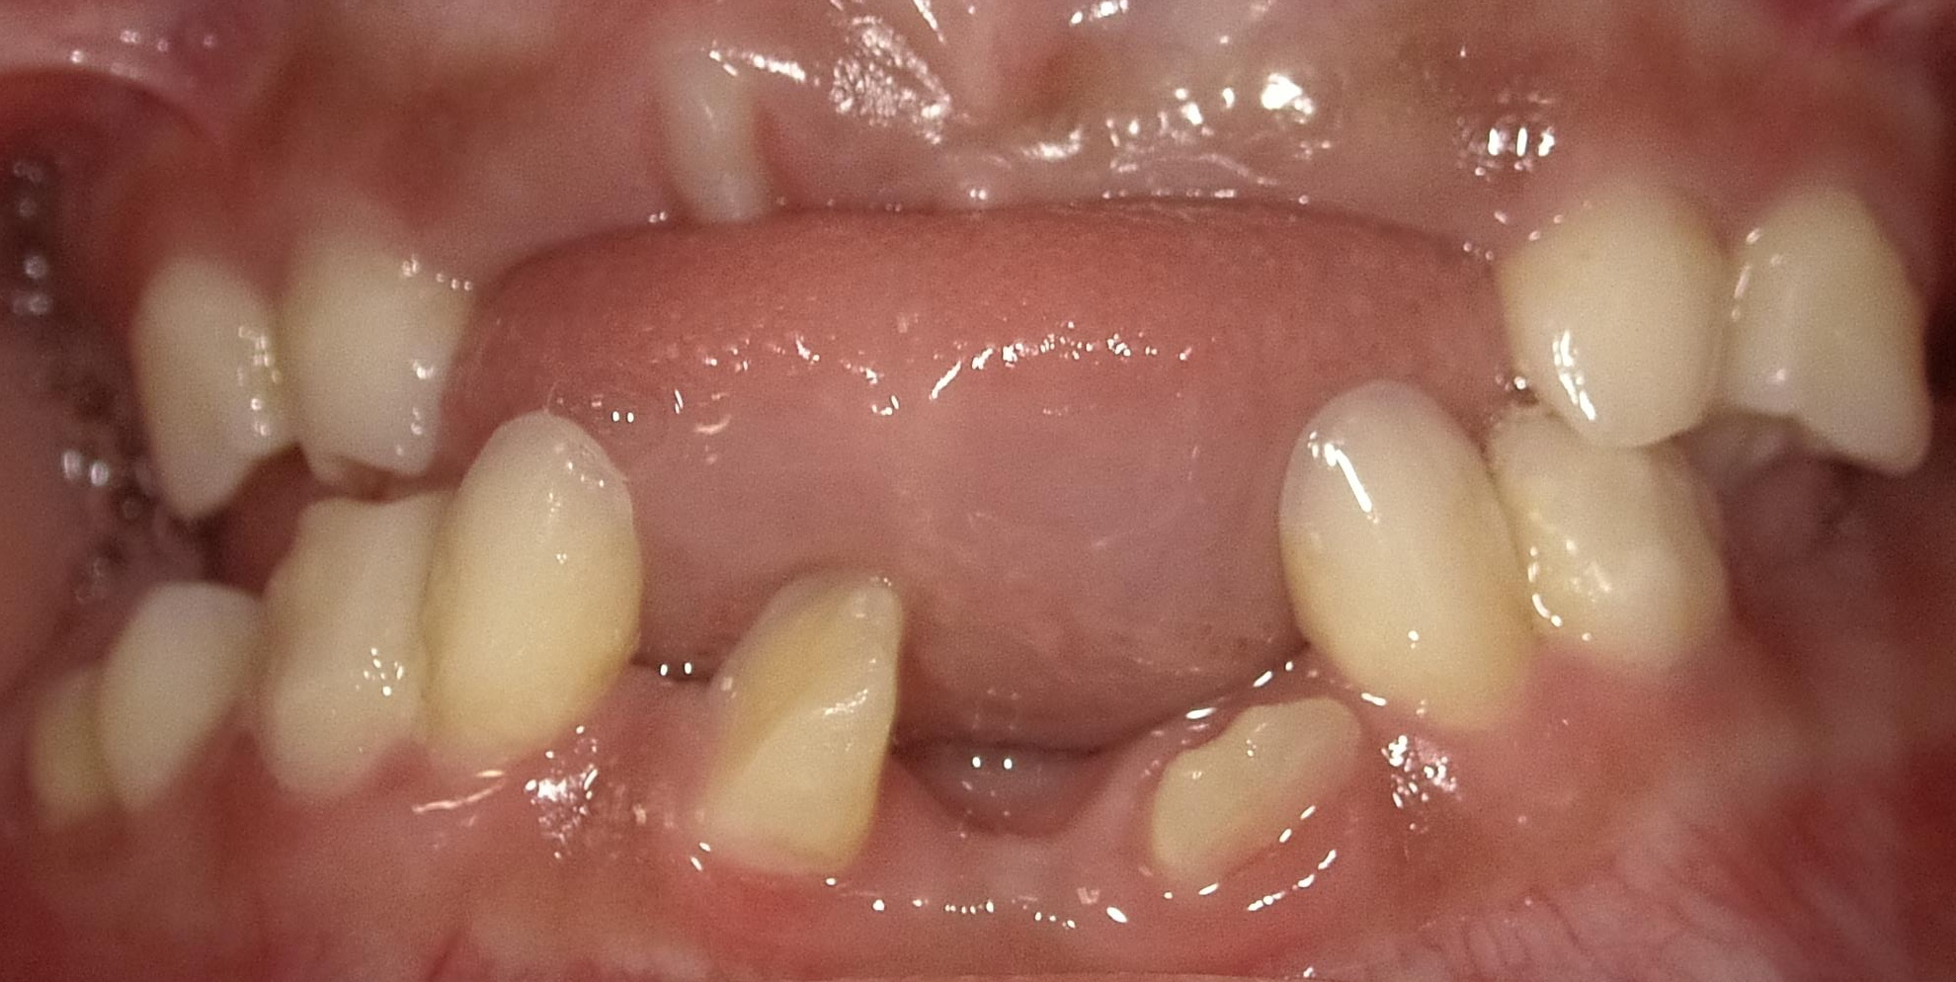
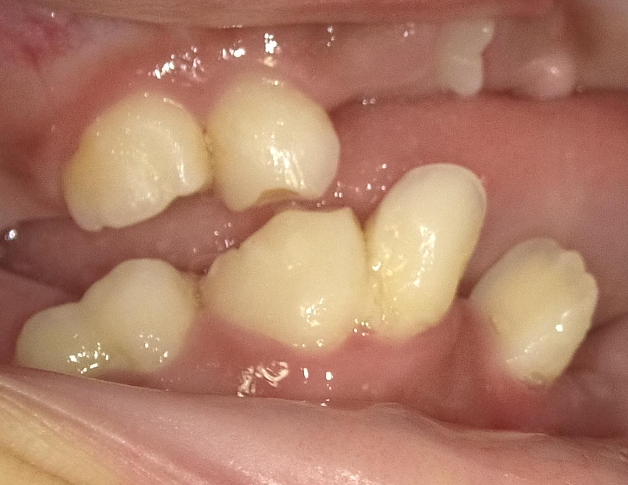
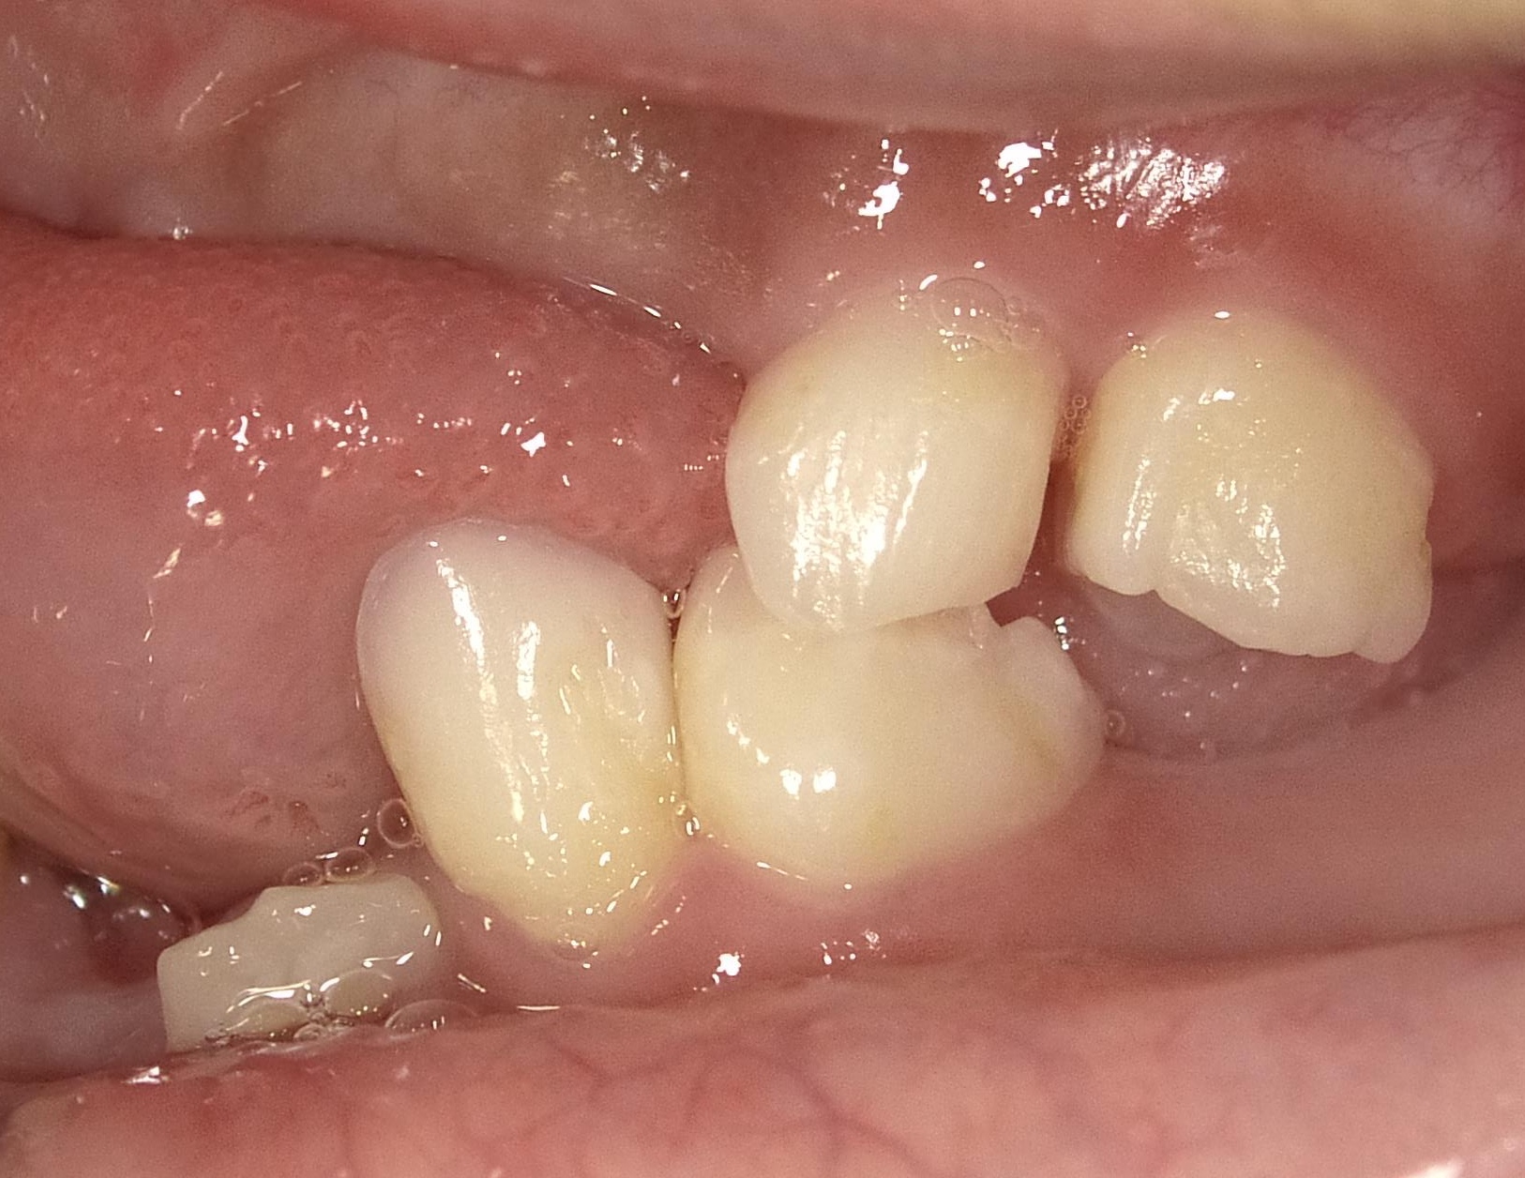
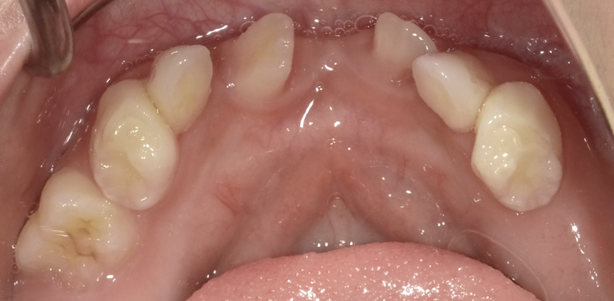
Figure 2

Slide 3
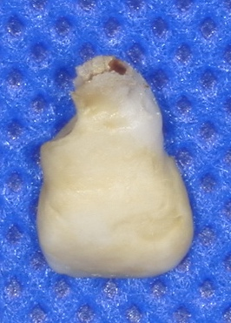
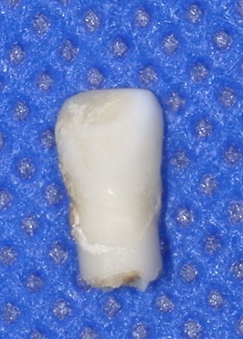
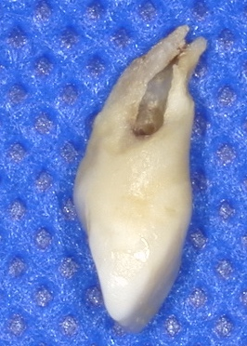
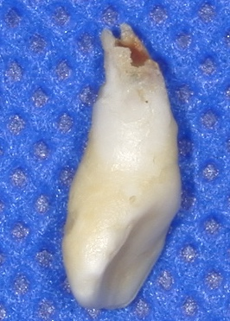
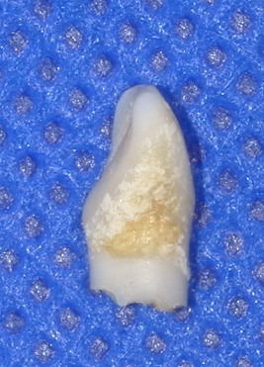
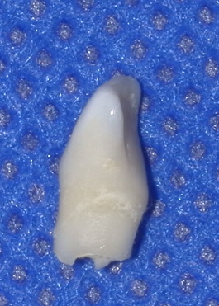
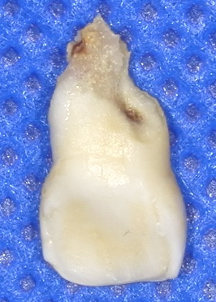
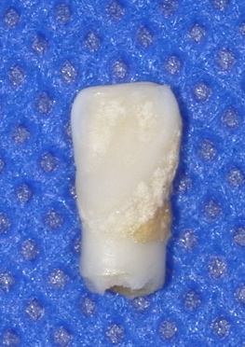
A
Buccal
B
Buccal
Mesial
Distal
Distal
Mesial
Palatal
Lingual
Figure 3

Slide 4
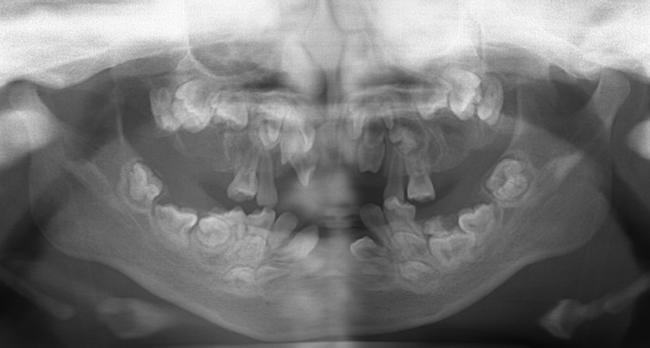
A
B
Figure 4

Slide 5
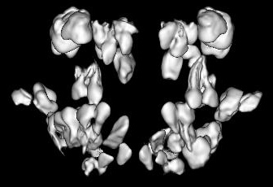
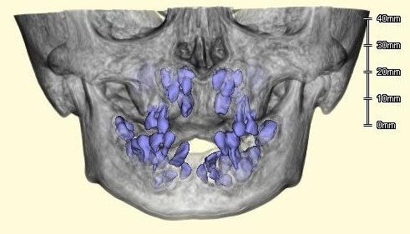
A
B
Figure 5

