Slide 1
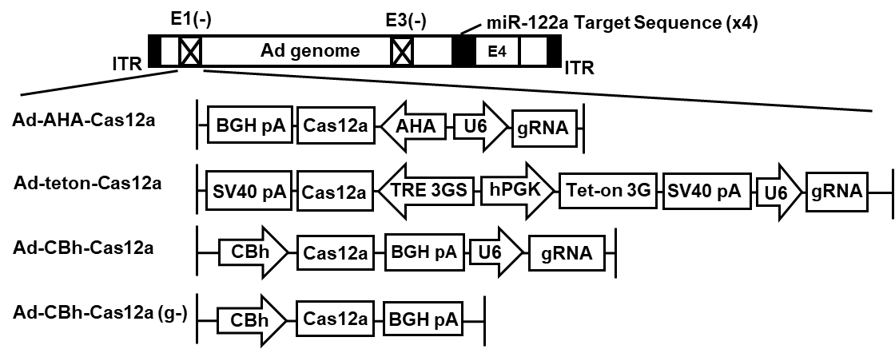
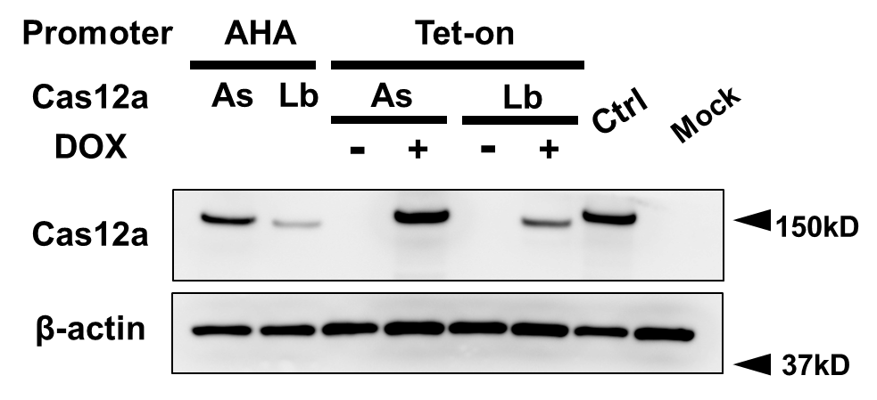
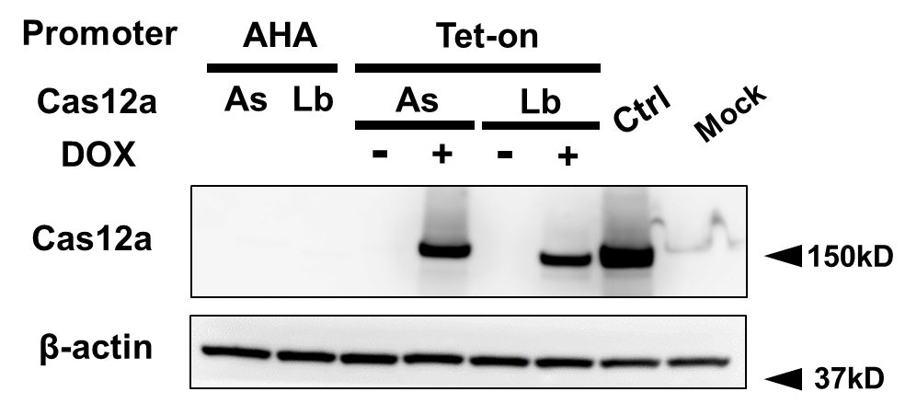
A
B
log₁₀ Ad genome copy number
10
9
8
7
6
0
Promoter
CBh | AHA | AHA | Tet | Tet | CBh | CBh
GFP | As | Lb | As | Lb | As | Lb
Cas12a
C
D
2.0
2.0
1.0
1.0
N.D.
N.D.
Promoter
AHA
AHA
Tet
Tet
Tet
Tet
Ctrl
Mock
Promoter
AHA
AHA
Tet
Tet
Tet
Tet
Ctrl
Mock
Cas12a
As
Lb
As
As
Lb
Lb
Cas12a
As
Lb
As
As
Lb
Lb
DOX
-
+
-
+
DOX
-
+
-
+

Slide 2
E
Ctrl + gRNA
（1 : 1）
AHA-As
AHA-Lb
Teton-As
Teton-Lb
MOI
Mock
-
-
-
-
-
DOX
+
+
+
+
+
-
+
uncleaved
cleaved
1
2
3
4
5
6
8
9
10
11
12
13
14
16
18
19
20
21
22
7
15
17
N.D.
N.D.
N.D.
N.D.
N.D.
N.D.
N.D.
N.D.

